Slide 1
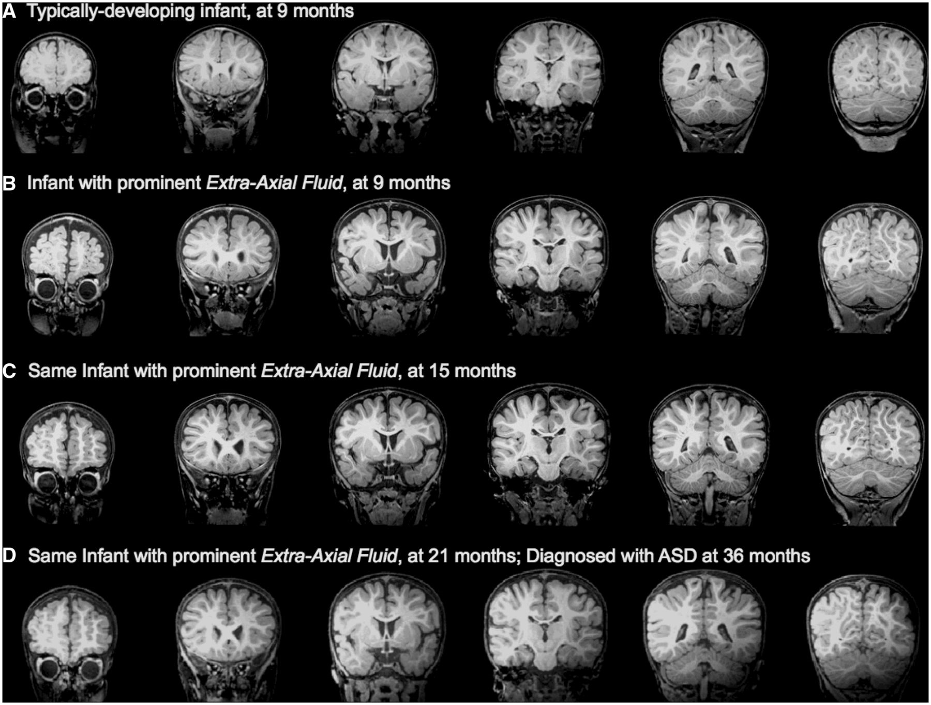
Figure 1 (A) Low-risk infant with normal MRI at 9 months, confirmed as having typical development at 36 months. (B) ...
Notes:
Figure 1 (A) Low-risk infant with normal MRI at 9 months, confirmed as having typical development at 36 months. (B) High-risk infant with excessive extra-axial fluid at 9 months. (C) The same high-risk infant with excessive extra-axial fluid still present at 15 months, and (D) at 21 months; infant was diagnosed with ASD at 36 months.
Unless provided in the caption above, the following copyright applies to the content of this slide: © The Author (2013). Published by Oxford University Press on behalf of the Guarantors of Brain. All rights reserved. For Permissions, please email: journals.permissions@oup.com

Slide 2
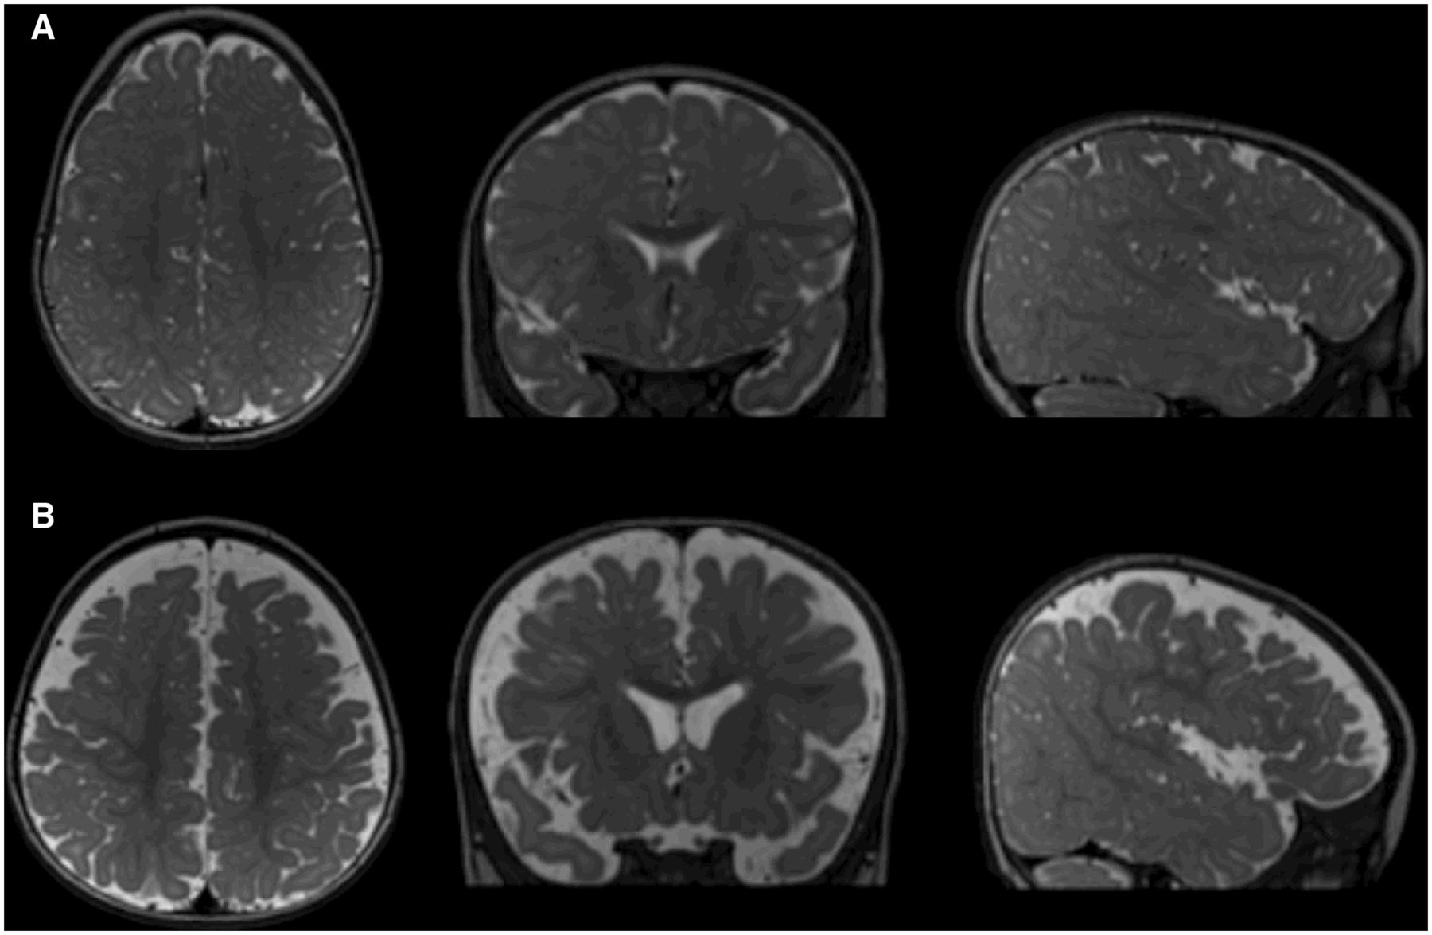
Figure 2 (A) T₂-weighted image of a low-risk infant with normal MRI at 9 months, confirmed as having ...
Notes:
Figure 2 (A) T2-weighted image of a low-risk infant with normal MRI at 9 months, confirmed as having typical development at 36 months. CSF is indicated as brighter regions in these images. Images are of a horizontal section (left) coronal section (middle) and sagittal section (right) through the brain. (B) Similar T2-weighted images of a high-risk infant with excessive extra-axial fluid at 9 months, diagnosed with ASD at 36 months.
Unless provided in the caption above, the following copyright applies to the content of this slide: © The Author (2013). Published by Oxford University Press on behalf of the Guarantors of Brain. All rights reserved. For Permissions, please email: journals.permissions@oup.com

Slide 3
Figure 3 Quantification of extra-axial fluid. (A) Manual tracing of dura on successive coronal slices are summed to ...
Notes:
Figure 3 Quantification of extra-axial fluid. (A) Manual tracing of dura on successive coronal slices are summed to yield intracranial volume; (B) semi-automated tissue segmentation with manual intervention yields total cerebral volume; (C) resulting space between dura and cerebral surface yields extra-axial fluid volume.
Unless provided in the caption above, the following copyright applies to the content of this slide: © The Author (2013). Published by Oxford University Press on behalf of the Guarantors of Brain. All rights reserved. For Permissions, please email: journals.permissions@oup.com

Slide 4
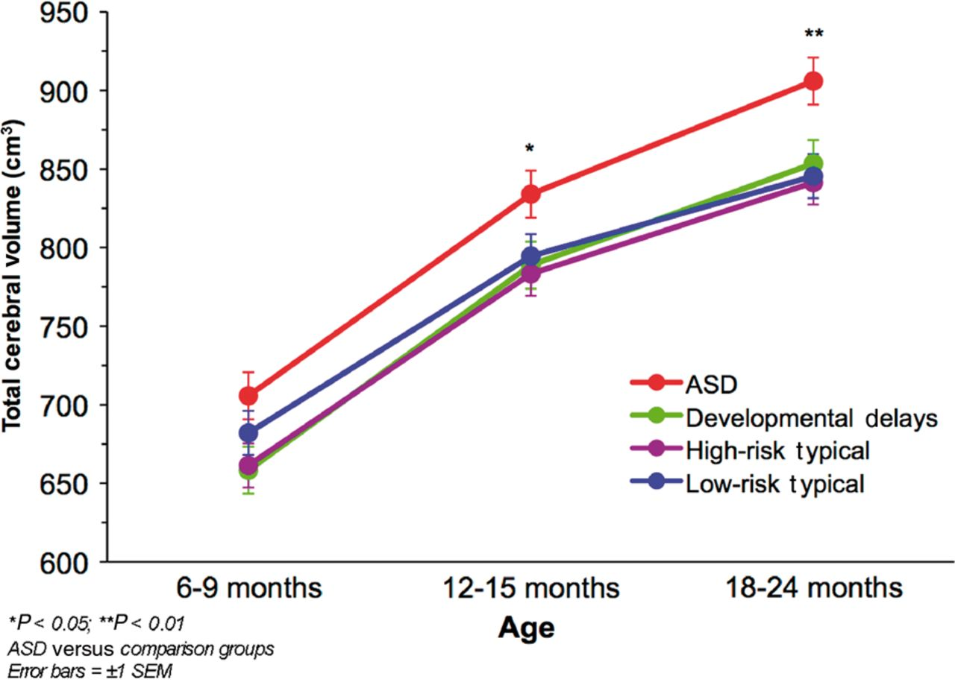
Figure 4 Mean total cerebral volume by outcome group at each MRI time point.
Notes:
Figure 4 Mean total cerebral volume by outcome group at each MRI time point.
Unless provided in the caption above, the following copyright applies to the content of this slide: © The Author (2013). Published by Oxford University Press on behalf of the Guarantors of Brain. All rights reserved. For Permissions, please email: journals.permissions@oup.com

Slide 5
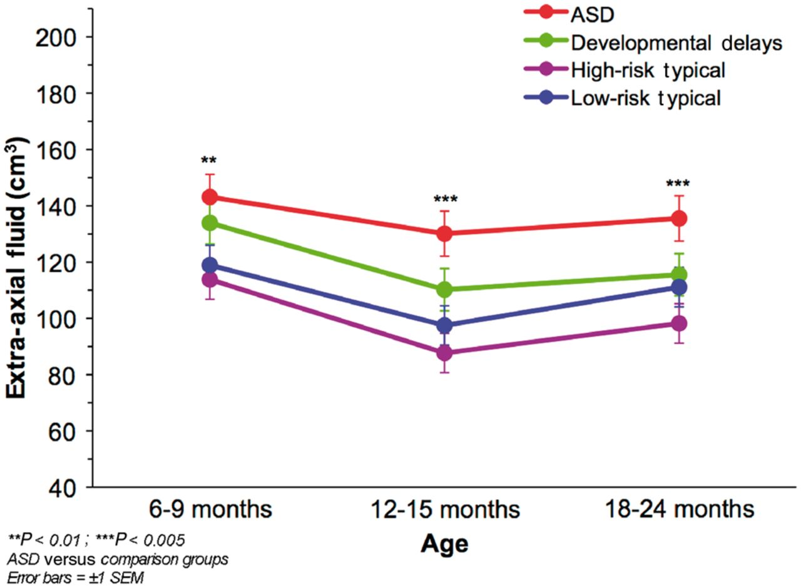
Figure 5 Mean extra-axial fluid volume by outcome group at each MRI time point.
Notes:
Figure 5 Mean extra-axial fluid volume by outcome group at each MRI time point.
Unless provided in the caption above, the following copyright applies to the content of this slide: © The Author (2013). Published by Oxford University Press on behalf of the Guarantors of Brain. All rights reserved. For Permissions, please email: journals.permissions@oup.com

Slide 6
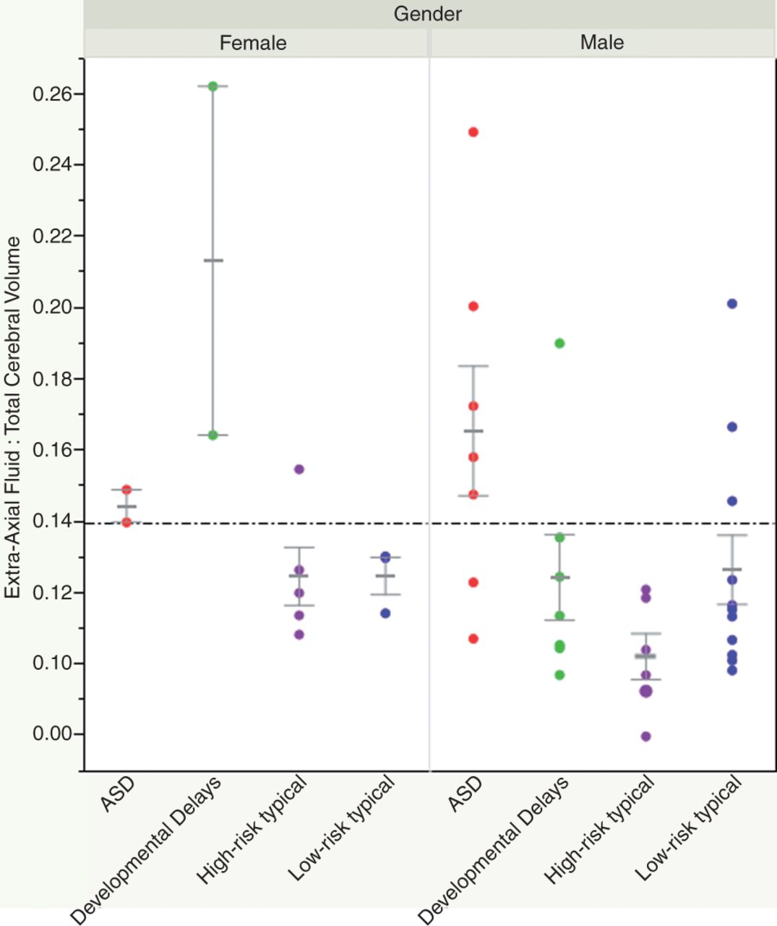
Figure 6 Predicting ASD cases using an extra-axial fluid threshold. The dotted line represents a level of ...
Notes:
Figure 6 Predicting ASD cases using an extra-axial fluid threshold. The dotted line represents a level of fluid-to-brain volume that yields 78% sensitivity (percentage of ASD cases above the threshold) and 79% specificity (percentage of non-ASD cases below the threshold) in predicting ASD cases at 12–15 months (i.e. ratio of extra-axial fluid to total cerebral volume = 0.14).
Unless provided in the caption above, the following copyright applies to the content of this slide: © The Author (2013). Published by Oxford University Press on behalf of the Guarantors of Brain. All rights reserved. For Permissions, please email: journals.permissions@oup.com

