Slide 1
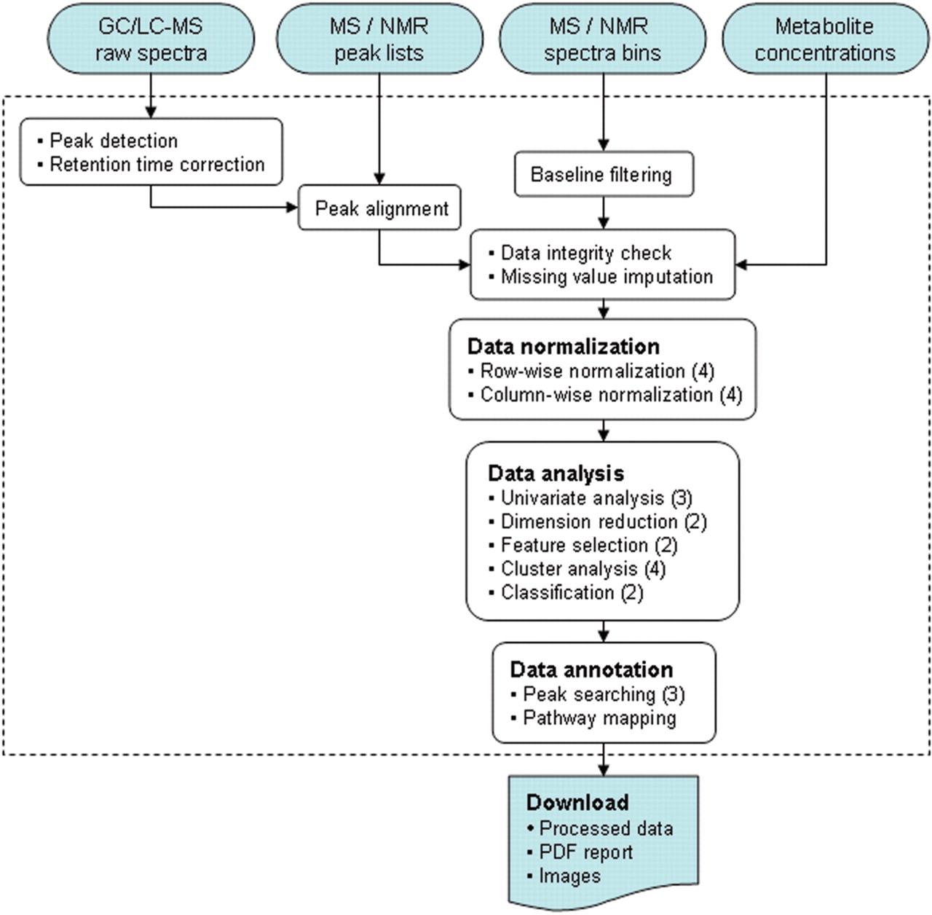
Figure 1. A diagram illustrating MetaboAnalyst's workflow and data processing options. Different data inputs are first ...
Notes:
Figure 1. A diagram illustrating MetaboAnalyst's workflow and data processing options. Different data inputs are first transformed into compatible data matrices using several different processing methods. A variety of algorithms are implemented for data normalization, analysis, and annotation. The number of available options is shown inside the round brackets for each category. At the end of any given analysis, a comprehensive PDF report, the processed data, and high-resolution images are available for download.
Unless provided in the caption above, the following copyright applies to the content of this slide: © 2009 The Author(s)This is an Open Access article distributed under the terms of the Creative Commons Attribution Non-Commercial License (http://creativecommons.org/licenses/by-nc/2.0/uk/) which permits unrestricted non-commercial use, distribution, and reproduction in any medium, provided the original work is properly cited.

Slide 2
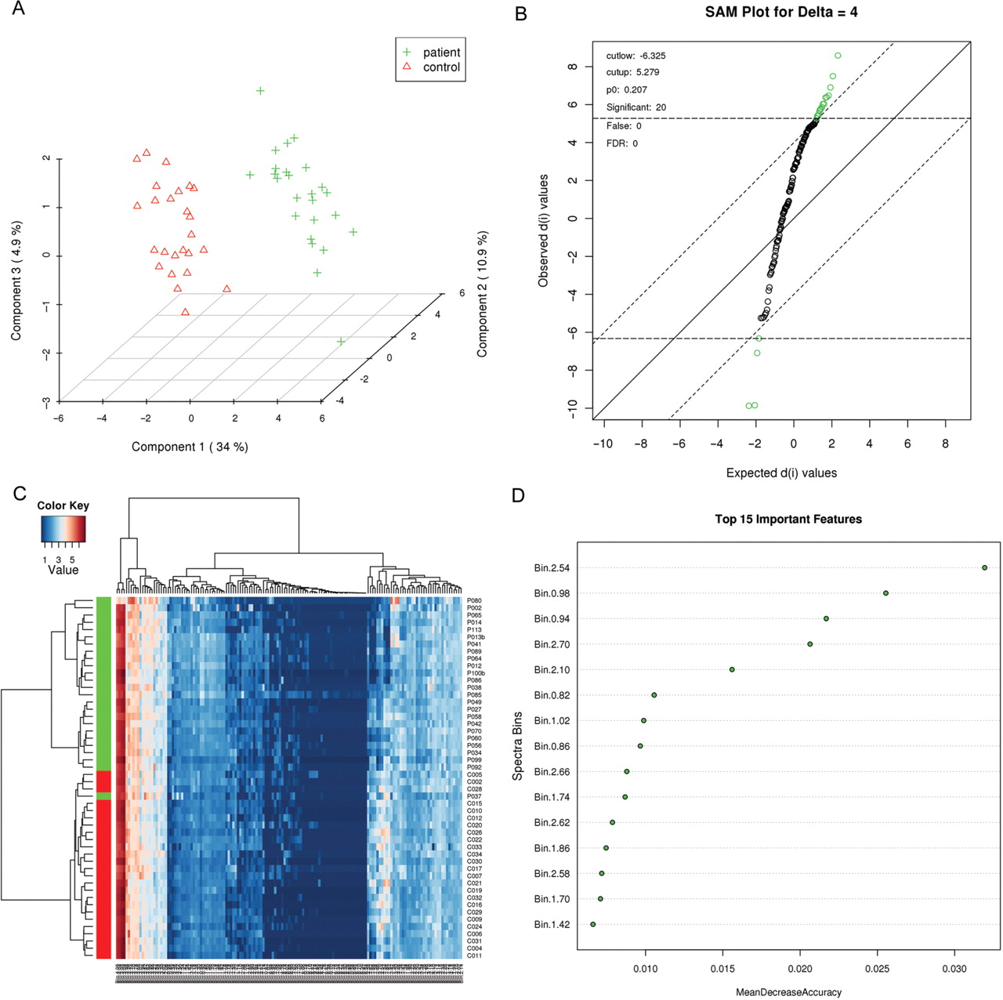
Figure 2. Examples of some of the graphical output and analyses available from MetaboAnalyst. (A) PLS-DA class ...
Notes:
Figure 2. Examples of some of the graphical output and analyses available from MetaboAnalyst. (A) PLS-DA class separation based on the top three components. (B) Significant features identified by SAM analysis. (C) Heat map generated from hierarchical clustering. (D) Features ranked by random forest. The binned NMR spectral data (test data #2) was used to generate these graphs.
Unless provided in the caption above, the following copyright applies to the content of this slide: © 2009 The Author(s)This is an Open Access article distributed under the terms of the Creative Commons Attribution Non-Commercial License (http://creativecommons.org/licenses/by-nc/2.0/uk/) which permits unrestricted non-commercial use, distribution, and reproduction in any medium, provided the original work is properly cited.

