Slide 1
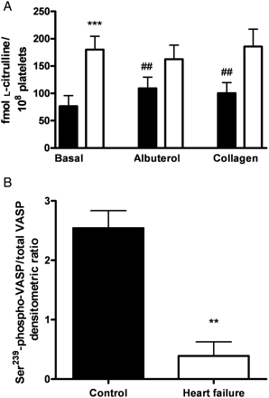
Figure 1 Basal and stimulated NOS activity, and serine-239 phosphorylation of VASP, in platelets from heart failure ...
Notes:
Figure 1 Basal and stimulated NOS activity, and serine-239 phosphorylation of VASP, in platelets from heart failure and healthy control subjects. (A) NOS activity at baseline and after stimulation with albuterol (10−5 mol/L) and collagen (0.8 µg/mL), in platelets from heart failure subjects (n= 16; open bars) and healthy controls (n= 23; solid bars). ***P < 0.001 vs. healthy controls. ##P < 0.01 vs. basal. (B) Densitometric ratio of serine-239-phospho-VASP to total VASP, in platelets from these same subjects. **P < 0.01 vs. healthy controls.
Unless provided in the caption above, the following copyright applies to the content of this slide: Published on behalf of the European Society of Cardiology. All rights reserved. © The Author 2011. For permissions please email: journals.permissions@oup.com.

Slide 2
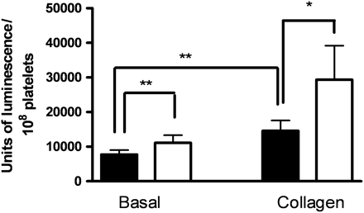
Figure 2 Basal and stimulated platelet O₂⁻ production in heart failure and healthy control ...
Notes:
Figure 2 Basal and stimulated platelet O2− production in heart failure and healthy control subjects. Pholasin-enhanced chemiluminescence was measured in platelets, both at baseline and after stimulation with collagen (0.8 µg/mL); the difference in light signal in the absence and presence of Tiron was taken as an index of O2− production. Data are shown for platelets from heart failure subjects (n= 16; open bars) and healthy controls (n= 19; solid bars). *P < 0.05, **P < 0.01.
Unless provided in the caption above, the following copyright applies to the content of this slide: Published on behalf of the European Society of Cardiology. All rights reserved. © The Author 2011. For permissions please email: journals.permissions@oup.com.

Slide 3
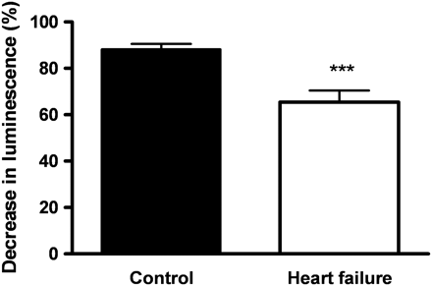
Figure 3 O₂⁻ scavenging capacity of platelets from heart failure and healthy control subjects. ...
Notes:
Figure 3 O2− scavenging capacity of platelets from heart failure and healthy control subjects. Pholasin-enhanced chemiluminescence was measured and the percent decrease in light signal following addition of platelets (normalized for platelet count) was taken as an index of platelet O2− scavenging capacity. Data are shown for platelets from heart failure subjects (n= 16; open bar) and healthy controls (n= 19; solid bar). ***P < 0.0005 vs. controls.
Unless provided in the caption above, the following copyright applies to the content of this slide: Published on behalf of the European Society of Cardiology. All rights reserved. © The Author 2011. For permissions please email: journals.permissions@oup.com.

