Slide 1
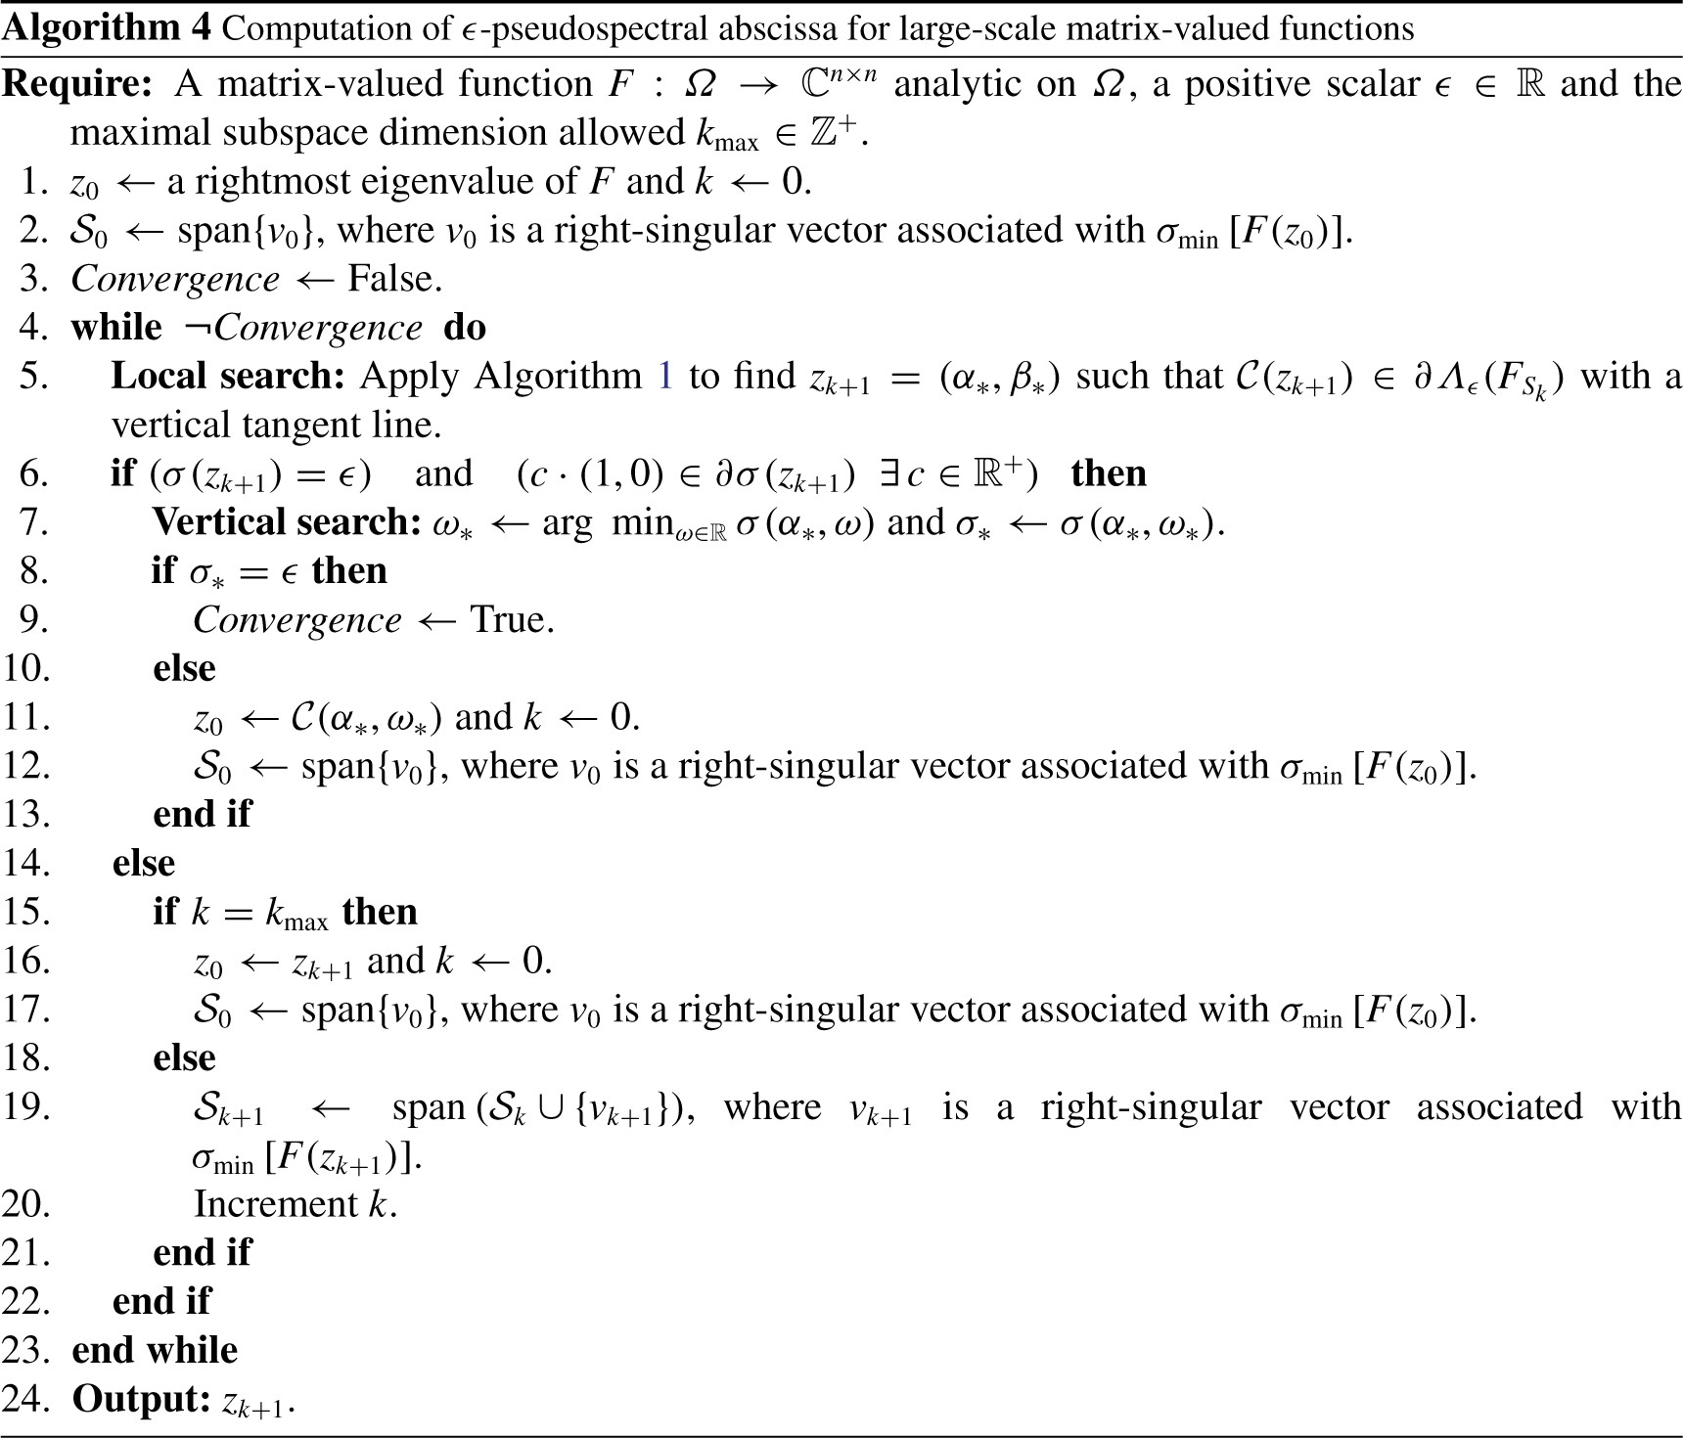
Notes:
Unless provided in the caption above, the following copyright applies to the content of this slide: © The authors 2017. Published by Oxford University Press on behalf of the Institute of Mathematics and its Applications. All rights reserved.

Slide 2
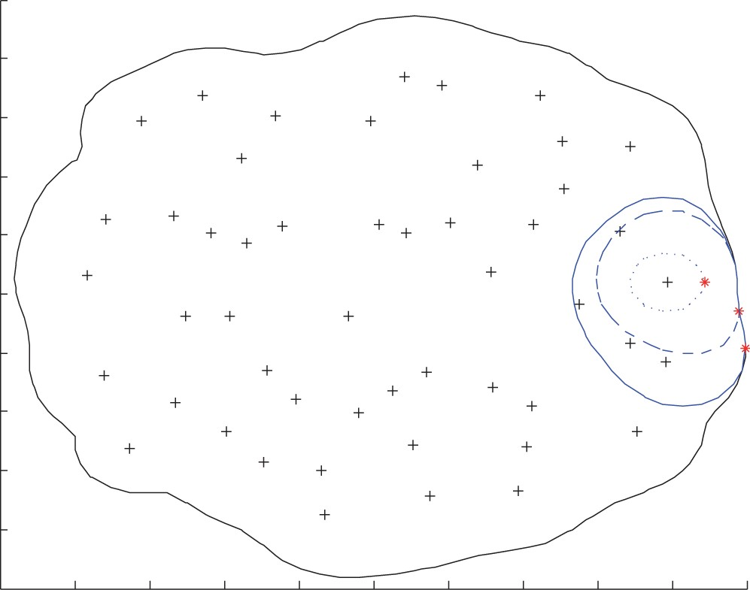
Fig. 1. Subspace iteration on a $50\times 50$ random matrix is displayed. The outermost curve represents the boundary ...
Notes:
Fig. 1. Subspace iteration on a $50\times 50$ random matrix is displayed. The outermost curve represents the boundary of the $\epsilon$-pseudospectrum of this matrix for $\epsilon = 1$, while each $+$ represents an eigenvalue. The $\epsilon$-pseudospectrum for the restricted problem $F_{S_k}$ is shown with dotted, dashed and solid inner curves for $k = 2, 4, 6$, respectively. The asterisks mark the rightmost points for these restricted problems.
Unless provided in the caption above, the following copyright applies to the content of this slide: © The authors 2017. Published by Oxford University Press on behalf of the Institute of Mathematics and its Applications. All rights reserved.

Slide 3
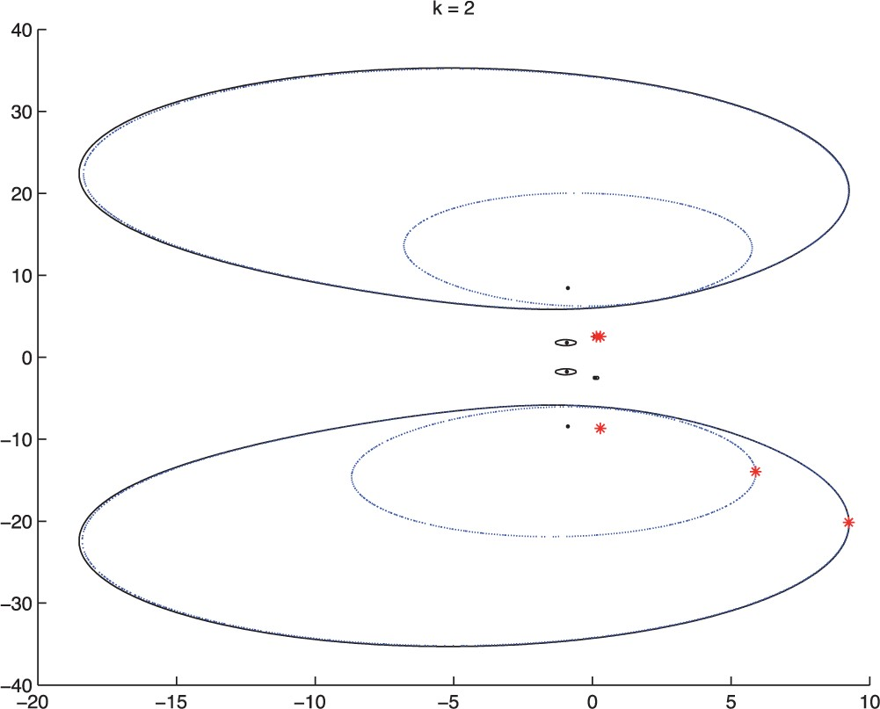
Fig. 2. The progress of the algorithm on the wing example $Q$ for $\epsilon = 10^{-0.8}$ is shown. The eigenvalues ...
Notes:
Fig. 2. The progress of the algorithm on the wing example $Q$ for $\epsilon = 10^{-0.8}$ is shown. The eigenvalues are marked with dots, and the iterates of the algorithm are marked with asterisks. The outermost solid curve corresponds to the boundary of ${\it\Lambda}_{\epsilon}(Q)$ for $\epsilon = 10^{-0.8}$, whereas the inner dotted curves represent the boundary of this $\epsilon$-pseudospectrum when the domain of the map $v \mapsto Qv$ is restricted to one- and two-dimensional subspaces.
Unless provided in the caption above, the following copyright applies to the content of this slide: © The authors 2017. Published by Oxford University Press on behalf of the Institute of Mathematics and its Applications. All rights reserved.

Slide 4
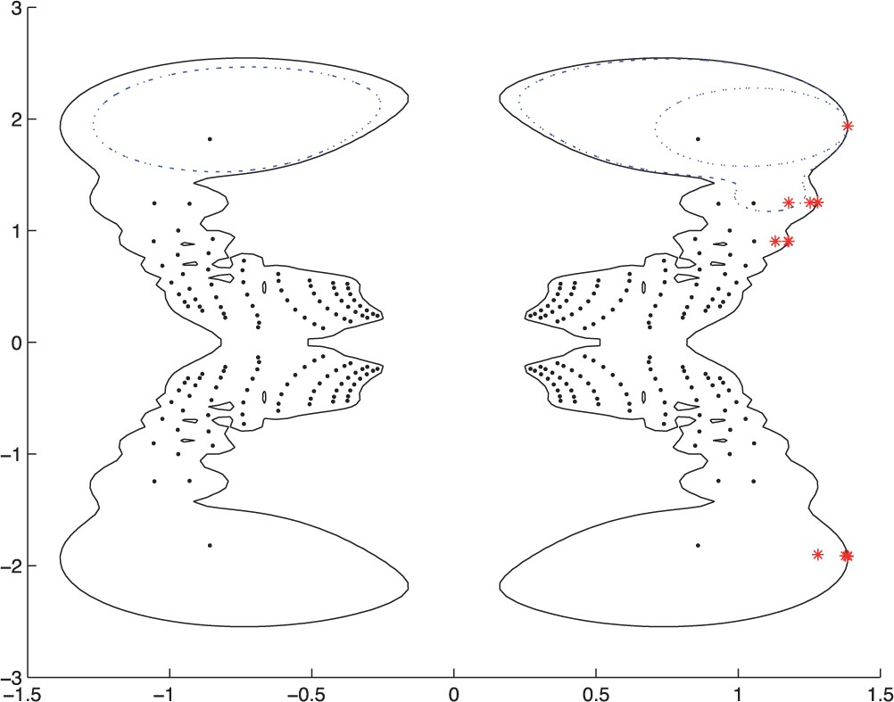
Fig. 3. The algorithm is depicted on the butterfly example with $\epsilon = 0.08$. Once again, the eigenvalues and ...
Notes:
Fig. 3. The algorithm is depicted on the butterfly example with $\epsilon = 0.08$. Once again, the eigenvalues and the iterates of the algorithm are marked with dots and asterisks, respectively. The outermost solid curve corresponds to the boundary of the $\epsilon$-pseudospectrum. The dotted curve and dashed dotted curve represent the $\epsilon$-pseudospectrum when the domain is restricted to a one-dimensional subspace and a three-dimensional subspace just a few iterations before termination.
Unless provided in the caption above, the following copyright applies to the content of this slide: © The authors 2017. Published by Oxford University Press on behalf of the Institute of Mathematics and its Applications. All rights reserved.

Slide 5
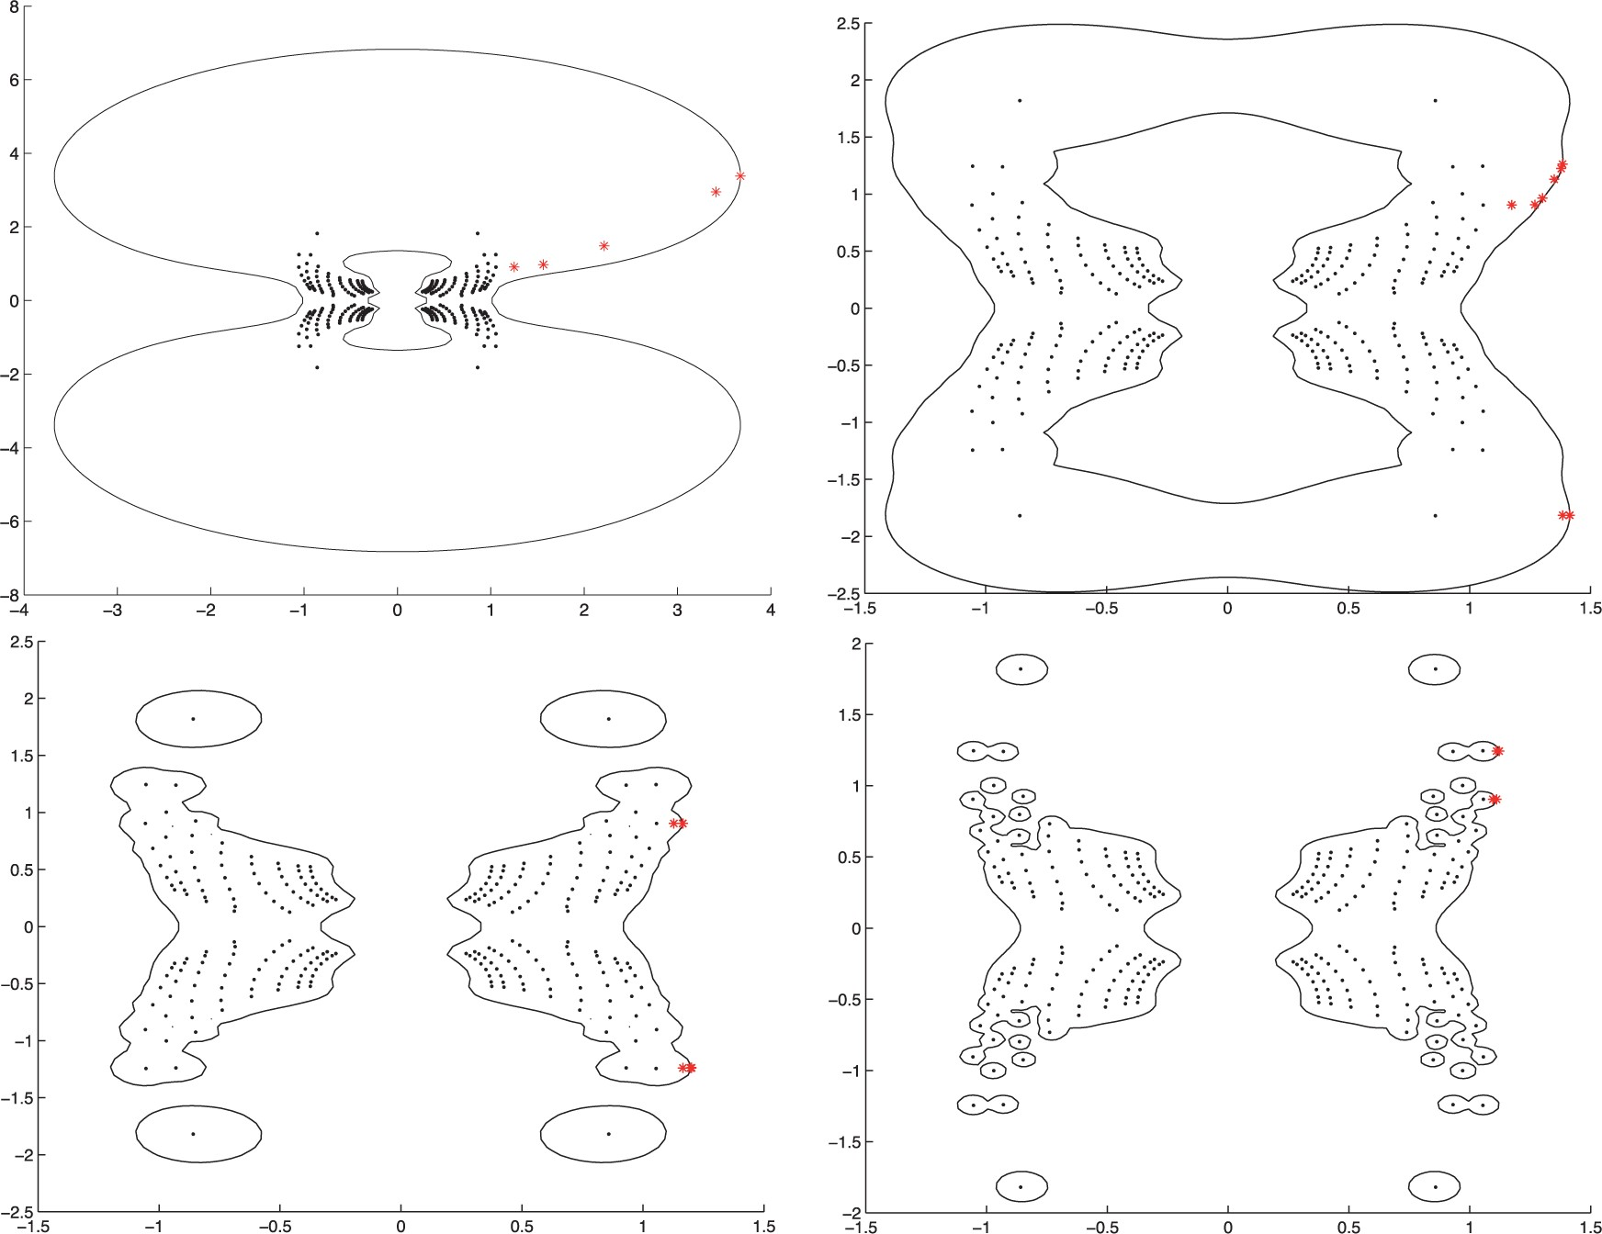
Fig. 4. The algorithm on the butterfly example with $\epsilon = 0.2$ is depicted for various choices of weights. The ...
Notes:
Fig. 4. The algorithm on the butterfly example with $\epsilon = 0.2$ is depicted for various choices of weights. The eigenvalues and the iterates are marked with dots and asterisks, respectively. The solid curve is the boundary of the $\epsilon$-pseudospectrum. Weights are as follows: (top left)$[1 \; 1 \; 1\; 1\; 1]$; (top right)$[1 \; 1 \; 1\; 1\; \infty]$; (bottom left)$[1 \; 1 \; 1\; \infty \; \infty ]$; (bottom right)$[1 \; 1 \; \infty \; \infty \; \infty ]$.
Unless provided in the caption above, the following copyright applies to the content of this slide: © The authors 2017. Published by Oxford University Press on behalf of the Institute of Mathematics and its Applications. All rights reserved.

Slide 6
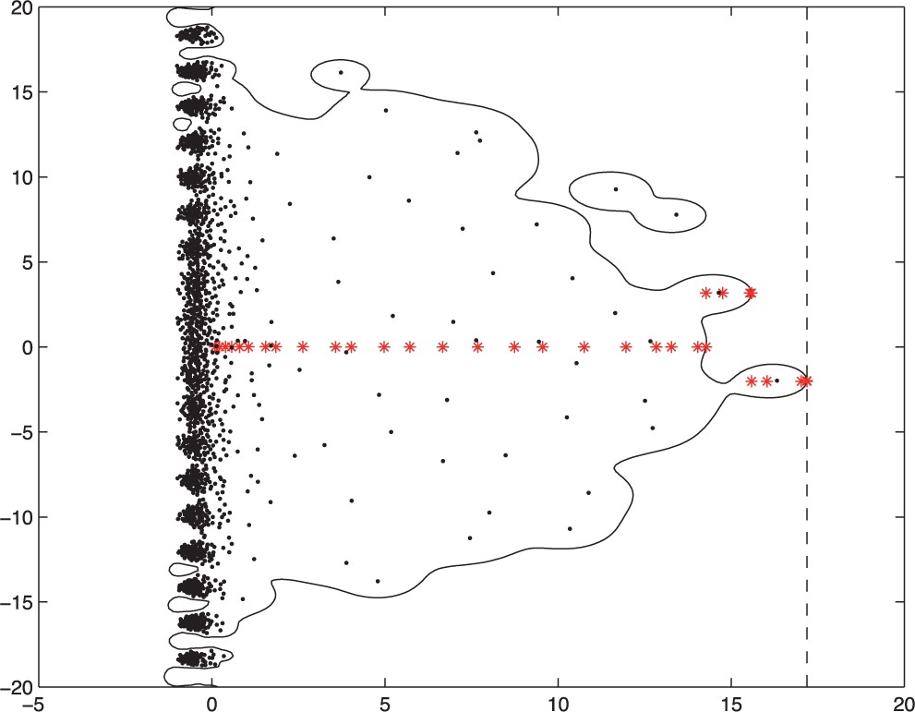
Fig. 5. The progress of the algorithm on delay example (6.1) for $\epsilon = 0.45$ is shown, when initiating at the ...
Notes:
Fig. 5. The progress of the algorithm on delay example (6.1) for $\epsilon = 0.45$ is shown, when initiating at the origin. The iterates are marked with asterisks, the eigenvalues are indicated by dots, whereas the solid curve corresponds to the boundary of the $\epsilon$-pseudospectrum. The dashed vertical line represents the points with real part equal to the computed $\epsilon$-pseudospectral abscissa.
Unless provided in the caption above, the following copyright applies to the content of this slide: © The authors 2017. Published by Oxford University Press on behalf of the Institute of Mathematics and its Applications. All rights reserved.

