Slide 1
Figure 1. Audiovisual stimulus combinations. Infrequent visual and acoustic deviants (solid and hatched boxes ...
Notes:
Figure 1. Audiovisual stimulus combinations. Infrequent visual and acoustic deviants (solid and hatched boxes respectively) were interspersed in a series of frequent congruent audiovisual stimulus presentations.
Unless provided in the caption above, the following copyright applies to the content of this slide: Cerebral Cortex V 15 N 5 © Oxford University Press 2004; all rights reserved

Slide 2
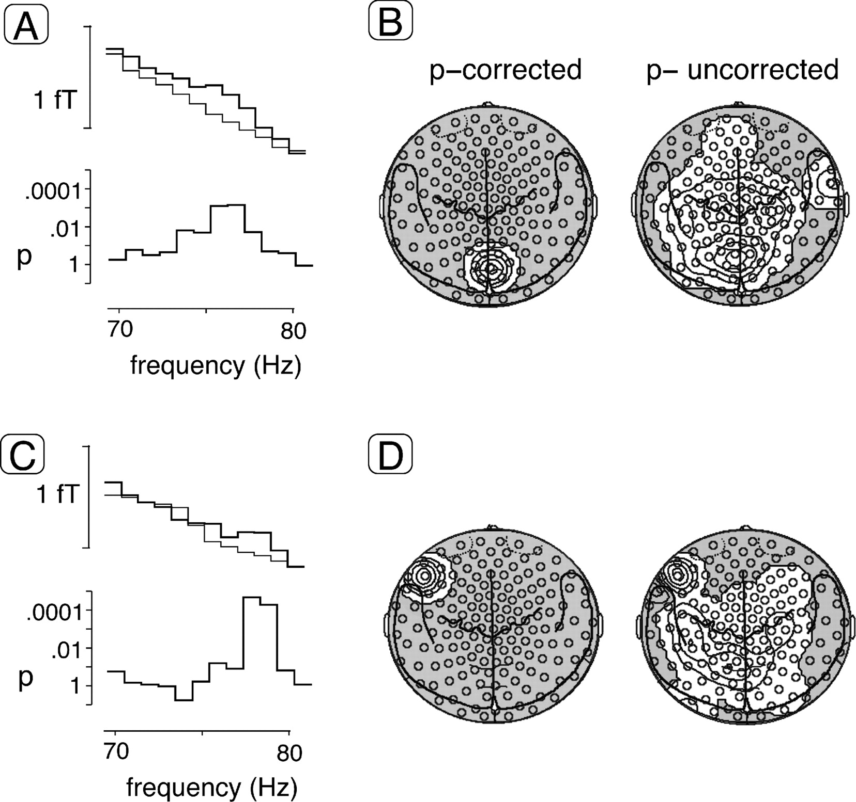
Figure 2. Statistical probability mapping of spectral amplitude differences between visual deviants and standards. (A) ...
Notes:
Figure 2. Statistical probability mapping of spectral amplitude differences between visual deviants and standards. (A) Frequency spectrum in a sensor showing significant differences at ∼75 Hz between deviants and standards for the entire sample of n = 16 subjects. The top graph depicts spectral amplitude absolute values in fT between 70 and 80 Hz for the visual deviants and the congruent audiovisual standards (bold and thin lines respectively). The bottom graph shows the results (P-values) of t-tests comparing spectral amplitudes between deviants and standards. (B) Statistical probability mapping of spectral amplitude differences between visual deviants and standards. Topographies are shown for the entire group at ∼75 Hz projected onto two-dimensional MEG sensor maps including anatomical landmarks (seen from above, nose up). The left map depicts isocontour plots of significant spectral amplitude increases (white areas) meeting the corrected t-value derived from the permutation test-based method correcting for multiple comparisons described in the Materials and Methods. Relative amplitude enhancements for the visual deviant were found over midline occipital cortex. The right map shows the results after application of an uncorrected significance criterion of P = 0.1. (C) Frequency spectrum in a sensor showing significant differences at ∼78 Hz between deviants and standards as in part (A). (D) Topographies of spectral amplitude differences between visual deviants and standards at ∼78 Hz are shown as in part (B). Applying the corrected P-value of 0.05, significant spectral amplitude enhancements for the visual deviant were located in a sensor over the left inferior frontal cortex.
Unless provided in the caption above, the following copyright applies to the content of this slide: Cerebral Cortex V 15 N 5 © Oxford University Press 2004; all rights reserved

Slide 3
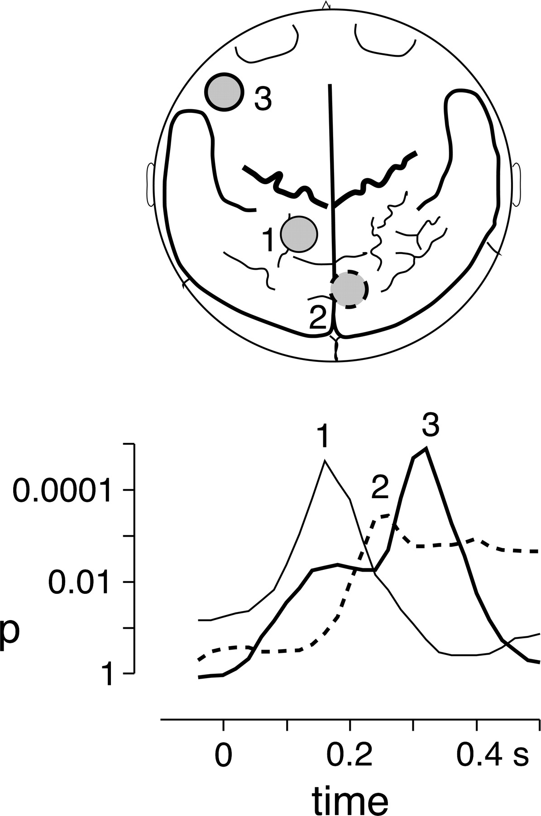
Figure 3. Topographies and time courses of GBA enhancements in response to visual deviants. Top: Locations of sensors ...
Notes:
Figure 3. Topographies and time courses of GBA enhancements in response to visual deviants. Top: Locations of sensors showing spectral amplitude increases at 77.5 ± 2 Hz (sensors 1 and 3) and 75 ± 2.5 Hz (sensor 2) for the visual deviants compared with congruent audiovisual standards. GBA increases were localized in sensors over left posterior parietal cortex (1), midline occipital cortex (2) and over left inferior frontal cortex (3). Bottom: Time-courses of spectral amplitude differences for the three sensors that showed GBA enhancements. The curves depict the results of t-test comparisons between visual deviants and standards, i.e. P-values for time points between 50 ms before to 500 ms after stimulus onset. The thin line shows the dynamics of the posterior parietal activation at sensor 1, the dotted line represents the activation of the midline occipital sensor 2, and the bold line shows the activation at the left inferior frontal sensor 3.
Unless provided in the caption above, the following copyright applies to the content of this slide: Cerebral Cortex V 15 N 5 © Oxford University Press 2004; all rights reserved

Slide 4
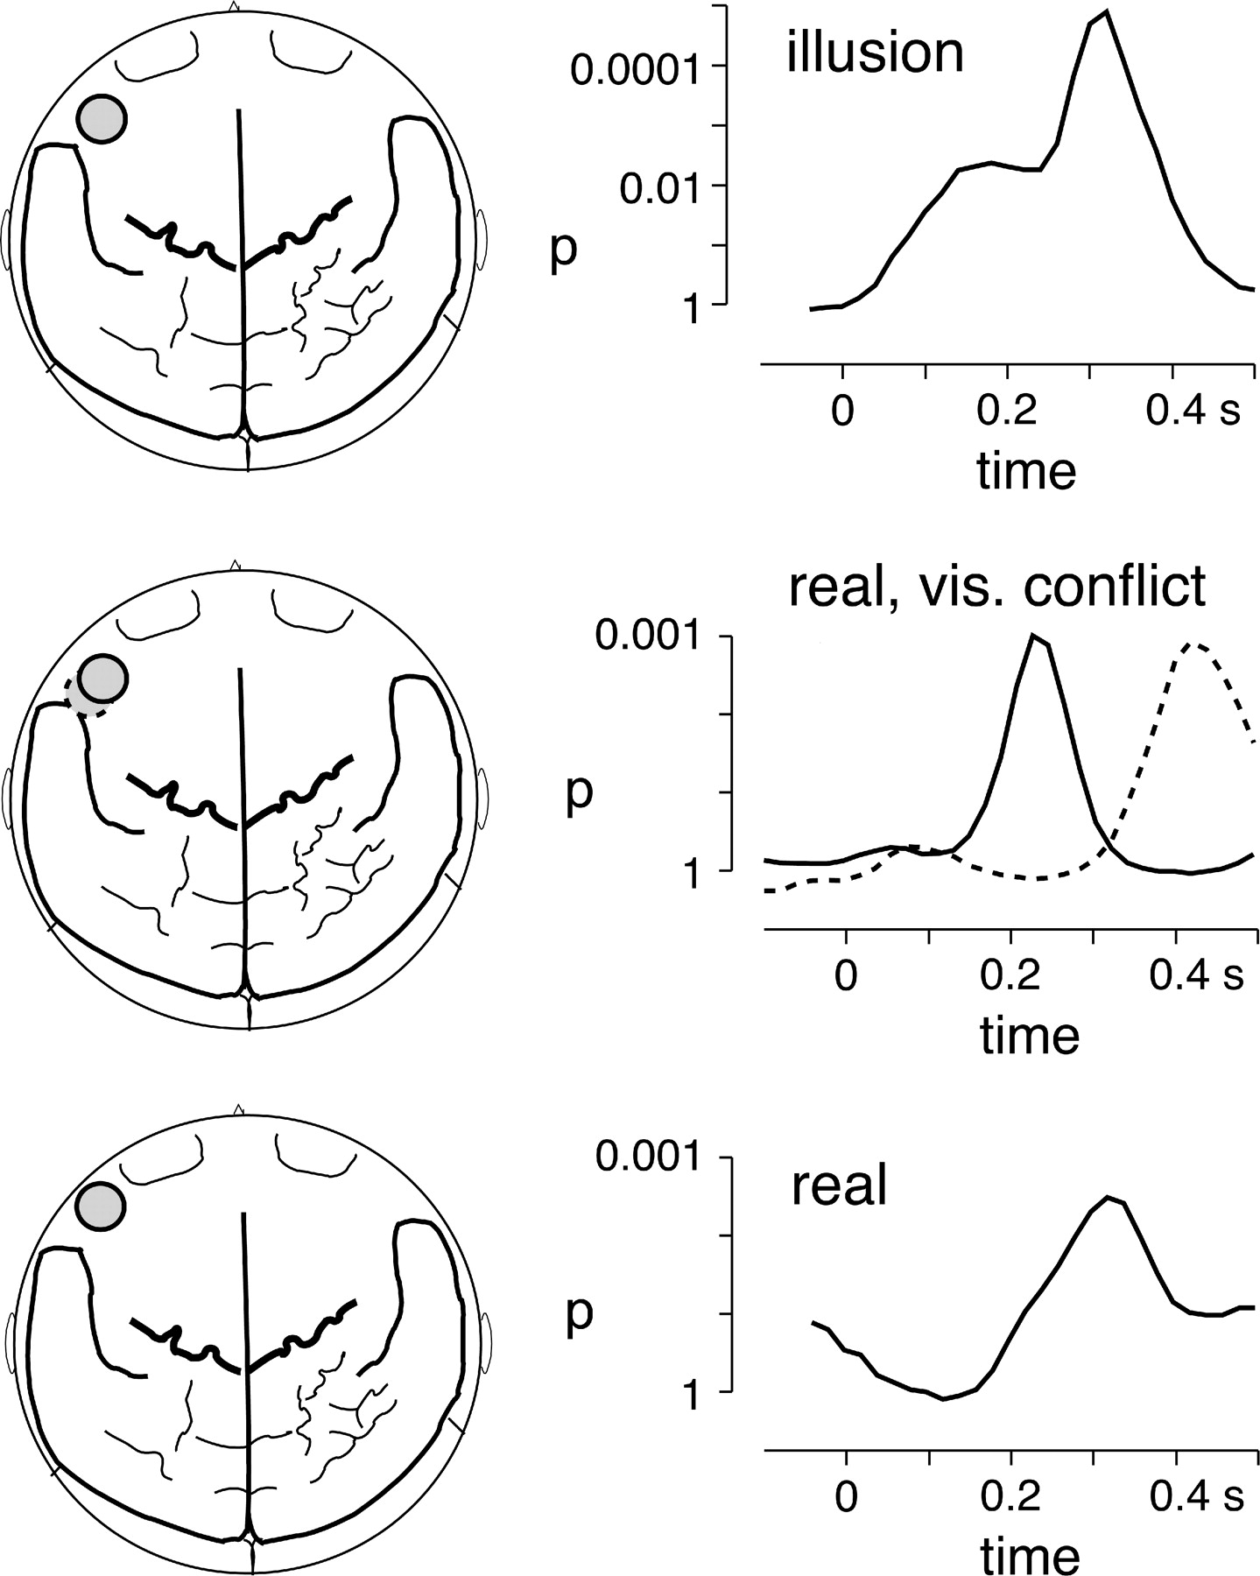
Figure 4. Comparison of GBA to illusory acoustic mismatch caused by an incongruent visual stimulus (top), to acoustic ...
Notes:
Figure 4. Comparison of GBA to illusory acoustic mismatch caused by an incongruent visual stimulus (top), to acoustic deviance in the presence of an incongruent visual stimulus (middle) and to purely auditory phonetic mismatch (bottom). The top left image shows the topography of the left inferior frontal sensor on a two-dimensional brain map with the major anatomical landmarks (seen from above, nose up), the top right graph depicts the time-course of the statistical difference in GBA at 77.5 ± 2 Hz between visual deviants and congruent audiovisual standards in the present study. The middle row depicts the topography and time-courses of GBA differences in the range of 75 ± 2 Hz between acoustic deviants and audiovisually congruent standards in the present study. The solid circle and line represent the activation during the first recording block, whereas the dashed circle and line depict the results during the second recording block. The bottom row shows topography and time course of activation in the frequency range of 86 ± 2.5 Hz for the processing of purely acoustic mismatch (deviant /ba/ versus standard /da/) in a previous study (Kaiser et al., 2002b).
Unless provided in the caption above, the following copyright applies to the content of this slide: Cerebral Cortex V 15 N 5 © Oxford University Press 2004; all rights reserved

