Slide 1
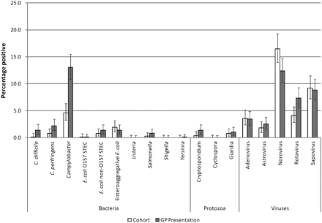
Figure 1. Microbiological findings in cohort and general practice presentation cases in the second Study of Infectious ...
Notes:
Figure 1. Microbiological findings in cohort and general practice presentation cases in the second Study of Infectious Intestinal Disease in the Community. Abbreviations: GP, general practice; STEC, Shiga toxin-producing Escherichia coli.
Unless provided in the caption above, the following copyright applies to the content of this slide: © The Author 2012. Published by Oxford University Press on behalf of the Infectious Diseases Society of America. All rights reserved. For Permissions, please email:journals.permissions@oup.com.This is an Open Access article distributed under the terms of the Creative Commons Attribution Non-Commercial License (http://creativecommons.org/licenses/by-nc/3.0), which permits unrestricted non-commercial use, distribution, and reproduction in any medium, provided the original work is properly cited.

Slide 2
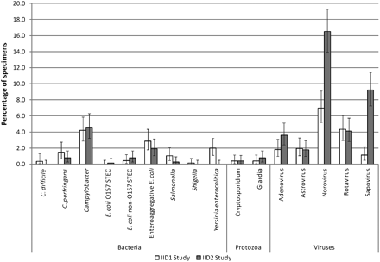
Figure 2. Microbiological findings among community cases of infectious intestinal disease in the Infectious Intestinal ...
Notes:
Figure 2. Microbiological findings among community cases of infectious intestinal disease in the Infectious Intestinal Disease Study in England and the second Study of Infectious Intestinal Disease in the Community. Abbreviations: IID1, Infectious Intestinal Disease Study in England; IID2, second Study of Infectious Intestinal Disease in the Community; STEC, Shiga toxin-producing Escherichia coli.
Unless provided in the caption above, the following copyright applies to the content of this slide: © The Author 2012. Published by Oxford University Press on behalf of the Infectious Diseases Society of America. All rights reserved. For Permissions, please email:journals.permissions@oup.com.This is an Open Access article distributed under the terms of the Creative Commons Attribution Non-Commercial License (http://creativecommons.org/licenses/by-nc/3.0), which permits unrestricted non-commercial use, distribution, and reproduction in any medium, provided the original work is properly cited.

Slide 3
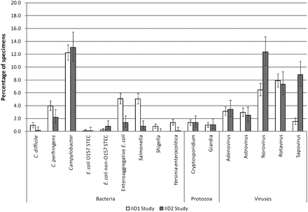
Figure 3. Microbiological findings among infectious intestinal disease cases presenting to general practice in the ...
Notes:
Figure 3. Microbiological findings among infectious intestinal disease cases presenting to general practice in the Infectious Intestinal Disease Study in England and the second Study of Infectious Intestinal Disease in the Community. Abbreviations: IID1, Infectious Intestinal Disease Study in England; IID2, second Study of Infectious Intestinal Disease in the Community; STEC, Shiga toxin-producing Escherichia coli.
Unless provided in the caption above, the following copyright applies to the content of this slide: © The Author 2012. Published by Oxford University Press on behalf of the Infectious Diseases Society of America. All rights reserved. For Permissions, please email:journals.permissions@oup.com.This is an Open Access article distributed under the terms of the Creative Commons Attribution Non-Commercial License (http://creativecommons.org/licenses/by-nc/3.0), which permits unrestricted non-commercial use, distribution, and reproduction in any medium, provided the original work is properly cited.

Slide 4
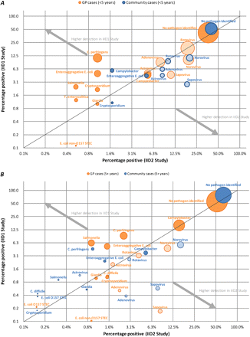
Figure 4. A, Percentage of specimens testing positive for different organisms among community and general practice ...
Notes:
Figure 4. A, Percentage of specimens testing positive for different organisms among community and general practice cases for patients aged 5 years in the IID1 and IID2 studies, England. Abbreviations: GP, general practice; IID1, Infectious Intestinal Disease Study in England; IID2, second Study of Infectious Intestinal Disease in the Community; STEC, Shiga toxin-producing Escherichia coli.
Unless provided in the caption above, the following copyright applies to the content of this slide: © The Author 2012. Published by Oxford University Press on behalf of the Infectious Diseases Society of America. All rights reserved. For Permissions, please email:journals.permissions@oup.com.This is an Open Access article distributed under the terms of the Creative Commons Attribution Non-Commercial License (http://creativecommons.org/licenses/by-nc/3.0), which permits unrestricted non-commercial use, distribution, and reproduction in any medium, provided the original work is properly cited.

Slide 5
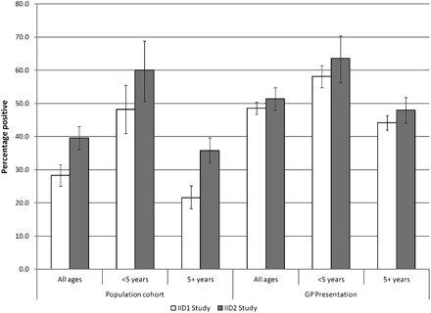
Figure 5. Detection of bacteria, viruses, and protozoa among infectious intestinal disease cases for patients <5 years ...
Notes:
Figure 5. Detection of bacteria, viruses, and protozoa among infectious intestinal disease cases for patients <5 years and ≥5 years of age in Infectious Intestinal Disease Study in England and the second Study of Infectious Intestinal Disease in the Community, England. Abbreviations: GP, general practice; IID1, Infectious Intestinal Disease Study in England; IID2, second Study of Infectious Intestinal Disease in the Community.
Unless provided in the caption above, the following copyright applies to the content of this slide: © The Author 2012. Published by Oxford University Press on behalf of the Infectious Diseases Society of America. All rights reserved. For Permissions, please email:journals.permissions@oup.com.This is an Open Access article distributed under the terms of the Creative Commons Attribution Non-Commercial License (http://creativecommons.org/licenses/by-nc/3.0), which permits unrestricted non-commercial use, distribution, and reproduction in any medium, provided the original work is properly cited.

