Slide 1
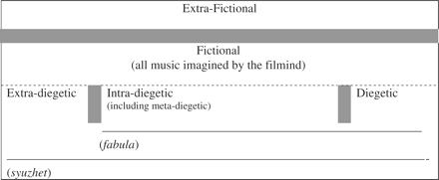
Fig. 1. Layers of music in film (greyed areas indicate liminal spaces)
Notes:
Fig. 1. Layers of music in film (greyed areas indicate liminal spaces)
Unless provided in the caption above, the following copyright applies to the content of this slide: © The Author (2010). Published by Oxford University Press. All rights reserved.

Slide 2
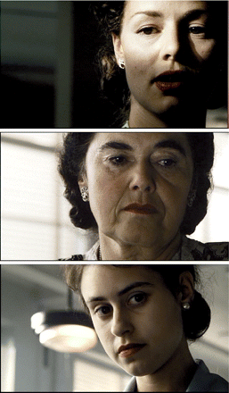
Pl. 1. Emphasizing the feminine in Saving Private Ryan
Notes:
Pl. 1. Emphasizing the feminine in Saving Private Ryan
Unless provided in the caption above, the following copyright applies to the content of this slide: © The Author (2010). Published by Oxford University Press. All rights reserved.

