Slide 1
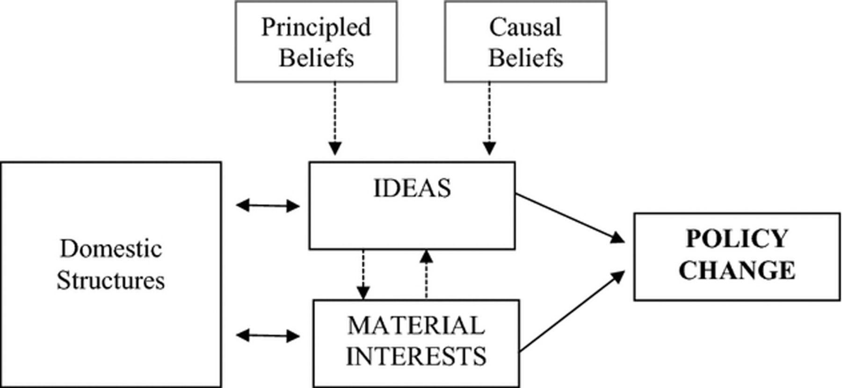
Figure 1 Ideational Influences on Policy Change
Notes:
Figure 1 Ideational Influences on Policy Change
Unless provided in the caption above, the following copyright applies to the content of this slide: © 2013 International Studies Association

Slide 2
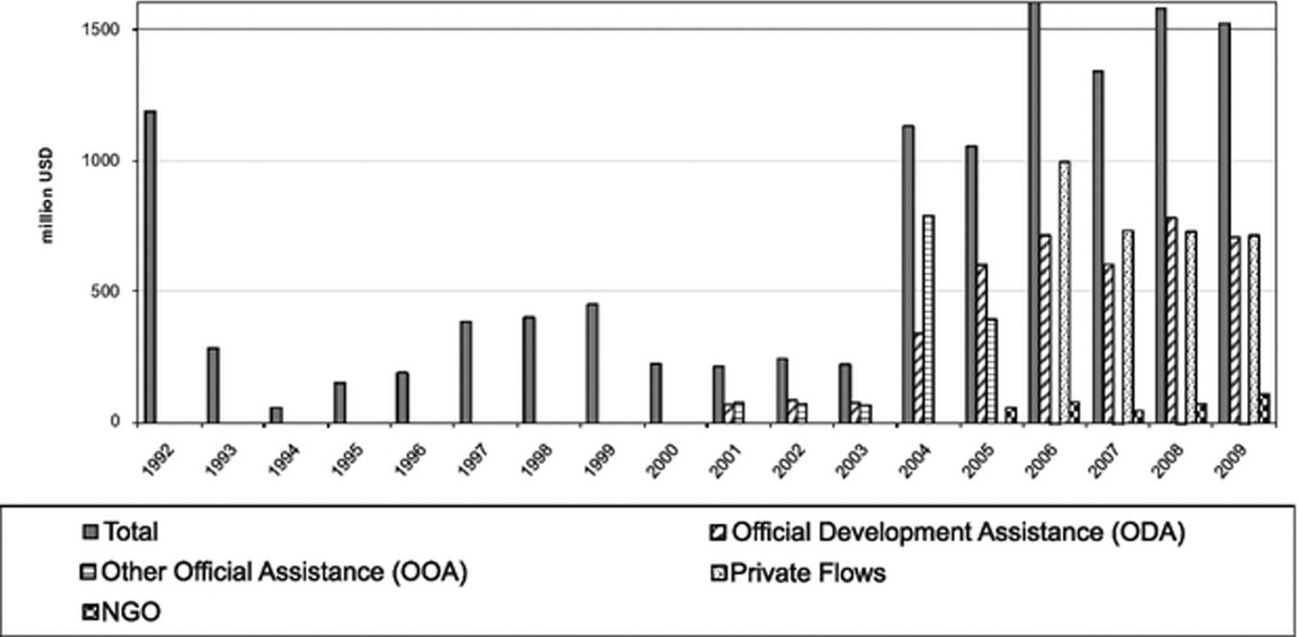
Figure 2 Turkey's Total Development Assistance. Source: Turkish International Cooperation and Development Agency, TIKA ...
Notes:
Figure 2 Turkey's Total Development Assistance. Source: Turkish International Cooperation and Development Agency, TIKA Annual Reports 2004–2010 and Parlak (2007:74 and 79)
Unless provided in the caption above, the following copyright applies to the content of this slide: © 2013 International Studies Association

Slide 3
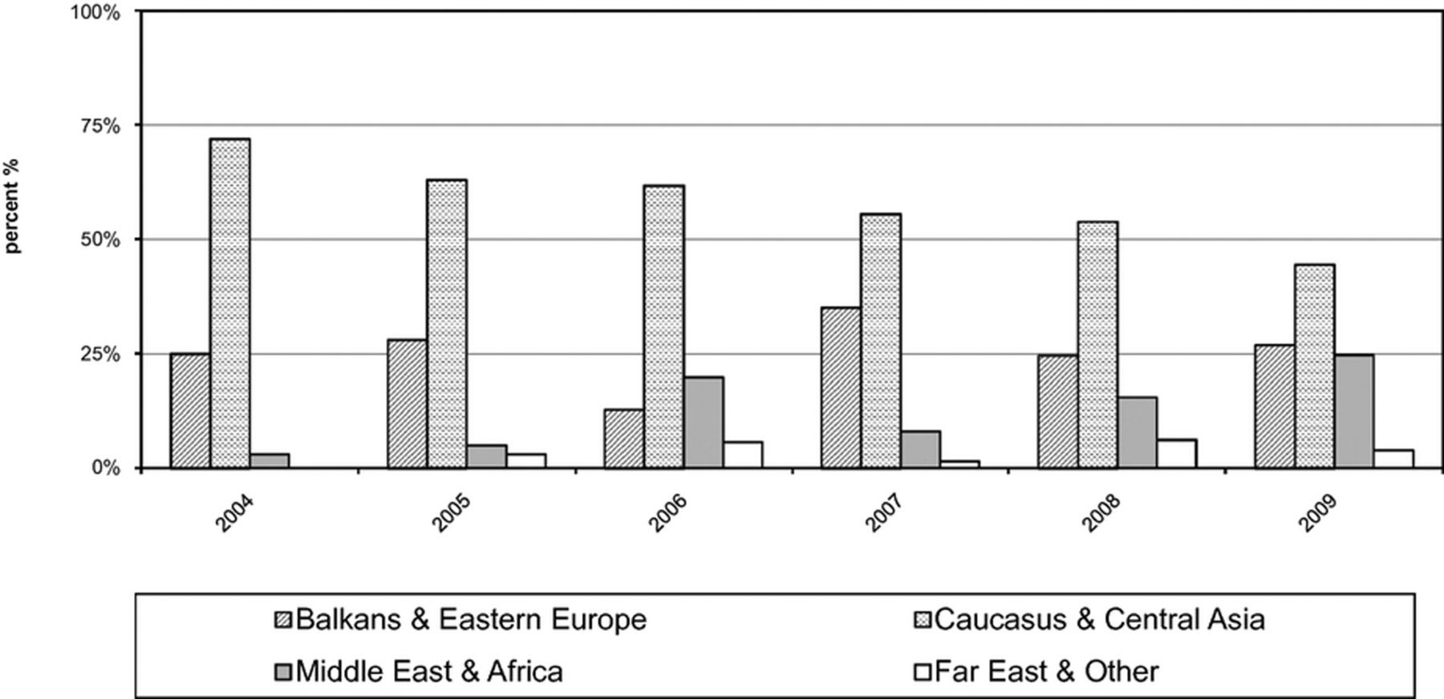
Figure 3 Turkey's Total Development Assistance by Regions. Source: Turkish International Cooperation and Development ...
Notes:
Figure 3 Turkey's Total Development Assistance by Regions. Source: Turkish International Cooperation and Development Agency, TIKA Annual Reports 2004–2010
Unless provided in the caption above, the following copyright applies to the content of this slide: © 2013 International Studies Association

Slide 4
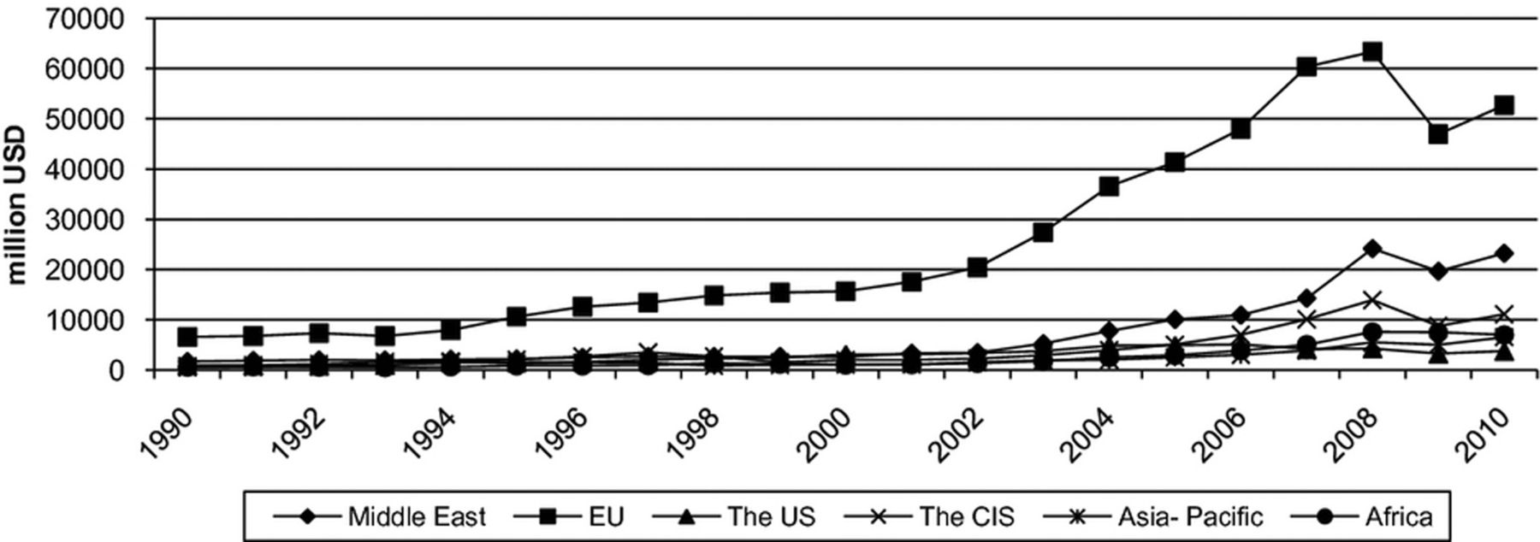
Figure 4 Turkey's Exports by Regions, 1990–2010.
Notes:
Figure 4 Turkey's Exports by Regions, 1990–2010. Source: Ministry of Economy, Trade Statistics by Countries
Unless provided in the caption above, the following copyright applies to the content of this slide: © 2013 International Studies Association

Slide 5
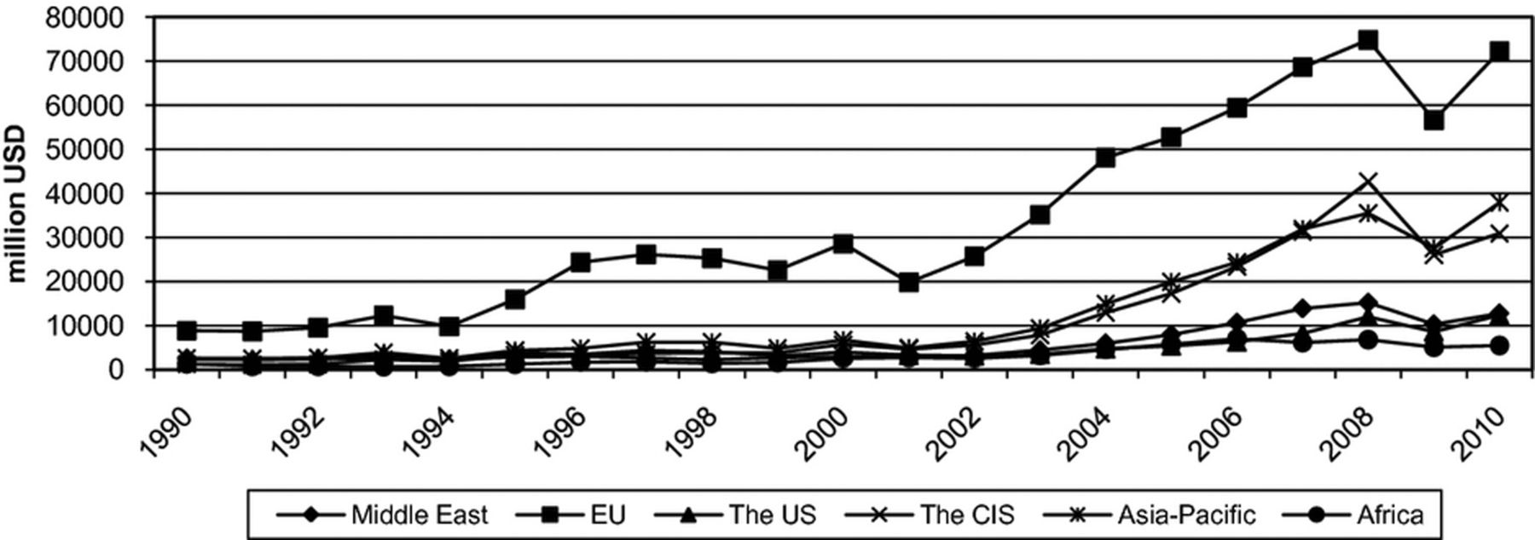
Figure 5 Turkey's Imports by Regions, 1990–2010. Source: Ministry of Economy, Trade Statistics by Countries
Notes:
Figure 5 Turkey's Imports by Regions, 1990–2010. Source: Ministry of Economy, Trade Statistics by Countries
Unless provided in the caption above, the following copyright applies to the content of this slide: © 2013 International Studies Association

