Slide 1
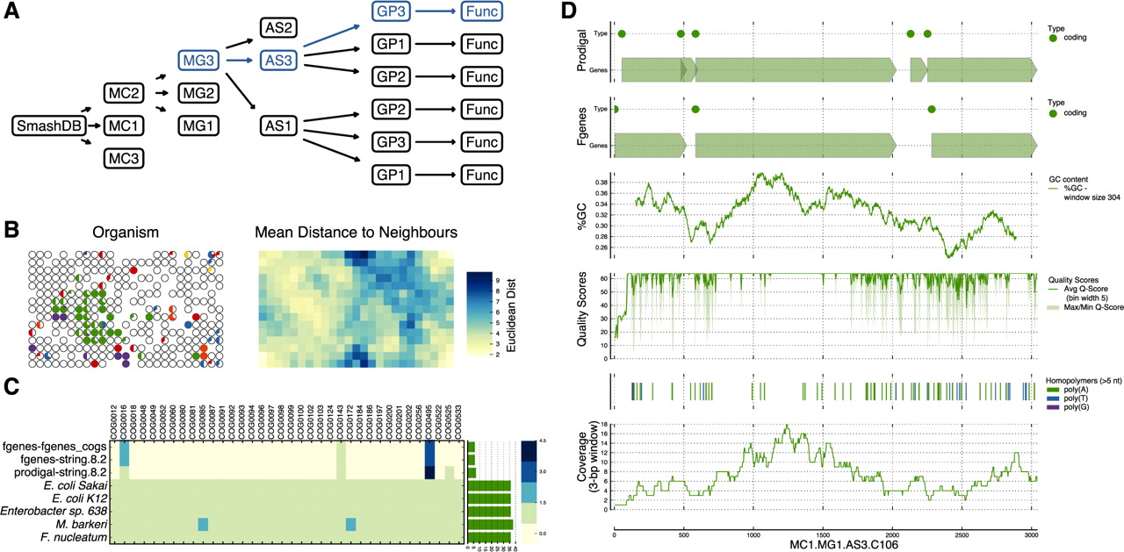
Fig. 1. (A) The data model used in SmashCell is designed to reduce redundancy and facilitate the comparison of ...
Notes:
Fig. 1. (A) The data model used in SmashCell is designed to reduce redundancy and facilitate the comparison of results using different parameters and/or algorithms [MC: metagenome collection, MG: metagenome (equivalent to a SAG), AS: assembly, GP: gene prediction, FUNC: functional annotation]. (B) K-mer frequency statistics supplement sequence similarity information to identify potential contaminants. This shows a self-organizing map (SOM) trained on the tetramer frequencies of an assembly. The left panel shows a series of pie charts highlighting the taxonomic identity (determined by best hit in GenBank, those with no hits are uncoloured) of the contigs assigned to each neuron. The right panel shows the U-matrix of the SOM. (C) The abundance of single-copy COGs can be used to assess genome completeness, the presence of contamination and the quality of the assembly. (D) SmashCell uses different graphs to aid in parameter and algorithm selection. Here the results from two different gene prediction algorithms are presented, along with GC-content, quality scores and read depth.
Unless provided in the caption above, the following copyright applies to the content of this slide: Published by Oxford University Press on behalf of the US Government 2010.This is an Open Access article distributed under the terms of the Creative Commons Attribution Non-Commercial License (http://creativecommons.org/licenses/by-nc/2.5), which permits unrestricted non-commercial use, distribution, and reproduction in any medium, provided the original work is properly cited.

