Slide 1
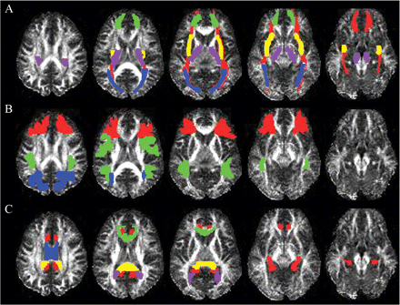
Fig. 1 Example region of interest masks for a single representative subject: (A) forceps minor (green), ...
Notes:
Fig. 1 Example region of interest masks for a single representative subject: (A) forceps minor (green), cortico-spinal tract (purple), inferior frontal-occipital fasciculus (red), external capsule (yellow), sagittal stratum (blue); (B) anterior corona radiata (green), superior longitudinal fasciculus (red), posterior corona radiata (blue); (C) cingulum (red), corpus callosum body (blue), splenium (yellow), and genu (green) and forceps major (purple).
Unless provided in the caption above, the following copyright applies to the content of this slide: © The Author (2007). Published by Oxford University Press on behalf of the Guarantors of Brain. All rights reserved. For Permissions, please email: journals.permissions@oxfordjournals.org

Slide 2
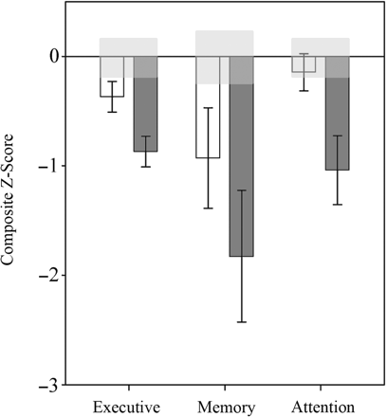
Fig. 2 Mean domain scores (normalized z-scores) for the MTBI (white) and M/STBI (dark gray). Note that the light ...
Notes:
Fig. 2 Mean domain scores (normalized z-scores) for the MTBI (white) and M/STBI (dark gray). Note that the light gray box around zero indicates 1 SEM around the control mean.
Unless provided in the caption above, the following copyright applies to the content of this slide: © The Author (2007). Published by Oxford University Press on behalf of the Guarantors of Brain. All rights reserved. For Permissions, please email: journals.permissions@oxfordjournals.org

Slide 3
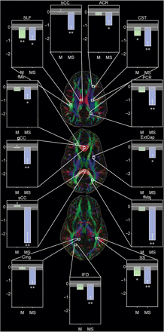
Fig. 3 Mean normalized FA for each ROI for the MTBI (green) and M/STBI (blue). Single asterisks indicate P < 0.05, ...
Notes:
Fig. 3 Mean normalized FA for each ROI for the MTBI (green) and M/STBI (blue). Single asterisks indicate P < 0.05, double asterisks indicate P < 0.001 for the control group compared to either MTBI (M) or M/STBI (MS). Note that the light gray box around zero indicates 1SEM around the control mean. Abbreviations: ACR, PCR: anterior and posterior corona radiata, CST: corticospinal tracts, Cing: cingulum, fMin, fMaj: forceps minor and major, bCC, sCC, gCC: body, genu and splenium of the corpus callosum, IFO: inferior fronto-occipital fasciculus, SLF: superior longitudinal fasciculus, SS: sagittal stratum, ExtCap: external capsule. Note that white boxes on the colour-coded direction map indicate the target fibres but do not indicate the entire region of interest.
Unless provided in the caption above, the following copyright applies to the content of this slide: © The Author (2007). Published by Oxford University Press on behalf of the Guarantors of Brain. All rights reserved. For Permissions, please email: journals.permissions@oxfordjournals.org

Slide 4
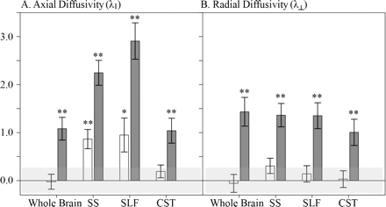
Fig. 4 Mean normalized axial (λ∥) and radial (λ⊥) diffusivity for the MTBI (white bars) and ...
Notes:
Fig. 4 Mean normalized axial (λ∥) and radial (λ⊥) diffusivity for the MTBI (white bars) and M/STBI (dark gray bars). Single asterisks indicate P < 0.05, double asterisks indicate P < 0.01 either the MTBI or M/STBI was compared to controls. Note that the light gray box around zero indicates 1 SEM around the control mean. Abbreviations: SS: sagittal stratum, SLF: superior longitudinal fasciculus, CST: corticospinal tract.
Unless provided in the caption above, the following copyright applies to the content of this slide: © The Author (2007). Published by Oxford University Press on behalf of the Guarantors of Brain. All rights reserved. For Permissions, please email: journals.permissions@oxfordjournals.org

Slide 5
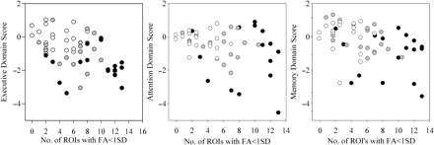
Fig. 5 Plots indicating the relationship between each normalized domain score (left: executive, middle: attention, ...
Notes:
Fig. 5 Plots indicating the relationship between each normalized domain score (left: executive, middle: attention, right: memory) as a function of the number of ROIs with FA <1 SD from the control mean. Controls are indicated by white dots, MTBI (gray dots), and M/STBI (black dots).
Unless provided in the caption above, the following copyright applies to the content of this slide: © The Author (2007). Published by Oxford University Press on behalf of the Guarantors of Brain. All rights reserved. For Permissions, please email: journals.permissions@oxfordjournals.org

