Slide 1
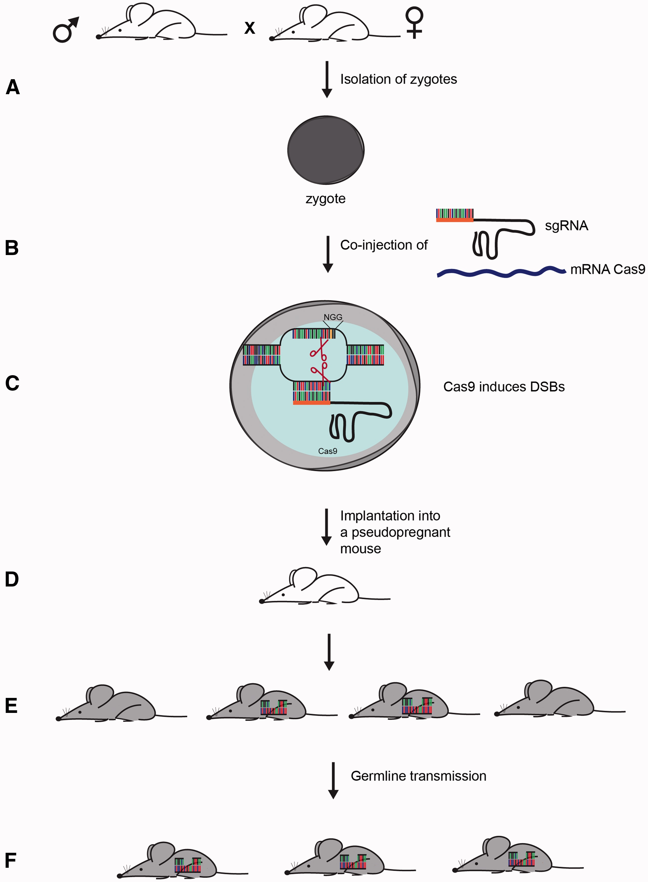
Figure 2. Generation of gene edited mice using CRISPR/Cas9 technology. The steps for generating different mutant ...
Notes:
Figure 2. Generation of gene edited mice using CRISPR/Cas9 technology. The steps for generating different mutant mice—knockout, gene-tagged or mice carrying missense mutations—using CRISPR/Cas9 are quite similar and are shown here in a generalized scheme. A protocol and an excellent review providing guidance on gene editing in mice have been published by ( 6 , 71 ). CRISPR/Cas9 editing requires the design of a short (20 bases) oligonucleotide, which can be easily carried out using one of the many on-line design tools enabling the selection of the most suitable oligonucleotide with least number of off-targets. These are typically cloned into a vector carrying trancrRNA sequence and can be transcribed in vitro as a fused single guide RNA (sgRNA). Some systems offer a single-vector solution for the expression of sgRNA and Cas9 mRNA. Alternatively, in vitro transcribed sgRNA complexed with Cas9 protein can also be used for gene editing. (A) and (B) In this figure, in vitro transcribed sgRNA and Cas9 mRNA are co-injected into zygotes that were isolated from fertilized female mice. (C) SgRNA-targeted Cas9 will induce DSBs at the target site whose repair will generate different mutations in the target locus. After short incubation, the two cell embryos developed from the zygotes are (D) transferred into pseudopregnant females and allowed to (E) develop into mutant mice. The desired mutations can be identified using different screening approaches, depending on the modification, from sequencing of the target site to Southern blot for large deletions. (F) As mice generated by this approach can be mosaic, it is beneficial to perform an additional breeding step to ensure germline transmission of the mutation.
Unless provided in the caption above, the following copyright applies to the content of this slide: © The Author 2016. Published by Oxford University Press. All rights reserved. For permissions, please e-mail: journals.permissions@oup.com

Slide 2
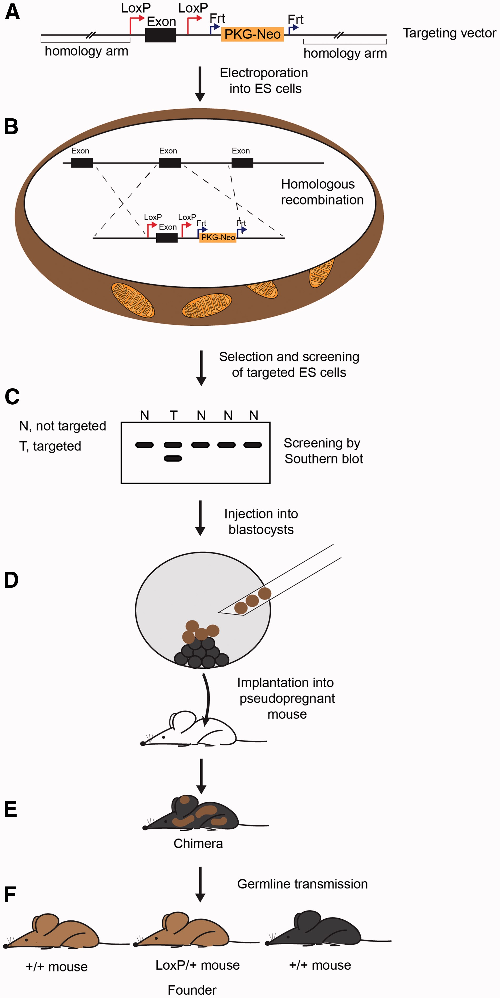
Figure 1. Generation of mouse models using ‘conventional’ gene targeting by homologous recombination. The figure shows ...
Notes:
Figure 1. Generation of mouse models using ‘conventional’ gene targeting by homologous recombination. The figure shows the generation of mice carrying a conditionally targeted allele. These mice can be used for conditional knockout of the gene of interest either in the whole body or in different tissues. Knock-in and constitutive knockout strategies utilize the same general approach. (A) The targeting vector is composed of 5′- and 3′-homology arms that span several kb each and flank an exon with loxP recombination sites on either side, and a Neomycin selection cassette similarly flanked by Frt sites; Cre - or Flp -mediated recombination at these sites will ‘excise’ the enclosed target exon or selection cassette, respectively. ( B ) The targeting construct is electroporated into isogenic mouse ES cells where it integrates by homologous recombination followed by selection of Neomycin-resistant ES cell clones. ( C ) These clones are expanded and screened by Southern blot analysis in large numbers, as homologous recombination efficiency occurs only ∼1–2% of the cells, to identify the few with correctly integrated targeting vector. (D) Targeted clones (brown) are injected into blastocysts from C57BL/6 mice, which also contain donor ES cells (black) and implanted into pseudopregnant mice. (E) The ES cells will develop into chimeric mice whose coat color, presenting with black and brown patches, reflects the relative contribution of each background to the cell population, termed chimerism. (F) Finally, male chimeras with the highest proportion of chimerism are crossed to C57BL/6 mice to ensure transmission of the targeted allele through the germline resulting in mice with two different coat colors: black, which are not targeted and brown, half of which carry the targeted allele.
Unless provided in the caption above, the following copyright applies to the content of this slide: © The Author 2016. Published by Oxford University Press. All rights reserved. For permissions, please e-mail: journals.permissions@oup.com

