Slide 1
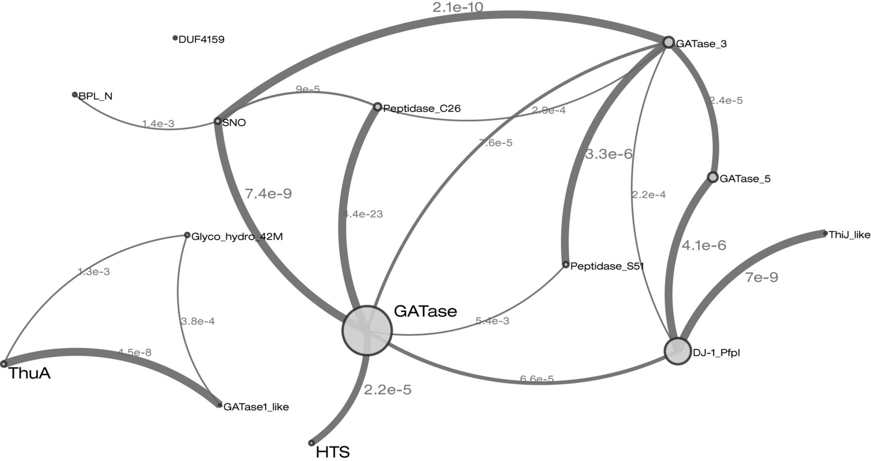
Figure 1. Example of the improved representation of relationships graph, indicating the similarity between the Pfam ...
Notes:
Figure 1. Example of the improved representation of relationships graph, indicating the similarity between the Pfam entries within a clan. This particular entry shows the relationship between the entries in the Glutaminase I clan (accession:CL0014). Each entry in the clan is a node in the graph and is represented as circle, with the diameter of the circle being proportional to the number of sequences in the full alignment. Nodes are connected (edges) based on the HHsearch results between the clan members, with the width of edges proportional to the E-value of the HHsearch similarity (E-values ≤ 0.01 are deemed significant). The clanviewer component has been included in the BioJS registry (http://biojs.io/d/clanviewer) and its code is freely available in github (https://github.com/ProteinsWebTeam/clanviewer). In this particular clan, there are three entries (ThuA (PF06283), GATaseI_like (PF07090) and Glyco_hydro_42M (PF08532)) that from a disconnected sub-cluster. DUF4159 (PF13709) is also unconnected to any other entry. However, these entries are included as part of this clan based on the structural similarities to other entries in the clan.
Unless provided in the caption above, the following copyright applies to the content of this slide: © The Author(s) 2015. Published by Oxford University Press on behalf of Nucleic Acids Research.This is an Open Access article distributed under the terms of the Creative Commons Attribution License (http://creativecommons.org/licenses/by-nc/4.0/), which permits non-commercial re-use, distribution, and reproduction in any medium, provided the original work is properly cited. For commercial re-use, please contact journals.permissions@oup.com

