Slide 1
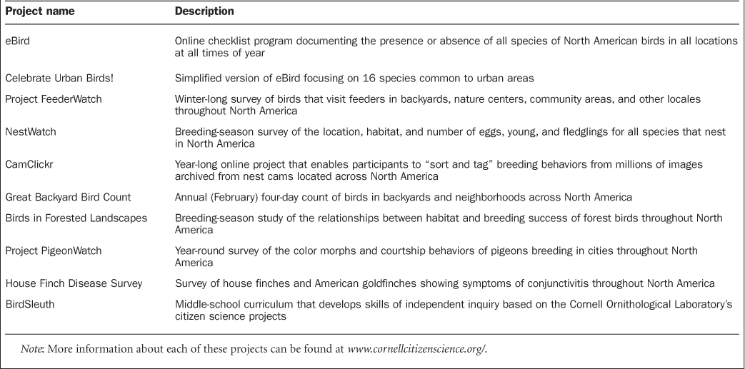
Table 1. Current Cornell Laboratory of Ornithology citizen science projects.
Notes:
Table 1. Current Cornell Laboratory of Ornithology citizen science projects.
Unless provided in the caption above, the following copyright applies to the content of this slide: © 2009 by American Institute of Biological Sciences.

Slide 2
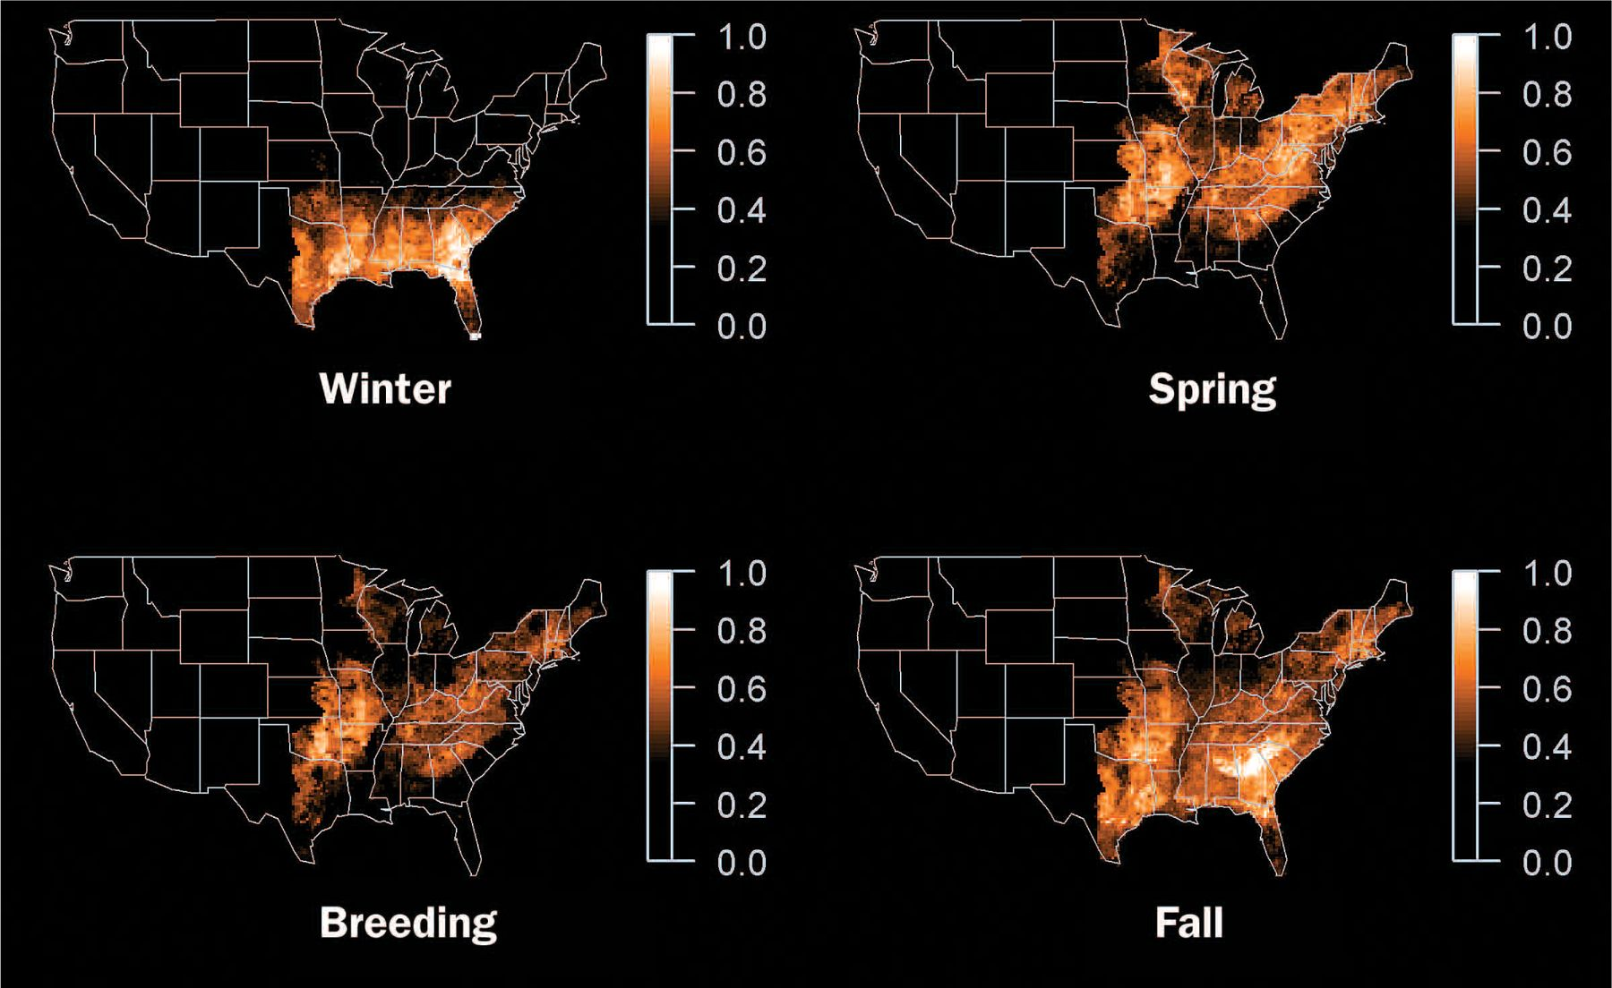
Figure 1. Seasonal patterns of relative abundance for eastern phoebe, a common Neotropical migrant. These surfaces are ...
Notes:
Figure 1. Seasonal patterns of relative abundance for eastern phoebe, a common Neotropical migrant. These surfaces are estimated using eBird traveling counts under five miles long, collected from 2004 to 2007. The data are fit with bagged decision-tree models. To account for habitat selectivity, remotely sensed habitat information compiled at a 15-by-15-kilometer scale is included in the analysis. Variation in detection rates is modeled as a function of both the effort spent watching birds and the length of the traveling count, and variation in availability for detection is modeled as a function of the observation time of day and date. The model is used to produce daily abundance estimates that take local habitat characteristics into account while controlling for variation in detection rates. Seasonal abundance estimates are computed as an average of daily abundance estimates.
Unless provided in the caption above, the following copyright applies to the content of this slide: © 2009 by American Institute of Biological Sciences.

