Slide 1
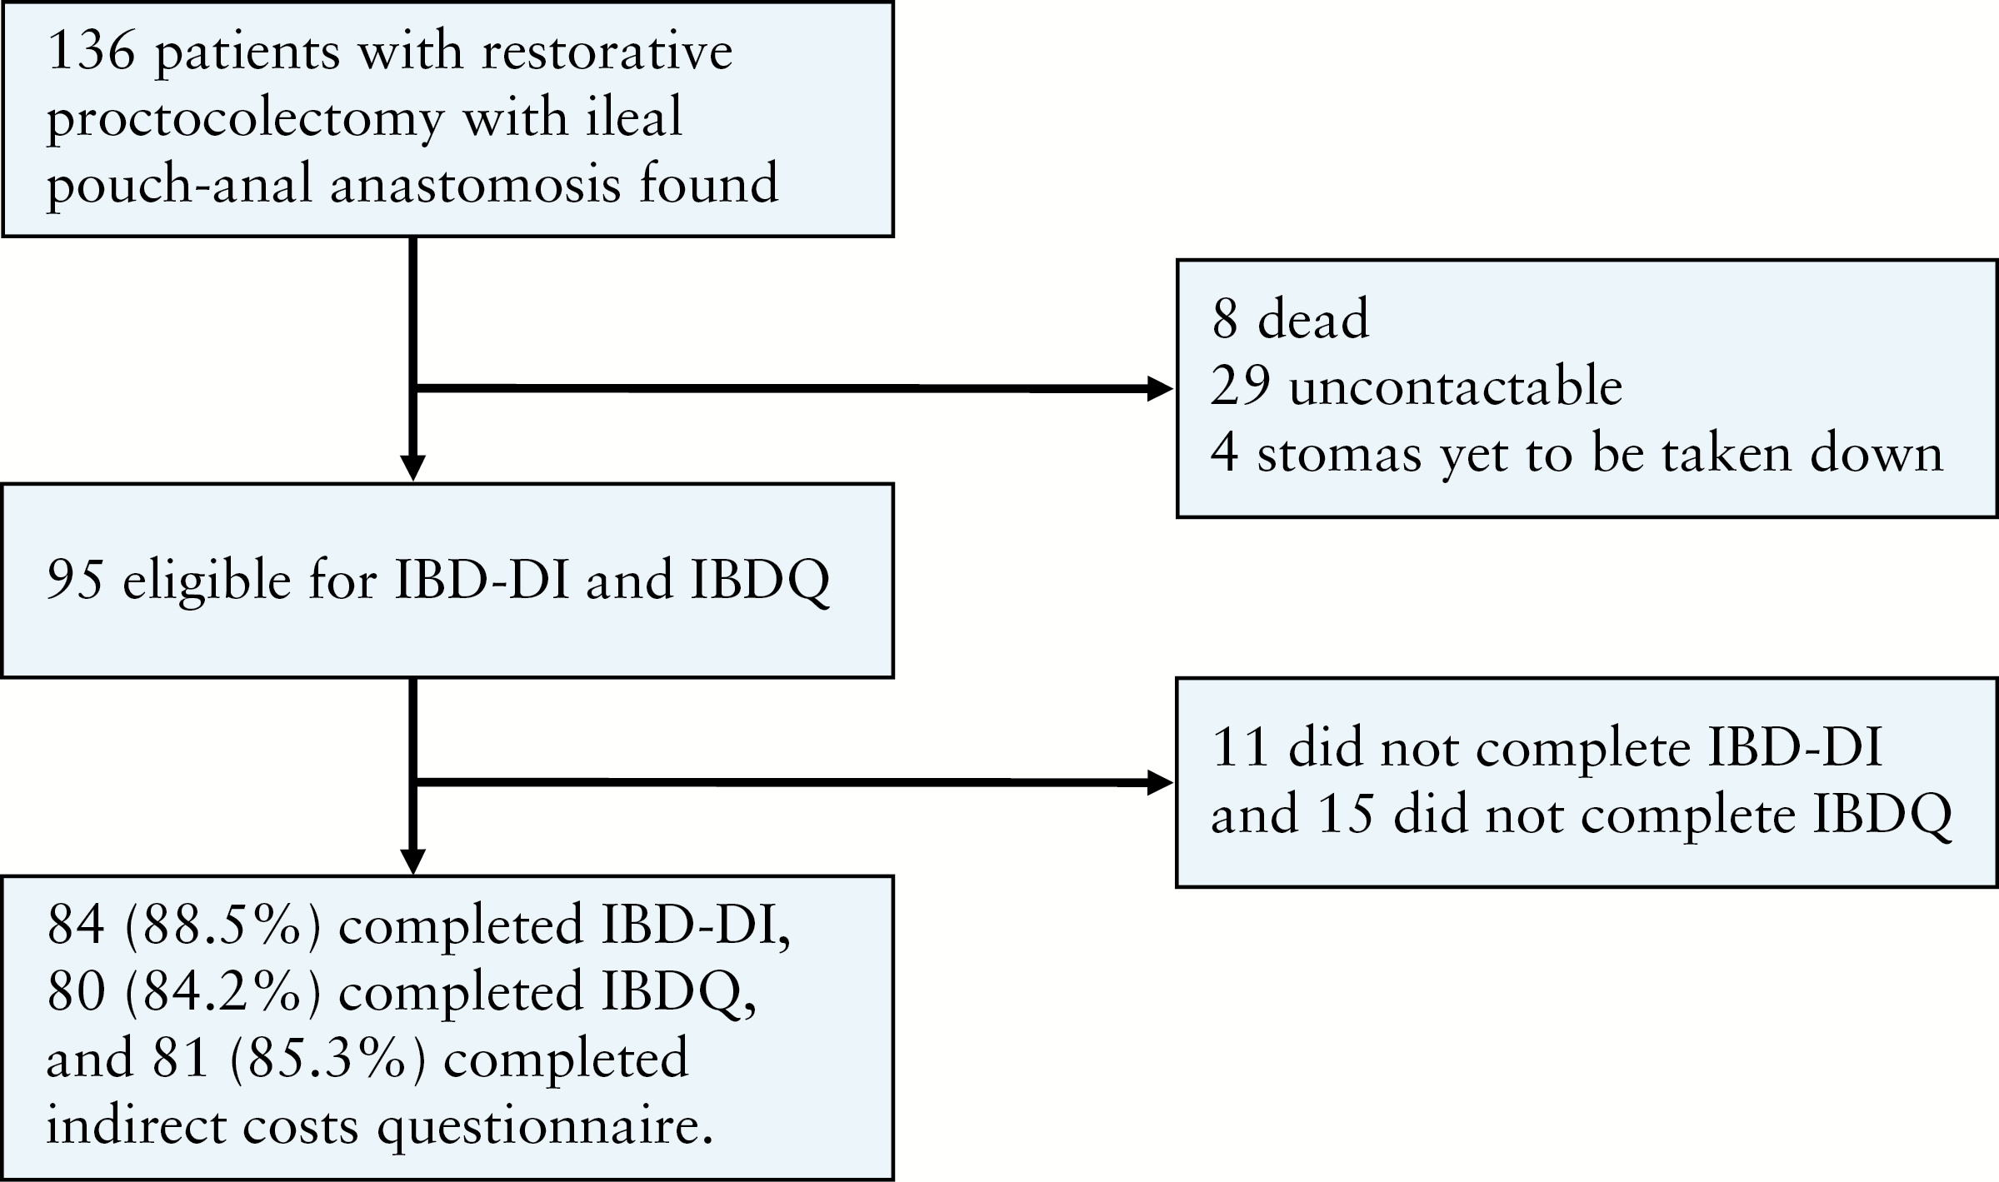
Figure 1. Participant identification and recruitment.
Notes:
Figure 1. Participant identification and recruitment.
Unless provided in the caption above, the following copyright applies to the content of this slide: Copyright © 2016 European Crohn’s and Colitis Organisation (ECCO). Published by Oxford University Press. All rights reserved. For permissions, please email: journals.permissions@oup.com

Slide 2
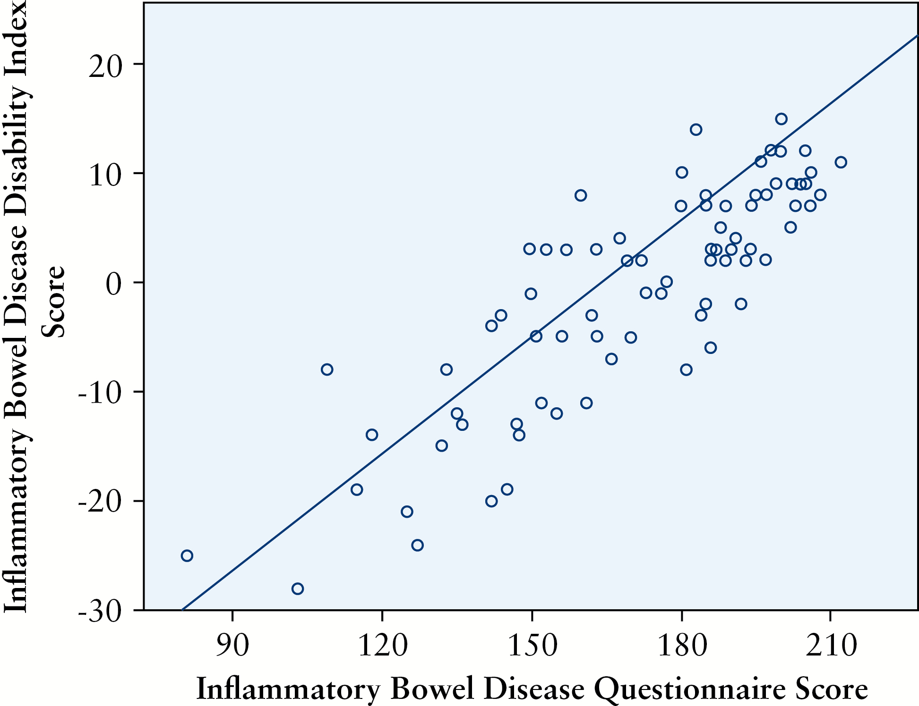
Figure 2. Scatterplot between the IBDQ and IBD-DI.
Notes:
Figure 2. Scatterplot between the IBDQ and IBD-DI.
Unless provided in the caption above, the following copyright applies to the content of this slide: Copyright © 2016 European Crohn’s and Colitis Organisation (ECCO). Published by Oxford University Press. All rights reserved. For permissions, please email: journals.permissions@oup.com

