Slide 1
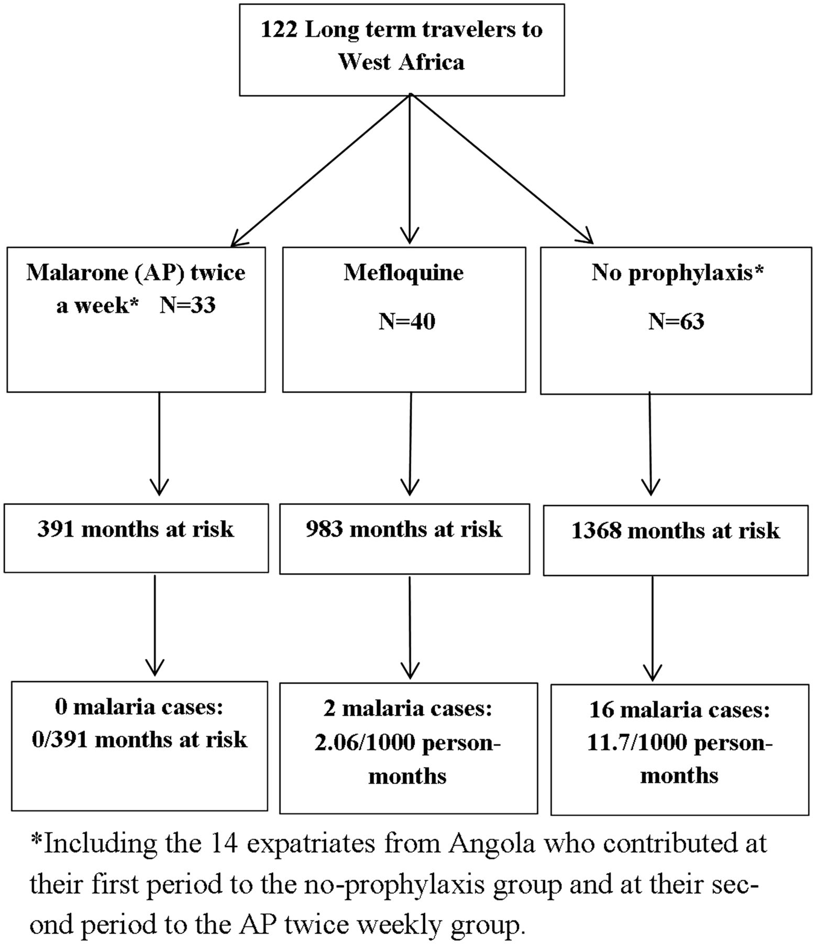
Figure 1 Malaria events according to the malaria chemoprophylaxis taken
Notes:
Figure 1 Malaria events according to the malaria chemoprophylaxis taken
Unless provided in the caption above, the following copyright applies to the content of this slide: © International Society of Travel Medicine, 2016. Published by Oxford University Press. All rights reserved. For Permissions, please e-mail: journals.permissions@oup.com

