Slide 1
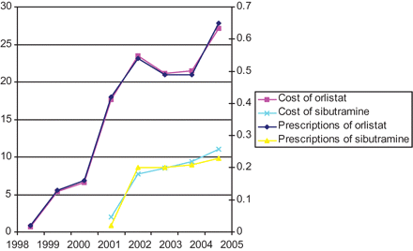
Fig. 1 The total cost and prescriptions of Orlistat and Sibutramine between 1998–2005.
Notes:
Fig. 1 The total cost and prescriptions of Orlistat and Sibutramine between 1998–2005.
Unless provided in the caption above, the following copyright applies to the content of this slide: © The Author 2007, Published by Oxford University Press on behalf of Faculty of Public Health. All rights reserved

