Slide 1
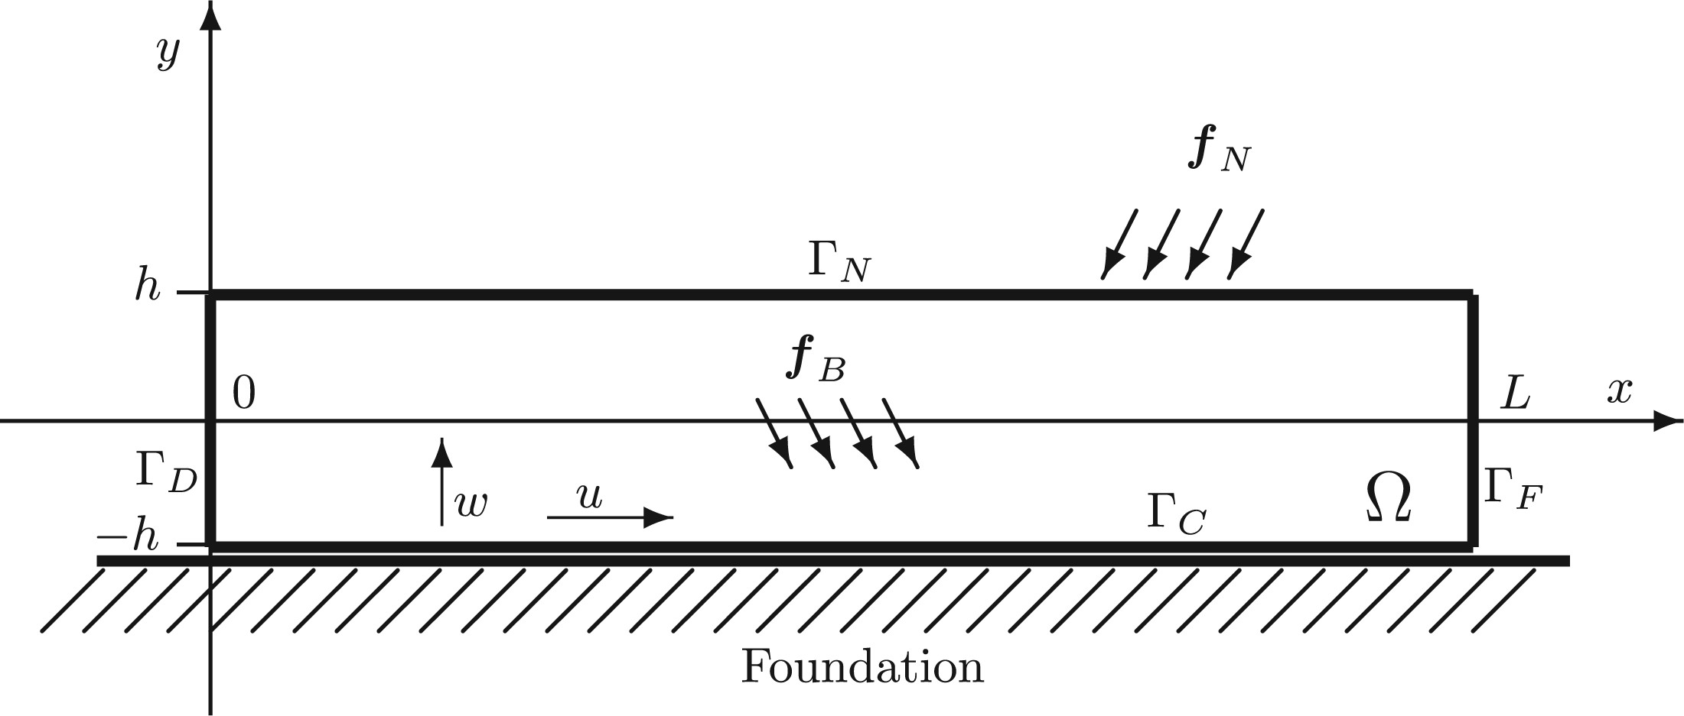
Fig. 1 The cross-section of the plate
Notes:
Fig. 1 The cross-section of the plate
Unless provided in the caption above, the following copyright applies to the content of this slide: © The Author, 2016. Published by Oxford University Press; all rights reserved. For Permissions, please email: journals.permissions@oup.com

