Slide 1
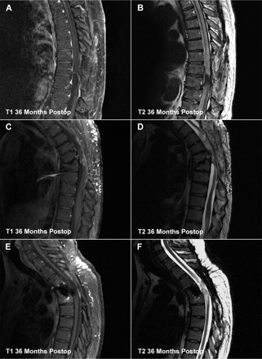
Fig. 1 Sagittal MR imaging of patients at 36 months after olfactory ensheathing cell transplants. Patients 1, 2 and ...
Notes:
Fig. 1 Sagittal MR imaging of patients at 36 months after olfactory ensheathing cell transplants. Patients 1, 2 and 3 are shown as pairs (A and B, C and D, E and F, respectively). On the left are T1-weighted images with gadolinium contrast. On the right are T2-weighted images. Patient 3 has two cylindrical metal cages in the vertebral spaces, placed for treatment of the original vertebral column trauma, seen as white artifacts prominent in the T1-weighted image.
Unless provided in the caption above, the following copyright applies to the content of this slide: © 2008 The Author(s)This is an Open Access article distributed under the terms of the Creative Commons Attribution Non-Commercial License (http://creativecommons.org/licenses/by-nc/2.0/uk/) which permits unrestricted non-commercial use, distribution, and reproduction in any medium, provided the original work is properly cited.

Slide 2
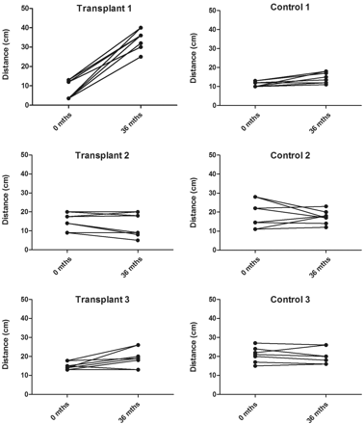
Fig. 3 Changes in light touch and pin prick sensitivity during the period the trial. The graph shows the differences ...
Notes:
Fig. 3 Changes in light touch and pin prick sensitivity during the period the trial. The graph shows the differences in location of sensitivity to light touch and pin prick, anteriorly and posteriorly (8 measurements per patient) at baseline (0 months) and 3 years later (36 months). The locations were measured in centimetres from the sternal notch (anteriorly) and spinous process (posteriorly).
Unless provided in the caption above, the following copyright applies to the content of this slide: © 2008 The Author(s)This is an Open Access article distributed under the terms of the Creative Commons Attribution Non-Commercial License (http://creativecommons.org/licenses/by-nc/2.0/uk/) which permits unrestricted non-commercial use, distribution, and reproduction in any medium, provided the original work is properly cited.

Slide 3
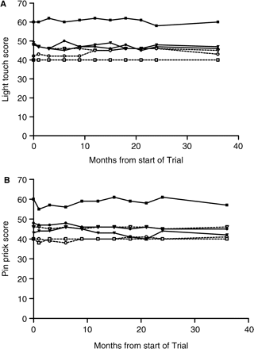
Fig. 2 ASIA sensory scores during the period of the trial. (A) Sensory scores for light touch in the transplant ...
Notes:
Fig. 2 ASIA sensory scores during the period of the trial. (A) Sensory scores for light touch in the transplant recipients (closed symbols, lines) and Controls (open symbols, dotted lines). (B) Pin prick scores for pin prick in the transplant recipients (closed symbols, lines) and controls (open symbols, dotted lines).
Unless provided in the caption above, the following copyright applies to the content of this slide: © 2008 The Author(s)This is an Open Access article distributed under the terms of the Creative Commons Attribution Non-Commercial License (http://creativecommons.org/licenses/by-nc/2.0/uk/) which permits unrestricted non-commercial use, distribution, and reproduction in any medium, provided the original work is properly cited.

