Slide 1
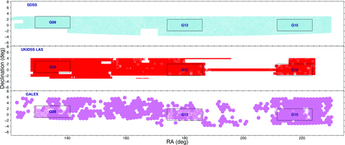
Figure 1 Coverage of the equatorial region of sky that contains the GAMA regions by SDSS DR6 (blue), UKIDSS LAS (red) ...
Notes:
Figure 1 Coverage of the equatorial region of sky that contains the GAMA regions by SDSS DR6 (blue), UKIDSS LAS (red) and GALEX (violet) imaging. The three rectangular boxes contain the regions of sky surveyed by the GAMA.
Unless provided in the caption above, the following copyright applies to the content of this slide: © 2010 The Authors Monthly Notices of the Royal Astronomical Society © 2010 RAS

Slide 2
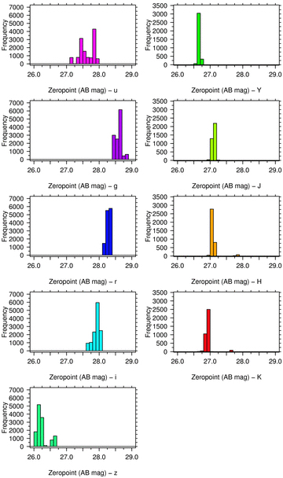
Figure 2 A histogram of the calculated total zero-points for the fields used to create our master region mosaics.
Notes:
Figure 2 A histogram of the calculated total zero-points for the fields used to create our master region mosaics.
Unless provided in the caption above, the following copyright applies to the content of this slide: © 2010 The Authors Monthly Notices of the Royal Astronomical Society © 2010 RAS

Slide 3
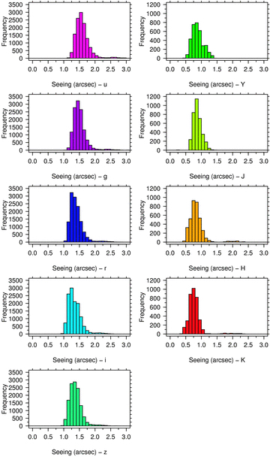
Figure 3 A histogram of the calculated seeing of the fields used to create our master region mosaics.
Notes:
Figure 3 A histogram of the calculated seeing of the fields used to create our master region mosaics.
Unless provided in the caption above, the following copyright applies to the content of this slide: © 2010 The Authors Monthly Notices of the Royal Astronomical Society © 2010 RAS

Slide 4
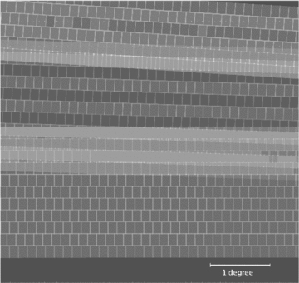
Figure 4 The r-band weight map of the 45000 × 45000 pixel subset region (5 × 5 deg²; defined in Section 5). ...
Notes:
Figure 4 The r-band weight map of the 45000 × 45000 pixel subset region (5 × 5 deg2; defined in Section 5). Joins and overlap between frames are apparent (light grey). The mosaic does not have imaging of the top right-hand corner or the bottom section (dark grey). These areas lie outside the region of interest as the mosaics are slightly larger in Dec. than the GAMA regions themselves.
Unless provided in the caption above, the following copyright applies to the content of this slide: © 2010 The Authors Monthly Notices of the Royal Astronomical Society © 2010 RAS

Slide 5
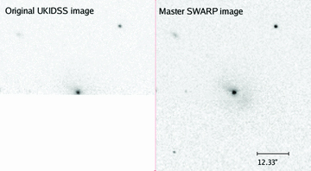
Figure 5 A comparison between the original normalized image and the K-band mosaic image of a galaxy on the bottom edge ...
Notes:
Figure 5 A comparison between the original normalized image and the K-band mosaic image of a galaxy on the bottom edge of an input UKIDSS frame. The bottom section of the galaxy is not part of this image and it has been stitched together on the mosaic using swarp.
Unless provided in the caption above, the following copyright applies to the content of this slide: © 2010 The Authors Monthly Notices of the Royal Astronomical Society © 2010 RAS

Slide 6
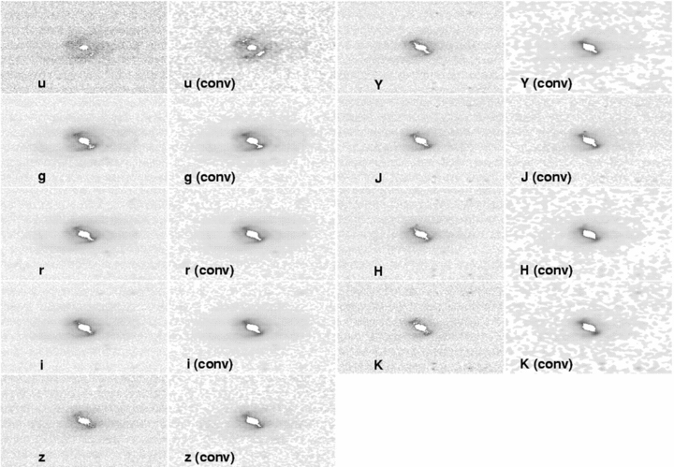
Figure A1 The effects of convolution and the change in passband of observations of SDSS object 588848900968480848.
Notes:
Figure A1 The effects of convolution and the change in passband of observations of SDSS object 588848900968480848.
Unless provided in the caption above, the following copyright applies to the content of this slide: © 2010 The Authors Monthly Notices of the Royal Astronomical Society © 2010 RAS

Slide 7
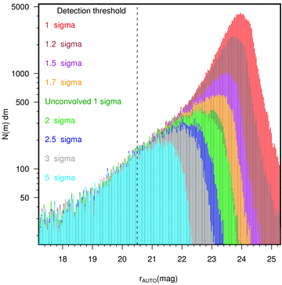
Figure 6 The effects of changing the SExtractor DETECT_THRESH parameter on a subset of an r-band mosaic. The dotted ...
Notes:
Figure 6 The effects of changing the SExtractor DETECT_THRESH parameter on a subset of an r-band mosaic. The dotted black line is the deepest r-band sample limit of the GAMA survey (for those objects that are K or z selected).
Unless provided in the caption above, the following copyright applies to the content of this slide: © 2010 The Authors Monthly Notices of the Royal Astronomical Society © 2010 RAS

Slide 8
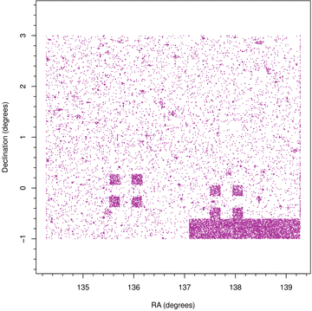
Figure 7 The RA and Dec. of SDSS objects that are not in either the r- or the K-band master-catalogue-matched ...
Notes:
Figure 7 The RA and Dec. of SDSS objects that are not in either the r- or the K-band master-catalogue-matched catalogue. The darker areas note a high density of unmatched objects.
Unless provided in the caption above, the following copyright applies to the content of this slide: © 2010 The Authors Monthly Notices of the Royal Astronomical Society © 2010 RAS

Slide 9
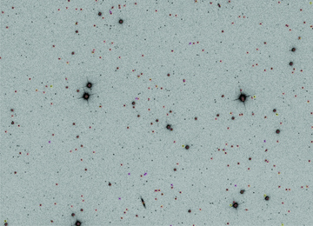
Figure 8 A comparison between the objects detected when SExtractor is run over an original SDSS image and when it is ...
Notes:
Figure 8 A comparison between the objects detected when SExtractor is run over an original SDSS image and when it is run over the convolved, mosaic imaging. Yellow circles are sources with r≤ 20.5 mag detected from the GAMA mosaic and red crosses are sources that are detected from the original SDSS data.
Unless provided in the caption above, the following copyright applies to the content of this slide: © 2010 The Authors Monthly Notices of the Royal Astronomical Society © 2010 RAS

Slide 10
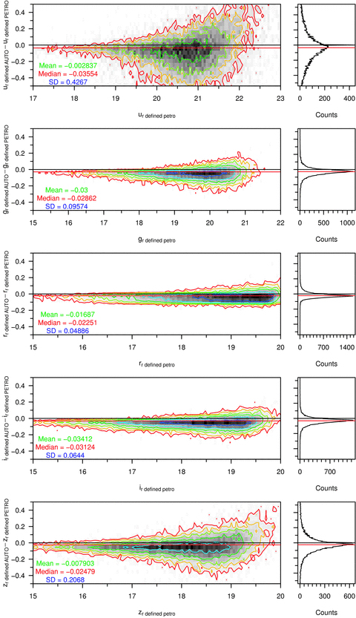
Figure 9 GAMA r-band-defined aperture Petrosian minus AUTO magnitudes for a clean sample of galaxies in ugriz. ...
Notes:
Figure 9 GAMA r-band-defined aperture Petrosian minus AUTO magnitudes for a clean sample of galaxies in ugriz. Contours are for 4–512 galaxies per bin, rising geometrically in powers of 2. Bins are 0.05 mag × 0.05 mag in size.
Unless provided in the caption above, the following copyright applies to the content of this slide: © 2010 The Authors Monthly Notices of the Royal Astronomical Society © 2010 RAS

Slide 11
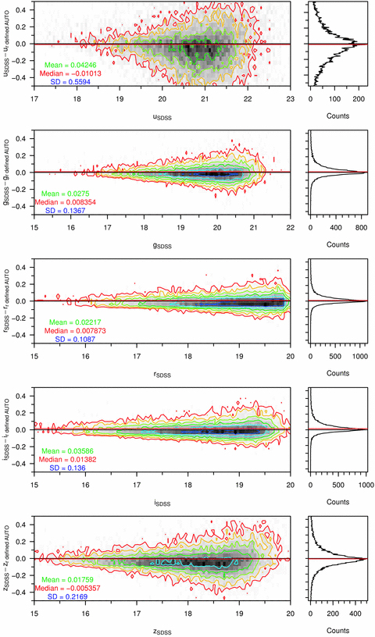
Figure 10 SDSS petromag minus GAMA r-band-defined aperture AUTO magnitudes for a clean sample of galaxies in ugriz. ...
Notes:
Figure 10 SDSS petromag minus GAMA r-band-defined aperture AUTO magnitudes for a clean sample of galaxies in ugriz. Contours are for 4–512 galaxies per bin, rising geometrically in powers of 2. Bins are 0.05 mag × 0.05 mag in size.
Unless provided in the caption above, the following copyright applies to the content of this slide: © 2010 The Authors Monthly Notices of the Royal Astronomical Society © 2010 RAS

Slide 12
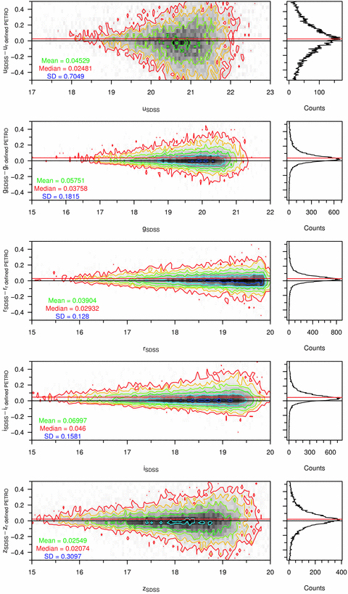
Figure 11 SDSS petromag minus GAMA r-band-defined aperture Petrosian magnitudes for a clean sample of galaxies in ...
Notes:
Figure 11 SDSS petromag minus GAMA r-band-defined aperture Petrosian magnitudes for a clean sample of galaxies in ugriz. Contours are for 4–512 galaxies per bin, rising geometrically in powers of 2. Bins are 0.05 mag × 0.05 mag in size.
Unless provided in the caption above, the following copyright applies to the content of this slide: © 2010 The Authors Monthly Notices of the Royal Astronomical Society © 2010 RAS

Slide 13
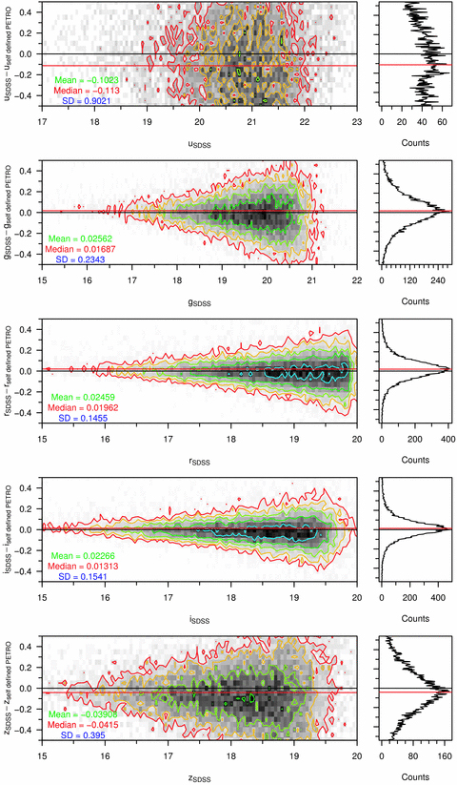
Figure 12 SDSS petromag minus GAMA self-defined aperture Petrosian magnitudes for a clean sample of galaxies in ugriz. ...
Notes:
Figure 12 SDSS petromag minus GAMA self-defined aperture Petrosian magnitudes for a clean sample of galaxies in ugriz. Contours are for 4–512 galaxies per bin, rising geometrically in powers of 2. Bins are 0.05 mag × 0.05 mag in size.
Unless provided in the caption above, the following copyright applies to the content of this slide: © 2010 The Authors Monthly Notices of the Royal Astronomical Society © 2010 RAS

Slide 14
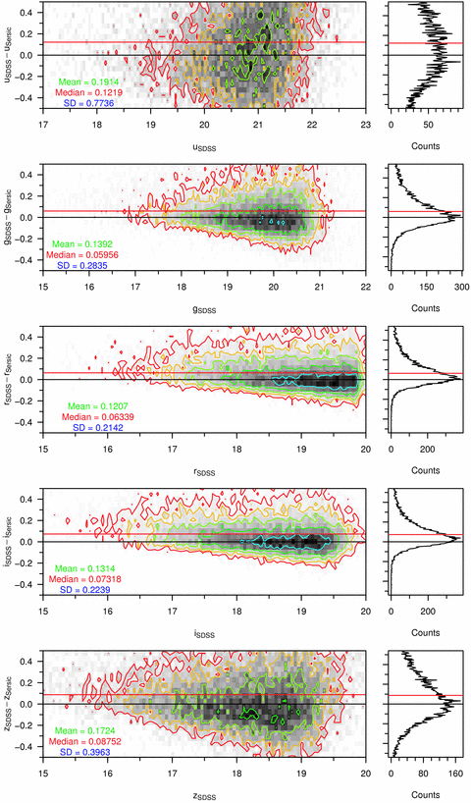
Figure 13 SDSS petromag minus GAMA Sérsic magnitudes for a clean sample of galaxies in ugriz. Contours are for 4–512 ...
Notes:
Figure 13 SDSS petromag minus GAMA Sérsic magnitudes for a clean sample of galaxies in ugriz. Contours are for 4–512 galaxies per bin, rising geometrically in powers of 2. Bins are 0.05 mag × 0.05 mag in size.
Unless provided in the caption above, the following copyright applies to the content of this slide: © 2010 The Authors Monthly Notices of the Royal Astronomical Society © 2010 RAS

Slide 15
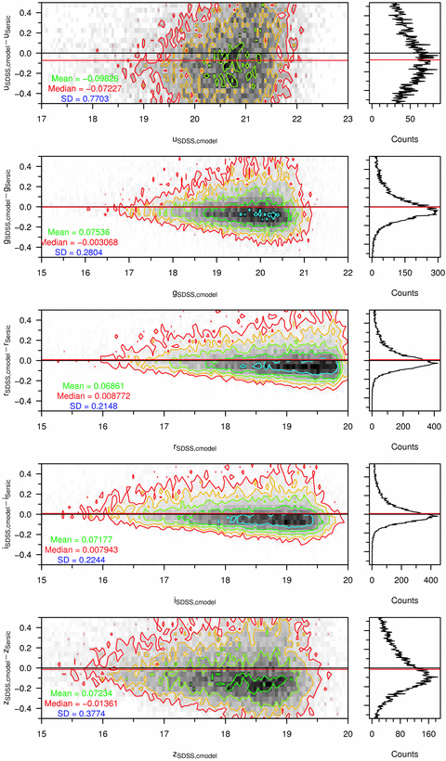
Figure 14 SDSS cmodel minus GAMA Sérsic magnitudes for a clean sample of galaxies in ugriz. Contours are for 4–512 ...
Notes:
Figure 14 SDSS cmodel minus GAMA Sérsic magnitudes for a clean sample of galaxies in ugriz. Contours are for 4–512 galaxies per bin, rising geometrically in powers of 2. Bins are 0.05 mag × 0.05 mag in size.
Unless provided in the caption above, the following copyright applies to the content of this slide: © 2010 The Authors Monthly Notices of the Royal Astronomical Society © 2010 RAS

Slide 16
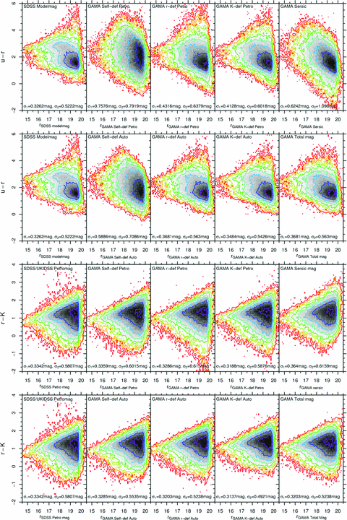
Figure 15 A comparison between the u−r and r−K colours produced using SDSS modelmag, GAMA self-defined Petrosian ...
Notes:
Figure 15 A comparison between the u−r and r−K colours produced using SDSS modelmag, GAMA self-defined Petrosian magnitudes, GAMA r/K-band-defined Petrosian magnitudes, Sérsic and GAMA total magnitudes for objects in the subset region. Contours shown are for 2–512 galaxies per bin, rising geometrically in powers of 2. Bins are 0.1 mag in width in each axis. The σ parameter comes from the best-fitting bivariate-Gaussian distribution, when it is fitted to the colour-distribution histogram in each plot.
Unless provided in the caption above, the following copyright applies to the content of this slide: © 2010 The Authors Monthly Notices of the Royal Astronomical Society © 2010 RAS

Slide 17
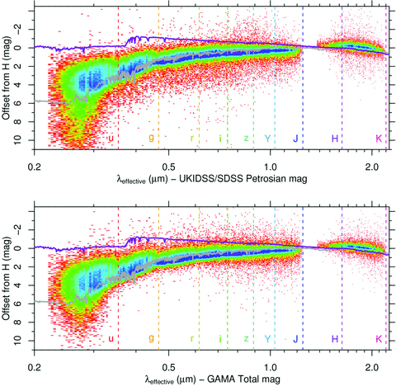
Figure 16 A comparison between the X−H colours produced using SDSS magnitudes and GAMA total magnitudes. Data come from ...
Notes:
Figure 16 A comparison between the X−H colours produced using SDSS magnitudes and GAMA total magnitudes. Data come from all GAMA galaxies with good-quality redshifts (0.033 < z < 0.6) and complete ugrizYJHK photometry. Effective wavelengths are calculated from the redshift of the galaxy and the filter effective wavelength, and the data set is binned into a 50 × 50 bin matrix. Two Bruzual-Charlot 03 SSP instantaneous-burst models are also plotted. Both models use the Chabrier (2003) initial mass function, with mass cut-offs at 0.1 and 100 M⊙. Stellar evolution is undertaken using the Padova 1994 prescription. The dark grey line is a model evolved to 11 Gyr, with Z = 0.05 and Y = 0.352. The purple line is a model evolved to 0.25 Gyr, using Z = 0.02 (Z⊙) and Y = 0.28.
Unless provided in the caption above, the following copyright applies to the content of this slide: © 2010 The Authors Monthly Notices of the Royal Astronomical Society © 2010 RAS

Slide 18
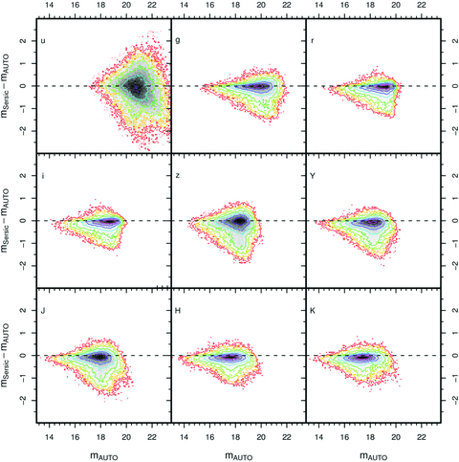
Figure 17 Sérsic minus GAMA r-band-defined AUTO magnitude against r-band-defined AUTO magnitude, in all nine bands, for ...
Notes:
Figure 17 Sérsic minus GAMA r-band-defined AUTO magnitude against r-band-defined AUTO magnitude, in all nine bands, for all objects in the GAMA sample that pass our star–galaxy separation criteria and have credible ugrizYJHKr-band-defined AUTO magnitudes. Contours increase geometrically in powers of 2, from 4 to 512. Bins are 0.1 mag (x-axis) × 0.05 mag (y-axis) in size.
Unless provided in the caption above, the following copyright applies to the content of this slide: © 2010 The Authors Monthly Notices of the Royal Astronomical Society © 2010 RAS

Slide 19
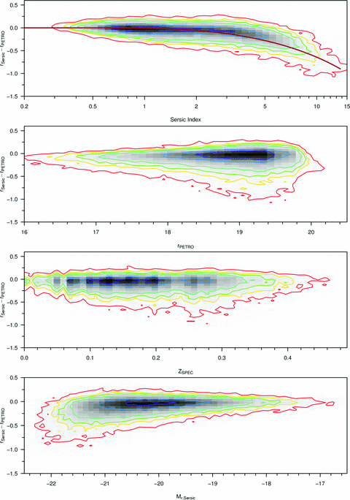
Figure 19 Sérsic r− GAMA r-band-defined Petrosian r against the Sérsic index, r-band-defined r-band Petrosian ...
Notes:
Figure 19 Sérsic r− GAMA r-band-defined Petrosian r against the Sérsic index, r-band-defined r-band Petrosian magnitude, z, Mr, Sersic for all objects in the GAMA sample that have passed our star–galaxy separation criteria and have credible urKr-defined Petrosian magnitudes. Contours increase geometrically in powers of 2, from 4 to 512. The brown function plotted in the Sérsic r− GAMA r-band-defined Petrosian r against the Sérsic index plot is taken from fig. 2 (upper panel) of Graham et al. (2005).
Unless provided in the caption above, the following copyright applies to the content of this slide: © 2010 The Authors Monthly Notices of the Royal Astronomical Society © 2010 RAS

Slide 20
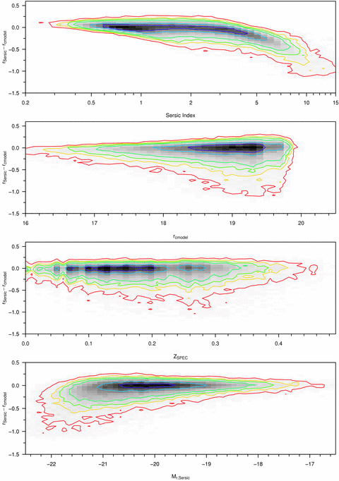
Figure 18 Sérsic r− SDSScmodelr magnitude against the Sérsic index, SDSS rcmodel magnitude, z, M_{r, Sersic} ...
Notes:
Figure 18 Sérsic r− SDSScmodelr magnitude against the Sérsic index, SDSS rcmodel magnitude, z, Mr, Sersic for all objects in the GAMA sample that have passed our star–galaxy separation criteria and have credible urKr-band-defined Petrosian magnitudes. Contours increase geometrically in powers of 2, from 4 to 512.
Unless provided in the caption above, the following copyright applies to the content of this slide: © 2010 The Authors Monthly Notices of the Royal Astronomical Society © 2010 RAS

Slide 21
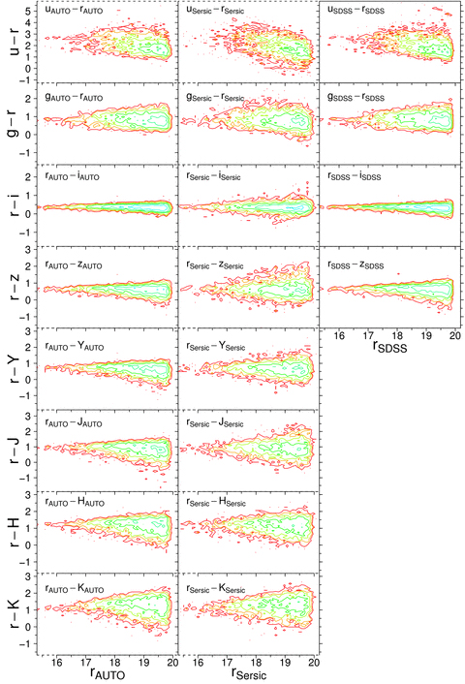
Figure 20 X−r distributions from GAMA r-band-defined AUTO magnitudes, GAMA Sérsic magnitudes and SDSS petromags ...
Notes:
Figure 20 X−r distributions from GAMA r-band-defined AUTO magnitudes, GAMA Sérsic magnitudes and SDSS petromags (left-hand to right-hand panel), against r, for all X=u, g, i, z, Y, J, H and K. Sources used are those within the subset region with credible AUTO and Sérsic magnitudes and without the SDSS-saturated object bit set. Contours increase geometrically in powers of 2, from 2 to 512 galaxies bin−1. Bins are 0.1 mag × 0.1 mag in size.
Unless provided in the caption above, the following copyright applies to the content of this slide: © 2010 The Authors Monthly Notices of the Royal Astronomical Society © 2010 RAS

Slide 22
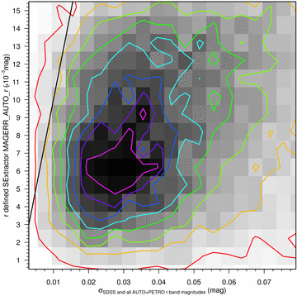
Figure 21 The distribution of standard deviation in the r-band apparent magnitude against SExtractor’s calculated ...
Notes:
Figure 21 The distribution of standard deviation in the r-band apparent magnitude against SExtractor’s calculated magnitude error (using the first quartile gain from the gain distribution of the mosaic’s input images) for our clean sample of galaxies, using SDSS, r-band-defined, K-band-defined and self-defined AUTO and PETRO magnitudes to calculate the standard deviation. Contours rise linearly by 16 galaxies bin−1, ranging from 8 to 120 galaxies bin−1. Bins are 0.004 mag (x-axis) × 0.001 mag (y-axis) in size.
Unless provided in the caption above, the following copyright applies to the content of this slide: © 2010 The Authors Monthly Notices of the Royal Astronomical Society © 2010 RAS

Slide 23
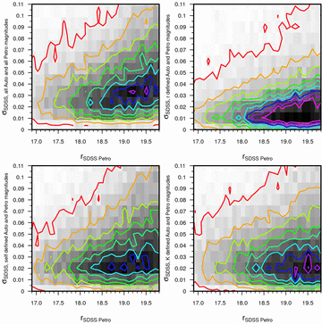
Figure 22 The distribution of standard deviation in the r-band apparent magnitude against apparent magnitude for our ...
Notes:
Figure 22 The distribution of standard deviation in the r-band apparent magnitude against apparent magnitude for our clean sample of galaxies, using four different sets of magnitudes to calculate the standard deviation in each case. Contours rise linearly by 20 galaxies bin−1, ranging from 10 to 170 galaxies bin−1. Bins are 0.1 mag (x-axis) × 0.01 mag (y-axis) in size.
Unless provided in the caption above, the following copyright applies to the content of this slide: © 2010 The Authors Monthly Notices of the Royal Astronomical Society © 2010 RAS

Slide 24
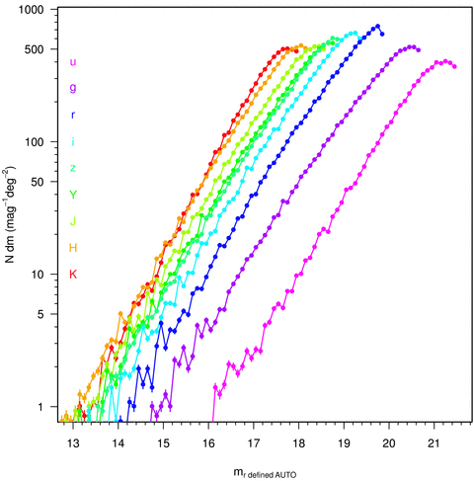
Figure 23 Number counts of GAMA galaxies (sources that have passed our star–galaxy separation criteria) with good ...
Notes:
Figure 23 Number counts of GAMA galaxies (sources that have passed our star–galaxy separation criteria) with good ugrizYJHK colours, split into 0.1-mag bins and divided by the total area they cover. Error bars shown are for Poissonian number counts.
Unless provided in the caption above, the following copyright applies to the content of this slide: © 2010 The Authors Monthly Notices of the Royal Astronomical Society © 2010 RAS

Slide 25
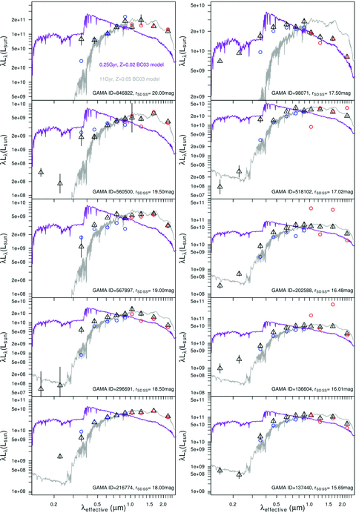
Figure 24 SEDs of 10 GAMA galaxies using GAMA-matched GALEX photometry and r-band-defined AUTO ugrizYJHK photometry ...
Notes:
Figure 24 SEDs of 10 GAMA galaxies using GAMA-matched GALEX photometry and r-band-defined AUTO ugrizYJHK photometry (black triangles), and the comparable SDSS (blue circles) and UKIDSS (red circles) PETROMAG photometry. Uncertainties shown for GAMA ugrizYJHK points are calculated from the standard deviation in the photometry (as in Section 7.3). GAMA–GALEX uncertainties are SExtractor errors from the GALEX pipeline catalogues. Two Bruzual–Charlot 03 models are also plotted: the grey line is a 11-Gyr model using Z = 0.05 and the purple line is a 0.25-Gyr model using Z = 0.02 (Z⊙). The models shown are the same as those in Fig. 16.
Unless provided in the caption above, the following copyright applies to the content of this slide: © 2010 The Authors Monthly Notices of the Royal Astronomical Society © 2010 RAS

Slide 26
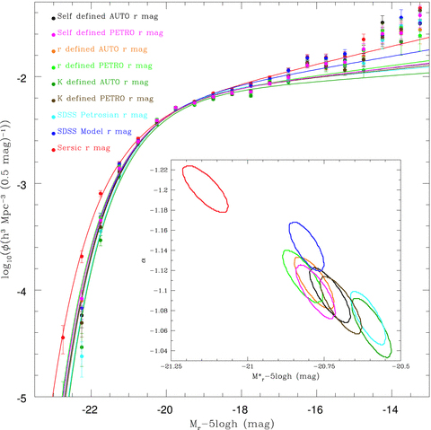
Figure 25 Luminosity distributions, and the best-fitting Schechter functions, calculated using different aperture ...
Notes:
Figure 25 Luminosity distributions, and the best-fitting Schechter functions, calculated using different aperture definitions. Inset: 1σ chi-squared best-fitting contours in the M*–α plane. Errors on luminosity distribution points are Poissonian errors.
Unless provided in the caption above, the following copyright applies to the content of this slide: © 2010 The Authors Monthly Notices of the Royal Astronomical Society © 2010 RAS

