Slide 1
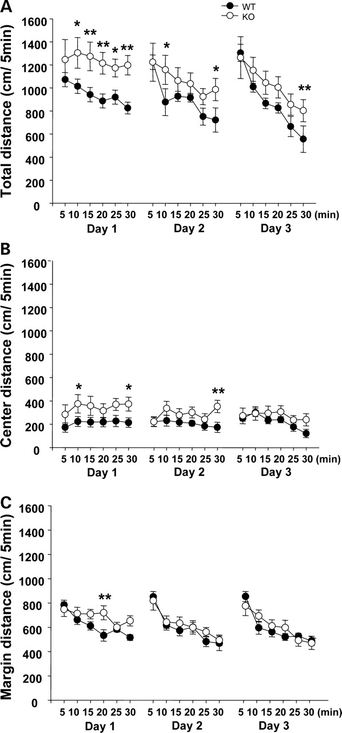
Figure 4. Delayed habituation in an inescapable open field in Maoa-KO mice. Distance traveled in the entire ...
Notes:
Figure 4. Delayed habituation in an inescapable open field in Maoa-KO mice. Distance traveled in the entire 676 cm2 field (A), in the center area (B) and in the margin area (C) is shown. Data are expressed as mean±SEM. * and ** indicate P<0.05 and P<0.01 (Newman–Keuls post hoc test). WT, n=10; Maoa-KO, n=9.
Unless provided in the caption above, the following copyright applies to the content of this slide: © The Author 2006. Published by Oxford University Press. All rights reserved. For Permissions, please email: journals.permissions@oxfordjournals.org

Slide 2
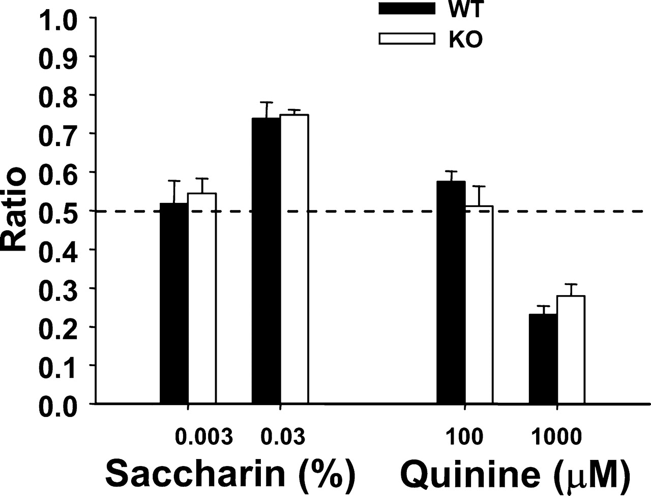
Figure 3. Normal saccharin preference and quinine avoidance in Maoa-KO mice. Data are expressed as mean±SEM. Saccharin, ...
Notes:
Figure 3. Normal saccharin preference and quinine avoidance in Maoa-KO mice. Data are expressed as mean±SEM. Saccharin, 0.003% (30 µg/ml): WT, n=10, KO, n=9; 0.03% (300 µg/ml): WT, n=6, KO, n=6; quinine, 100 µm: WT, n=10, KO, n=10; 1000 µm: WT, n=6, KO, n=6. Ratios higher and lower than 0.5 indicate preference and avoidance, respectively.
Unless provided in the caption above, the following copyright applies to the content of this slide: © The Author 2006. Published by Oxford University Press. All rights reserved. For Permissions, please email: journals.permissions@oxfordjournals.org

Slide 3
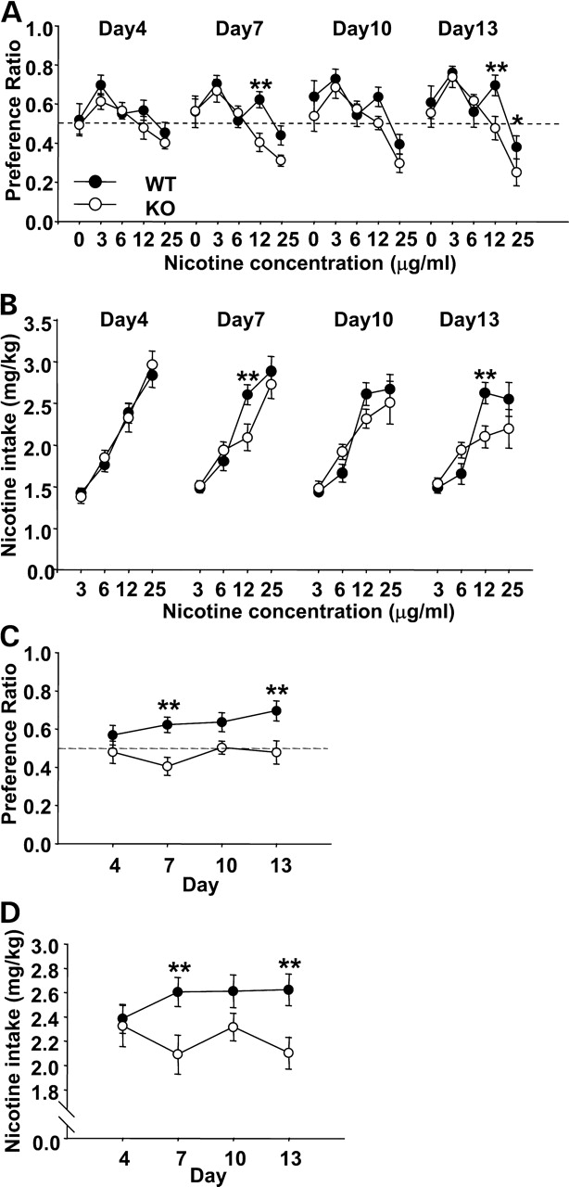
Figure 2. Attenuated nicotine preference (A) and intake (B) in Maoa-KO mice. (A) The ratio was calculated by dividing ...
Notes:
Figure 2. Attenuated nicotine preference (A) and intake (B) in Maoa-KO mice. (A) The ratio was calculated by dividing the amount of nicotine solution intake by the total fluid intake (water and nicotine solution) for each recording period. (B) The amount of nicotine intake, expressed as square-root values of milligram/kilogram over each 3-day period. Daily change in nicotine preference (C) and intake (D) at 12.5 µg/ml. Data are expressed as mean±SEM. Ratios higher and lower than 0.5 in (A) and (C) indicate that mice preferred and avoided nicotine solution, respectively, as compared with water. Asterisks indicate a statistically significant difference between WT littermates and Maoa-KO mice at 5% (*) and 1% (**), as determined by Newman–Keuls post hoc tests. 0.0 µg/ml: WT, n=9 and KO, n=8; 3.125 µg/ml: WT, n=7, KO, n=6; 6.25 µg/ml: WT, n=9, KO, n=10; 12.5 µg/ml: WT, n=10, KO, n=10; 25.0 µg/ml: WT, n=12, KO, n=10.
Unless provided in the caption above, the following copyright applies to the content of this slide: © The Author 2006. Published by Oxford University Press. All rights reserved. For Permissions, please email: journals.permissions@oxfordjournals.org

Slide 4
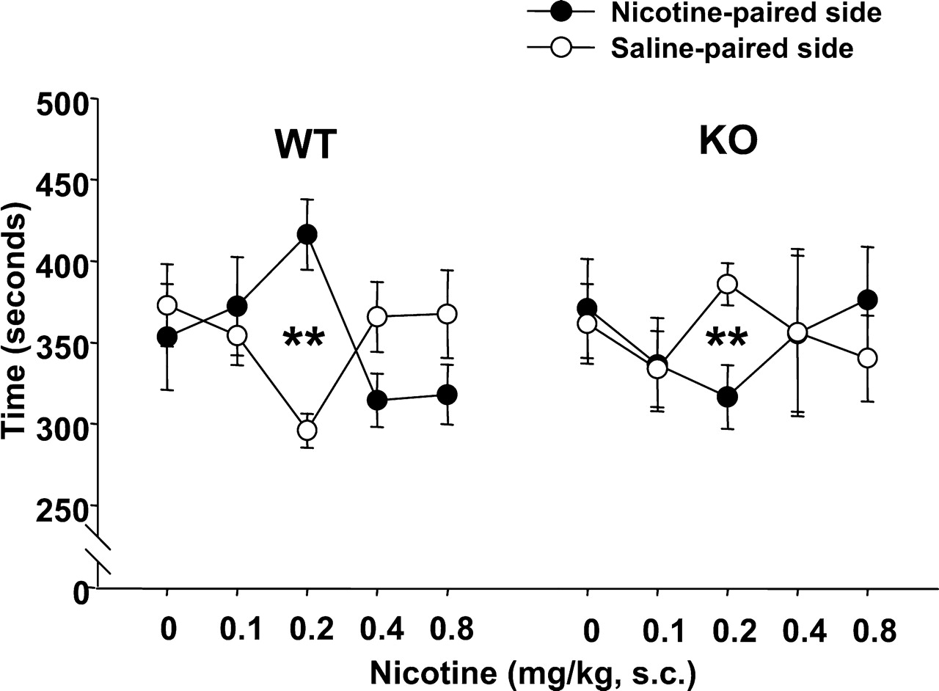
Figure 1. Nicotine-induced CPP in WT littermates and CPA in Maoa-KO mice. Time spent in a nicotine-paired compartment ...
Notes:
Figure 1. Nicotine-induced CPP in WT littermates and CPA in Maoa-KO mice. Time spent in a nicotine-paired compartment and a saline-paired compartment is plotted against nicotine dose. Data are expressed as mean±SEM. Asterisks indicate a statistically significant difference in time between the two compartments at 1% (**), as determined with the Newman–Keuls post hoc test. 0 mg/kg: WT, n=8, KO, n=6; 0.1 mg/kg: WT, n=10, KO, n=6; 0.2 mg/kg: WT, n=15, KO, n=6; 0.4 mg/kg: WT, n=10, KO, n=8; 0.8 mg/kg: WT, n=10, KO, n=5.
Unless provided in the caption above, the following copyright applies to the content of this slide: © The Author 2006. Published by Oxford University Press. All rights reserved. For Permissions, please email: journals.permissions@oxfordjournals.org

Slide 5
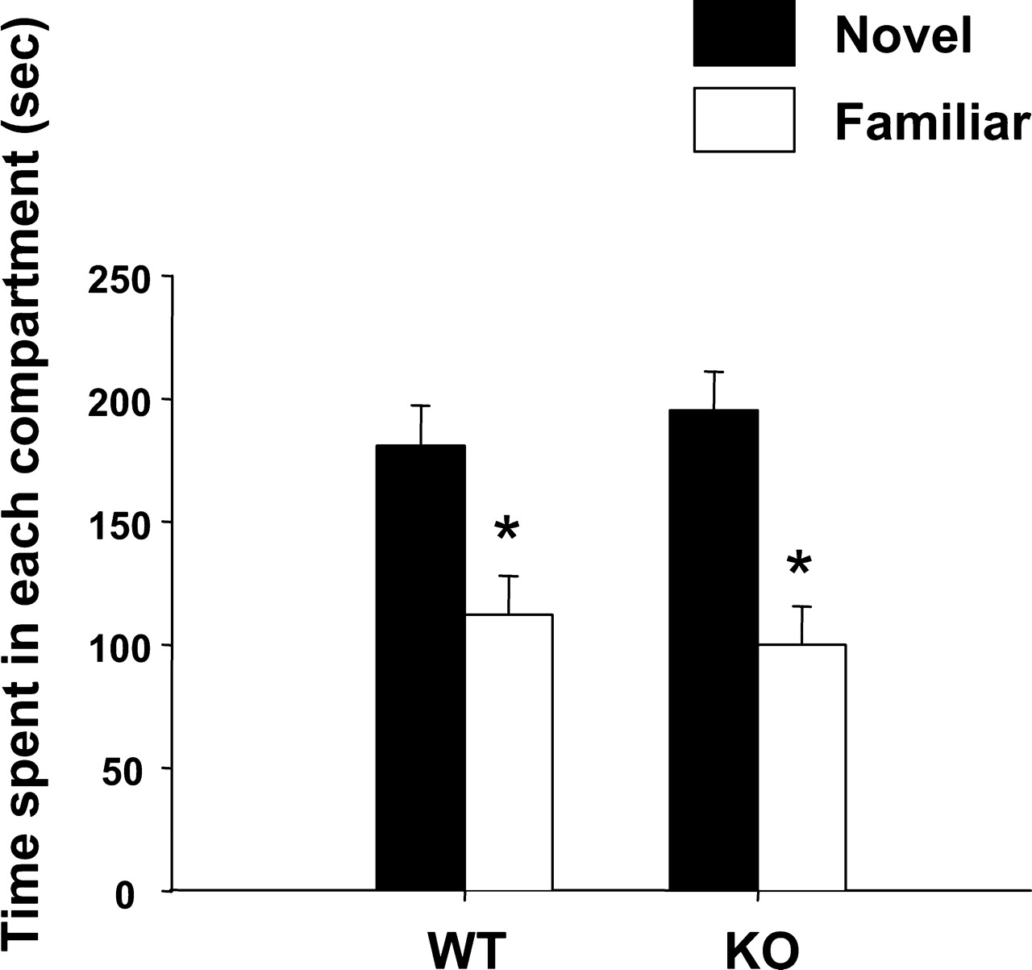
Figure 5. Normal preference for a novel home cage over a habituated home cage in Maoa-KO mice. Data are expressed as ...
Notes:
Figure 5. Normal preference for a novel home cage over a habituated home cage in Maoa-KO mice. Data are expressed as mean±SEM. Asterisks indicate a statistically significant difference in time spent in the novel and habituated (i.e. familiar) home cages, as determined with the Newman–Keuls post hoc test. WT littermates, n=21; Maoa-KO, n=18.
Unless provided in the caption above, the following copyright applies to the content of this slide: © The Author 2006. Published by Oxford University Press. All rights reserved. For Permissions, please email: journals.permissions@oxfordjournals.org

