Slide 1
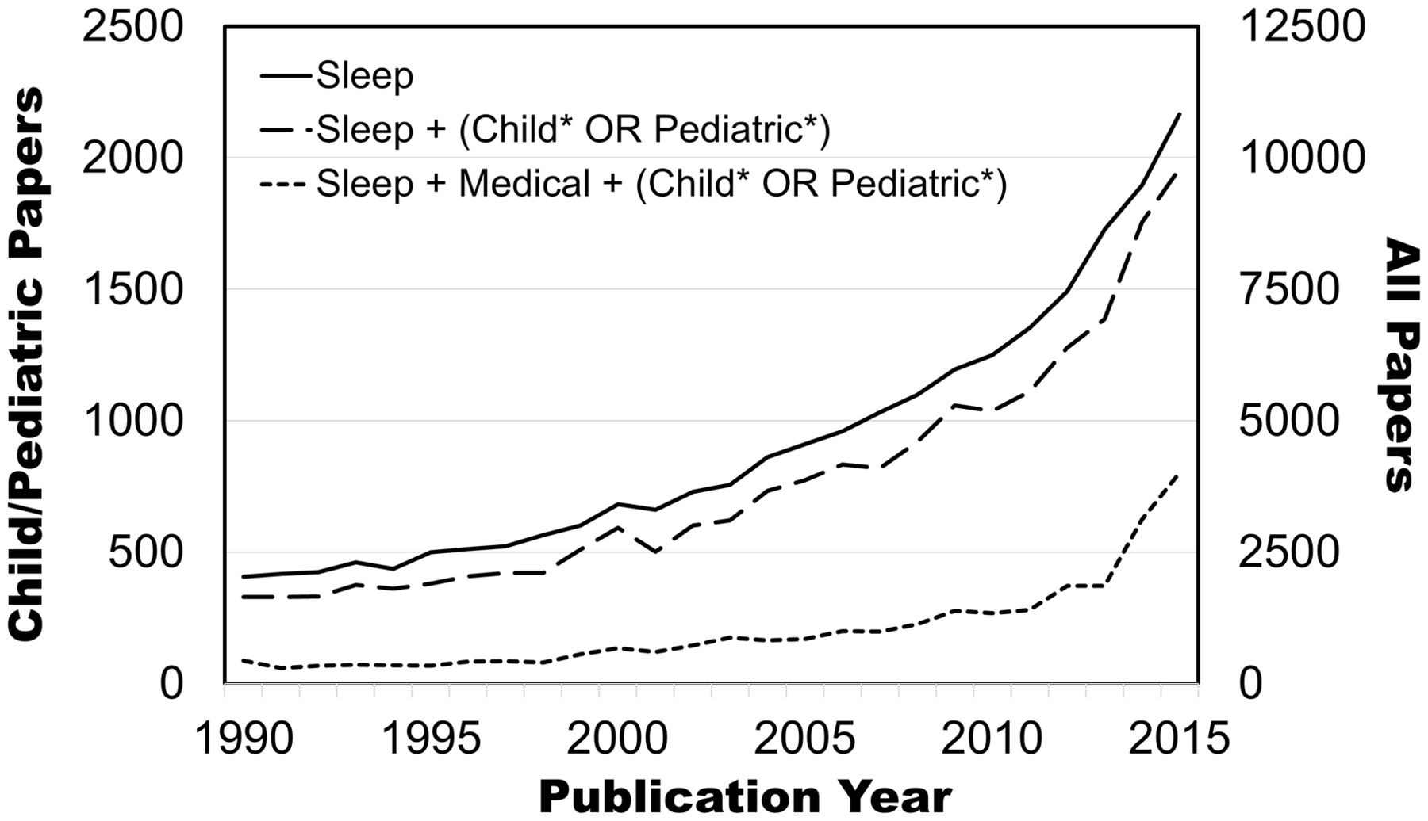
Figure 1. Papers indexed in Pubmed over time that are broadly related to sleep (search term: “Sleep”), sleep in ...
Notes:
Figure 1. Papers indexed in Pubmed over time that are broadly related to sleep (search term: “Sleep”), sleep in children (search term: “Sleep (child* OR pediatric*)” using * as a wildcard marker), and sleep in children with medical conditions (search terms: “Sleep Medical (child* OR pediatric*)”). The left vertical axis provides the count for child-oriented papers, while the right axis provides the count for all sleep papers.
Unless provided in the caption above, the following copyright applies to the content of this slide: © The Author 2016. Published by Oxford University Press on behalf of the Society of Pediatric Psychology. All rights reserved. For permissions, please e-mail: journals.permissions@oup.com

