Slide 1
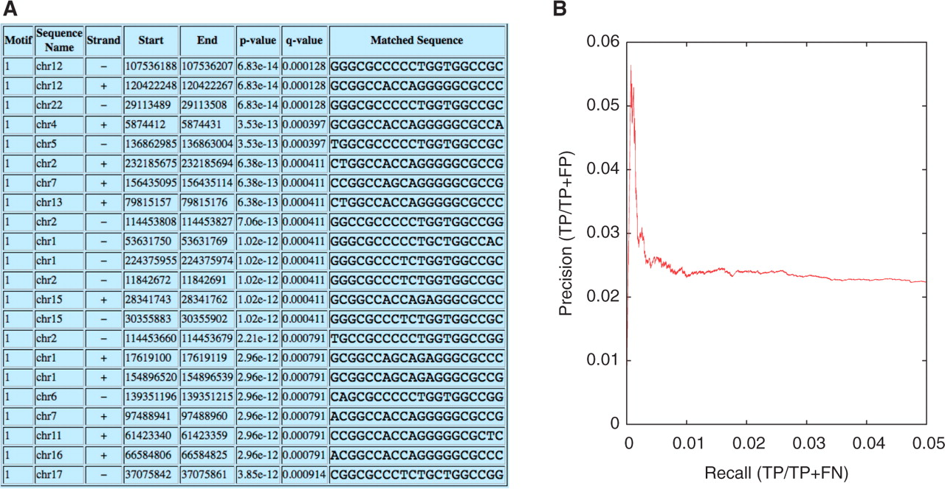
Fig. 1. Using FIMO to identify candidate CTCF binding sites in the human genome. (A) Sample FIMO HTML output, showing ...
Notes:
Fig. 1. Using FIMO to identify candidate CTCF binding sites in the human genome. (A) Sample FIMO HTML output, showing the locations of the top-scoring occurrences of the CTCF motif in the human genome. (B) A precision-recall curve created by comparing FIMO's ranked list of CTCF sites with a gold standard derived from a ChIP-seq experiment.
Unless provided in the caption above, the following copyright applies to the content of this slide: © The Author(s) 2011. Published by Oxford University Press.This is an Open Access article distributed under the terms of the Creative Commons Attribution Non-Commercial License (http://creativecommons.org/licenses/by-nc/2.5), which permits unrestricted non-commercial use, distribution, and reproduction in any medium, provided the original work is properly cited.

