Slide 1
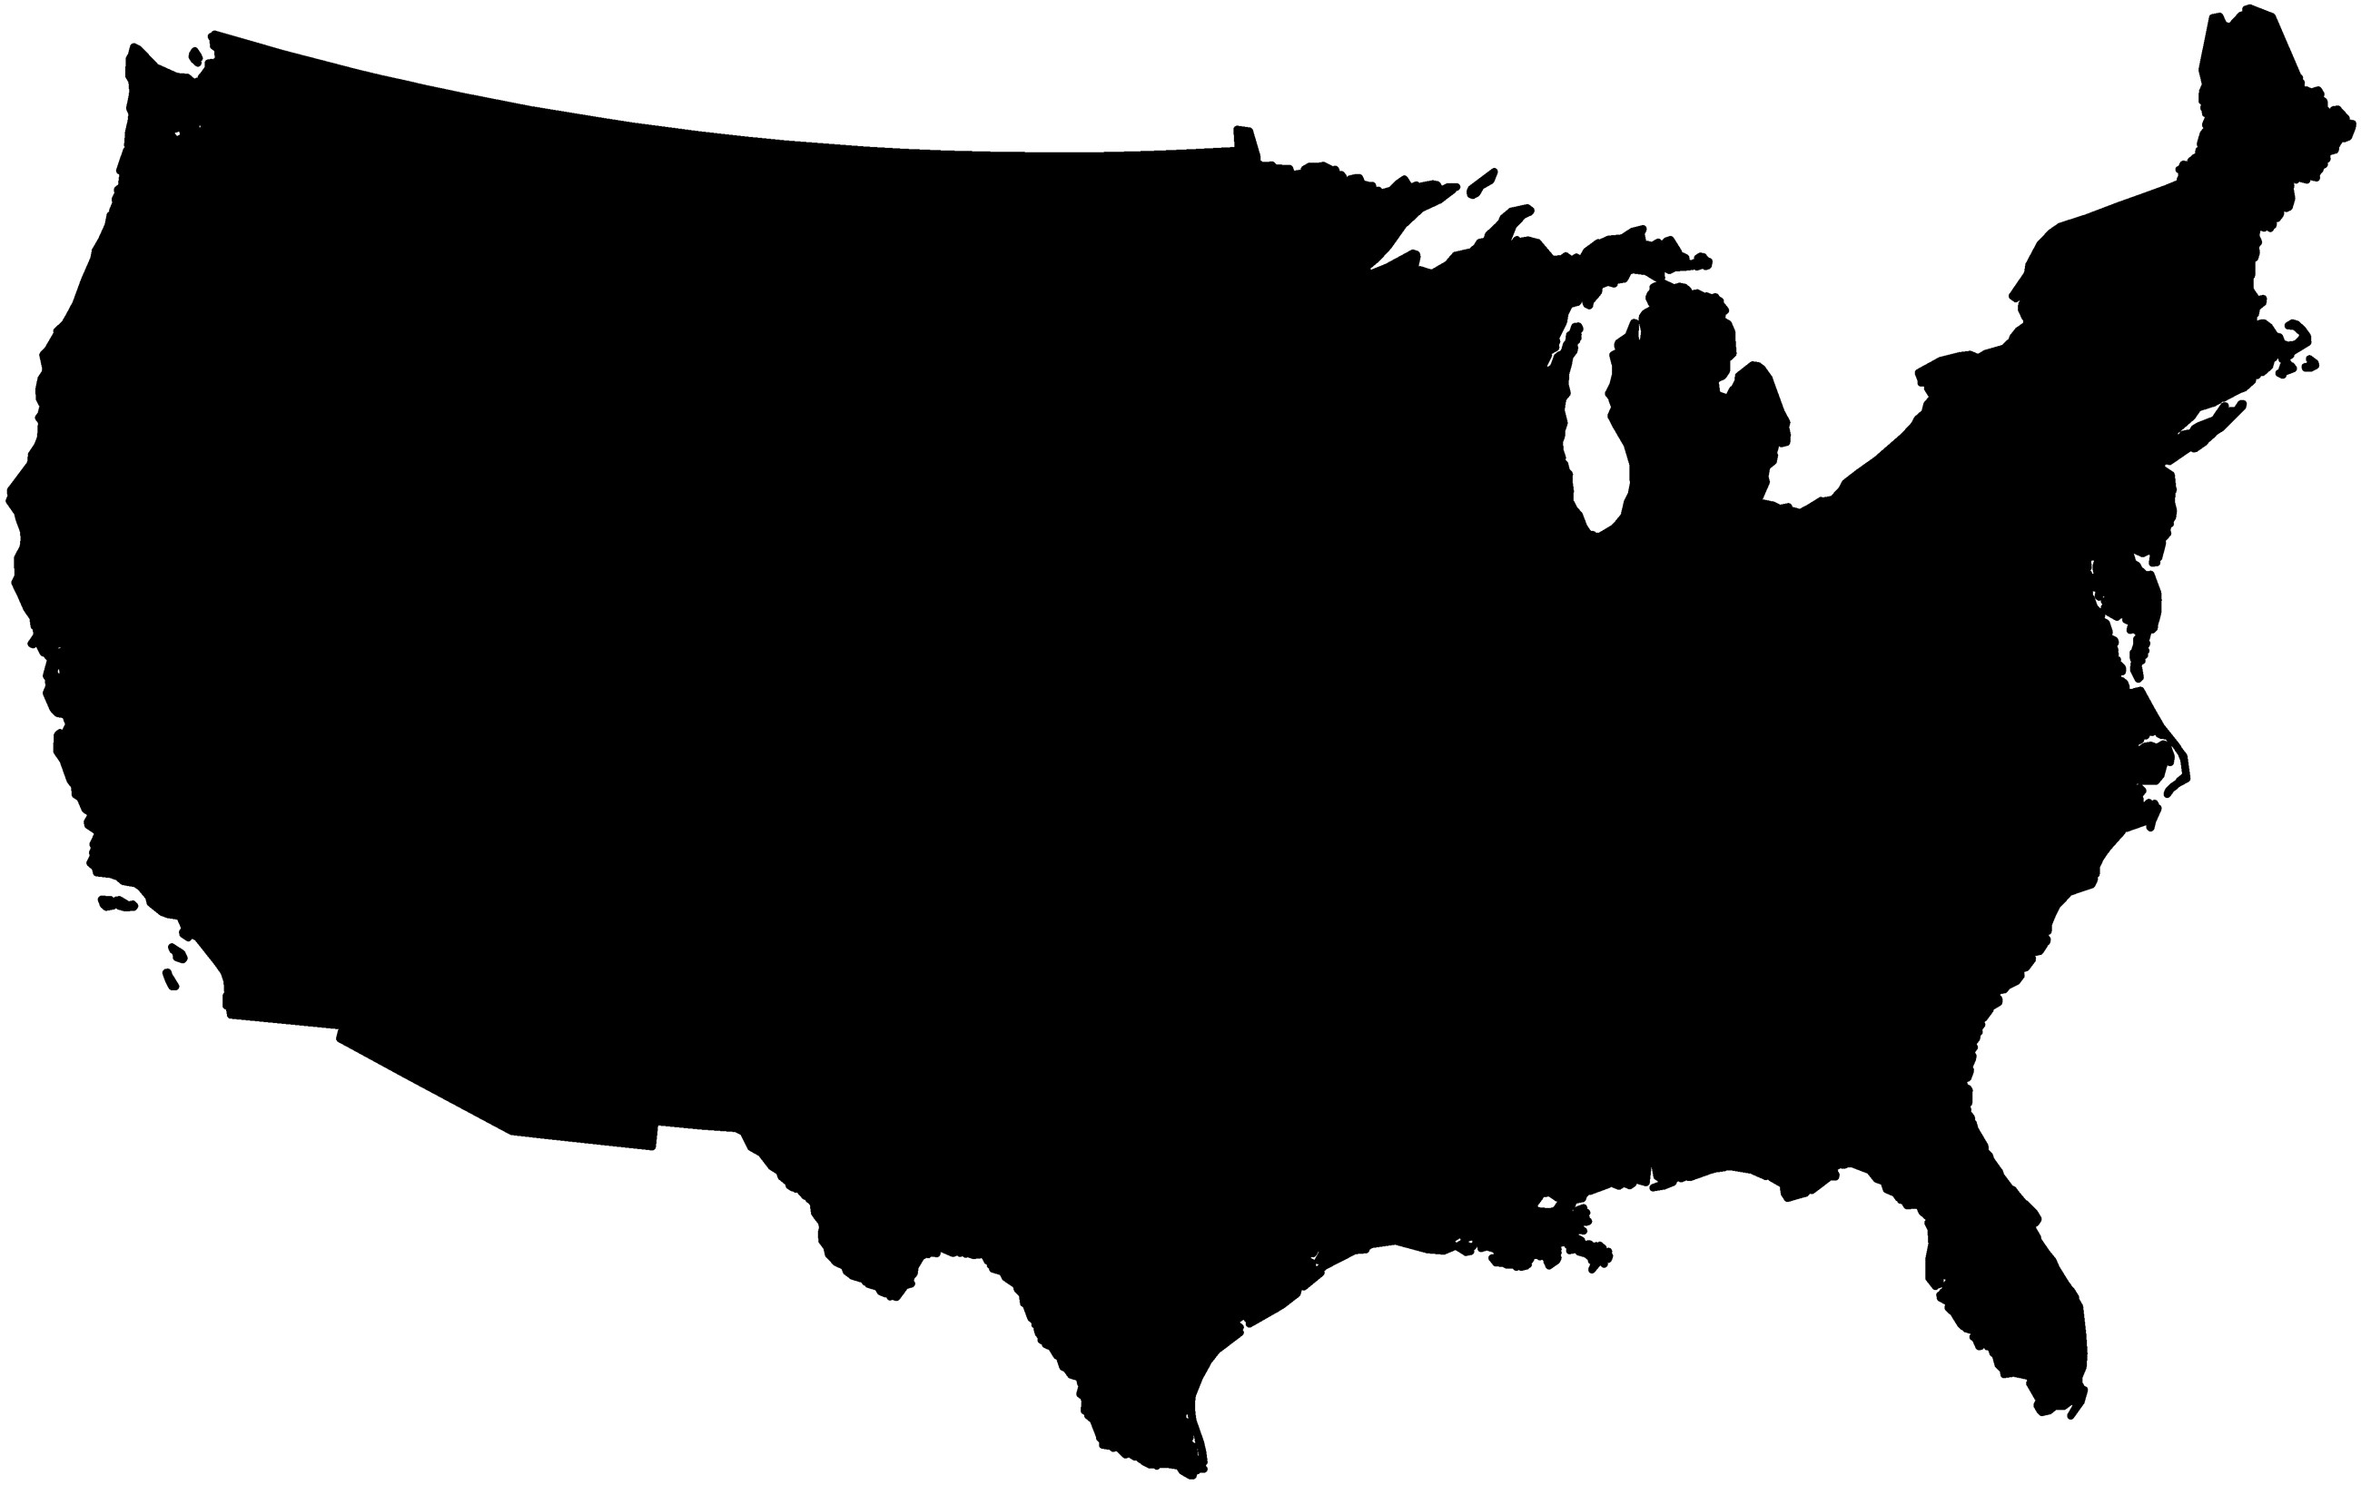
Figure 1: The logo map.
Notes:
Figure 1: The logo map.
Unless provided in the caption above, the following copyright applies to the content of this slide: © The Author 2016. Published by Oxford University Press on behalf of the Society for Historians of American Foreign Relations. All rights reserved. For permissions, please e-mail: journals.permissions@oup.com.

Slide 2
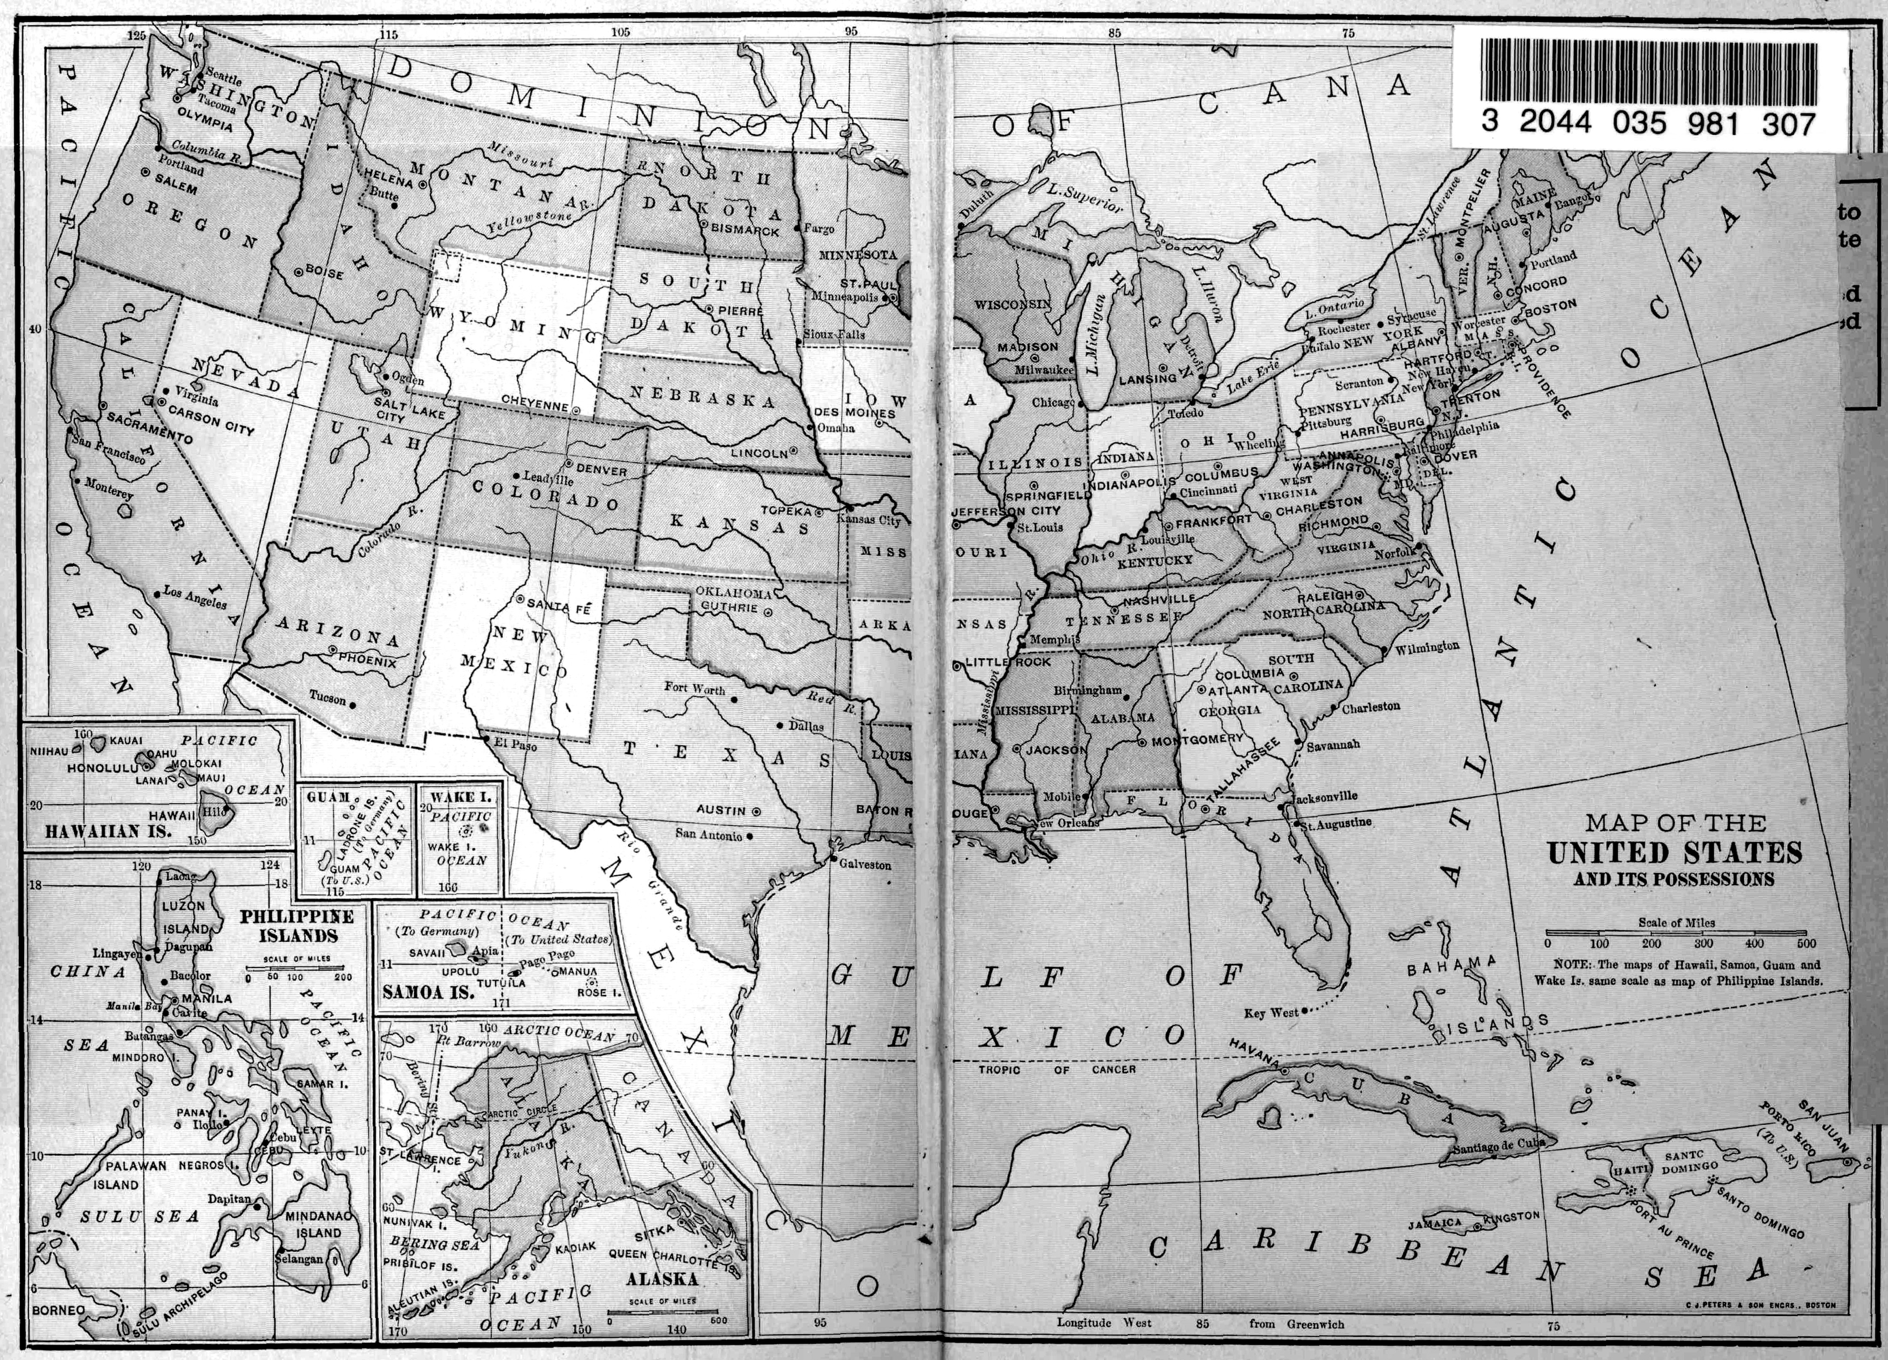
Figure 2: This box map, from the inside cover of the 1910 edition of Allen C. Thomas's textbook, An Elementary History ...
Notes:
Figure 2: This box map, from the inside cover of the 1910 edition of Allen C. Thomas's textbook, An Elementary History of the United States (first published 1900), shows the Philippines, Alaska, Hawai'i, Guam, Wake Island, American Samoa, and Puerto Rico.
Unless provided in the caption above, the following copyright applies to the content of this slide: © The Author 2016. Published by Oxford University Press on behalf of the Society for Historians of American Foreign Relations. All rights reserved. For permissions, please e-mail: journals.permissions@oup.com.

Slide 3
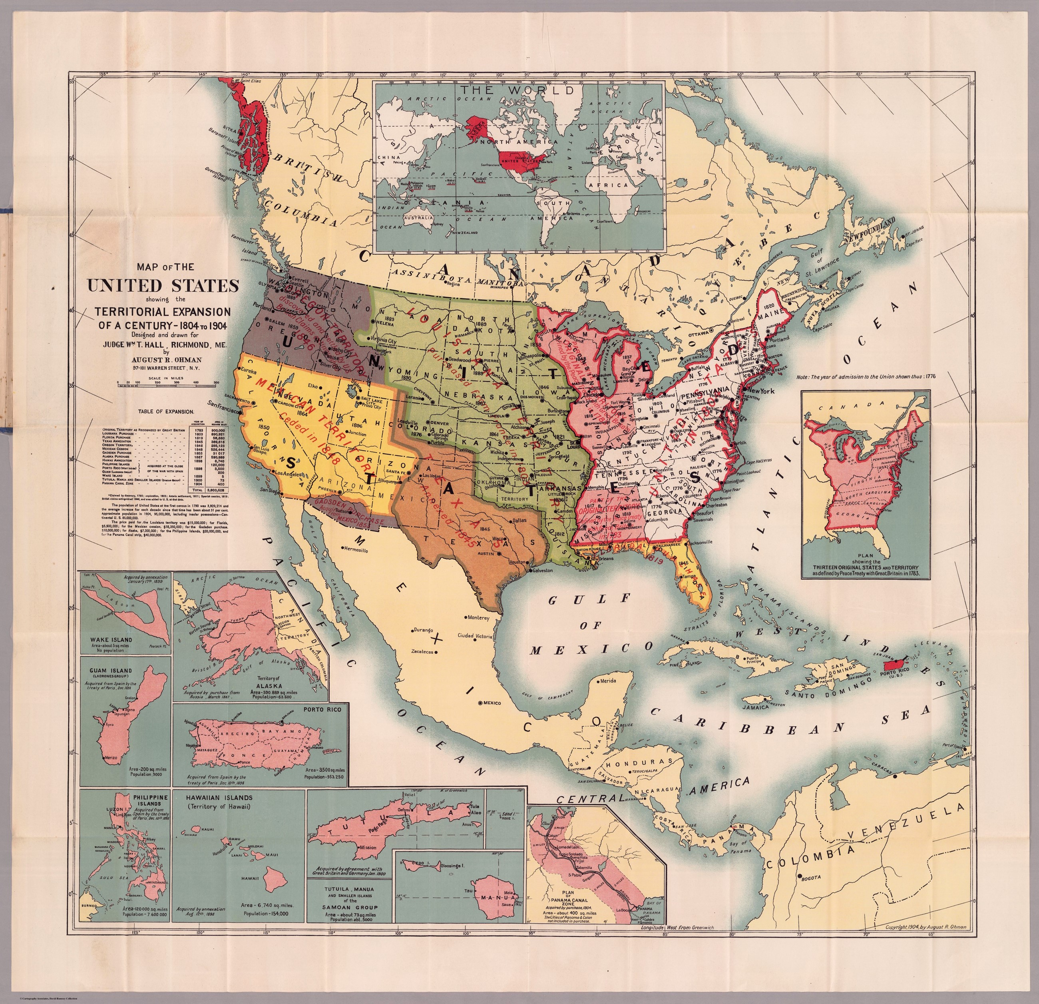
Figure 3: August R. Ohman’s 1904 pocket map, highlighting the expansion of the United States, feautures a world map, ...
Notes:
Figure 3: August R. Ohman’s 1904 pocket map, highlighting the expansion of the United States, feautures a world map, top inset. It also shows the Philippines, Alaska, Hawai’i, Guam, Wake Island, American Samoa, Puerto Rico, and the Panama Canal Zone in boxes. David Rumsey Map Collection.
Unless provided in the caption above, the following copyright applies to the content of this slide: © The Author 2016. Published by Oxford University Press on behalf of the Society for Historians of American Foreign Relations. All rights reserved. For permissions, please e-mail: journals.permissions@oup.com.

Slide 4
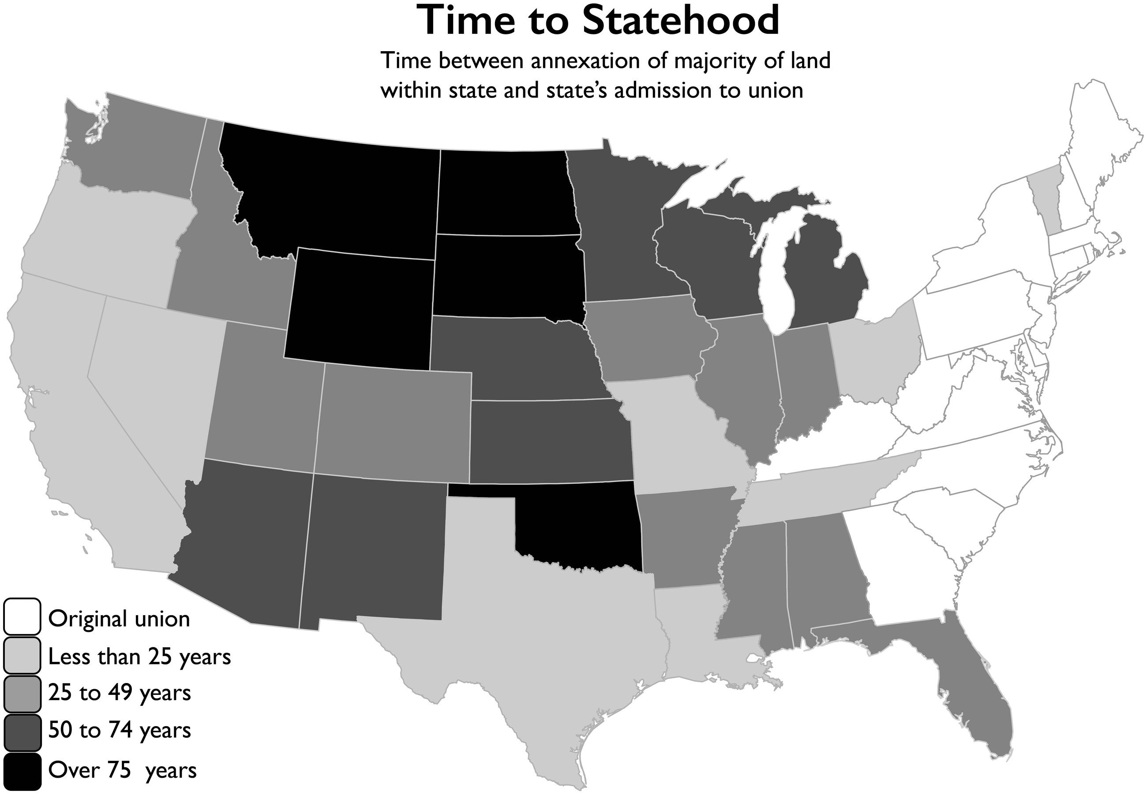
Figure 4: Time to statehood.
Notes:
Figure 4: Time to statehood.
Unless provided in the caption above, the following copyright applies to the content of this slide: © The Author 2016. Published by Oxford University Press on behalf of the Society for Historians of American Foreign Relations. All rights reserved. For permissions, please e-mail: journals.permissions@oup.com.

