Slide 1
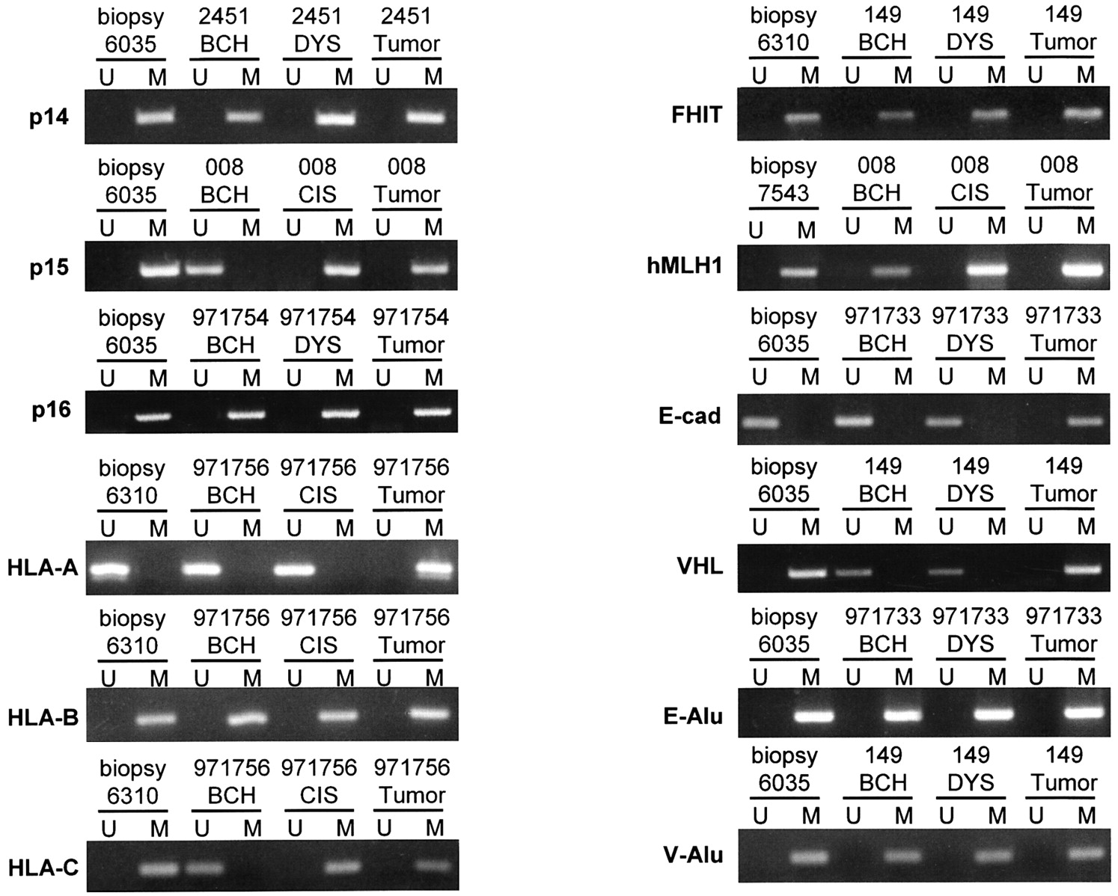
Fig. 1. Methylation detection using methylation-specific PCR. The methylation status of the Alu sequences and the CpG ...
Notes:
Fig. 1. Methylation detection using methylation-specific PCR. The methylation status of the Alu sequences and the CpG islands of the selected genes was determined. U, unmethylated PCR product using unmethylated-specific primers. M, methylated PCR product using methylated-specific primers. Presence of methylated PCR product and absence of unmethylated product indicate that the gene is methylated, and vice versa. For each gene, the results from one biopsy sample and one resected esophagus with different stages of lesions are illustrated. For example, for p14ARF, biopsy sample no. 6035 and resected sample no. 2451 are shown.
Unless provided in the caption above, the following copyright applies to the content of this slide: © Oxford University Press

Slide 2
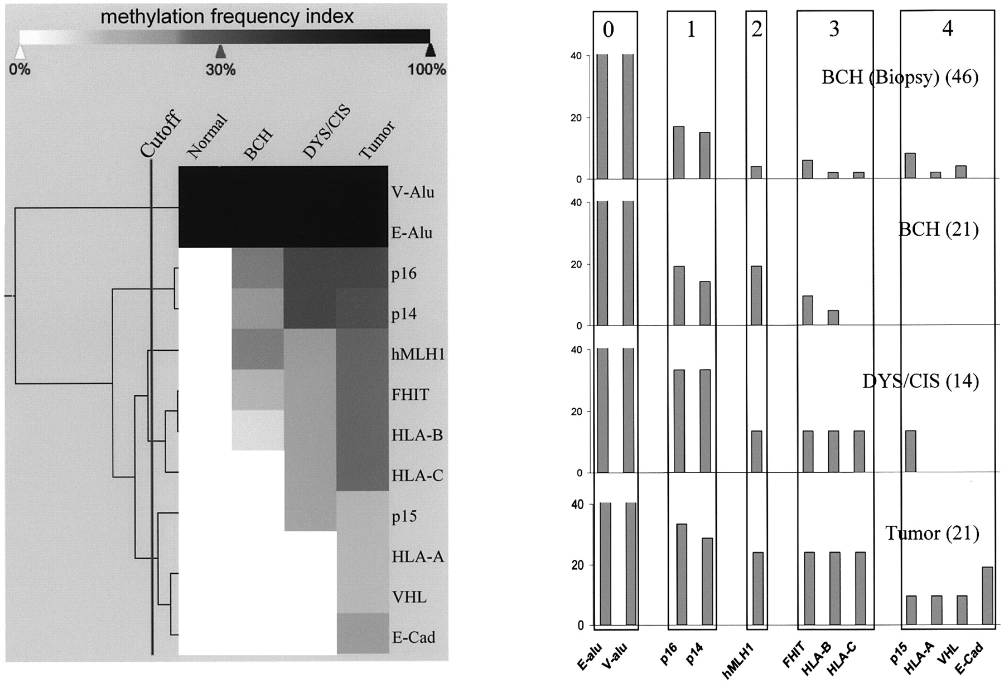
Fig. 2. Methylation frequencies of selected genes in different stages during the development of ESCC. The genes were ...
Notes:
Fig. 2. Methylation frequencies of selected genes in different stages during the development of ESCC. The genes were clustered according to the methylation frequencies as described previously. (Left) As indicated in the methylation frequency index, darker color corresponds to higher frequency and vice versa. Genes with similar patterns were organized close to each other and the distances between genes were shown as the width of the stacked shapes that connect them. The vertical dark line indicates the cut-off point where the five groups were obtained. (Right) The vertical boxes represent the methylation frequencies of genes in specific stages. The numbers on the top indicate the group number from the clustering. The two Alu sequences were clustered into group 0 for their complete methylation in all stages. p16INK4a and p14ARF had the highest methylation frequencies in all stages. They were the earliest methylated genes and were clustered into group 1. hMLH1 was clustered into group 2; FHIT, HLA-B and HLA-C were clustered into group 3; p15INK4b, HLA-A, E-cad and VHL were rarely hypermethylated in precancerous lesions and clustered into group 4.
Unless provided in the caption above, the following copyright applies to the content of this slide: © Oxford University Press

Slide 3
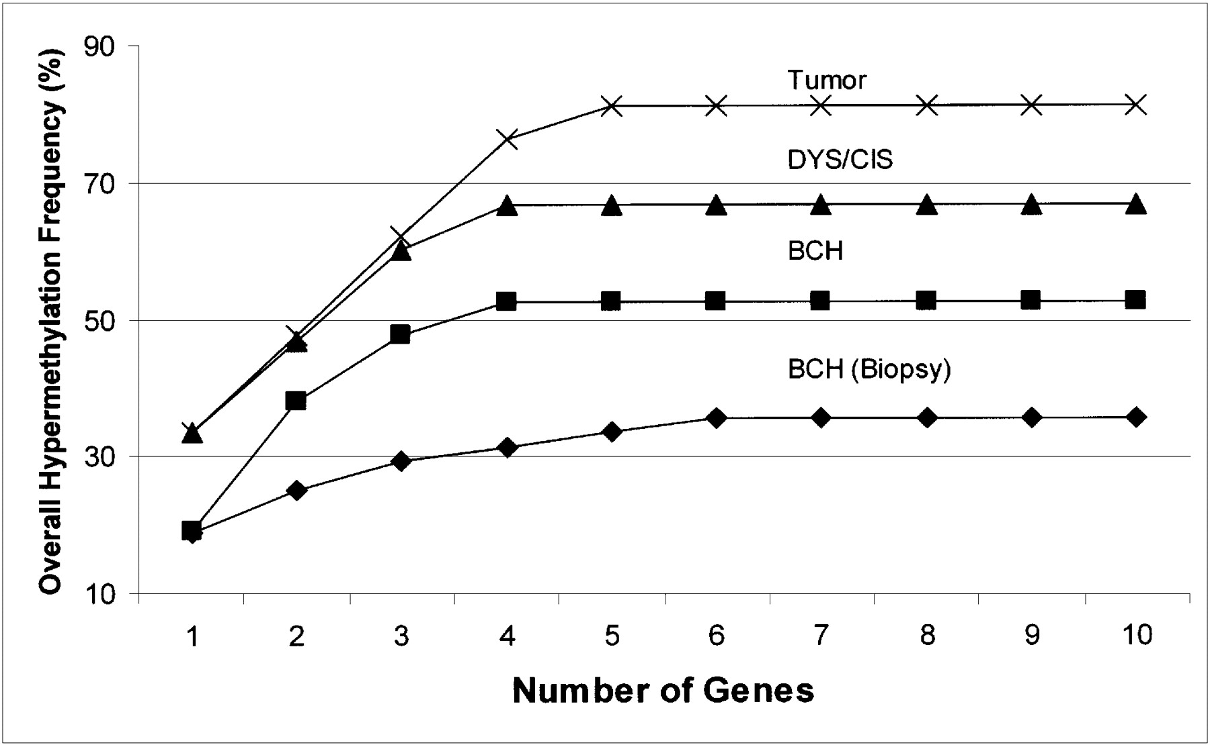
Fig. 3. . Selection of genes as possible biomarkers. At each specific stage (represented by different shape marked ...
Notes:
Fig. 3. . Selection of genes as possible biomarkers. At each specific stage (represented by different shape marked lines), the maximum overall hypermethylation frequency of a number of genes, with all possible combinations, was shown. The overall frequencies increased when more genes were counted. A goal of this project was to find the smallest number of genes that confer the highest overall hypermethylation frequency. As shown in the curves, when five genes were used, the overall frequencies at all four stages were only slightly lower than those when all 10 genes were counted. Such five genes are p16INK4a, p14ARF, hMLH1, FHIT and HLA-B.
Unless provided in the caption above, the following copyright applies to the content of this slide: © Oxford University Press

