Slide 1
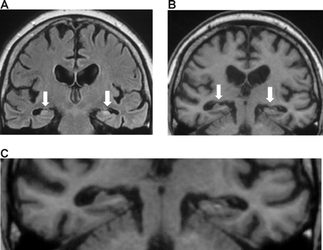
Fig. 1 Coronal sections from the patient's structural MRI scan, with the white arrows indicating the atrophic ...
Notes:
Fig. 1 Coronal sections from the patient's structural MRI scan, with the white arrows indicating the atrophic hippocampi (see Methods for more details). (A) FLAIR image from a section through the anterior temporal lobes. (B) A T1 image from a more posterior section. (C) A magnified view of TT's medial temporal lobes taken from his T1 structural scan.
Unless provided in the caption above, the following copyright applies to the content of this slide: © The Author (2006). Published by Oxford University Press on behalf of the Guarantors of Brain. All rights reserved. For Permissions, please email: journals.permissions@oxfordjournals.org

Slide 2
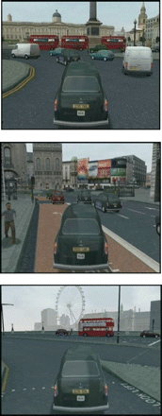
Fig. 2 Example views from within the video game ‘The Getaway’ © 2002 Sony Computer Entertainment Europe. Upper panel ...
Notes:
Fig. 2 Example views from within the video game ‘The Getaway’ © 2002 Sony Computer Entertainment Europe. Upper panel shows a view at Trafalgar Square, middle panel a view at Piccadilly Circus, lower panel a view looking towards the London Eye/Millenium Wheel. These images are reproduced with the kind permission of Sony Computer Entertainment Europe.
Unless provided in the caption above, the following copyright applies to the content of this slide: © The Author (2006). Published by Oxford University Press on behalf of the Guarantors of Brain. All rights reserved. For Permissions, please email: journals.permissions@oxfordjournals.org

Slide 3
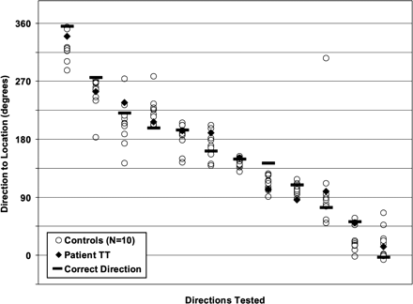
Fig. 3 Performance on the direction-pointing task. Subjects were asked to point to different places in London from a ...
Notes:
Fig. 3 Performance on the direction-pointing task. Subjects were asked to point to different places in London from a fixed location in the laboratory (see Material and methods). Responses were compared with the correct direction relative to magnetic north for each of 12 locations. The data for every location for each subject and patient TT are shown in descending order rather than the order tested. Note, these are circular data shown in flattened format for ease of viewing.
Unless provided in the caption above, the following copyright applies to the content of this slide: © The Author (2006). Published by Oxford University Press on behalf of the Guarantors of Brain. All rights reserved. For Permissions, please email: journals.permissions@oxfordjournals.org

Slide 4
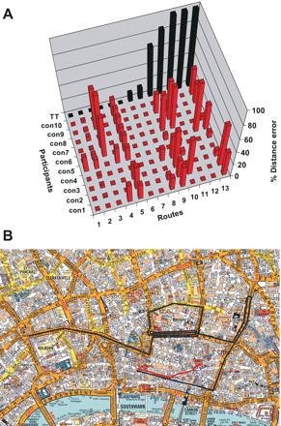
Fig. 4 Navigation performance. (A) A 3D graph showing navigation performance around (virtual) London for each route ...
Notes:
Fig. 4 Navigation performance. (A) A 3D graph showing navigation performance around (virtual) London for each route for every subject (see text, and Table 3). Note: routes were not performed in the order shown but are presented in this way, and in Table 3 and Fig. 5, to better illustrate the pattern of TT's performance. (B) An example of navigation performance for Route 11 (St Paul's Cathedral to the Bank of England). All 10 control subjects performed in an identical manner, shown in red on this map. TT was grossly impaired; his route is shown in black. Map reproduced by permission of Geographers’ A–Z Map Co. Ltd © Crown Copyright 2005. All rights reserved. Licence number 100017302.
Unless provided in the caption above, the following copyright applies to the content of this slide: © The Author (2006). Published by Oxford University Press on behalf of the Guarantors of Brain. All rights reserved. For Permissions, please email: journals.permissions@oxfordjournals.org

Slide 5
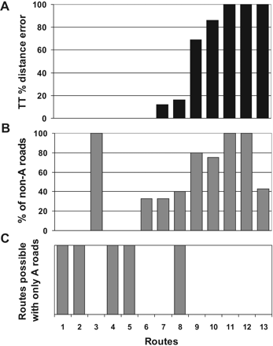
Fig. 5 Non-A roads. The top panel (A) reprises TT's navigation data across the 13 routes (see also Fig. 4A and Table ...
Notes:
Fig. 5 Non-A roads. The top panel (A) reprises TT's navigation data across the 13 routes (see also Fig. 4A and Table 3). The middle panel (B) shows the corresponding percentage of non-A roads for each route. The bottom panel (C) indicates whether routes could be navigated using only A roads. See text for further details of Route 3 (Soho).
Unless provided in the caption above, the following copyright applies to the content of this slide: © The Author (2006). Published by Oxford University Press on behalf of the Guarantors of Brain. All rights reserved. For Permissions, please email: journals.permissions@oxfordjournals.org

