Slide 1
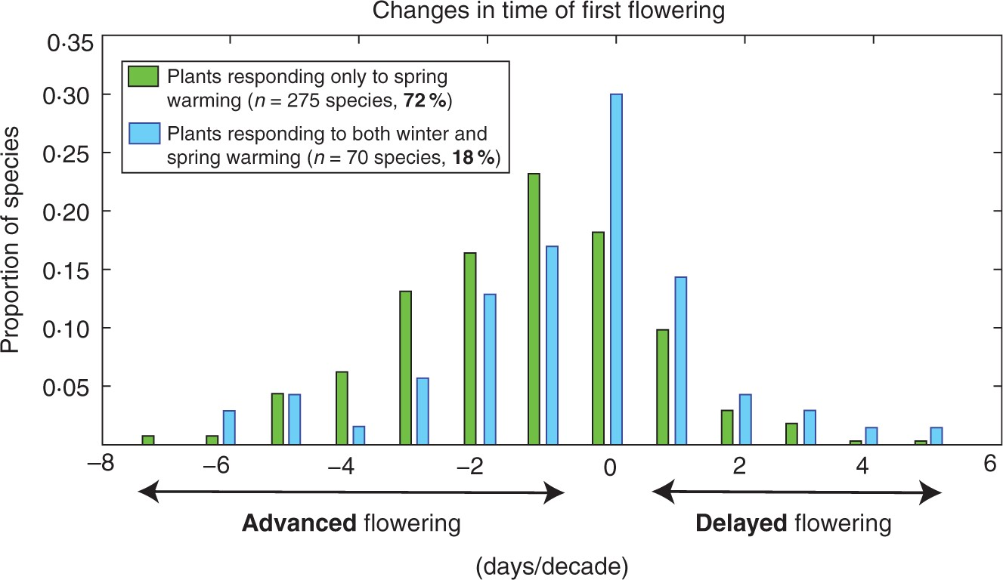
Fig. 1. Changes in flowering phenology (timing of first flowering) from 1954 to 2000 for plant species in northern ...
Notes:
Fig. 1. Changes in flowering phenology (timing of first flowering) from 1954 to 2000 for plant species in northern England. Green bars are species that showed sensitivity only to spring temperatures; blue bars are species that showed sensitivity to both spring and autumn/winter temperatures. Modified from Cook et al. (2012).
Unless provided in the caption above, the following copyright applies to the content of this slide: © The Author 2015. Published by Oxford University Press on behalf of the Annals of Botany Company. All rights reserved. For Permissions, please email: journals.permissions@oup.com

Slide 2
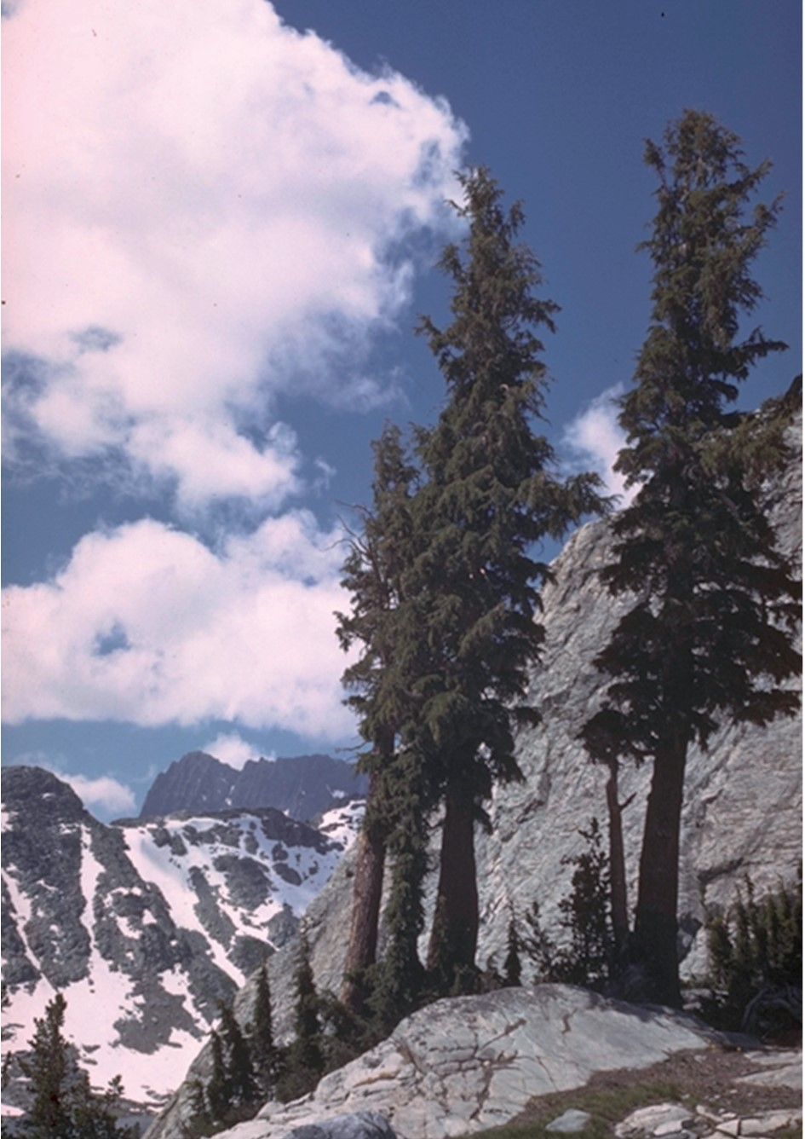
Fig. 2. ACC has driven an increase in precipitation in much of the more northerly latitudes (IPCC, 2014). This has, ...
Notes:
Fig. 2. ACC has driven an increase in precipitation in much of the more northerly latitudes (IPCC, 2014). This has, in turn, driven complex responses in wild plants. Mountain hemlock (Tsuga mertensiana) has shifted the centre of gravity of its distribution to lower elevations in California (a 255 -m downwards elevational shift), in spite of an increase in mean annual temperature of 2·85°C during the study period (1930s to 2000s). The observed downhill shift, while counter to expectations from warming, was in concert with a decline in water deficit of 134 mm over the past 70 years (Crimmins et al., 2011). Photo is courtesy of Charles Webber © California Academy of Sciences.
Unless provided in the caption above, the following copyright applies to the content of this slide: © The Author 2015. Published by Oxford University Press on behalf of the Annals of Botany Company. All rights reserved. For Permissions, please email: journals.permissions@oup.com

Slide 3
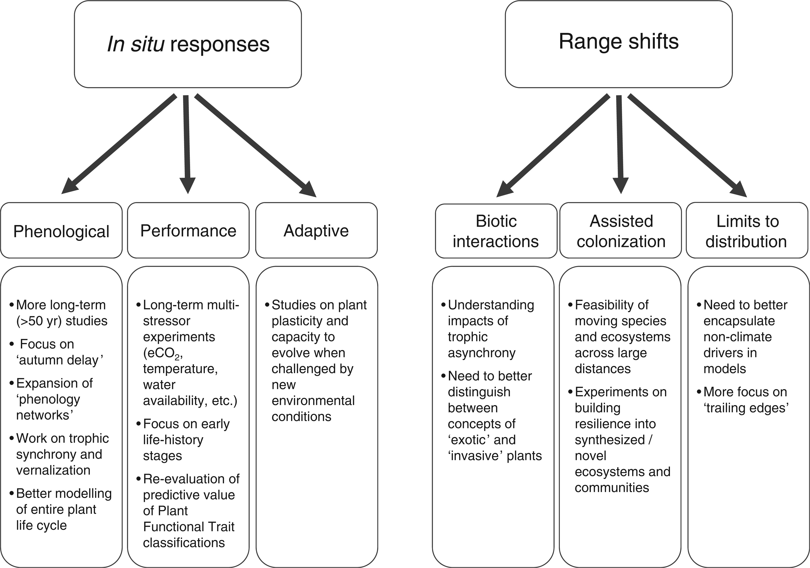
Fig. 3. A summary of research priorities to enable plant scientists to better understand plant species and community ...
Notes:
Fig. 3. A summary of research priorities to enable plant scientists to better understand plant species and community response to various climate change drivers.
Unless provided in the caption above, the following copyright applies to the content of this slide: © The Author 2015. Published by Oxford University Press on behalf of the Annals of Botany Company. All rights reserved. For Permissions, please email: journals.permissions@oup.com

