Slide 1
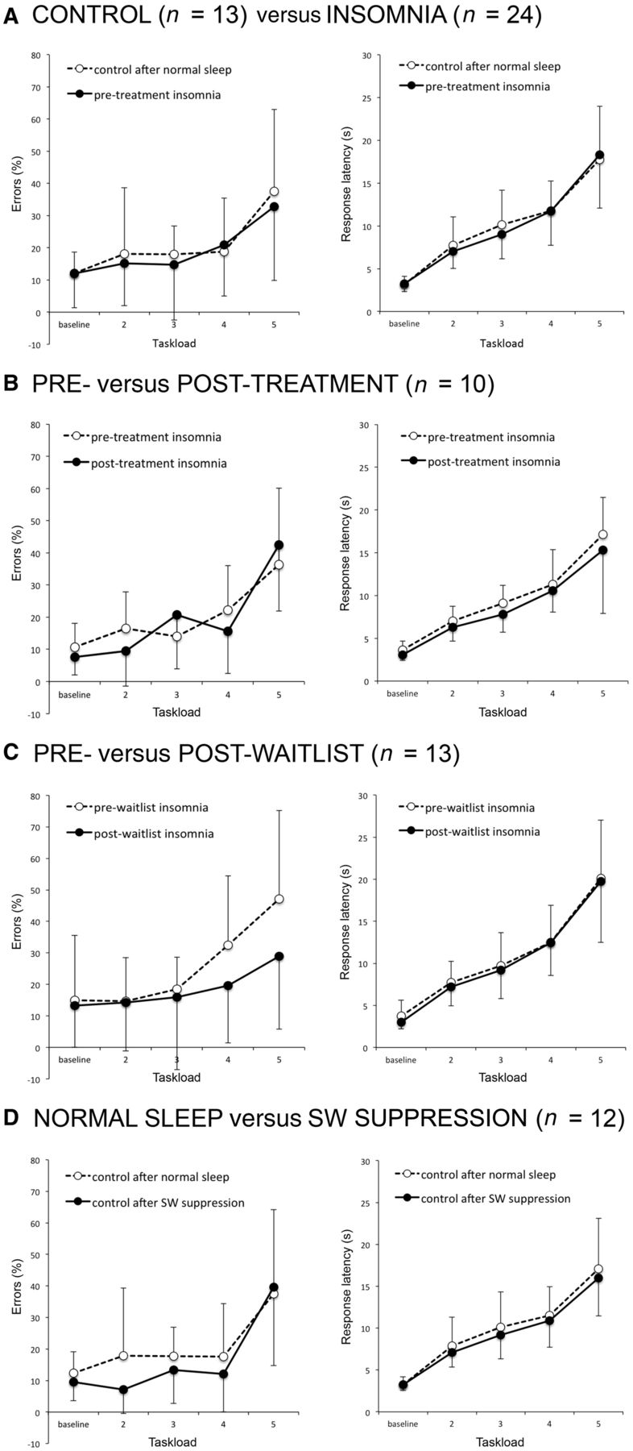
Figure 3 Tower of London task performance. (A) Comparison between controls after a night of normal sleep (open ...
Notes:
Figure 3 Tower of London task performance. (A) Comparison between controls after a night of normal sleep (open circles, dashed lines) and patients with insomnia before treatment (closed circles, solid lines). (B) Comparison between patients with insomnia before treatment (open circles, dashed lines) and the same patients after 5–7 weeks of multi-modal sleep therapy (closed circles, solid lines). (C) Comparison between patients with insomnia before waitlist (open circles, dashed lines) and the same patients after 5–7 weeks of being on a waitlist for multi-modal sleep therapy (closed circles, solid lines). (D) Comparison between controls after a night of normal sleep (open circles, dashed lines) and the same participants after a night of slow-wave sleep fragmentation (closed circles, solid lines). Left: Number of errors (%) as a function of task load levels 2, 3, 4 and 5 (and baseline condition). Right: Mean latencies (s) of correct responses as a function of task load. Error bars signify 1 SD of the mean and are displayed on a single, opposing side for the groups in a particular comparison for reasons of clarity.
Unless provided in the caption above, the following copyright applies to the content of this slide: © The Author (2013). Published by Oxford University Press on behalf of the Guarantors of Brain.This is an Open Access article distributed under the terms of the Creative Commons Attribution Non-Commercial License (http://creativecommons.org/licenses/by-nc/3.0/), which permits non-commercial re-use, distribution, and reproduction in any medium, provided the original work is properly cited. For commercial re-use, please contact journals.permissions@oup.com

Slide 2
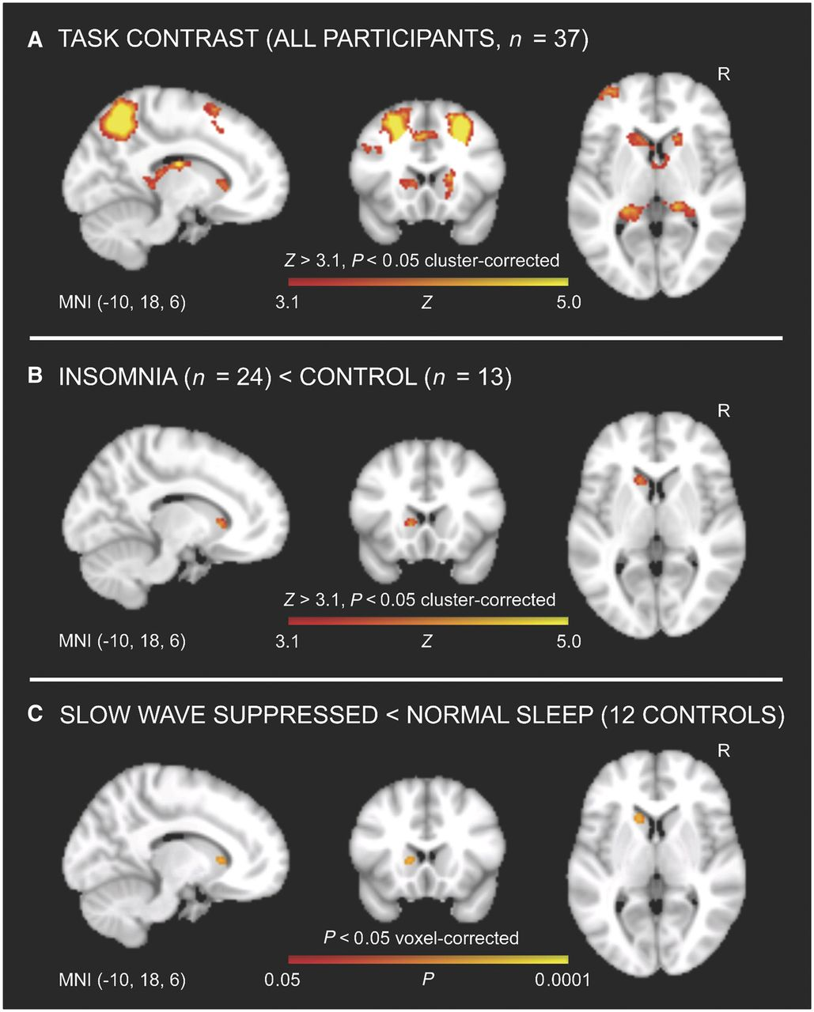
Figure 2 Reduced caudate recruitment in insomnia and after slow-wave sleep fragmentation. (A) The head of the left ...
Notes:
Figure 2 Reduced caudate recruitment in insomnia and after slow-wave sleep fragmentation. (A) The head of the left caudate shows increased BOLD signal during executive functioning relative to baseline trials across all participants. (B) Patients with insomnia show an attenuated task-elicited BOLD response in the head of the left caudate nucleus when compared to controls [Zmax = 4.31 at MNI coordinates (−12, 18, 2); cluster size = 43 voxels = 344 mm3]. (C) Controls show an attenuated task-elicited BOLD response in the head of the left caudate nucleus after a night of slow-wave sleep suppression relative to a night of normal sleep [Zmax = 3.32 at MNI coordinates (−12, 18, 4); 36 of 43 voxels in the region of interest = 84%]. Significant clusters (A and B) or voxels (C) are shown in a gradient from red to yellow overlaid on the most informative orthogonal slices from the averaged MNI152 brain, displayed according to neurological convention (left = left). MNI coordinates for the orthogonal slices, statistical thresholds and a colour bar indicating Z-value or significance level are shown at the bottom.
Unless provided in the caption above, the following copyright applies to the content of this slide: © The Author (2013). Published by Oxford University Press on behalf of the Guarantors of Brain.This is an Open Access article distributed under the terms of the Creative Commons Attribution Non-Commercial License (http://creativecommons.org/licenses/by-nc/3.0/), which permits non-commercial re-use, distribution, and reproduction in any medium, provided the original work is properly cited. For commercial re-use, please contact journals.permissions@oup.com

Slide 3
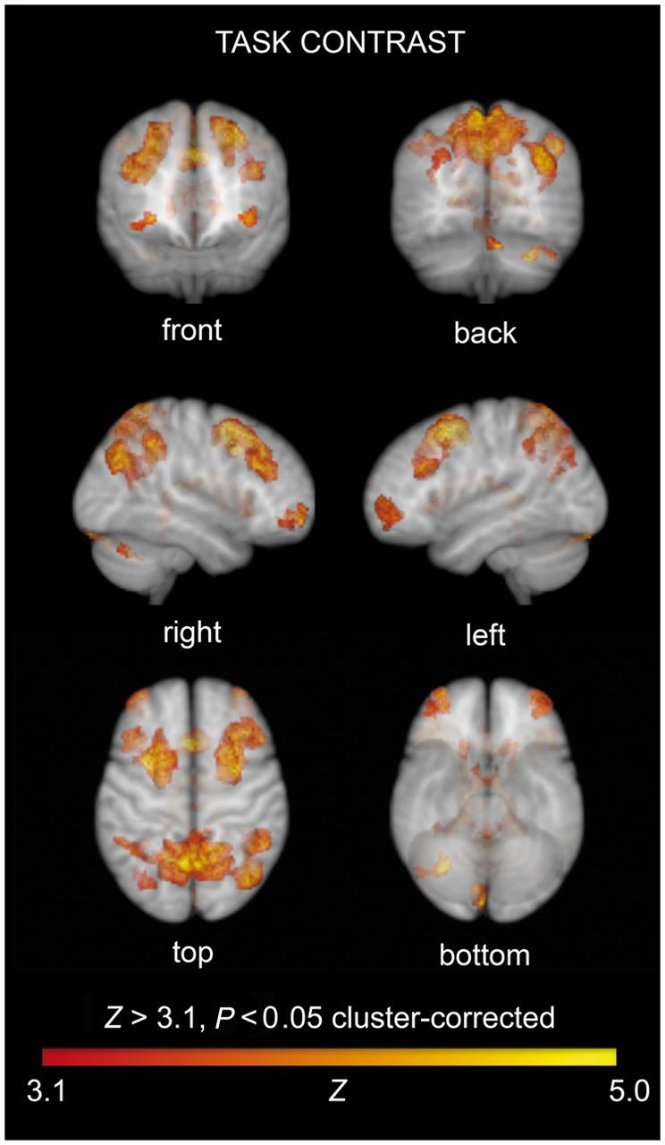
Figure 1 Brain regions showing increased BOLD signal during executive functioning relative to baseline peg-counting ...
Notes:
Figure 1 Brain regions showing increased BOLD signal during executive functioning relative to baseline peg-counting trials across all participants (task contrast, n = 37), before sleep therapy or waitlist in patients and after a night of normal sleep in controls. Significant clusters (family-wise error corrected using Gaussian random field theory) are shown in a gradient from red to yellow within a translucent averaged MNI152 brain, displayed according to neurological convention (left = left). Statistical thresholds and a colour bar indicating Z-value are shown at the bottom. Note that task performance is associated with BOLD responses in clusters in the bilateral superior and middle frontal gyrus, paracingulate gyrus, caudate nucleus, hippocampus, precuneus and left frontal pole.
Unless provided in the caption above, the following copyright applies to the content of this slide: © The Author (2013). Published by Oxford University Press on behalf of the Guarantors of Brain.This is an Open Access article distributed under the terms of the Creative Commons Attribution Non-Commercial License (http://creativecommons.org/licenses/by-nc/3.0/), which permits non-commercial re-use, distribution, and reproduction in any medium, provided the original work is properly cited. For commercial re-use, please contact journals.permissions@oup.com

Slide 4
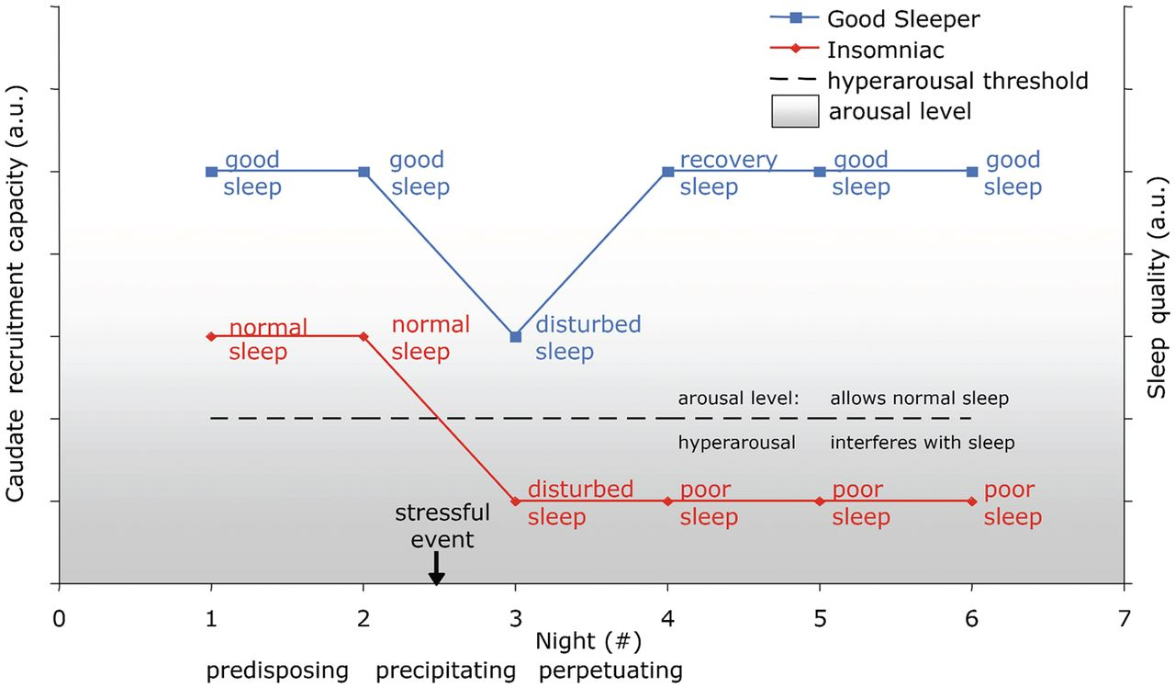
Figure 4 Limitations in the capacity for caudate recruitment may both predispose to, and perpetuate, hyper-arousal and ...
Notes:
Figure 4 Limitations in the capacity for caudate recruitment may both predispose to, and perpetuate, hyper-arousal and insomnia. Patients with insomnia have a constitutionally lower capacity to recruit the head of the caudate, predisposing them to increased arousal. When an external factor (sleep manipulation in the laboratory, stress in real life) disrupts sleep, the capacity to recruit the head of the caudate is further reduced. In people without the aforementioned predisposition this will not bring their arousal level into the realm of hyper-arousal, which consequently normalizes as soon as a precipitating factor is no longer present. In people with the predisposition, a further reduction of their already limited caudate recruitment capacity, elicited by a night of disrupted sleep, could bring it to a level so low that it can no longer sufficiently inhibit autonomic and CNS responses to sensory input. The resulting hyper-aroused state of behavioural restlessness, hyper-responsivity and elevated autonomic and cortical excitability is in itself sufficient to interfere with sleep, thus perpetuating both the limited caudate recruitment capacity and disturbed sleep. a.u. = arbitrary units.
Unless provided in the caption above, the following copyright applies to the content of this slide: © The Author (2013). Published by Oxford University Press on behalf of the Guarantors of Brain.This is an Open Access article distributed under the terms of the Creative Commons Attribution Non-Commercial License (http://creativecommons.org/licenses/by-nc/3.0/), which permits non-commercial re-use, distribution, and reproduction in any medium, provided the original work is properly cited. For commercial re-use, please contact journals.permissions@oup.com

