Slide 1
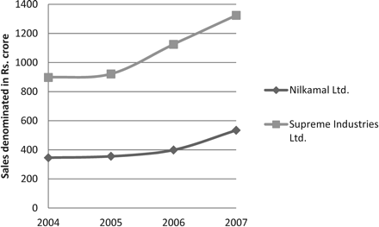
Figure 1 Sales
Notes:
Figure 1 Sales
Unless provided in the caption above, the following copyright applies to the content of this slide: © The Author 2012. Published by Oxford University Press on behalf of The Society for Financial Studies. All rights reserved. For Permissions, please e-mail: journals.permissions@oup.com.

Slide 2
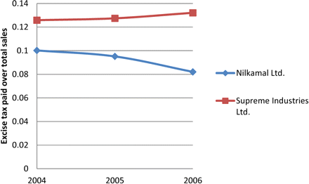
Figure 2 Excise tax over sales
Notes:
Figure 2 Excise tax over sales
Unless provided in the caption above, the following copyright applies to the content of this slide: © The Author 2012. Published by Oxford University Press on behalf of The Society for Financial Studies. All rights reserved. For Permissions, please e-mail: journals.permissions@oup.com.

Slide 3
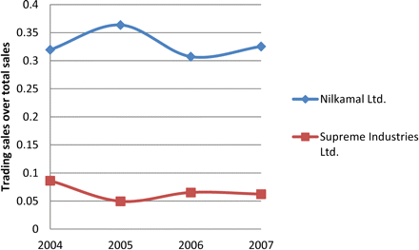
Figure 3 Trading sales over total sales
Notes:
Figure 3 Trading sales over total sales
Unless provided in the caption above, the following copyright applies to the content of this slide: © The Author 2012. Published by Oxford University Press on behalf of The Society for Financial Studies. All rights reserved. For Permissions, please e-mail: journals.permissions@oup.com.

