Slide 1
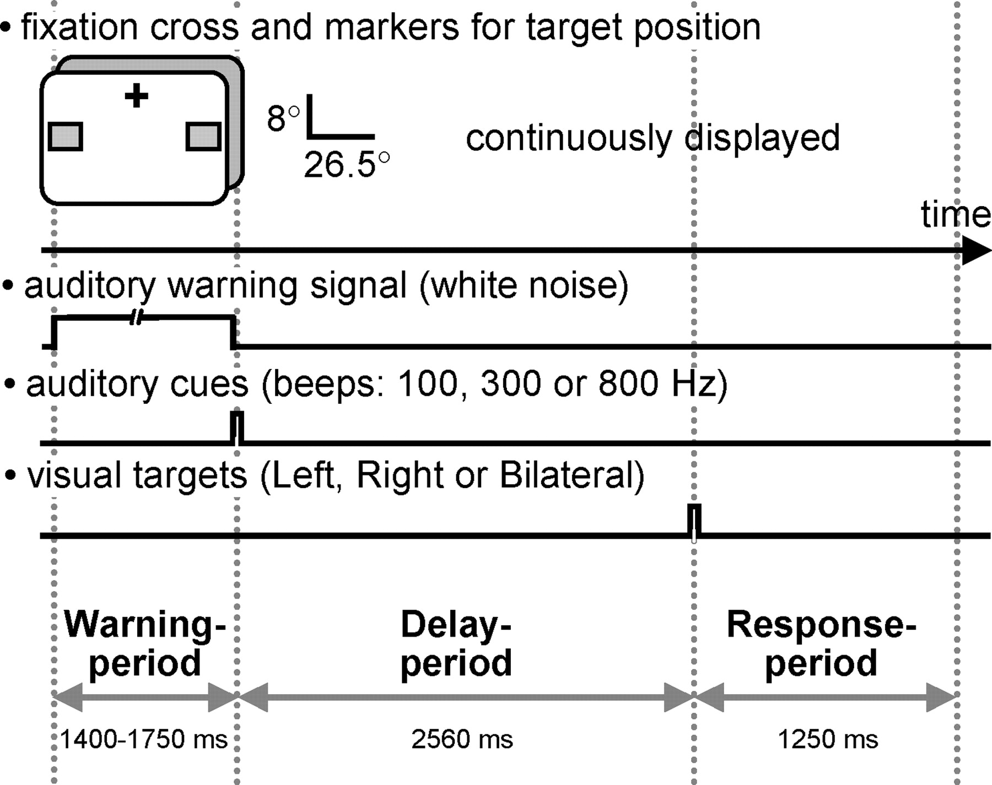
Figure 1. Schematic illustration of stimulus configurations, paradigm and time-course of events within a trial. A ...
Notes:
Figure 1. Schematic illustration of stimulus configurations, paradigm and time-course of events within a trial. A fixation cross and two lower visual field markers for target position (gray squares) were continuously displayed. Each trial was initiated by a warning period of variable length (1400–1750 ms) characterized by a sustained auditory white noise. The cue which followed on the warning stimulus was a brief auditory tone (50 ms) of either 100, 300 or 800 Hz frequency instructing the subject either to direct their attention covertly to the lower left or lower right marker and to maintain attention at the indicated position (directional cues, 100 and 800 Hz tone respectively), or to covertly attend to both markers simultaneously (neutral cue, 300 Hz tone). After a constant delay of 2560 ms, a target was flashed for 40 ms either in the left or right square or bilaterally. Following a directional cue, targets were more likely to appear at cued position (probability 0.66). Following neutral cues, targets appeared at left or right location markers with equal probability. Subjects were asked to respond with index, middle and ring finger of their right hand as a function of perceived target location.
Unless provided in the caption above, the following copyright applies to the content of this slide: Cerebral Cortex V 15 N 5 © Oxford University Press 2004; all rights reserved

Slide 2
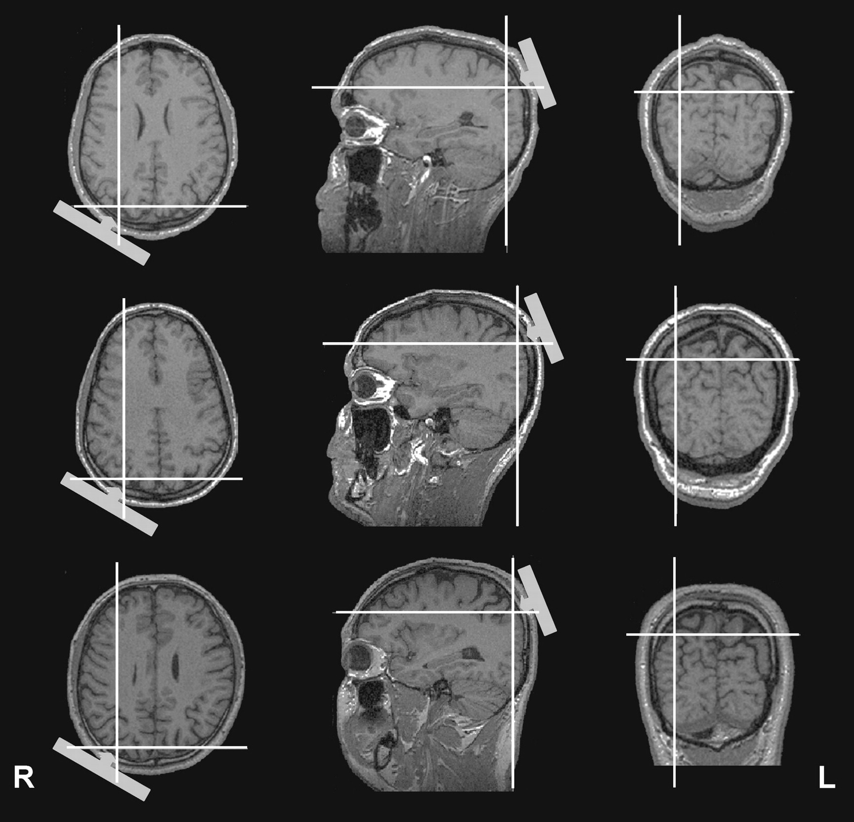
Figure 2. TMS sites relative to individual magnetic resonance images of three subjects as extrapolated using a ...
Notes:
Figure 2. TMS sites relative to individual magnetic resonance images of three subjects as extrapolated using a frameless stereotaxic system. The cross-hairs highlight the cortical point located radially inward from the center of the coil (positioned on P4 of the 10–20 international electrode system). The figure suggests right dorsal PPC (around the intraparietal sulcus) as the site of TMS for all three exemplar subjects.
Unless provided in the caption above, the following copyright applies to the content of this slide: Cerebral Cortex V 15 N 5 © Oxford University Press 2004; all rights reserved

Slide 3
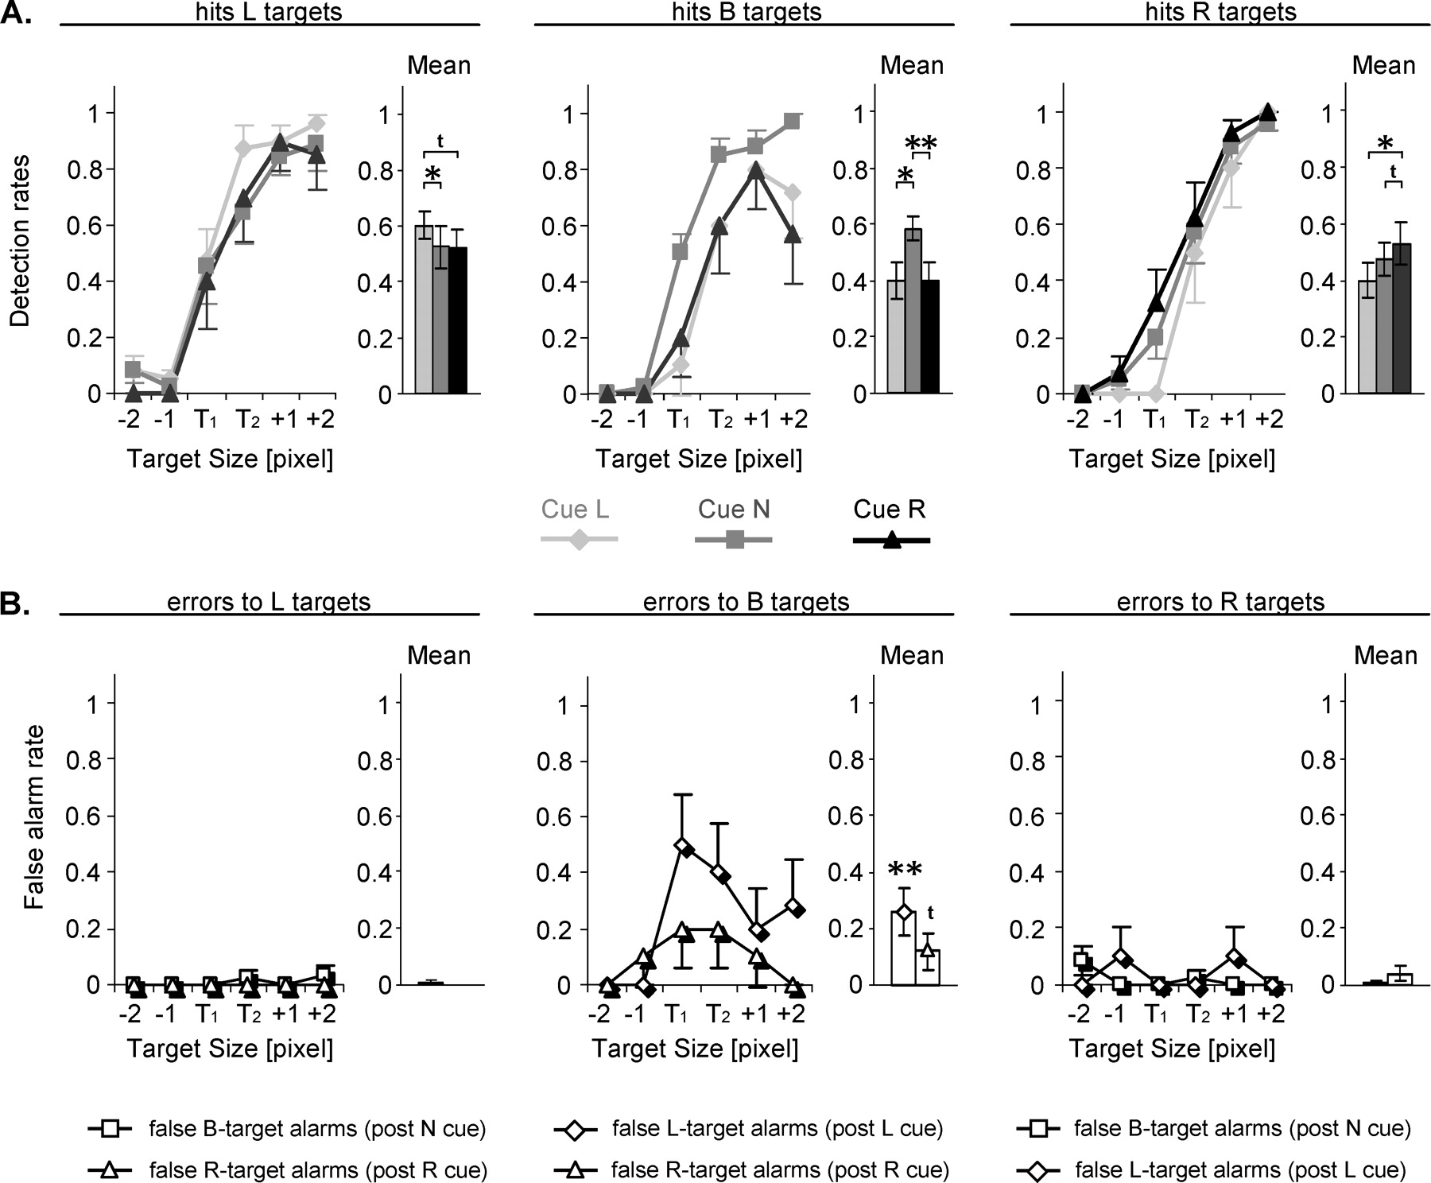
Figure 3. Performance during training session. (A) Average detection rate of correctly perceived targets (±SE) during ...
Notes:
Figure 3. Performance during training session. (A) Average detection rate of correctly perceived targets (±SE) during the last training run as a function of target position (L: left, B: bilateral, R: right), cue (L: left, N: neutral, R: right) and target size (five different sizes tested per subject). The curves are aligned on the peri-threshold targets [Target 1 (T1) and 2 (T2)] that were chosen for the experimental session. Box plots to the right of each line drawing represent average detection rates over all target sizes. Note that subjects showed an advantage for target detection at cued positions (see box plots), suggesting that subjects performed the covert attention shifts correctly. Asterisks indicate significant (*P < 0.05, **P < 0.01), and the symbol t a trend (P < 0.08) for statistical differences between conditions. (B) Average false alarm rates at cued locations (±SE) during the last training run as a function of target position and size. Box plots to the right represent average false alarm rates over all target sizes. Note that the false alarm rates at cued locations were low, except regarding false left- or right-target alarms to bilateral targets following left or right cueing respectively (middle panel), which would be expected if subjects adequately allocate their attention to cued positions (‘neglect’ of unattended locations). Asterisks indicate significant (**P < 0.01) or the symbol t a trend (P < 0.08) for statistical difference from zero as revealed by one-sample t-tests.
Unless provided in the caption above, the following copyright applies to the content of this slide: Cerebral Cortex V 15 N 5 © Oxford University Press 2004; all rights reserved

Slide 4
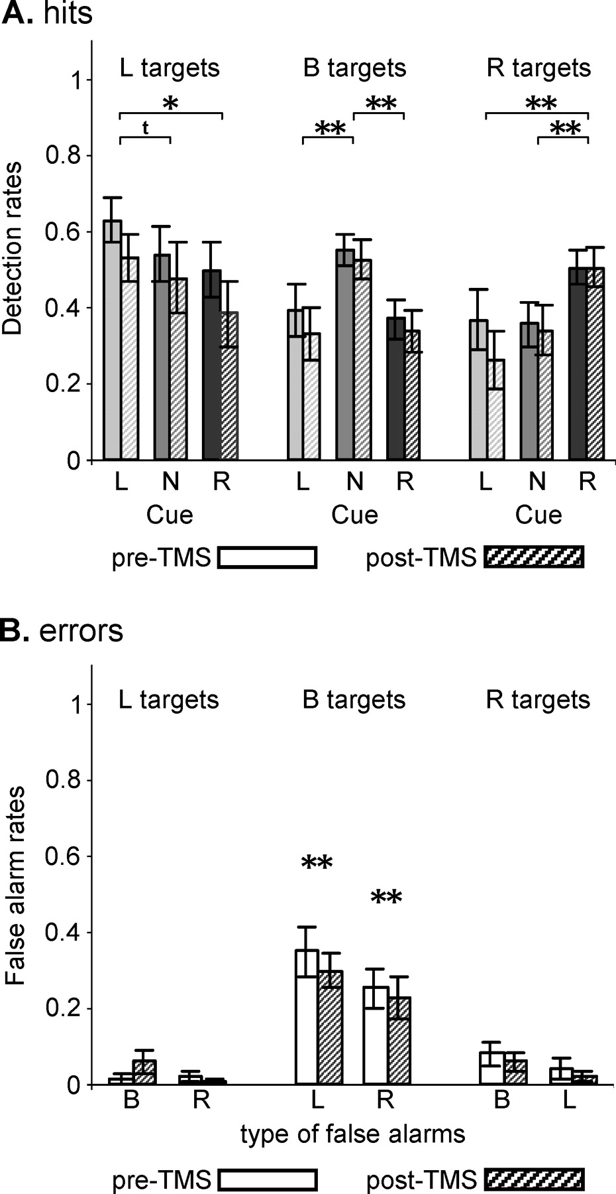
Figure 4. Effect of cue on target detection in the experimental session. (A) Average detection rates (±SE) as a ...
Notes:
Figure 4. Effect of cue on target detection in the experimental session. (A) Average detection rates (±SE) as a function of target location and cue conditions prior and following rTMS. Data are collapsed over the two peri-threshold targets T1 and T2. Participants showed a significant advantage for target detection at cued positions, replicating the results of the training session (see Fig. 3A, box plots). Asterisks or the symbol t refer to significant (*P < 0.05, **P < 0.01) or to a trend (P < 0.08) for statistical differences (data collapsed over pre- and post-TMS values). (B) Corresponding false alarm rates at cued positions (average ± SE) as a function of target position. As in the training session (see Fig. 3B, box plots), false unilateral alarm rates to bilateral targets following directional cueing (middle panel) were significantly different from zero as revealed by one-sample t-tests.
Unless provided in the caption above, the following copyright applies to the content of this slide: Cerebral Cortex V 15 N 5 © Oxford University Press 2004; all rights reserved

Slide 5
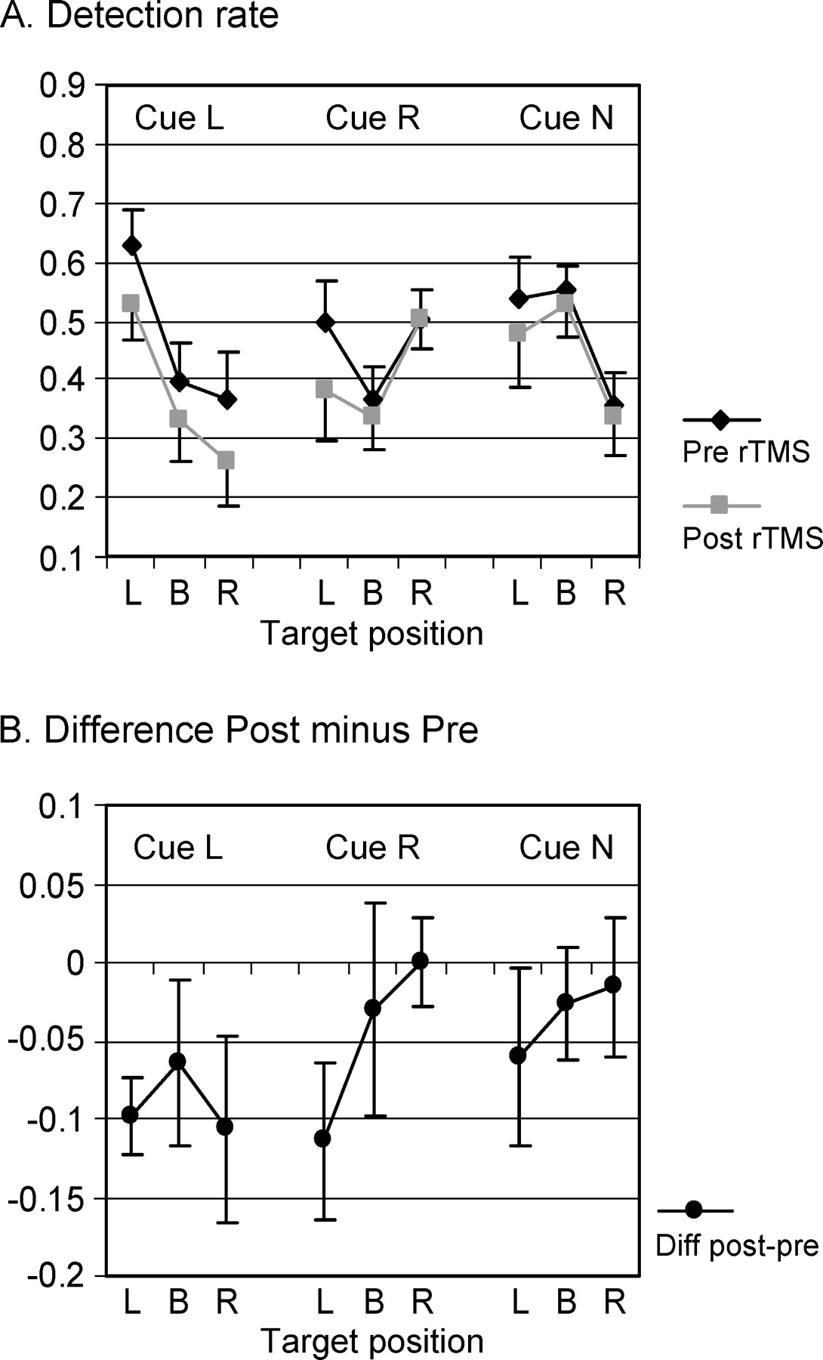
Figure 5. Effects of right posterior parietal rTMS on target detection with no significant change over time of testing. ...
Notes:
Figure 5. Effects of right posterior parietal rTMS on target detection with no significant change over time of testing. Average detection rate and standard errors in all nine conditions (three Cues × three Targets) and collapsed over 30 min of testing (A) during baseline (pre-rTMS) and following 25 min of 1 Hz rTMS (post-rTMS) and (B) represented as changes in correct target detection after rTMS (difference values Post minus Pre, negative values correspond to impaired detection rate). The data shown are identical to Figure 4A, except for reordering to better represent the effects of TMS. rTMS affected target detection in left-cue conditions irrespective of target position (Cue L, P < 0.01) and impaired left-target detection following right cueing (Cue R/Target L, P < 0.05). No significant effects were observed for neutral cues (Cue N).
Unless provided in the caption above, the following copyright applies to the content of this slide: Cerebral Cortex V 15 N 5 © Oxford University Press 2004; all rights reserved

Slide 6
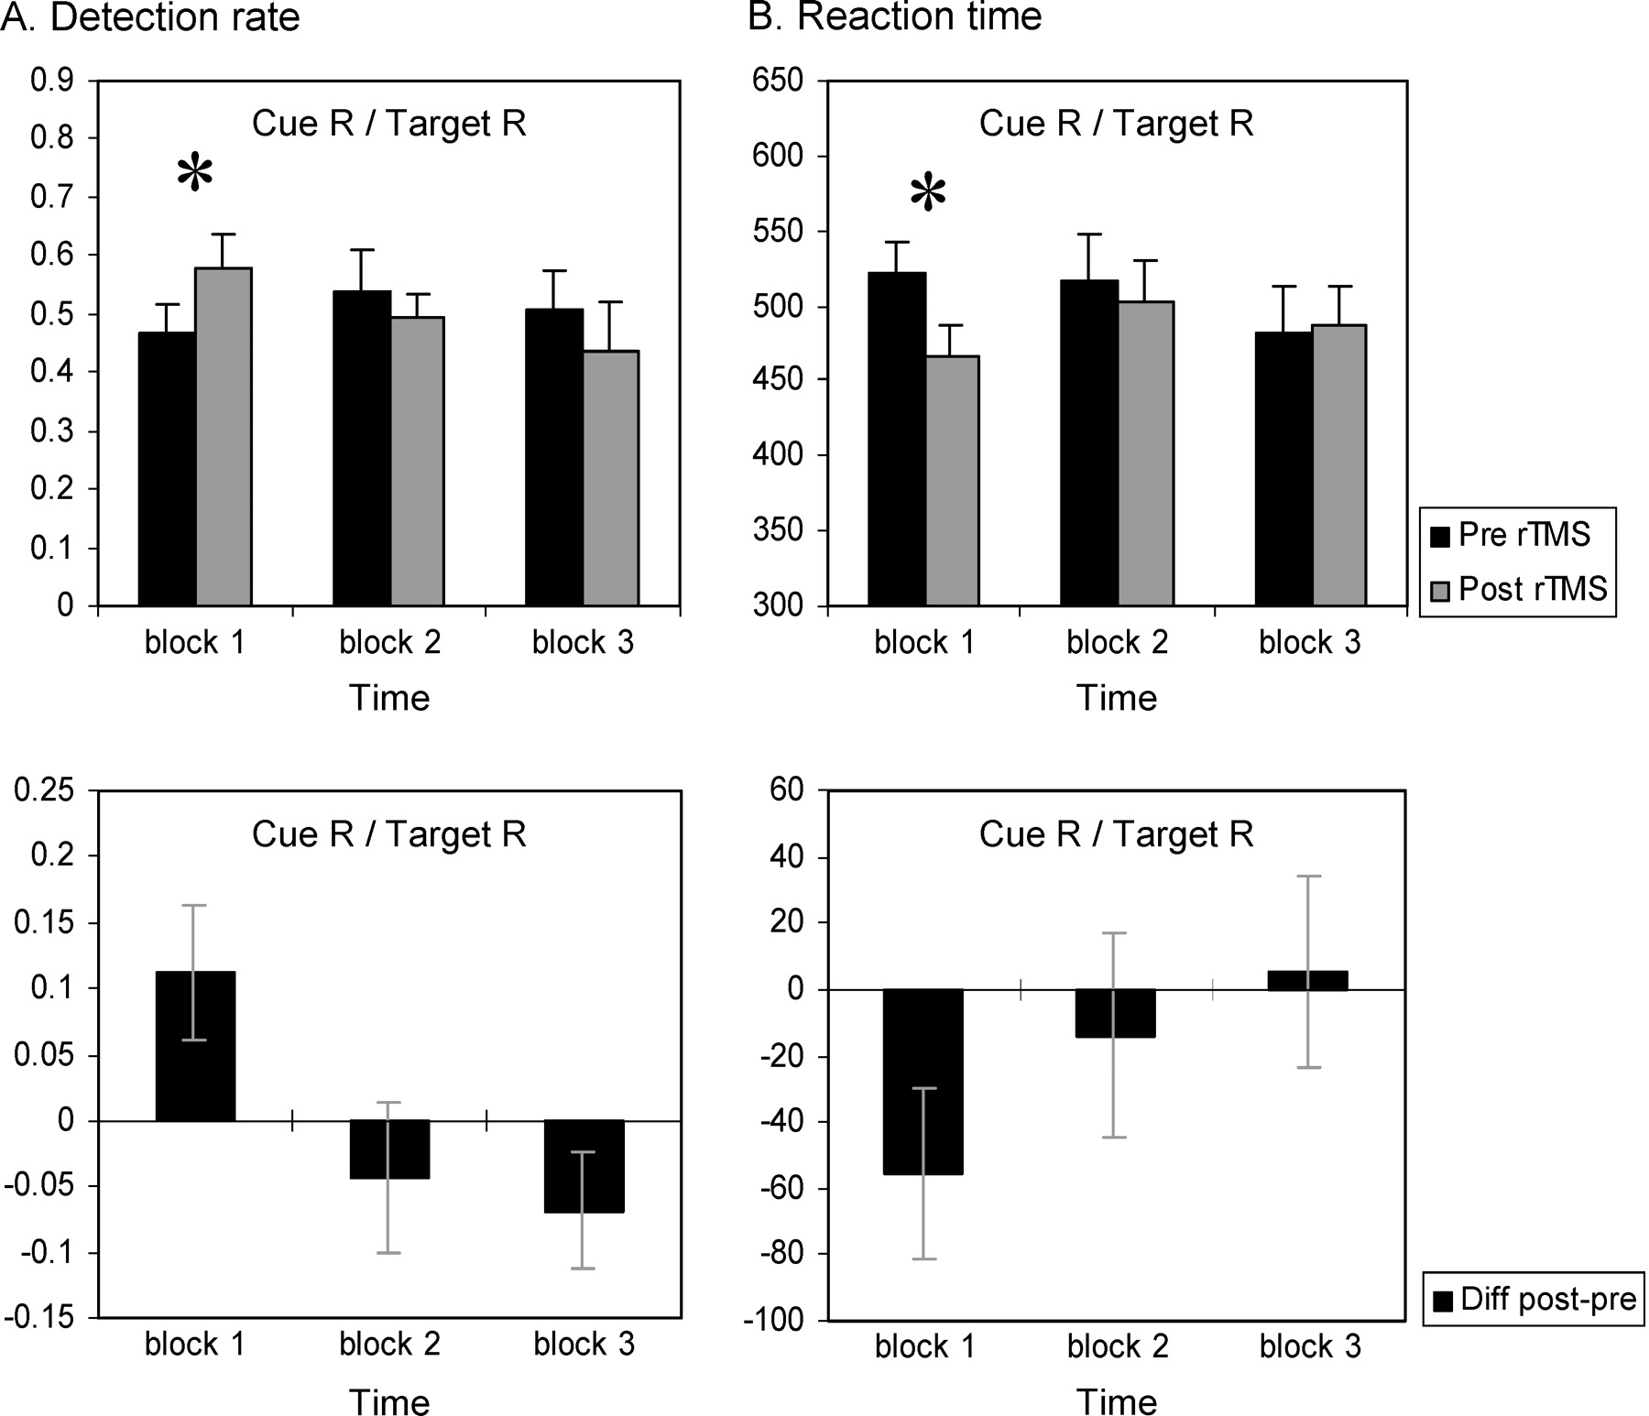
Figure 6. Time-dependent effects of right posterior parietal rTMS on target detection. (A) Average detection rate and ...
Notes:
Figure 6. Time-dependent effects of right posterior parietal rTMS on target detection. (A) Average detection rate and (B) reaction time to right targets following right cueing (Cue R/Target R) over time (three blocks of 10 min each) during pre- (baseline) versus post-rTMS (upper panels) and represented as difference values (lower panels, see legend Fig. 5). The data show an advantage for target detection within the first 10 min after rTMS that was observed for both detection rate (significantly increased) and RT (significantly decreased) but was washed out in the subsequent 20 min of testing.
Unless provided in the caption above, the following copyright applies to the content of this slide: Cerebral Cortex V 15 N 5 © Oxford University Press 2004; all rights reserved

