Slide 1
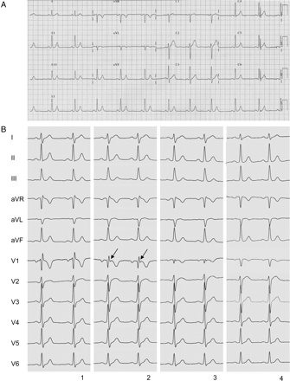
Figure 1 Twelve-lead electrocardiogram of the patient with short QT syndrome. (A) QT interval is 317 ms (QTc 329 ms) ...
Notes:
Figure 1 Twelve-lead electrocardiogram of the patient with short QT syndrome. (A) QT interval is 317 ms (QTc 329 ms) on resting surface electrocardiogram at presentation (paper speed 25 mm/s). (B) Surface electrocardiogram prior to and after flecainide challenge test. (1) Twelve-lead electrocardiogram shows incomplete right bundle branch block at baseline. (2) Tenminutes after flecainide (2 mg/kg) administration, a prominent notch in V1 in the early ST-segment (arrow) is depicted. Notably, the ST-segment becomes more convex. (3) Fifteen minutes after flecainide challenge, reduction in the QRS amplitude in V1 is observed. (4) Twenty minutes later, a prominent Q-wave is seen in V1. Six hours later, the right precordial electrocardiogram changes returned to baseline.
Unless provided in the caption above, the following copyright applies to the content of this slide: Published on behalf of the European Society of Cardiology. All rights reserved. © The Author 2011. For permissions please email: journals.permissions@oup.com

Slide 2
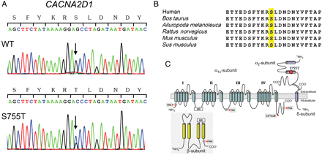
Figure 2 Genetic analysis identified a novel CACNA2D1 mutation. (A) Electropherograms of wild-type (WT) and mutant ...
Notes:
Figure 2 Genetic analysis identified a novel CACNA2D1 mutation. (A) Electropherograms of wild-type (WT) and mutant CACNA2D1 gene showing a heterozygous transition c.2264G > C predicting replacement of serine by threonine at position 755 (p.Ser755Thr). (B) Amino acid sequence alignment showing that serine at position 755 is highly conserved among mammalian species. (C) Predicted topology of the L-type calcium channel Cavα2δ-1 subunit showing the location of the S755T mutation (red circle) at the external carboxyl terminal of CACNA2D1. AID, α-subunit-interacting domain. BID, β-subunit-interacting domain.
Unless provided in the caption above, the following copyright applies to the content of this slide: Published on behalf of the European Society of Cardiology. All rights reserved. © The Author 2011. For permissions please email: journals.permissions@oup.com

Slide 3
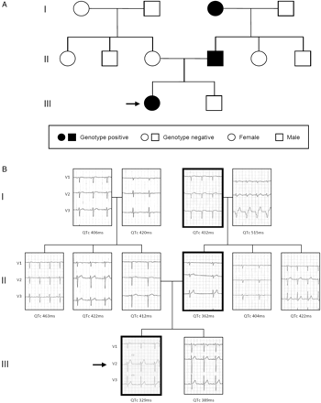
Figure 3 (A) Pedigree of the reported family. (B) Right precordial electrocardiographic leads (V1, V2, and V3; 25 ...
Notes:
Figure 3 (A) Pedigree of the reported family. (B) Right precordial electrocardiographic leads (V1, V2, and V3; 25 mm/s; electrodes were placed in the normal position) and the QTc intervals of the family members. Paternal grandmother had a previous anteroseptal myocardial infarction and paternal grandfather had an implanted pacemaker. The black arrows mark the index patient.
Unless provided in the caption above, the following copyright applies to the content of this slide: Published on behalf of the European Society of Cardiology. All rights reserved. © The Author 2011. For permissions please email: journals.permissions@oup.com

Slide 4
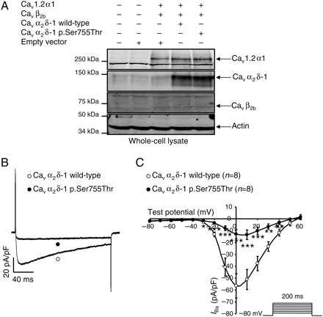
Figure 4 The barium current (I_{Ba}) is reduced by Ca_{v}α₂δ-1 p.Ser755Thr. (A) Western ...
Notes:
Figure 4 The barium current (IBa) is reduced by Cavα2δ-1 p.Ser755Thr. (A) Western blot showing that the expression of all subunits is not modified in the condition where Cavα2δ-1 p.Ser755Thr is expressed compared with the control condition (Cav1.2α1/Cavβ2b/Cavα2δ-1). (B) Representative whole-cell current traces at 0 mV during 200 ms. (C) I–V relationships recorded (protocol in inset) from HEK-293 cells transfected with Cav1.2α1/Cavβ2b/Cavα2δ-1 channels (open circle) or with Cav1.2α1/Cavβ2b/Cavα2δ-1 p.Ser755Thr (filled circle). (D) Activation curves and steady-state inactivation curves recorded (protocol in inset) from HEK-293 cells transfected under the same condition of transfection as in (C) and fitted as mentioned in the Methods section. Activation curves: Cav1.2α1/Cavβ2b/Cavα2δ-1 (open circle) V1/2= −10.5 ± 0.6 mV, K = 5.9 ± 0.4; Cav1.2α1/Cavβ2b/Cavα2δ-1 p.Ser755Thr (filled circle) V1/2 = −8.4 ± 0.9 mV (*compared with Cav1.2α1/Cavβ2b/Cavα2δ-1), K = 6.1 ± 0.3 (n.s. compared with Cav1.2α1/Cavβ2b/Cavα2δ-1). Steady-state inactivation curves: Cav1.2α1/Cavβ2b/Cavα2δ-1 (open diamond) V1/2 = −33.1 ± 0.9 mV, K = 7.9 ± 0.3; Cav1.2α1/Cavβ2b/Cavα2δ-1 p.Ser755Thr (filled diamond) V1/2 = −30.6 ± 0.5 mV (**compared with Cav1.2α1/Cavβ2b/Cavα2δ-1), K = 8.2 ± 0.5 (n.s. compared with Cav1.2α1/Cavβ2b/Cavα2δ-1). (E) I–V relationships recorded (protocol in inset) from HEK-293 cells transfected with Cav1.2α1/Cavβ2b/Cavα2δ-1 channels (open circle) or with Cav1.2α1/Cavβ2b (filled circle). (F) Activation curves and steady-state inactivation curves recorded (protocol in inset) from HEK-293 cells transfected in the same condition as in (E) and fitted as mentioned in the Methods section. Activation curves: Cav1.2α1/Cavβ2b/Cavα2δ-1 (open circle) V1/2 = −10.5 ± 0.6 mV, K = 5.9 ± 0.4; Cav1.2α1/Cavβ2b (filled circle) V1/2 = −2.0 ± 0.6 mV (***compared with Cav1.2α1/Cavβ2b/Cavα2δ-1), K = 7.6 ± 0.3 (**compared with Cav1.2α1/Cavβ2b/Cavα2δ-1). Steady-state inactivation curves: Cav1.2α1/Cavβ2b/Cavα2δ-1 (open diamond) V1/2 = −33.1 ± 0.9 mV, K = 7.9 ± 0.3; Cav1.2α1/Cavβ2b (filled diamond) V1/2 = −26.0 ± 2.8 mV (*compared with Cav1.2α1/Cavβ2b/Cavα2δ-1), K = 12.4 ± 1.3 (**compared with Cav1.2α1/Cavβ2b/Cavα2δ-1). The number of cells recorded is indicated in parentheses. *P < 0.05, **P< 0.01, and ***P< 0.001.
Unless provided in the caption above, the following copyright applies to the content of this slide: Published on behalf of the European Society of Cardiology. All rights reserved. © The Author 2011. For permissions please email: journals.permissions@oup.com

Slide 5
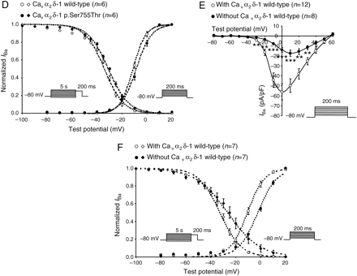
Figure 4 The barium current (I_{Ba}) is reduced by Ca_{v}α₂δ-1 p.Ser755Thr. (A) Western ...
Notes:
Figure 4 The barium current (IBa) is reduced by Cavα2δ-1 p.Ser755Thr. (A) Western blot showing that the expression of all subunits is not modified in the condition where Cavα2δ-1 p.Ser755Thr is expressed compared with the control condition (Cav1.2α1/Cavβ2b/Cavα2δ-1). (B) Representative whole-cell current traces at 0 mV during 200 ms. (C) I–V relationships recorded (protocol in inset) from HEK-293 cells transfected with Cav1.2α1/Cavβ2b/Cavα2δ-1 channels (open circle) or with Cav1.2α1/Cavβ2b/Cavα2δ-1 p.Ser755Thr (filled circle). (D) Activation curves and steady-state inactivation curves recorded (protocol in inset) from HEK-293 cells transfected under the same condition of transfection as in (C) and fitted as mentioned in the Methods section. Activation curves: Cav1.2α1/Cavβ2b/Cavα2δ-1 (open circle) V1/2= −10.5 ± 0.6 mV, K = 5.9 ± 0.4; Cav1.2α1/Cavβ2b/Cavα2δ-1 p.Ser755Thr (filled circle) V1/2 = −8.4 ± 0.9 mV (*compared with Cav1.2α1/Cavβ2b/Cavα2δ-1), K = 6.1 ± 0.3 (n.s. compared with Cav1.2α1/Cavβ2b/Cavα2δ-1). Steady-state inactivation curves: Cav1.2α1/Cavβ2b/Cavα2δ-1 (open diamond) V1/2 = −33.1 ± 0.9 mV, K = 7.9 ± 0.3; Cav1.2α1/Cavβ2b/Cavα2δ-1 p.Ser755Thr (filled diamond) V1/2 = −30.6 ± 0.5 mV (**compared with Cav1.2α1/Cavβ2b/Cavα2δ-1), K = 8.2 ± 0.5 (n.s. compared with Cav1.2α1/Cavβ2b/Cavα2δ-1). (E) I–V relationships recorded (protocol in inset) from HEK-293 cells transfected with Cav1.2α1/Cavβ2b/Cavα2δ-1 channels (open circle) or with Cav1.2α1/Cavβ2b (filled circle). (F) Activation curves and steady-state inactivation curves recorded (protocol in inset) from HEK-293 cells transfected in the same condition as in (E) and fitted as mentioned in the Methods section. Activation curves: Cav1.2α1/Cavβ2b/Cavα2δ-1 (open circle) V1/2 = −10.5 ± 0.6 mV, K = 5.9 ± 0.4; Cav1.2α1/Cavβ2b (filled circle) V1/2 = −2.0 ± 0.6 mV (***compared with Cav1.2α1/Cavβ2b/Cavα2δ-1), K = 7.6 ± 0.3 (**compared with Cav1.2α1/Cavβ2b/Cavα2δ-1). Steady-state inactivation curves: Cav1.2α1/Cavβ2b/Cavα2δ-1 (open diamond) V1/2 = −33.1 ± 0.9 mV, K = 7.9 ± 0.3; Cav1.2α1/Cavβ2b (filled diamond) V1/2 = −26.0 ± 2.8 mV (*compared with Cav1.2α1/Cavβ2b/Cavα2δ-1), K = 12.4 ± 1.3 (**compared with Cav1.2α1/Cavβ2b/Cavα2δ-1). The number of cells recorded is indicated in parentheses. *P < 0.05, **P< 0.01, and ***P< 0.001.
Unless provided in the caption above, the following copyright applies to the content of this slide: Published on behalf of the European Society of Cardiology. All rights reserved. © The Author 2011. For permissions please email: journals.permissions@oup.com

Slide 6
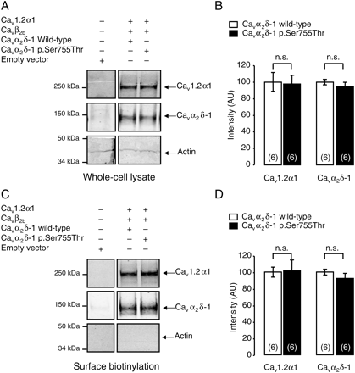
Figure 5 Surface biotinylation assays were performed using ...
Notes:
Figure 5 Surface biotinylation assays were performed using Cav1.2α1/Cavβ2b/Cavα2δ-1 and Cav1.2α1/Cavβ2b/Cavα2δ-1 p.Ser755Thr subunit-transfected HEK-293 cells. (A) Western blots showing Cav1.2α1 and Cavα2δ-1 subunits detected in the whole-cell lysates and (C) corresponding biotinylated fraction. (B and D) Bar graphs summarizing the effect of the mutation on the expression of Cav1.2α1 and Cavα2δ-1 subunits in whole-cell lysates (B) and in biotinylated fractions (D). The number of independent experiments is indicated in parentheses; n.s., not significant compared with control cells transfected with Cav1.2α1/Cavβ2b/Cavα2δ-1 subunits.
Unless provided in the caption above, the following copyright applies to the content of this slide: Published on behalf of the European Society of Cardiology. All rights reserved. © The Author 2011. For permissions please email: journals.permissions@oup.com

Slide 7
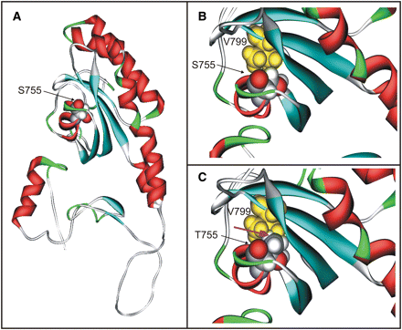
Figure 6 Model of the sensory domain (residues 659–889) of CACNA2D1. (A) Helices, sheets, turns, and coil regions are ...
Notes:
Figure 6 Model of the sensory domain (residues 659–889) of CACNA2D1. (A) Helices, sheets, turns, and coil regions are coloured in red, cyan, green, and white, respectively. (B and C) The site of the p.Ser755Thr mutation is shown in space-filled presentation and is shown as an enlargement in the right panels. (B) Interactions of Ser755 and Val799 in the WT protein. The hydrophobic moieties of both side chains pack tightly, but no clashes are observed. Residue 755 is coloured by atom type and Val799 is depicted in yellow. (C) Interactions of Thr755 and Val799 in the mutant protein. The magenta arrow indicates clashes between the methyl groups of Thr755 and Val799. Colour coding as in (B).
Unless provided in the caption above, the following copyright applies to the content of this slide: Published on behalf of the European Society of Cardiology. All rights reserved. © The Author 2011. For permissions please email: journals.permissions@oup.com

