Slide 1
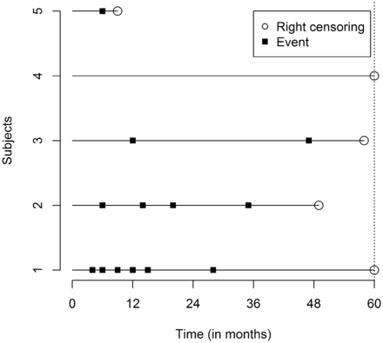
Figure 1. Schematic plot for recurrent time-to-event data for five hypothetical subjects.
Notes:
Figure 1. Schematic plot for recurrent time-to-event data for five hypothetical subjects.
Unless provided in the caption above, the following copyright applies to the content of this slide: © The Author 2014; all rights reserved. Published by Oxford University Press on behalf of the International Epidemiological Association

Slide 2
Figure 2. Schematic for full multi-state model for recurrent events.
Notes:
Figure 2. Schematic for full multi-state model for recurrent events.
Unless provided in the caption above, the following copyright applies to the content of this slide: © The Author 2014; all rights reserved. Published by Oxford University Press on behalf of the International Epidemiological Association

Slide 3
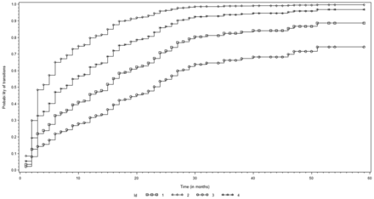
Figure 3. Predicted transition probabilities for four patients using the AG multi-state model fitted to bladder study.
Notes:
Figure 3. Predicted transition probabilities for four patients using the AG multi-state model fitted to bladder study.
Unless provided in the caption above, the following copyright applies to the content of this slide: © The Author 2014; all rights reserved. Published by Oxford University Press on behalf of the International Epidemiological Association

Slide 4
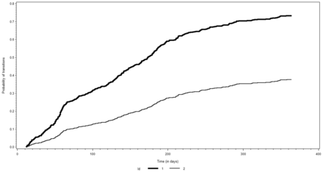
Figure 4. Predicted transition probabilities for two girls using the AG multi-state model fitted to ALRI study.
Notes:
Figure 4. Predicted transition probabilities for two girls using the AG multi-state model fitted to ALRI study.
Unless provided in the caption above, the following copyright applies to the content of this slide: © The Author 2014; all rights reserved. Published by Oxford University Press on behalf of the International Epidemiological Association

