Slide 1
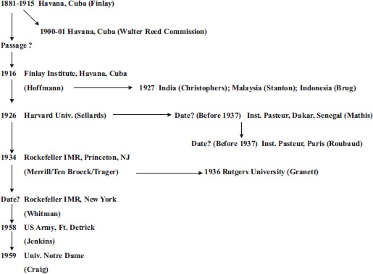
Fig. 1. The Inter-Institutional Sharing History of the “ROCK” strain of Ae. aegypti. The names in parentheses are the ...
Notes:
Fig. 1. The Inter-Institutional Sharing History of the “ROCK” strain of Ae. aegypti. The names in parentheses are the individuals who were involved in the strain sharing and/or maintenance. Question marks for passage and date indicate uncertain status.
Unless provided in the caption above, the following copyright applies to the content of this slide: © 2010 Entomological Society of AmericaThis is an Open Access article distributed under the terms of the Creative Commons Attribution Non-Commercial License (http://creativecommons.org/licenses/by-nc/3.0/), which permits non-commercial reuse, distribution, and reproduction in any medium, provided the original work is properly cited. For commercial re-use, please contact journals.permissions@oup.com

