Slide 1
Fig. 1. Examples of types of discrimination on the NIH Toolbox Pattern Comparison Processing Speed Test.
Notes:
Fig. 1. Examples of types of discrimination on the NIH Toolbox Pattern Comparison Processing Speed Test.
Unless provided in the caption above, the following copyright applies to the content of this slide: © The Author 2015. Published by Oxford University Press. All rights reserved. For permissions, please e-mail: journals.permissions@oup.com.

Slide 2
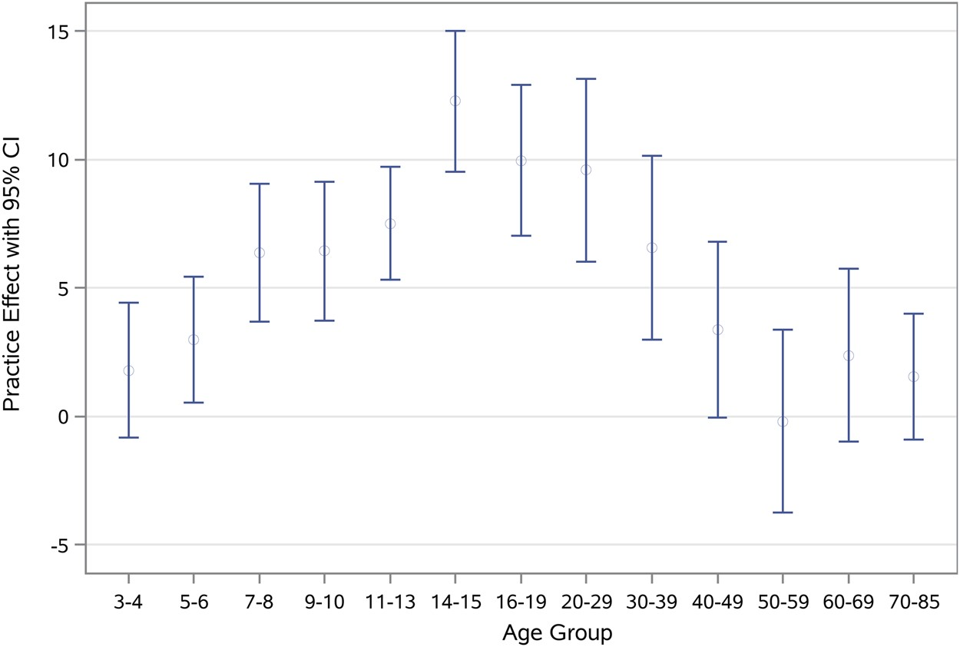
Fig. 2. Practice effects for the NIH Toolbox Pattern Comparison Processing Speed Test scores by age (mean scaled ...
Notes:
Fig. 2. Practice effects for the NIH Toolbox Pattern Comparison Processing Speed Test scores by age (mean scaled score difference ±2 standard error).
Unless provided in the caption above, the following copyright applies to the content of this slide: © The Author 2015. Published by Oxford University Press. All rights reserved. For permissions, please e-mail: journals.permissions@oup.com.

Slide 3
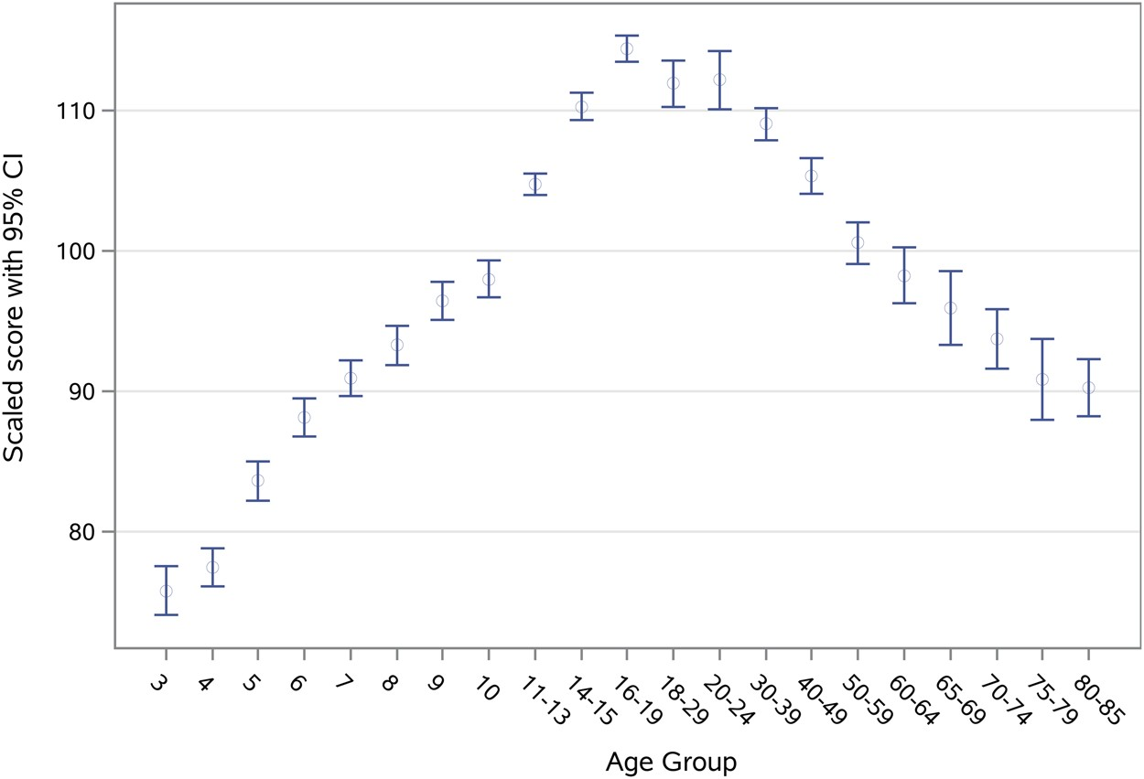
Fig. 3. The NIH Toolbox Pattern Comparison Processing Speed Test scores by age (scaled score ±2 standard error).
Notes:
Fig. 3. The NIH Toolbox Pattern Comparison Processing Speed Test scores by age (scaled score ±2 standard error).
Unless provided in the caption above, the following copyright applies to the content of this slide: © The Author 2015. Published by Oxford University Press. All rights reserved. For permissions, please e-mail: journals.permissions@oup.com.

