Slide 1
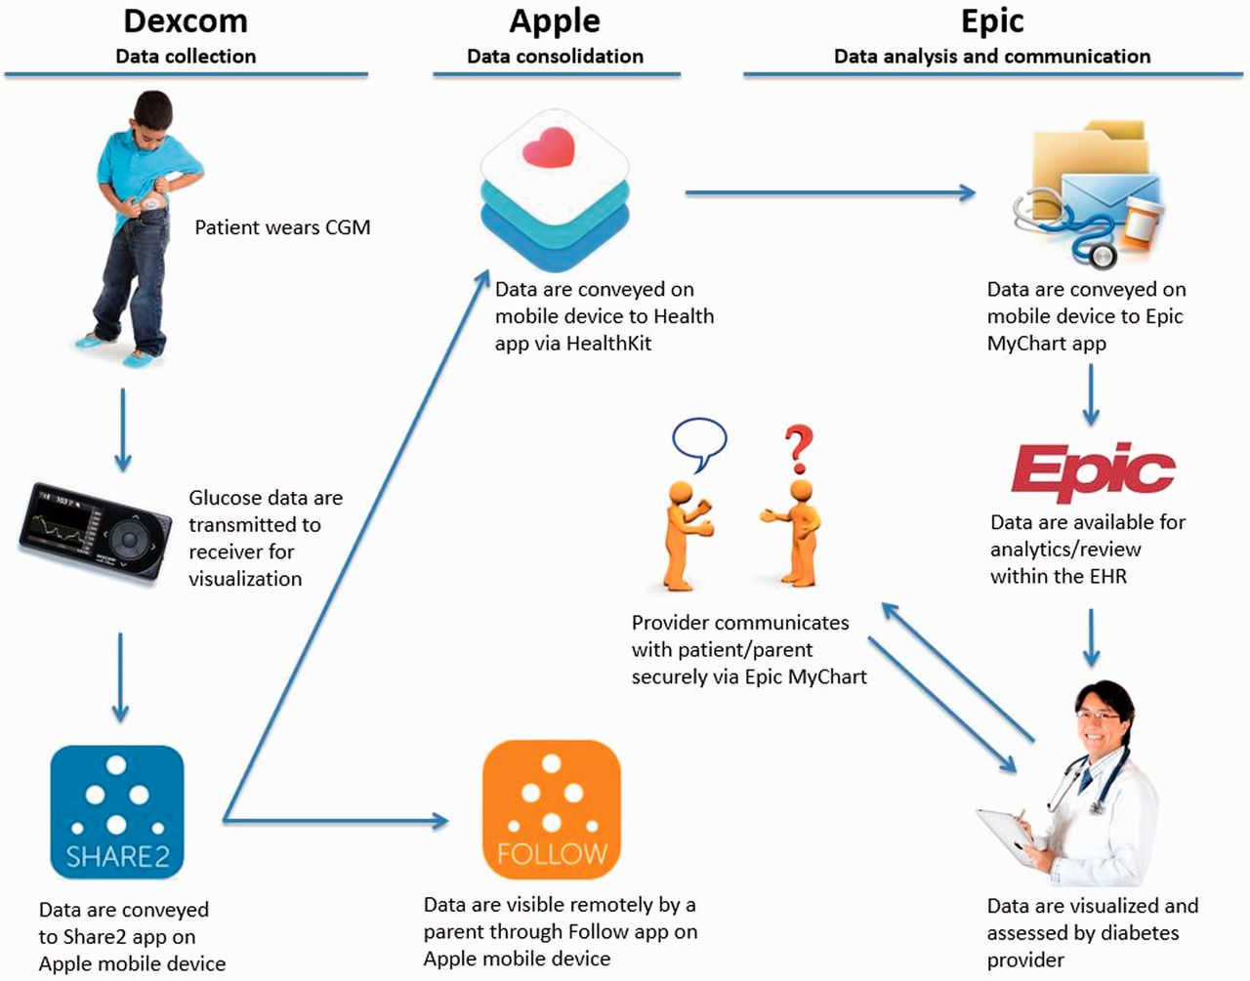
Figure 1 Overview of the CGM data communication bridge architecture.
Notes:
Figure 1 Overview of the CGM data communication bridge architecture.
Unless provided in the caption above, the following copyright applies to the content of this slide: © The Author 2016. Published by Oxford University Press on behalf of the American Medical Informatics Association.This is an Open Access article distributed under the terms of the Creative Commons Attribution Non-Commercial License (http://creativecommons.org/licenses/by-nc/4.0/), which permits non-commercial re-use, distribution, and reproduction in any medium, provided the original work is properly cited. For commercial re-use, please contact journals.permissions@oup.com

Slide 2
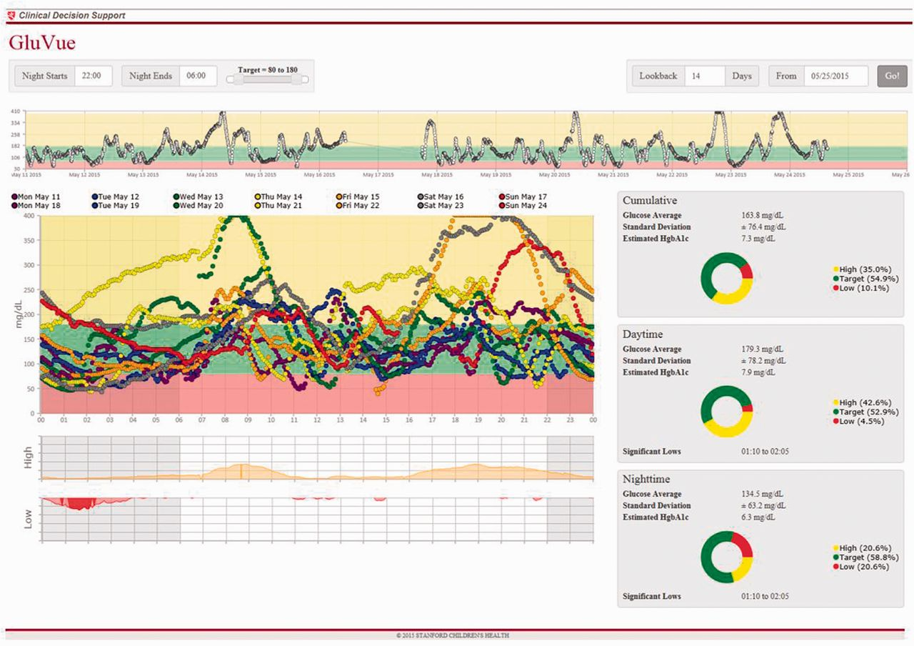
Figure 2 Modal day visualization of 2 weeks of CGM data for a single participant with a custom web-service embedded in ...
Notes:
Figure 2 Modal day visualization of 2 weeks of CGM data for a single participant with a custom web-service embedded in the EHR (available at https://gluvue.stanfordchildrens.org) A pattern of nocturnal hypoglycemia is readily identified.
Unless provided in the caption above, the following copyright applies to the content of this slide: © The Author 2016. Published by Oxford University Press on behalf of the American Medical Informatics Association.This is an Open Access article distributed under the terms of the Creative Commons Attribution Non-Commercial License (http://creativecommons.org/licenses/by-nc/4.0/), which permits non-commercial re-use, distribution, and reproduction in any medium, provided the original work is properly cited. For commercial re-use, please contact journals.permissions@oup.com

