Slide 1
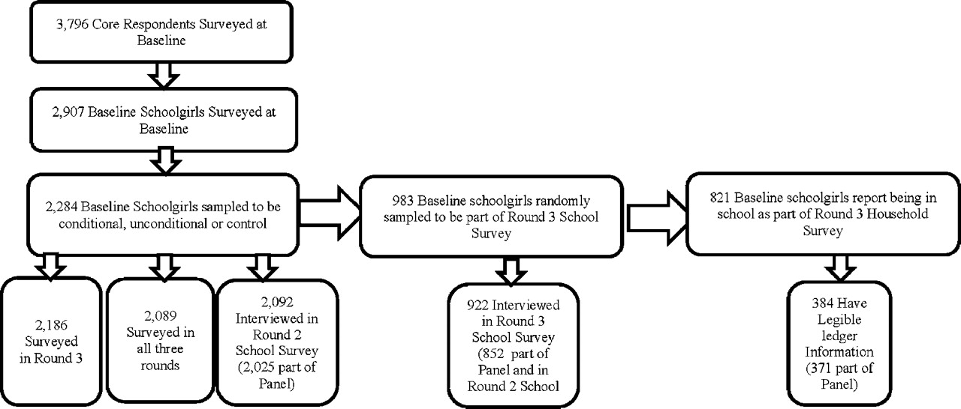
F IGURE I Study Sample and Attrition
Notes:
F IGURE I Study Sample and Attrition
Unless provided in the caption above, the following copyright applies to the content of this slide: © The Author(s) 2011. Published by Oxford University Press, on behalf of President and Fellows of Harvard College. All rights reserved. For Permissions, please email: journals.permissions@oup.com.

