Slide 1
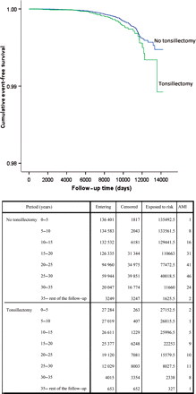
Figure 2 Life tables and Kaplan–Meier plots for cumulative proportion of surviving patients who did not have an acute ...
Notes:
Figure 2 Life tables and Kaplan–Meier plots for cumulative proportion of surviving patients who did not have an acute myocardial infarction during the follow-up in relation to tonsillectomy <20 years of age at the time of surgery (P for log-rank test = 0.047).
Unless provided in the caption above, the following copyright applies to the content of this slide: Published on behalf of the European Society of Cardiology. All rights reserved. © The Author 2011. For permissions please email: journals.permissions@oup.com

Slide 2
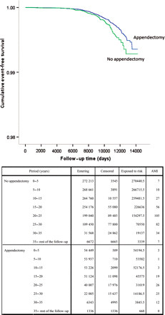
Figure 1 Life tables and Kaplan–Meier plots for cumulative proportion of surviving patients who did not have an acute ...
Notes:
Figure 1 Life tables and Kaplan–Meier plots for cumulative proportion of surviving patients who did not have an acute myocardial infarction during the follow-up in relation to appendectomy <20 years of age at the time of surgery (P for log-rank test = 0.012).
Unless provided in the caption above, the following copyright applies to the content of this slide: Published on behalf of the European Society of Cardiology. All rights reserved. © The Author 2011. For permissions please email: journals.permissions@oup.com

