Slide 1
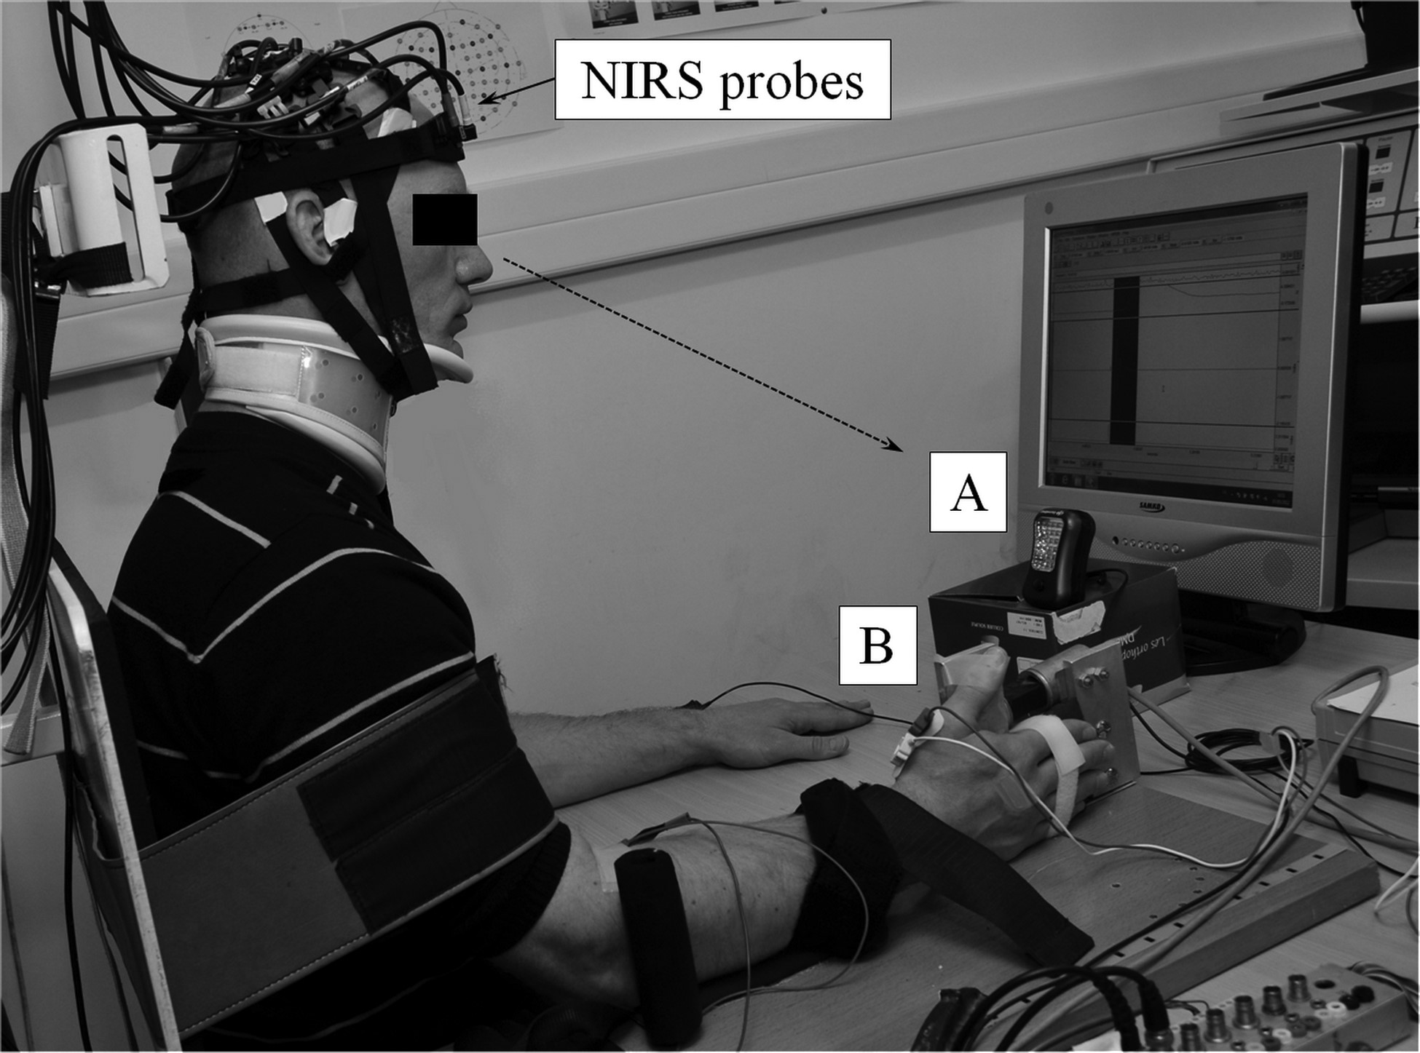
Figure 1. The experimental setup during the NIRS experiment. (a) Light source evoking the visual target stimuli during ...
Notes:
Figure 1. The experimental setup during the NIRS experiment. (a) Light source evoking the visual target stimuli during the sustained attention RT task. From the beginning of the task, subjects had to attend and prepare for the upcoming stimulus when the lighting source was off (i.e., during interstimuli intervals). Subjects were instructed that when a flash occurred they should generate a thumb abduction as quickly as possible. (b) Dynamometer allowing the measurement of the thumb abduction movements (i.e., the motor responses). EMG electrodes can be distinguished on the belly of APB muscle. The screen positioned just behind the light source was turned off during the task and the resting state periods and turned on during the periods of the protocol requiring a visual feedback of the force production (i.e., during the neuromuscular tests and the warming-up phase).
Unless provided in the caption above, the following copyright applies to the content of this slide: © The Author 2013. Published by Oxford University Press. All rights reserved. For Permissions, please e-mail: journals.permissions@oup.com

Slide 2
Figure 2. (A) Neuromuscular tests (NMT). M and H represent the neural stimulation pulses performed at the intensity ...
Notes:
Figure 2. (A) Neuromuscular tests (NMT). M and H represent the neural stimulation pulses performed at the intensity generating the M-wave and the superimposed H-reflex responses, respectively. MVC, maximal voluntary contraction. (B) Time course of NIRS and TMS protocols. Protocol events are 1: Warming-up. 2: Resting period. 3: Familiarization through 1 min of sustained attention. 4: pretask NMT. 5: NIRS experiment = pretask resting period; TMS experiment = pretask TMS. 6: Sustained attention task for 32 min. 7: NIRS experiment = post-task resting period; TMS experiment = post-task TMS. 8: post-task NMT. The thin black arrows in NIRS experiments represent the NIRS events, delineating the resting state periods and the task and each 5 min of the task. In TMS experiment, the thick gray arrows represent 4 TMS pulses without any contraction and the thick white arrows represent 4 TMS superimposed pulses (with voluntary contractions at 10% MVC).
Unless provided in the caption above, the following copyright applies to the content of this slide: © The Author 2013. Published by Oxford University Press. All rights reserved. For Permissions, please e-mail: journals.permissions@oup.com

Slide 3
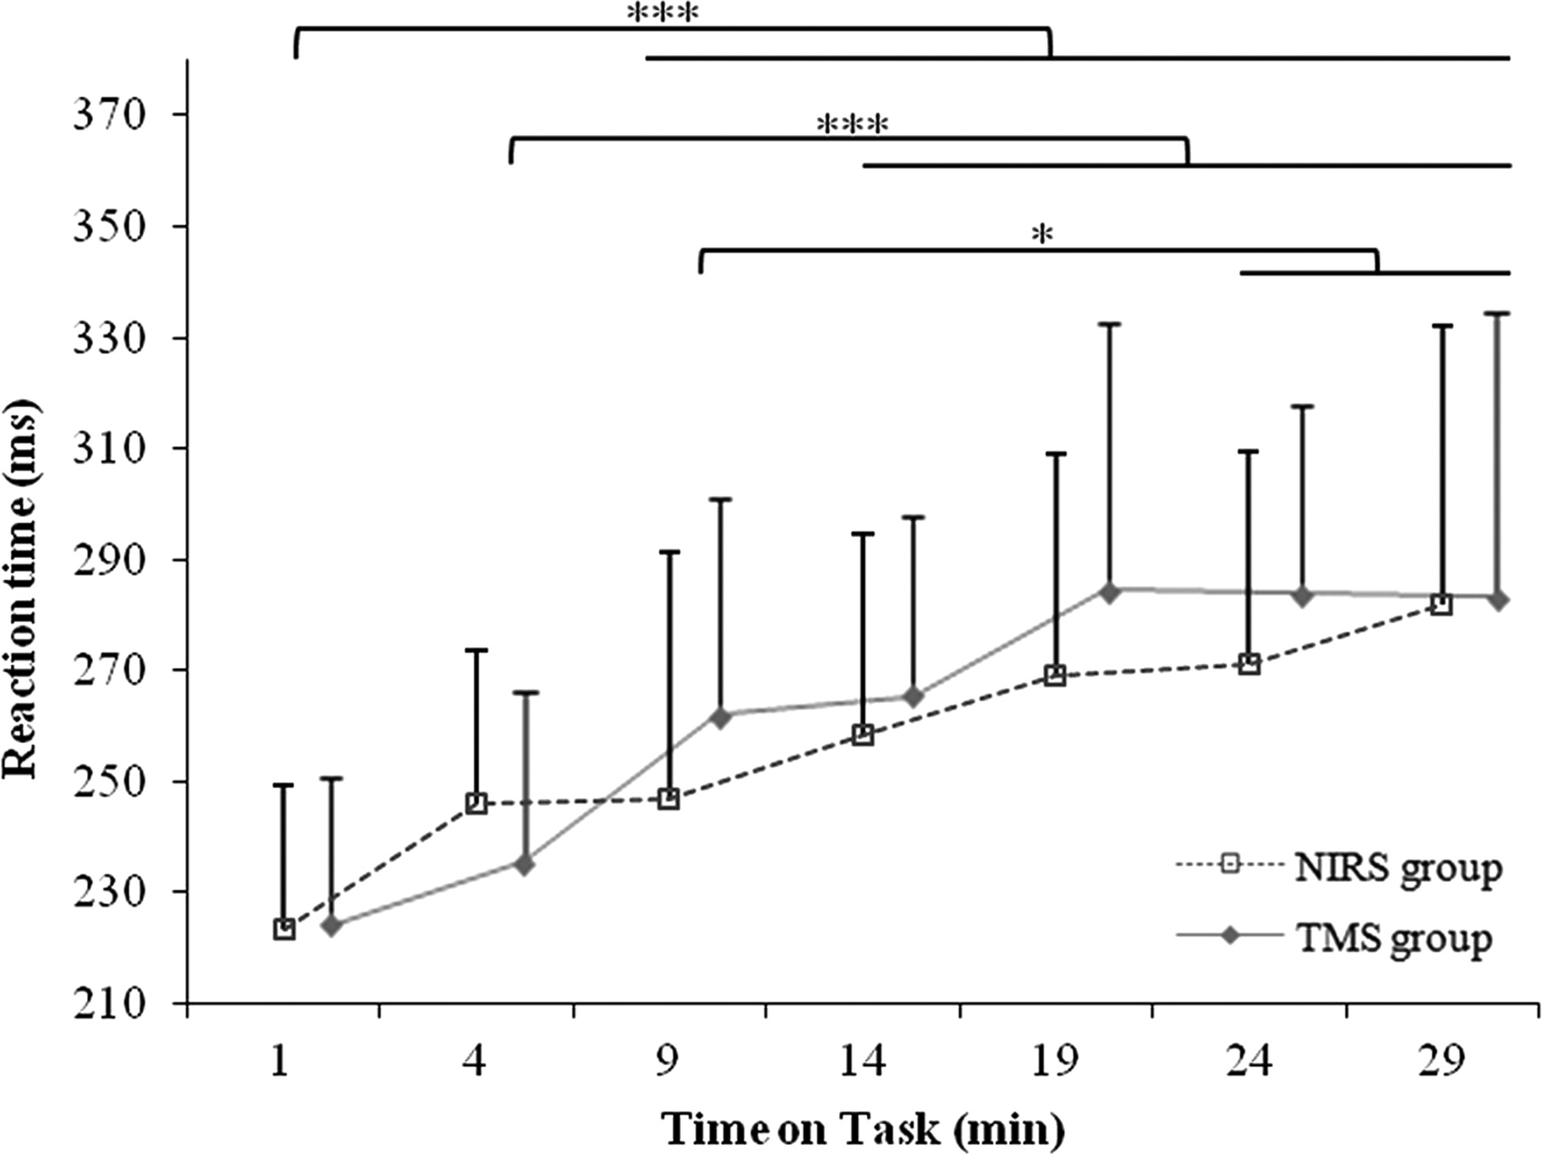
Figure 3. Evolution of reaction time over time during a sustained attention RT task of 30 min. Significant increase in ...
Notes:
Figure 3. Evolution of reaction time over time during a sustained attention RT task of 30 min. Significant increase in RT occurred after 9 min of task compared with RT values of the first minute of task. ***P < .001; *P < 0.05. Vertical bars represent SD.
Unless provided in the caption above, the following copyright applies to the content of this slide: © The Author 2013. Published by Oxford University Press. All rights reserved. For Permissions, please e-mail: journals.permissions@oup.com

Slide 4
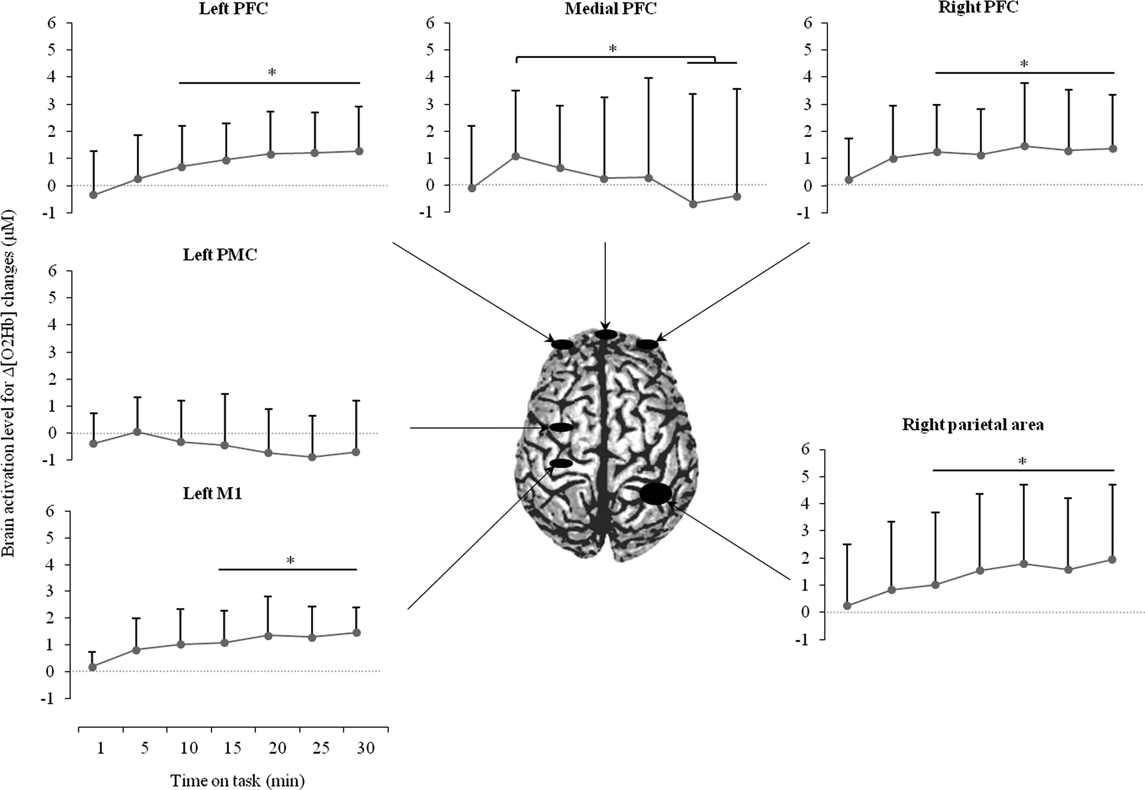
Figure 4. Evolution of NIRS signals over time during a sustained attention RT task of 30 min. *P < 0.05 after ...
Notes:
Figure 4. Evolution of NIRS signals over time during a sustained attention RT task of 30 min. *P < 0.05 after Bonferroni correction. Gray traces represent Δ[O2Hb] changes. Significant changes are the results of post hoc tests and horizontal bars represent comparisons with cortical activation after 1 min of task over the respective area (except for the mPFC where the significant changes are compared with the cortical activation after 5 min of task). Black circles represent the cortical areas investigated by the NIRS probes. Vertical bars represent SD.
Unless provided in the caption above, the following copyright applies to the content of this slide: © The Author 2013. Published by Oxford University Press. All rights reserved. For Permissions, please e-mail: journals.permissions@oup.com

Slide 5
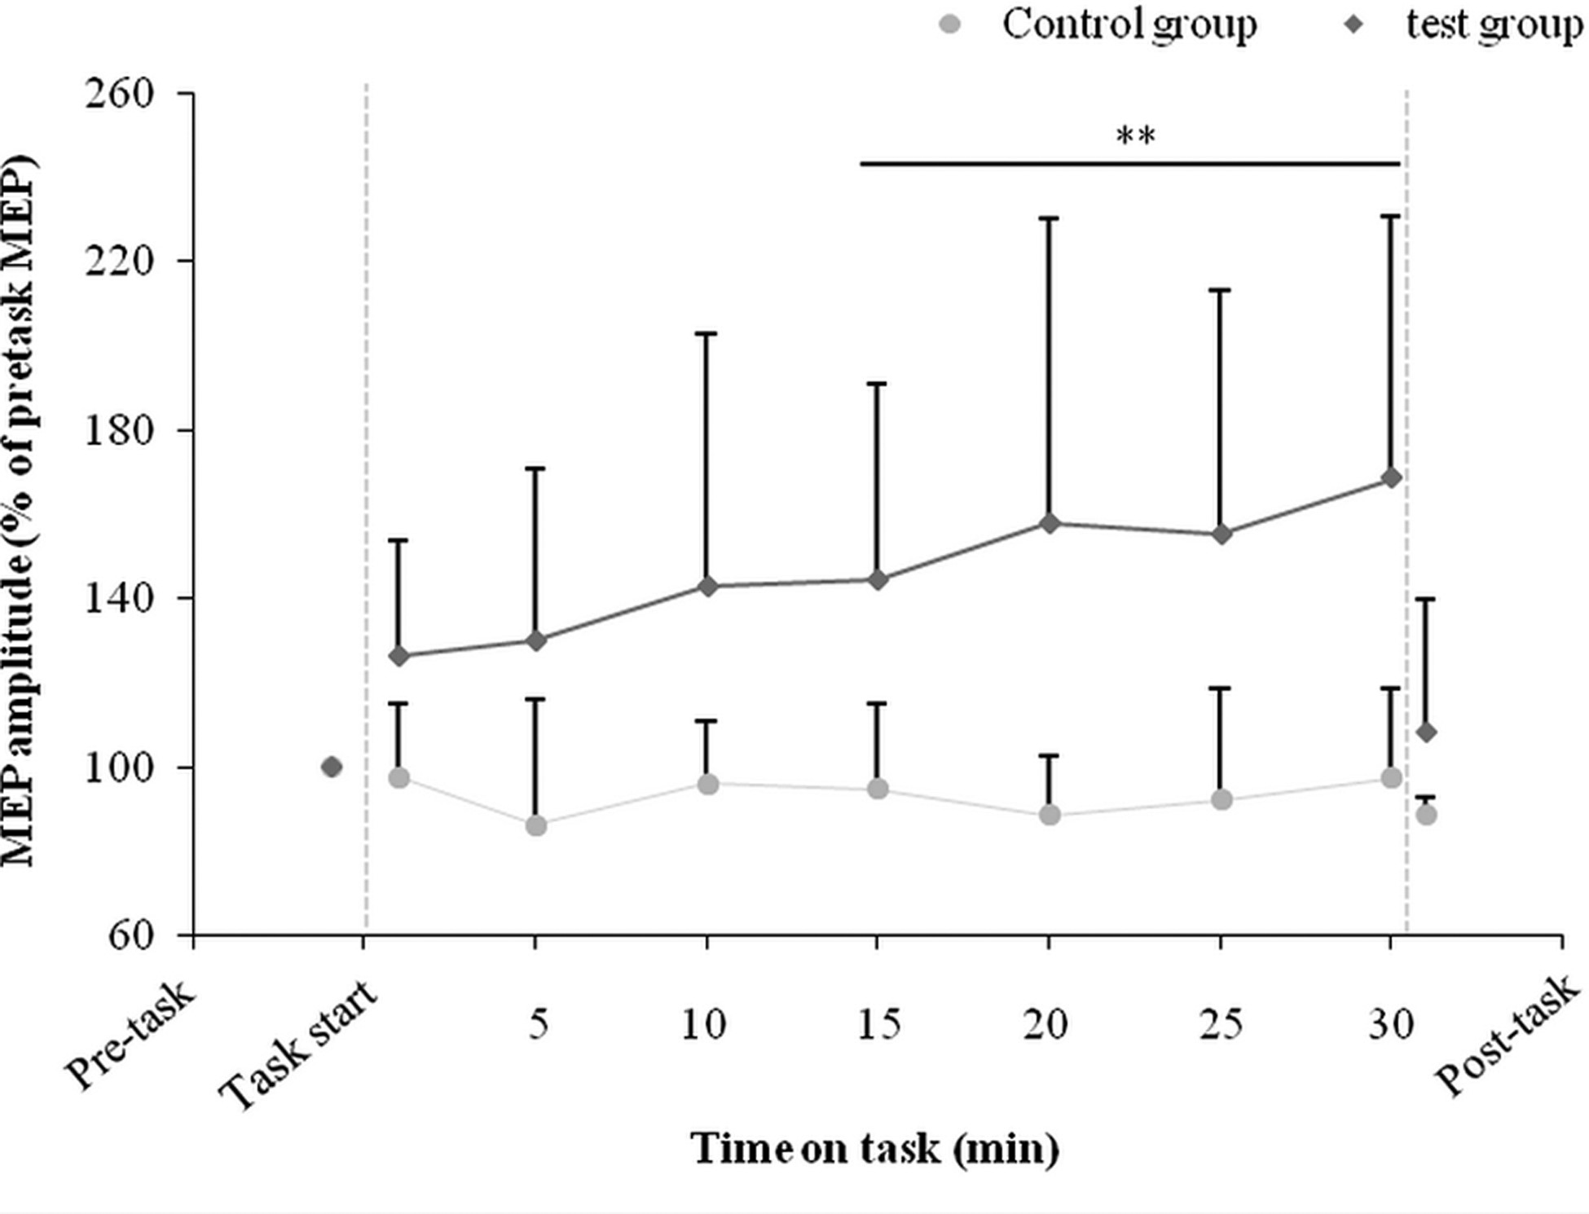
Figure 5. Evolution of the largest motor evoked potential (MEP) amplitude over time during a sustained attention RT ...
Notes:
Figure 5. Evolution of the largest motor evoked potential (MEP) amplitude over time during a sustained attention RT task of 30 min (experimental group) and at rest (control group). **P 0.05). This finding highlights a link between the act of sustaining attention and the rise in MEP amplitude. Vertical bars represent SD.
Unless provided in the caption above, the following copyright applies to the content of this slide: © The Author 2013. Published by Oxford University Press. All rights reserved. For Permissions, please e-mail: journals.permissions@oup.com

