Slide 1
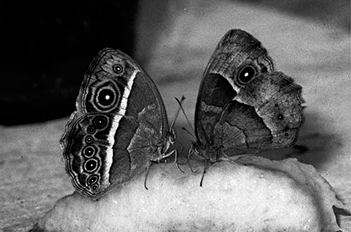
Figure 1. Seasonal polyphenism in Bicyclus safitza with butterflies of the wet-season form (WSF) and dry-season form ...
Notes:
Figure 1. Seasonal polyphenism in Bicyclus safitza with butterflies of the wet-season form (WSF) and dry-season form (DSF) to the left and right, respectively. The ventral wing surfaces are displayed whereas the butterflies are feeding on banana fruit. When resting inactively for a long time, butterflies of the DSF will withdraw their forewings a little between their hindwings, thus hiding the forewing posterior eyespot. These two butterflies are sisters. Although they are of similar genotype, they differ in wing pattern because, whereas the WSF individual was reared at 27 °C, its DSF sister was switched to a low temperature of 17 °C in the final larval instar before pupation. The dorsal wing surfaces do not differ between the seasonal forms.
Unless provided in the caption above, the following copyright applies to the content of this slide:

Slide 2
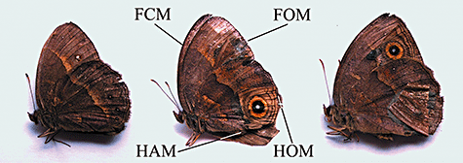
Figure 2. The three forms of the butterfly Bicyclus anynana used for the observations. On the left a specimen of the ...
Notes:
Figure 2. The three forms of the butterfly Bicyclus anynana used for the observations. On the left a specimen of the artificially selected Low line is shown with an extreme dry-season form pattern (DSF). The other specimens show manipulated butterflies with eyespots pasted on their wings: middle, hindwing spotted (HS) specimen; right, forewing spotted (FS) specimen. FCM, FOM, HAM, and HOM refer to wing margins, see text.
Unless provided in the caption above, the following copyright applies to the content of this slide:

Slide 3
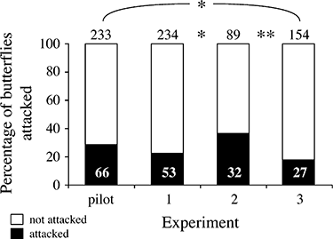
Figure 3. Numbers of Bicyclus anynana attacked by Anolis carolinensis lizards in each experiment expressed as a ...
Notes:
Figure 3. Numbers of Bicyclus anynana attacked by Anolis carolinensis lizards in each experiment expressed as a percentage of the total number offered. The numbers above the bars give the total numbers of butterflies used, and the numbers in the bars give the number attacked. *P < 0.05; **P < 0.01, from χ2-tests for comparisons between experiments.
Unless provided in the caption above, the following copyright applies to the content of this slide:

Slide 4
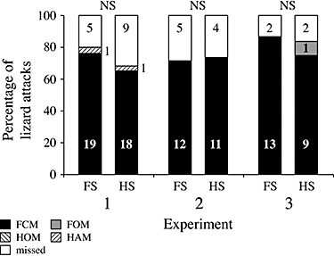
Figure 4. The locations on the wings at which Bicyclus anynana butterflies were attacked or grabbed by the lizard ...
Notes:
Figure 4. The locations on the wings at which Bicyclus anynana butterflies were attacked or grabbed by the lizard Anolis carolinensis in experiments 1, 2, and 3. The number to which each percentage corresponds is noted in the columns. FCM, FOM, HAM, and HOM refer to wing margins (see text); with FS and HS referring to the forewing spotted and hindwing spotted manipulated butterflies, respectively (Fig. 2). NS, not significant (χ2-test).
Unless provided in the caption above, the following copyright applies to the content of this slide:

