Slide 1
Table 1 Clinical differences between diarrhea due to Clostridium difficile infection (CDI) and antibiotic-associated ...
Notes:
Table 1 Clinical differences between diarrhea due to Clostridium difficile infection (CDI) and antibiotic-associated diarrhea (AAD) due to other causes.
Unless provided in the caption above, the following copyright applies to the content of this slide: © 2008 Infectious Diseases Society of America.

Slide 2
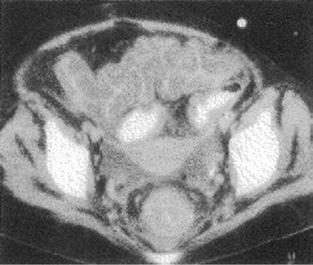
Figure 1 CT scan showing the “accordion sign.” Note the thickened, low attenuation of the colon wall suggestive of ...
Notes:
Figure 1 CT scan showing the “accordion sign.” Note the thickened, low attenuation of the colon wall suggestive of submucosal edema. This finding is seen in patients with pseudomembranous colitis but is also observed in patients with other inflammatory conditions involving the colon. Reproduced with permission from the following article published by the Radiological Society of North America: Kawamoto S, Horton KM, Fishman EK. Pseudomembranous colitis: spectrum of imaging findings with clinical and pathologic correlation. Radiographics 1999; 19:887–97.
Unless provided in the caption above, the following copyright applies to the content of this slide: © 2008 Infectious Diseases Society of America.

Slide 3
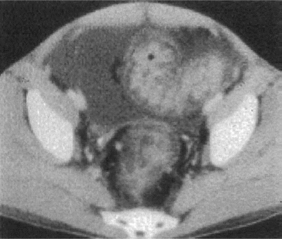
Figure 2 CT scan showing the “double-halo sign” suggestive of pseudomembranous colitis. Typical findings are 2 or 3 ...
Notes:
Figure 2 CT scan showing the “double-halo sign” suggestive of pseudomembranous colitis. Typical findings are 2 or 3 concentric rings with different attenuation, indicating submucosal hyperemia and submucosal edema. Reproduced with permission from the following article published by the Radiological Society of North America: Kawamoto S, Horton KM, Fishman EK. Pseudomembranous colitis: spectrum of imaging findings with clinical and pathologic correlation. Radiographics 1999; 19:887–97.
Unless provided in the caption above, the following copyright applies to the content of this slide: © 2008 Infectious Diseases Society of America.

