Slide 1
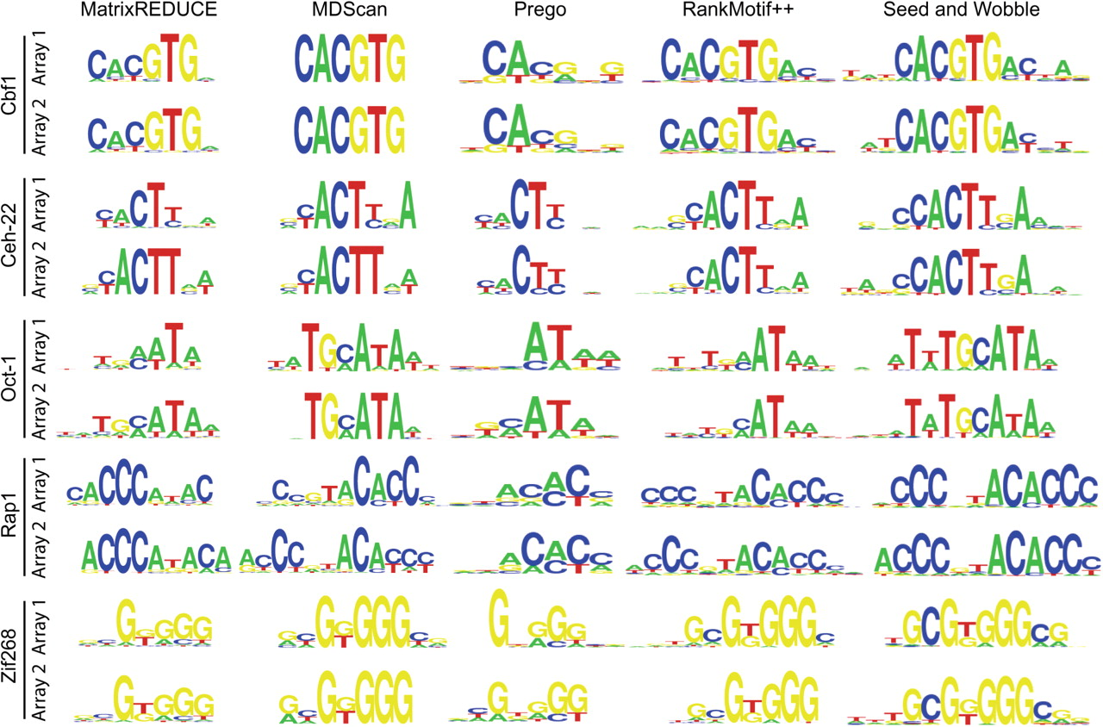
Fig. 1. Sequence logo representations of the PWMs generated by the five motif finding algorithms for the five TFs on ...
Notes:
Fig. 1. Sequence logo representations of the PWMs generated by the five motif finding algorithms for the five TFs on each of the two arrays.
Unless provided in the caption above, the following copyright applies to the content of this slide: © 2007 The Author(s)This is an Open Access article distributed under the terms of the Creative Commons Attribution Non-Commercial License (http://creativecommons.org/licenses/by-nc/2.0/uk/) which permits unrestricted non-commercial use, distribution, and reproduction in any medium, provided the original work is properly cited.

Slide 2
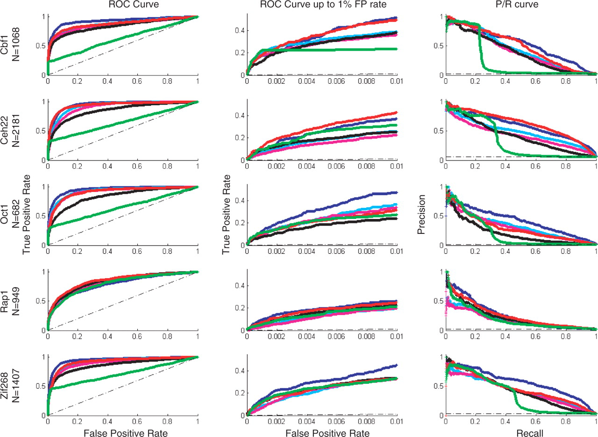
Fig. 2. The ROC curves and the Precision/Recall curves for array #1 for each of the six methods and each of the five ...
Notes:
Fig. 2. The ROC curves and the Precision/Recall curves for array #1 for each of the six methods and each of the five TFs.
Unless provided in the caption above, the following copyright applies to the content of this slide: © 2007 The Author(s)This is an Open Access article distributed under the terms of the Creative Commons Attribution Non-Commercial License (http://creativecommons.org/licenses/by-nc/2.0/uk/) which permits unrestricted non-commercial use, distribution, and reproduction in any medium, provided the original work is properly cited.

