Slide 1
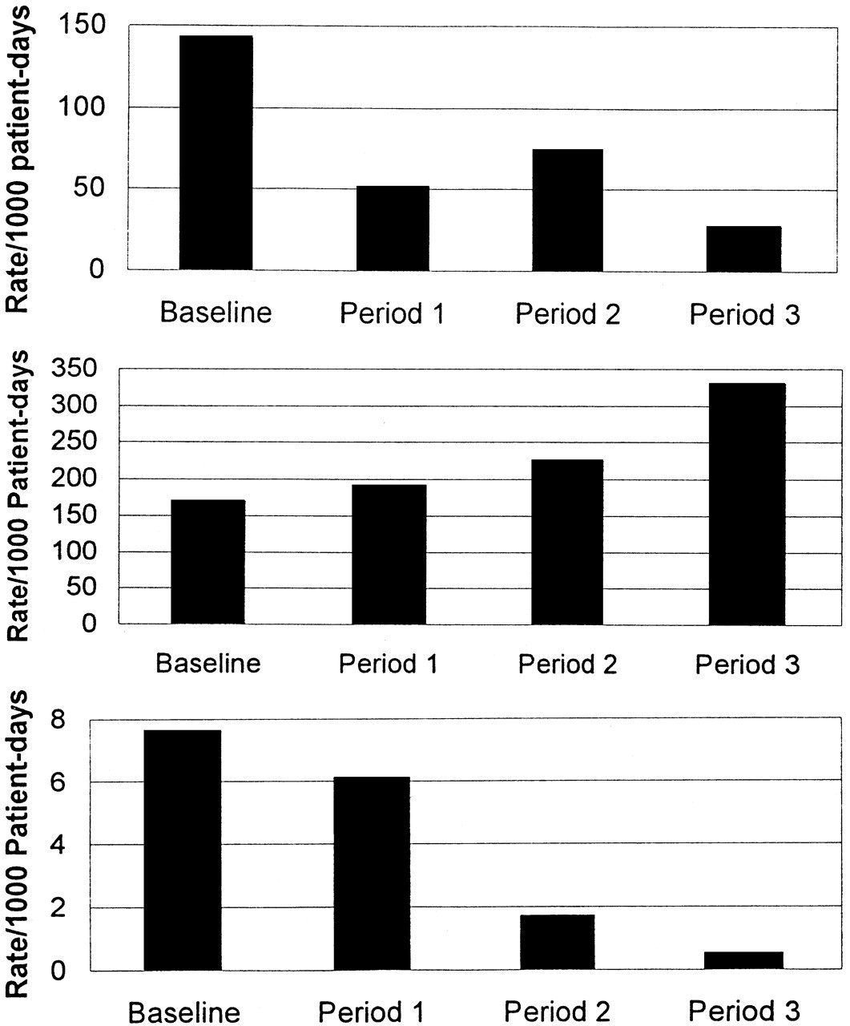
Figure 1 Event rates by period. Top, the non-missed-dose medication error rate per 1,000 patient-days, by period. This ...
Notes:
Figure 1 Event rates by period. Top, the non-missed-dose medication error rate per 1,000 patient-days, by period. This rate dropped 64 percent between baseline and period 1, then climbed 45 percent between periods 1 and 2, and finally fell 64 percent between periods 2 and 3; the overall decline was 81 percent (P < 0.0001). Middle, the missed dose error rate per 1,000 patient-days across periods, which climbed significantly during the study (P < 0.0001). Bottom, the non-intercepted serious medication error rate per 1,000 patient-days, which fell during the study (P = 0.0003). Non-intercepted serious medication errors were defined as either non-intercepted potential adverse drug events (ADEs) or preventable ADEs.
Unless provided in the caption above, the following copyright applies to the content of this slide: American Medical Informatics Association

