Slide 1
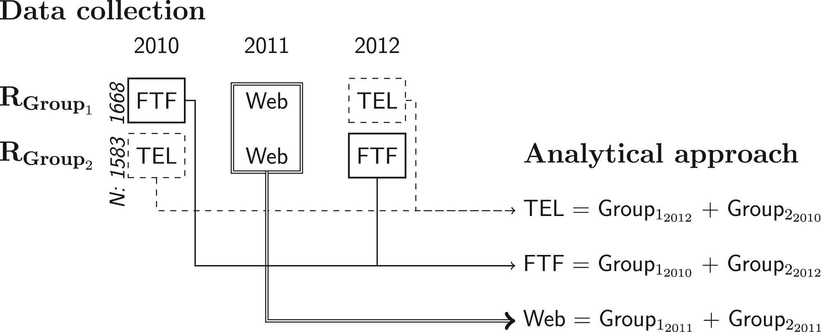
1 The Link Between the Quasi-Experimental Data Collection Design and Analysis Strategy.
Notes:
1 The Link Between the Quasi-Experimental Data Collection Design and Analysis Strategy.
Unless provided in the caption above, the following copyright applies to the content of this slide: © The Author 2016. Published by Oxford University Press on behalf of the American Association for Public Opinion Research. All rights reserved. For Permissions, please email: journals.permissions@oup.com

Slide 2
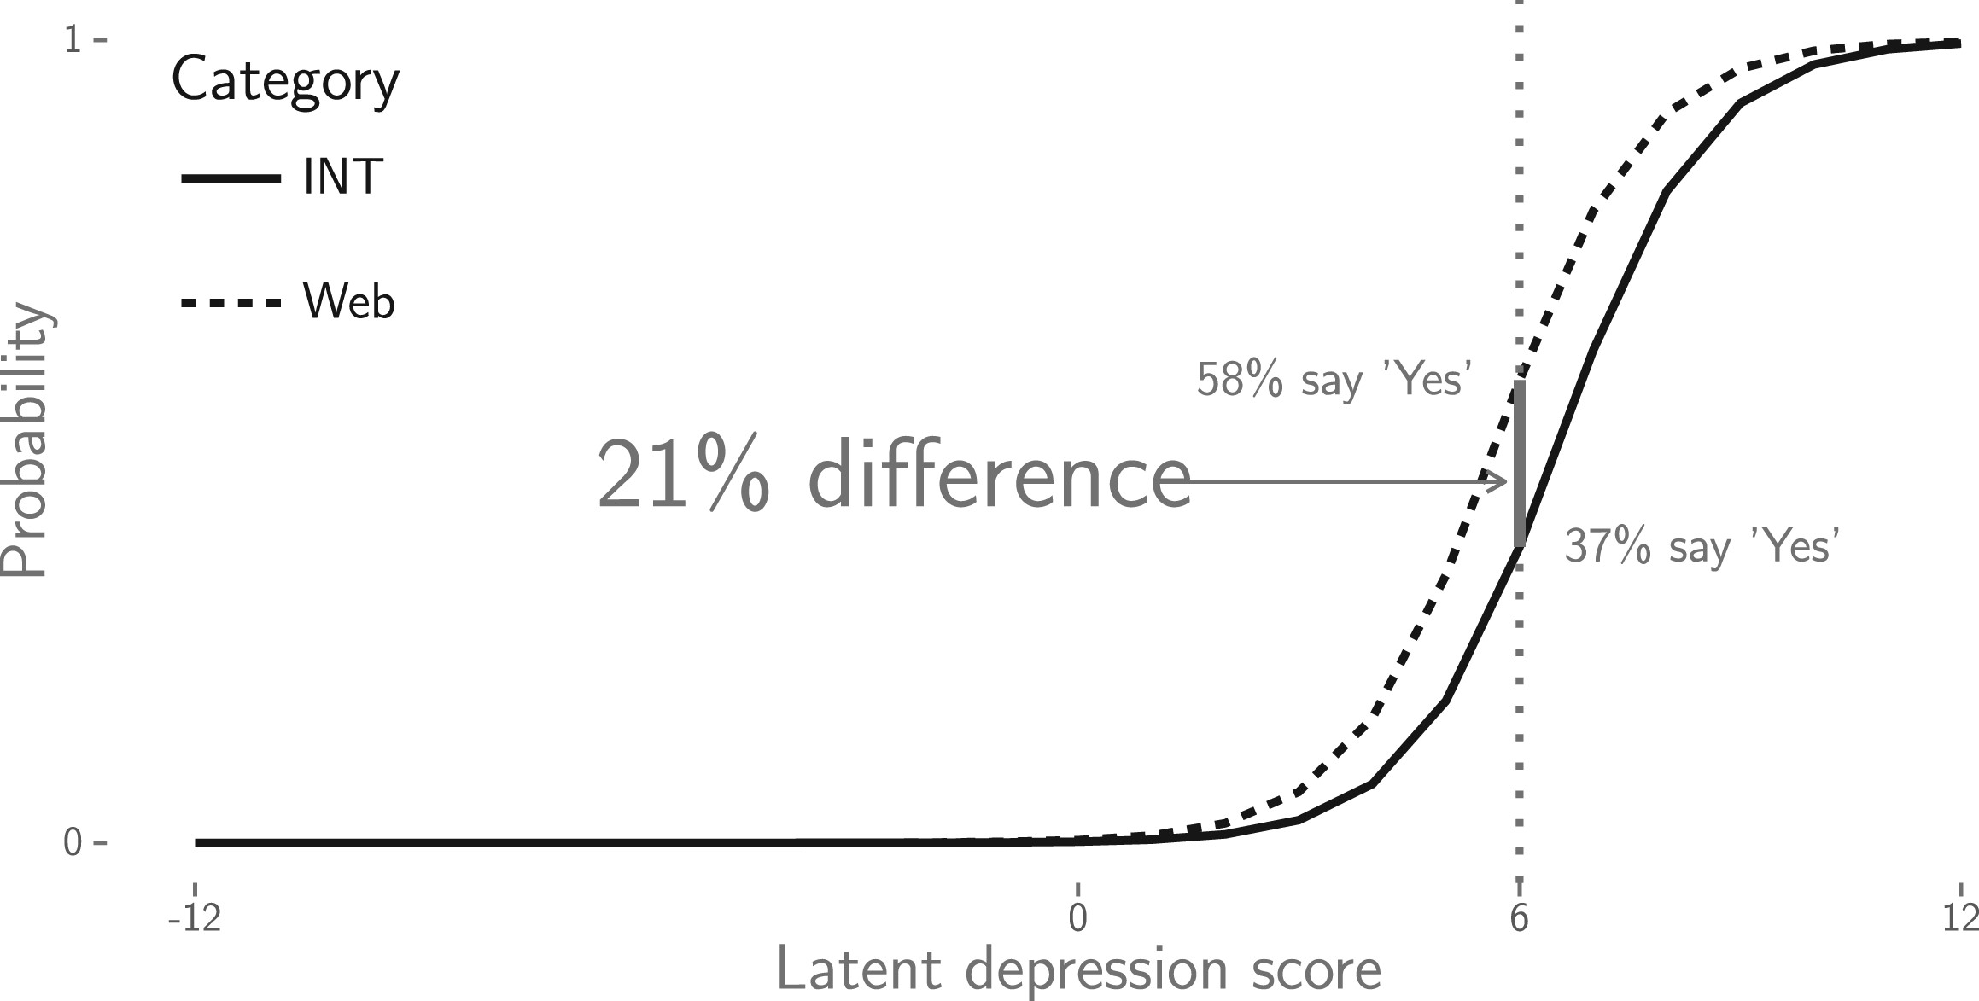
Figure 2. Item Characteristic Curves for Saying “Yes” to the Depressed Question, Interviewer Versus Web.
Notes:
Figure 2. Item Characteristic Curves for Saying “Yes” to the Depressed Question, Interviewer Versus Web.
Unless provided in the caption above, the following copyright applies to the content of this slide: © The Author 2016. Published by Oxford University Press on behalf of the American Association for Public Opinion Research. All rights reserved. For Permissions, please email: journals.permissions@oup.com

Slide 3
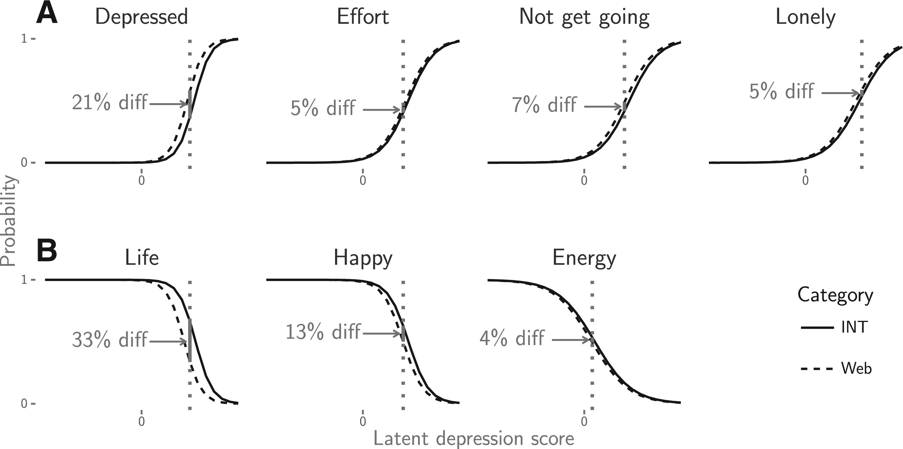
Figure 3. Item Characteristic Curves for “Yes” in the Significantly Nonequivalent CES-D Items, Interviewer Versus Web. ...
Notes:
Figure 3. Item Characteristic Curves for “Yes” in the Significantly Nonequivalent CES-D Items, Interviewer Versus Web. Largest difference between the groups is highlighted. First row items (A) are negatively worded, while second row ones (B) are positively worded.
Unless provided in the caption above, the following copyright applies to the content of this slide: © The Author 2016. Published by Oxford University Press on behalf of the American Association for Public Opinion Research. All rights reserved. For Permissions, please email: journals.permissions@oup.com

