Slide 1
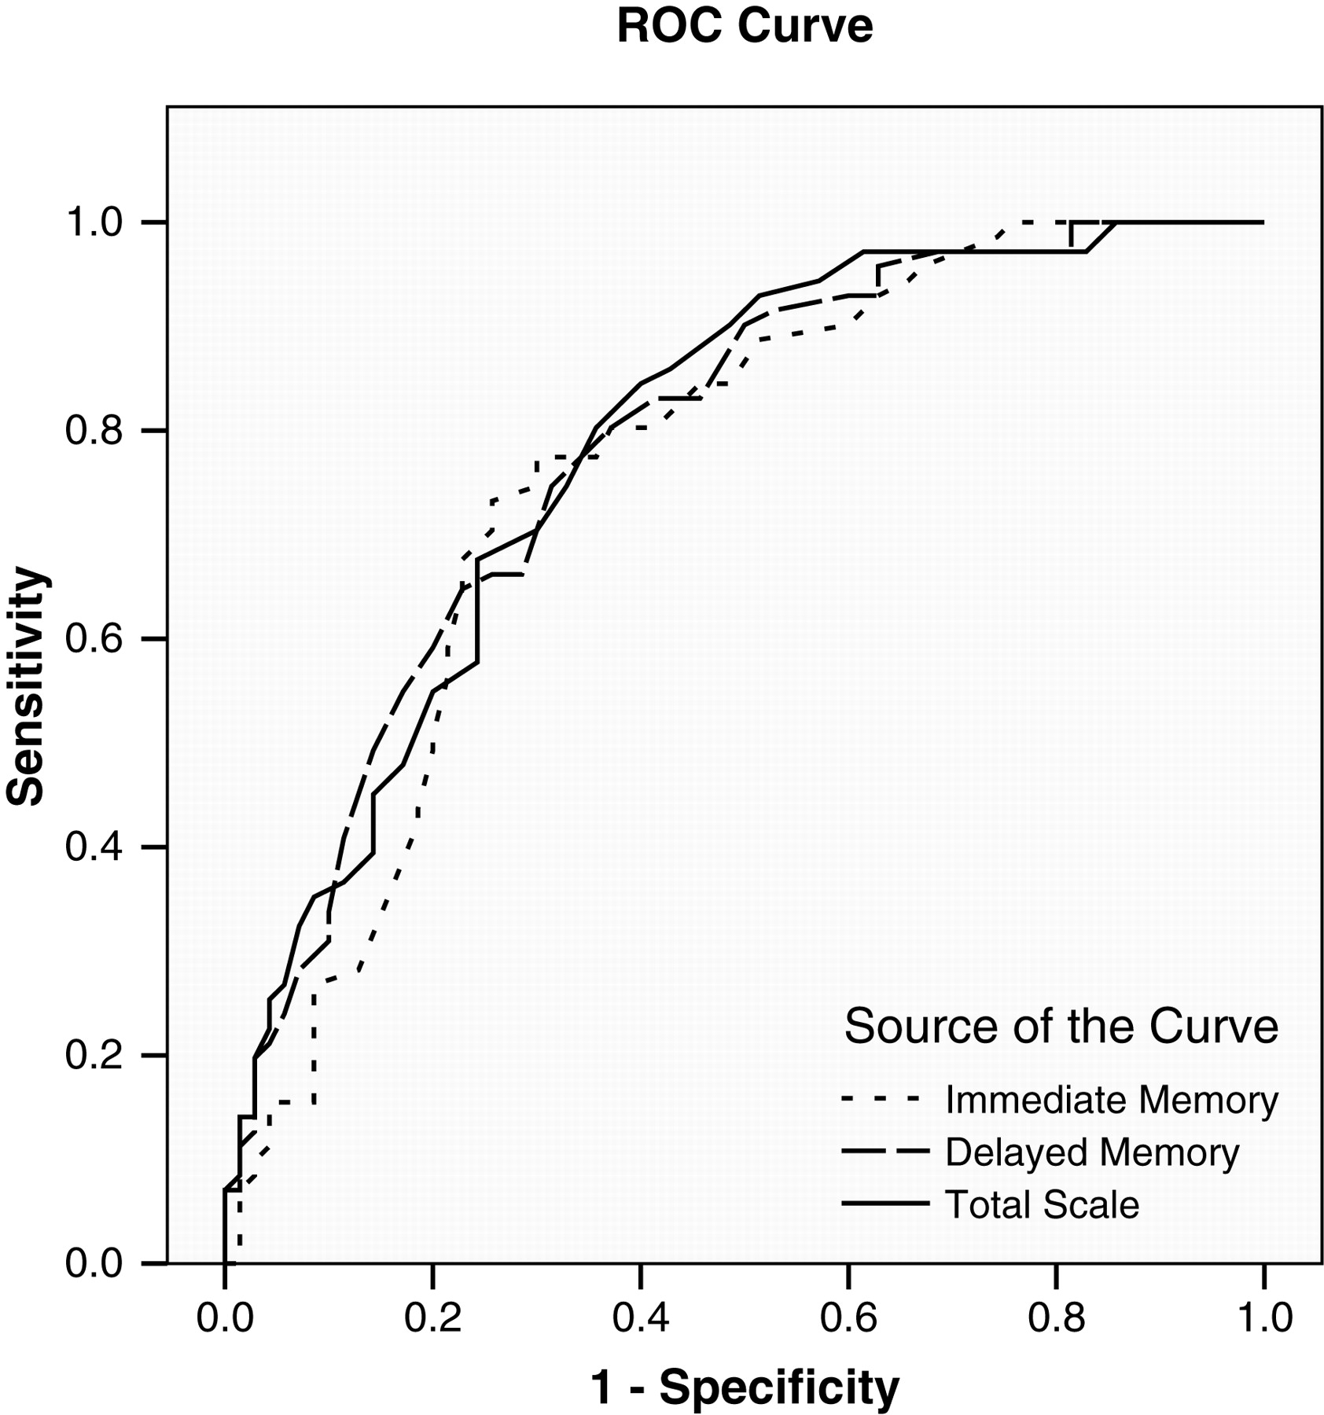
Fig. 1. ROC curves for selected RBANS Indexes. All RBANS Index scores are adjusted for age, education, and WRAT-3 ...
Notes:
Fig. 1. ROC curves for selected RBANS Indexes. All RBANS Index scores are adjusted for age, education, and WRAT-3 Reading scores.
Unless provided in the caption above, the following copyright applies to the content of this slide: © The Author 2010. Published by Oxford University Press. All rights reserved. For permissions, please e-mail: journals.permissions@oxfordjournals.org.

