Slide 1
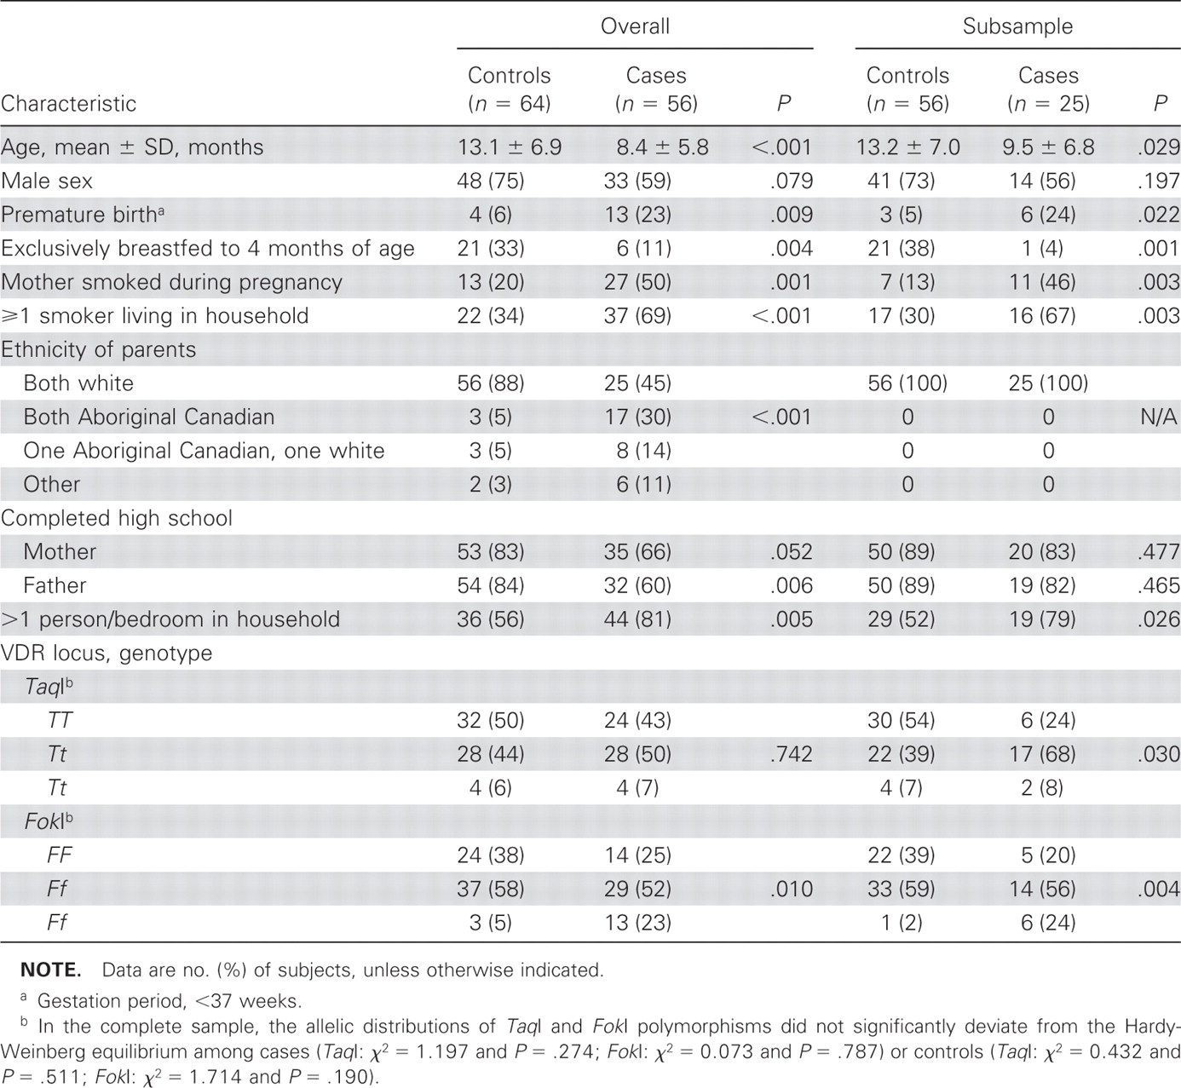
Table 1 Characteristics and vitamin D receptor (VDR) polymorphisms in healthy controls and in cases with acute lower ...
Notes:
Table 1 Characteristics and vitamin D receptor (VDR) polymorphisms in healthy controls and in cases with acute lower respiratory tract infection, overall and in a subsample with 2 white parents.
Unless provided in the caption above, the following copyright applies to the content of this slide: © 2008 by the Infectious Diseases Society of America

Slide 2
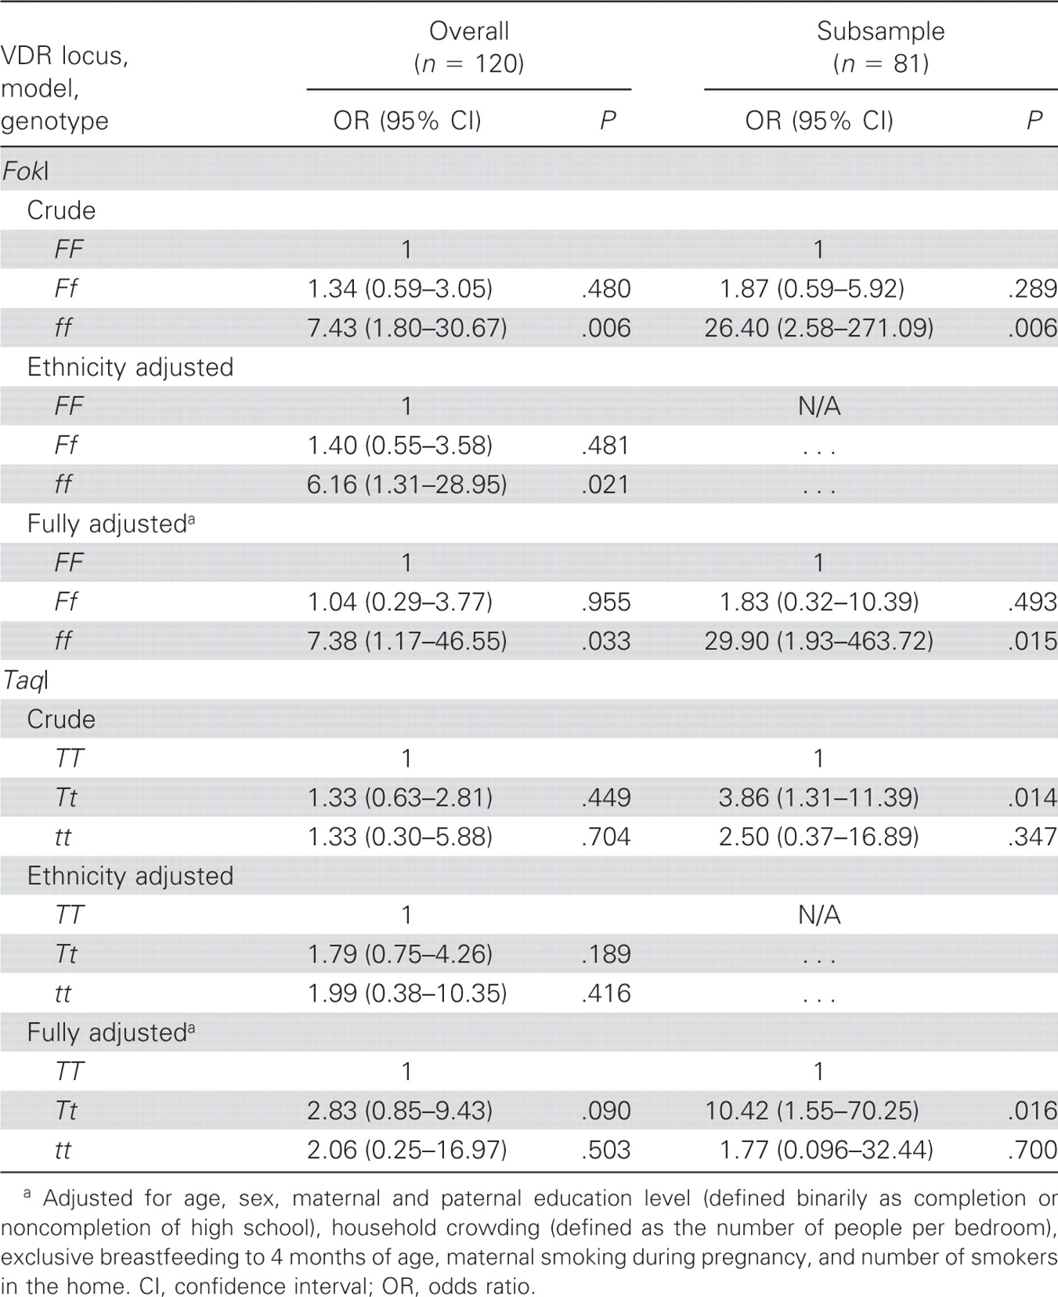
Table 2 Analysis of the association between vitamin D receptor (VDR) genotypes and the risk of acute lower ...
Notes:
Table 2 Analysis of the association between vitamin D receptor (VDR) genotypes and the risk of acute lower respiratory tract infection, overall and in a subsample of children with 2 white parents.
Unless provided in the caption above, the following copyright applies to the content of this slide: © 2008 by the Infectious Diseases Society of America

