Slide 1
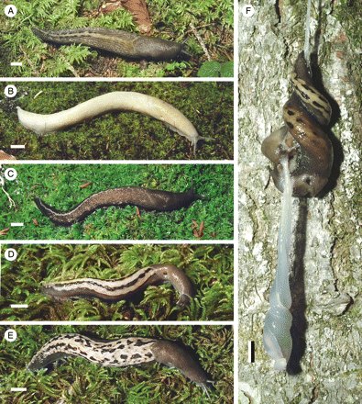
Figure 1. External appearance of living specimens of Limax sarnensis Heim & Nitz n. sp. A. Holotype NMLU 14200. B. ...
Notes:
Figure 1. External appearance of living specimens of Limax sarnensis Heim & Nitz n. sp. A. Holotype NMLU 14200. B. Brightly coloured specimen, paratype NMLU 14286. C. Dark specimen, NMLU 14228, Göschenertal, Switzerland. D. Striped specimen, NMLU 14260, Innertkirchen, Nessental, Switzerland. E. Spotted specimen, NMLU 14257, Innertkirchen, Nessental, Switzerland. F. Copulation, paratypes NMLU 14419/14420. Scale bars: A–F = 10 mm.
Unless provided in the caption above, the following copyright applies to the content of this slide: © The Author 2009. Published by Oxford University Press on behalf of The Malacological Society of London, all rights reserved

Slide 2
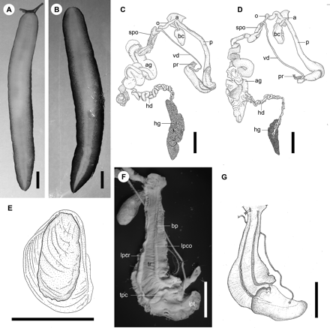
Figure 2. A, B. Sole coloration of living specimens of Limax sarnensis n. sp. A. Paratype NMLU 14419. B. Paratype NMLU ...
Notes:
Figure 2. A, B. Sole coloration of living specimens of Limax sarnensis n. sp. A. Paratype NMLU 14419. B. Paratype NMLU 14415. C, D. Genital anatomy. C. Paratype NMLU 13438. D. Specimen ZSM Mol 20071533, Poschiavo, Switzerland. E. Shell, paratype NMLU 13438. F, G. Penial interior, paratype NMLU 14282. Scale bars: A–G = 10 mm. Abbreviations: a, atrium; ag, albumen gland; bc, bursa copulatrix; hd, hermaphrodite duct; hg, hermaphrodite gland; ipt, interior penial tongue; lpco, longitudinal interior penial cord; lpcr, longitudinal interior penial crest; o, oviduct; p, penis; pr, penis retractor muscle; spo, spermoviduct; tr, transverse riblets; tpc, transverse penial crest; vd, vas deferens. Drawings C–E by R. Kühbandner.
Unless provided in the caption above, the following copyright applies to the content of this slide: © The Author 2009. Published by Oxford University Press on behalf of The Malacological Society of London, all rights reserved

Slide 3
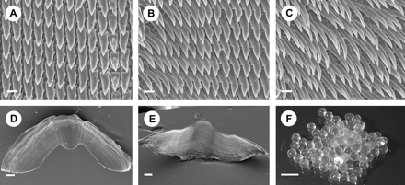
Figure 3. A–C. Radula, paratype NMLU 13438. A. Central and lateral teeth. B. Lateral and marginal teeth. C. Marginal ...
Notes:
Figure 3. A–C. Radula, paratype NMLU 13438. A. Central and lateral teeth. B. Lateral and marginal teeth. C. Marginal teeth. D, E. Jaw, specimen NMLU 14240, Canton Ticino, Switzerland. D. Lateral view. E. Dorsal view. F. Eggs of specimen NMLU 14231, Aosta valley, Italy. Scale bars: A–C = 20 µm; D, E = 200 µm; F = 10 mm.
Unless provided in the caption above, the following copyright applies to the content of this slide: © The Author 2009. Published by Oxford University Press on behalf of The Malacological Society of London, all rights reserved

Slide 4
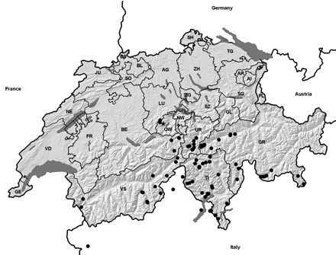
Figure 4. Map of localities. Type locality marked with a star. See Table 1 for details. Map provided by the Centre ...
Notes:
Figure 4. Map of localities. Type locality marked with a star. See Table 1 for details. Map provided by the Centre Suisse de Cartographie de la Faune (CSCF), Switzerland.
Unless provided in the caption above, the following copyright applies to the content of this slide: © The Author 2009. Published by Oxford University Press on behalf of The Malacological Society of London, all rights reserved

Slide 5
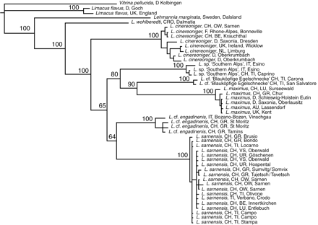
Figure 5. Majority-rule consensus tree from the Bayesian inference analysis of the COI sequence data. Posterior ...
Notes:
Figure 5. Majority-rule consensus tree from the Bayesian inference analysis of the COI sequence data. Posterior probabilities are marked above the branches.
Unless provided in the caption above, the following copyright applies to the content of this slide: © The Author 2009. Published by Oxford University Press on behalf of The Malacological Society of London, all rights reserved

