Slide 1
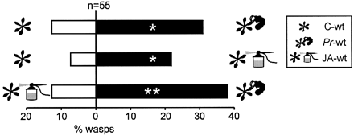
Fig. 1. Response of C. rubecula to jasmonic acid‐treated wild‐type Arabidopsis compared to P. rapae‐infested ...
Notes:
Fig. 1. Response of C. rubecula to jasmonic acid‐treated wild‐type Arabidopsis compared to P. rapae‐infested plants. In a two‐choice set‐up the response of naive C. rubecula females was tested to undamaged wild‐type plants (C‐wt), wild‐type plants infested with 15 first instar P. rapae caterpillars 24 h before an experiment (Pr‐wt), and wild‐type plants treated with a 1 mM jasmonic acid solution 24 h before an experiment (JA‐wt). The percentage of in total 55 wasps (this total includes the wasps not making a choice) per combination, choosing one odour source or the other, is shown. Asterisks indicate a significant difference within a choice test: **P<0.01, *P<0.05 (χ2‐test).
Unless provided in the caption above, the following copyright applies to the content of this slide:

Slide 2
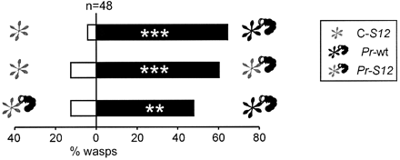
Fig. 2. Response of C. rubecula to P. rapae‐infested wild‐type and S12 transgenic Arabidopsis. In a ...
Notes:
Fig. 2. Response of C. rubecula to P. rapae‐infested wild‐type and S12 transgenic Arabidopsis. In a two‐choice set‐up the response of naive C. rubecula females was tested to undamaged S12 plants (C‐S12), wild‐type plants infested with five first instar P. rapae caterpillars 24 h before an experiment (Pr‐wt), and S12 plants infested with five first instar P. rapae caterpillars 24 h before an experiment (Pr‐S12). S12 plants do not accumulate jasmonic acid after wounding. The percentage of in total 48 wasps (this total includes the wasps not making a choice) per combination, choosing one odour source or the other, is shown. Asterisks indicate a significant difference within a choice test: ***P<0.001, **P<0.01 (χ2‐test).
Unless provided in the caption above, the following copyright applies to the content of this slide:

Slide 3
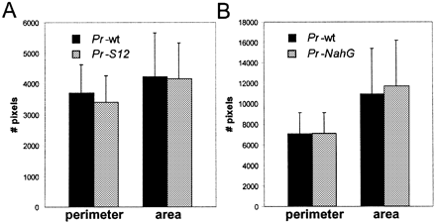
Fig. 3. Damage analysis of P. rapae‐infested wild‐type, S12 and NahG plants. Both the perimeter and the area ...
Notes:
Fig. 3. Damage analysis of P. rapae‐infested wild‐type, S12 and NahG plants. Both the perimeter and the area of damage inflicted by five first instar P. rapae larvae after 24 h of feeding on a single wild‐type or S12 plant were determined for in total 40 wild‐type and 40 S12 plants (A). Similarly, the damaged inflicted by 10 first instar P. rapae larvae after 24 h of feeding on a single wild‐type or NahG plant was determined for in total 27 wild‐type and 27 NahG plants (B). The average number of pixels with standard deviation is shown. There is no significant difference between wild‐type and S12 plants and between wild‐type and NahG plants, both for the perimeter and area of damage (P >0.05, two‐tailed Wilcoxon‐Mann‐Whitney ranking test).
Unless provided in the caption above, the following copyright applies to the content of this slide:

Slide 4
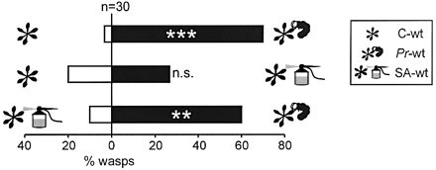
Fig. 4. Response of C. rubecula to salicylic acid‐treated wild‐type Arabidopsis compared to P. rapae‐infested ...
Notes:
Fig. 4. Response of C. rubecula to salicylic acid‐treated wild‐type Arabidopsis compared to P. rapae‐infested plants. In a two‐choice set‐up the response of naive C. rubecula females was tested to undamaged wild‐type plants (C‐wt), wild‐type plants infested with 20 first instar P. rapae caterpillars 24 h before an experiment (Pr‐wt), and wild‐type plants treated with a 5 mM salicylic acid solution 24 h before an experiment (SA‐wt). The percentage of in total 30 wasps (this total includes the wasps not making a choice) per combination, choosing one odour source or the other, is shown. Asterisks indicate a significant difference within a choice test: ***P <0.001, **P <0.01, n.s. = not significant (χ2‐test).
Unless provided in the caption above, the following copyright applies to the content of this slide:

Slide 5
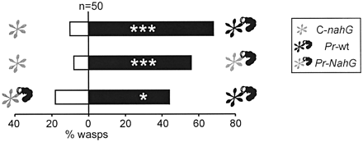
Fig. 5. Response of C. rubecula to P. rapae‐infested wild‐type and NahG transgenic plants. In a two‐choice ...
Notes:
Fig. 5. Response of C. rubecula to P. rapae‐infested wild‐type and NahG transgenic plants. In a two‐choice set‐up the response of naive C. rubecula females was tested to undamaged NahG plants (C‐NahG), wild‐type plants infested with five first instar P. rapae caterpillars 24 h before an experiment (Pr‐wt), and NahG plants infested with five first instar P. rapae caterpillars 24 h before an experiment (Pr‐NahG). NahG plants cannot accumulate salicylic acid. The percentage of in total 50 wasps (this total includes the wasps not making a choice) per combination, choosing one odour source or the other, is shown. Asterisks indicate a significant difference within a choice test: ***P <0.001, *P <0.05 (χ2‐test).
Unless provided in the caption above, the following copyright applies to the content of this slide:

