Slide 1
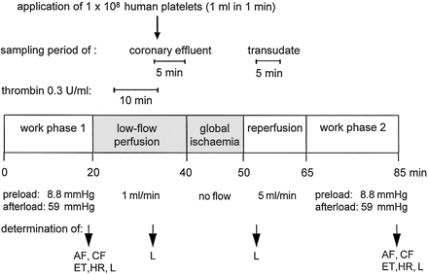
Fig. 1 Schematic presentation of the standard experimental protocol. Hearts performed volume–pressure work for 20 ...
Notes:
Fig. 1 Schematic presentation of the standard experimental protocol. Hearts performed volume–pressure work for 20 min each at the beginning and at the end of the protocol. After work phase W1, the coronary system was perfused at constant volume in a low-flow phase (1 ml/min), followed by a global ischaemia (no flow) and a reperfusion phase (5 ml/min). In the 15th min of the low-flow phase, a platelet bolus was applied (1 ml in 60 s, 100 000/μl perfusate). Coronary effluent and epicardial transudate were sampled during the periods indicated in the figure. During low-flow perfusion, endothelium was temporarily stimulated with thrombin. AF, aortic flow; CF, coronary flow; ET, ejection time; HR, heart rate; L, effluent sample for lactate and pyruvate analysis.
Unless provided in the caption above, the following copyright applies to the content of this slide: Copyright © 1998, European Society of Cardiology

Slide 2
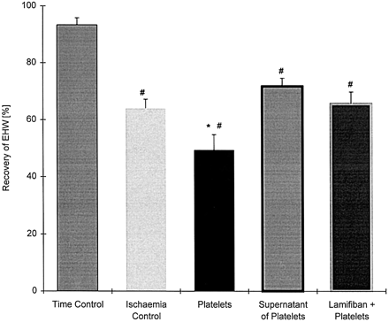
Fig. 2 Recovery of external heart work (EHW). The left column shows the time-control hearts which were not subjected ...
Notes:
Fig. 2 Recovery of external heart work (EHW). The left column shows the time-control hearts which were not subjected to ischaemia. The ischaemia-control group was subjected successively to low-flow and global ischaemia. After application of 108 washed platelets, recovery of EHW was significantly impaired, but not after infusion of supernatant of thrombin-stimulated platelets or of washed platelets in the presence of 1 μM lamifiban. *P<0.05 vs. all other groups; #P<0.05 vs. time-control group. Values are means±s.e.m., n=5–8.
Unless provided in the caption above, the following copyright applies to the content of this slide: Copyright © 1998, European Society of Cardiology

Slide 3
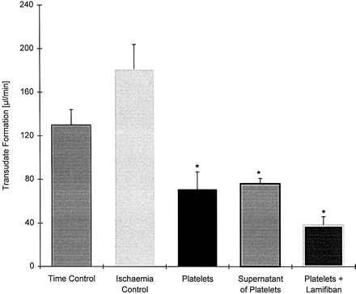
Fig. 3 Transudate (epicardial fluid) was collected from the apex of the heart over a 5-min period in the reperfusion ...
Notes:
Fig. 3 Transudate (epicardial fluid) was collected from the apex of the heart over a 5-min period in the reperfusion phase (6th–10th min). The time-controls were perfused at constant volume without inducing ischaemia. The ischaemia-control group was subjected to low-flow and global ischaemia. After application of either 108 washed platelets, the supernatant of 108 thrombin-stimulated platelets or 1 μM lamifiban plus 108 platelets in the low-flow phase the formation of transudate was significantly decreased in comparison to the ischaemia-control (*P<0.05). Values are means±s.e.m., n=5–8.
Unless provided in the caption above, the following copyright applies to the content of this slide: Copyright © 1998, European Society of Cardiology

Slide 4
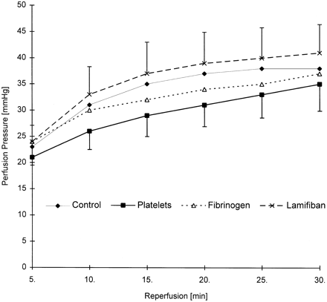
Fig. 5 Time course of coronary perfusion pressure (mmHg) in the extended reperfusion phase (30 min). A slight ...
Notes:
Fig. 5 Time course of coronary perfusion pressure (mmHg) in the extended reperfusion phase (30 min). A slight increase over the course of time is visible in all groups, but no statistically significant differences were detectable between groups. Values are means±s.e.m., n=6 per group.
Unless provided in the caption above, the following copyright applies to the content of this slide: Copyright © 1998, European Society of Cardiology

Slide 5
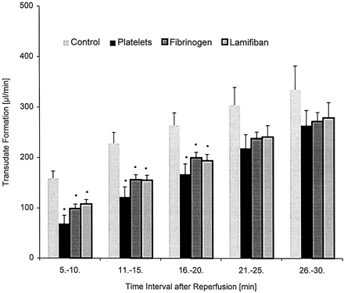
Fig. 4 Time course of transudate formation in the extended reperfusion phase (30 min). Transudate was sampled in ...
Notes:
Fig. 4 Time course of transudate formation in the extended reperfusion phase (30 min). Transudate was sampled in 5-min periods. Application of 108 washed platelets, fibrinogen (2 μM), or lamifiban (2 μM) in the low-flow phase reduced the production of transudate after reflow in a statistically significant and long-lasting manner. Values are means±s.e.m., n=6 per group. *P<0.05 vs. the control group.
Unless provided in the caption above, the following copyright applies to the content of this slide: Copyright © 1998, European Society of Cardiology

Slide 6
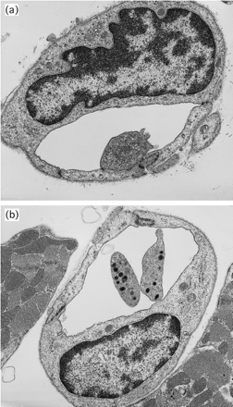
Fig. 6 Two sections of a guinea pig heart fixed after application of human platelets, as viewed by electron ...
Notes:
Fig. 6 Two sections of a guinea pig heart fixed after application of human platelets, as viewed by electron microscopy (1:17 700). One (A) and two (B) adherent platelets are located in a coronary capillary vessel surrounded by myocardium (B). The adherent human platelets still contain their α- and dense granula. No aggregate formation by platelets was visible.
Unless provided in the caption above, the following copyright applies to the content of this slide: Copyright © 1998, European Society of Cardiology

