Slide 1
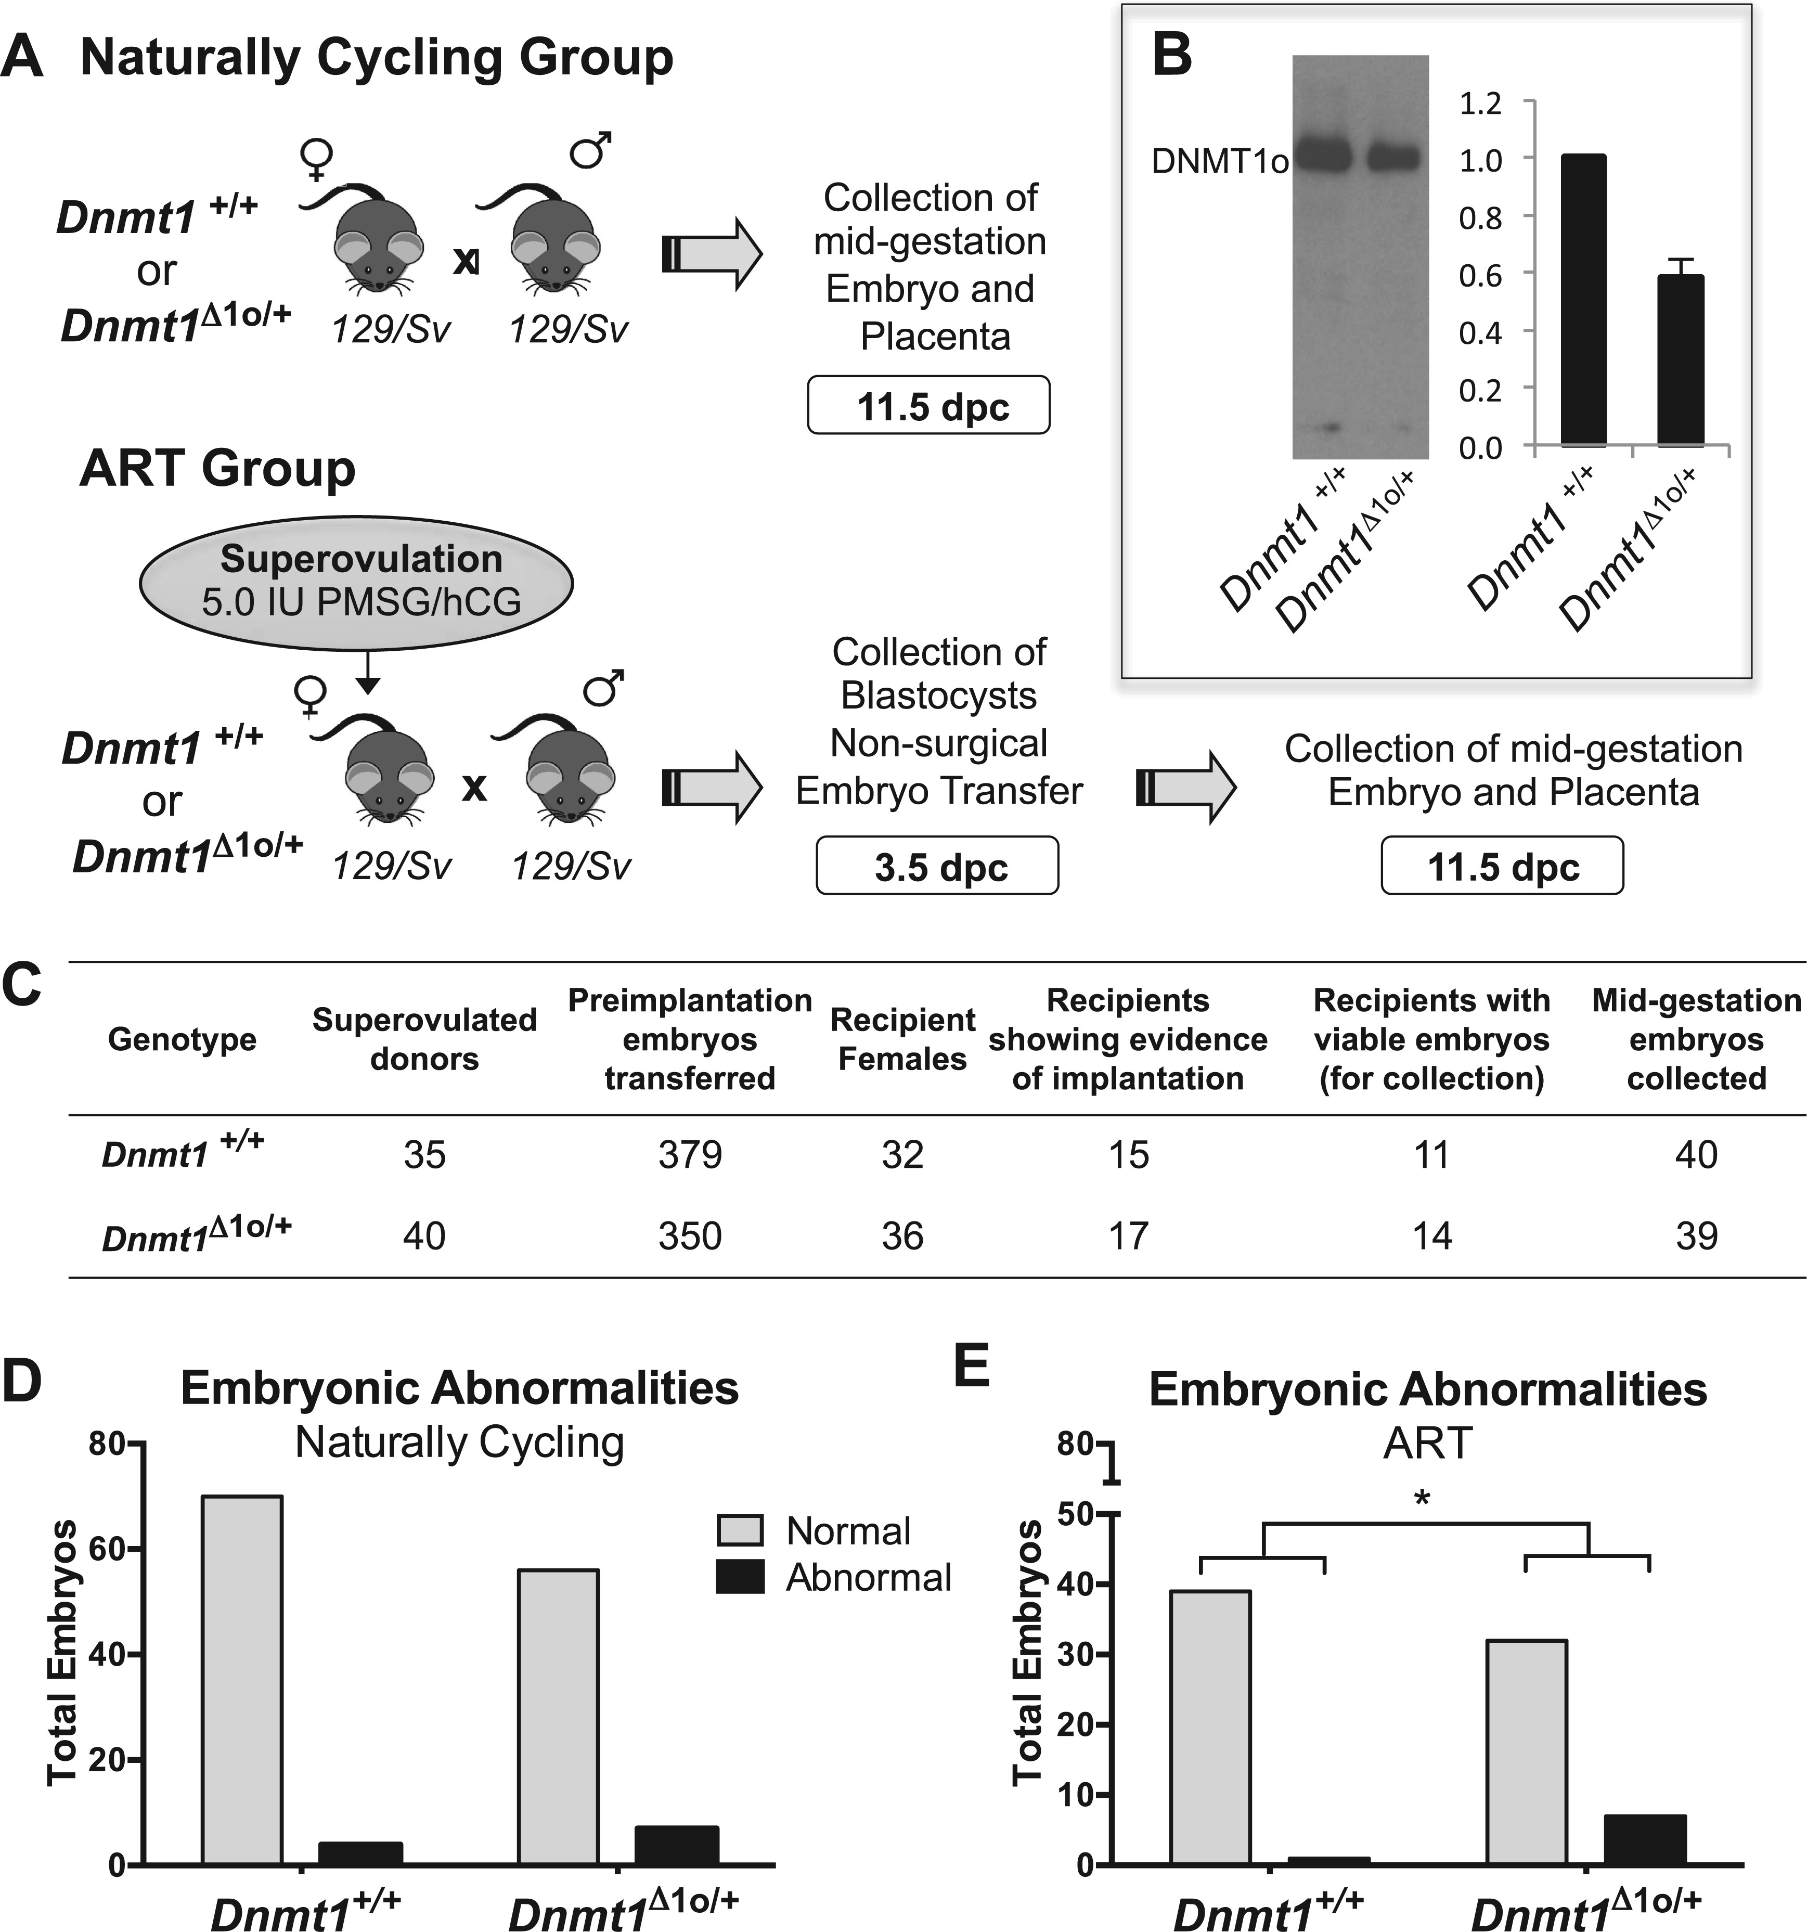
Figure 1. (A) Experimental design used to assess the effects of DNMT1o- deficiency on offspring development and ...
Notes:
Figure 1. (A) Experimental design used to assess the effects of DNMT1o- deficiency on offspring development and epigenetic patterning alone (Naturally Cycling group) and in combination with ART (ART group). Naturally cycling Dnmt1+/+ (wild type; WT) and Dnmt1Δ1o/+ females were mated to WT males and mid-gestation embryos and placentas were collected. In the ART group, WT and Dnmt1Δ1o/+ females were superovulated and mated to WT males. Embryos were collected at 3.5 dpc, transferred to recipient females and mid-gestation embryos and placentas were collected 8 days after embryo transfer (11.5 dpc). (B) On left: Representative Western blot comparing DNMT1o protein in oocytes from WT and Dnmt1Δ1o/+ females. On right: Relative amounts of DNMT1o protein are quantified (n = 5) (C) Summary of preimplantation embryo collections and transfers in the ART group. (D-E) DNMT1o deficiency in combination with ART results in an increased proportion of abnormal embryos. Numbers of normal and abnormal embryos collected from (D) Naturally Cycling litters (n = 12–13 litters, 63–74 embryos/group) and (E) ART litters (n = 11–14 litters, 39–40 embryos/group). Mean ± SEM are shown. *depicts an increased proportion of abnormal embryos in the ART/Dnmt1Δ1o/+ group as compared to the ART/WT group, P < 0.05 by Fisher Exact test.
Unless provided in the caption above, the following copyright applies to the content of this slide: © The Author 2016. Published by Oxford University Press. All rights reserved. For Permissions, please email: journals.permissions@oup.com

Slide 2
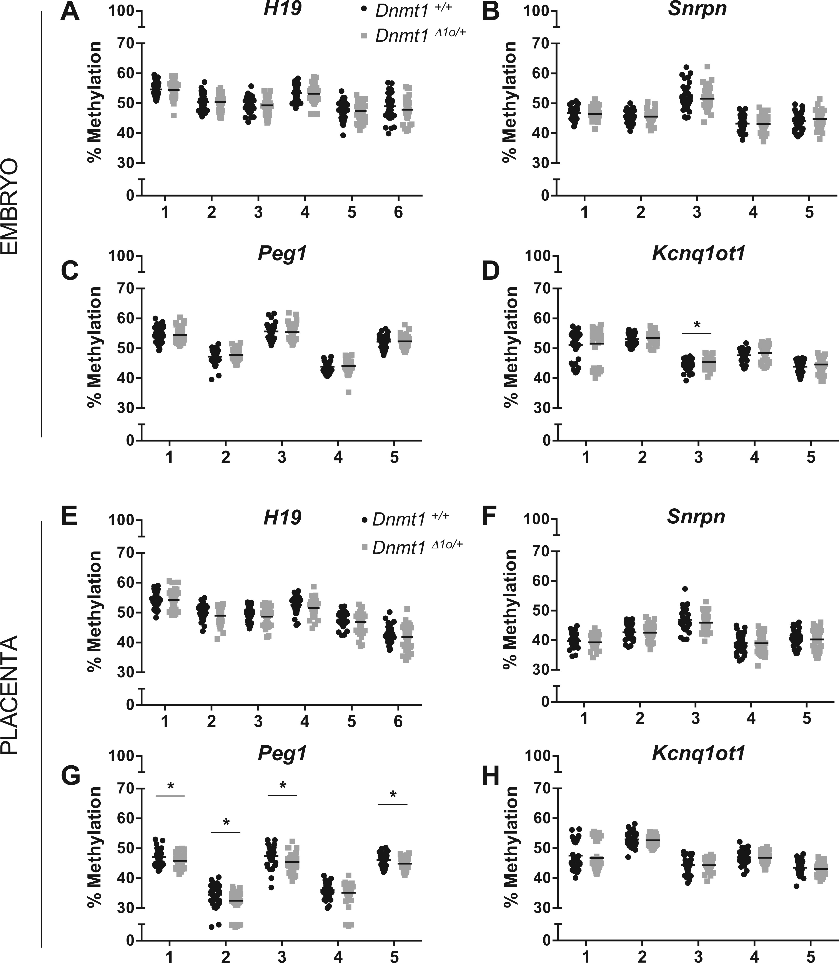
Figure 2. Placenta exhibits increased susceptibility to imprinting abnormalities than embryo proper in ART group. ...
Notes:
Figure 2. Placenta exhibits increased susceptibility to imprinting abnormalities than embryo proper in ART group. Quantitative DNA methylation analysis of differentially methylated regions in imprinted genes in ART group embryonic and placental tissues. Methylation values of individual CpG sites are shown for all collected ART group embryos (A–D) and placentas (E-H) for paternally methylated H19 (A, E; 6 CpG sites), and maternally methylated Snrpn (B, F), Peg1 (C, G) and Kcnq1ot1 (D, H) (5 CpG sites each), assessed by bisulfite pyrosequencing. Each point represents the methylation value for individual embryos (n = 37–40 embryos/genotype) or placentas (n = 37–40 embryos/genotype). *P < 0.05 by t-test (using the Holm-Sidak method for multiple comparison correction). For H19 in placenta there was a significant difference in variance across all CpGs in the examined region, P < 0.01 by unpaired t-test.
Unless provided in the caption above, the following copyright applies to the content of this slide: © The Author 2016. Published by Oxford University Press. All rights reserved. For Permissions, please email: journals.permissions@oup.com

Slide 3
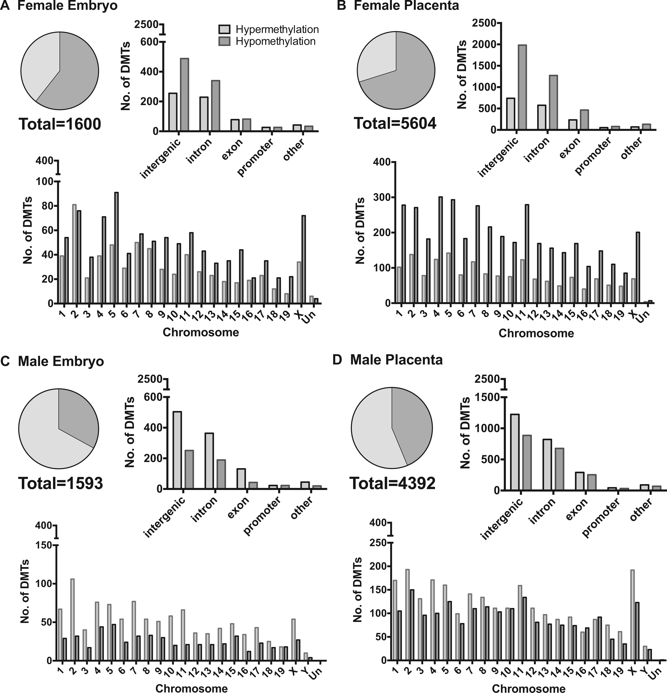
Figure 3. Following ART, RRBS reveals sex-specific genome-wide DNA methylation changes with an increased placental ...
Notes:
Figure 3. Following ART, RRBS reveals sex-specific genome-wide DNA methylation changes with an increased placental sensitivity to DNMT1o-deficiency. Genome-wide DNA methylation analysis of embryonic and placental tissues in the ART group. Genome-wide distributions of Differentially Methylated Tiles (DMTs) between genotypes are shown for (A) female embryo, (B) female placenta, (C) male embryo and (D) male placenta derived from superovulated donor females (n = 5/genotype for each comparison). Inclusion criteria for RRBS DMT analysis include a minimum 10-fold coverage, 10% cut-off for differential methylation between genotypes, and a minimum 2 CpGs per 100-base pair tile. Distribution of gain of methylation (hypermethylated tiles) and loss of methylation (hypomethylated tiles) are shown globally, across the various genomic regions, and across chromosomes.
Unless provided in the caption above, the following copyright applies to the content of this slide: © The Author 2016. Published by Oxford University Press. All rights reserved. For Permissions, please email: journals.permissions@oup.com

Slide 4
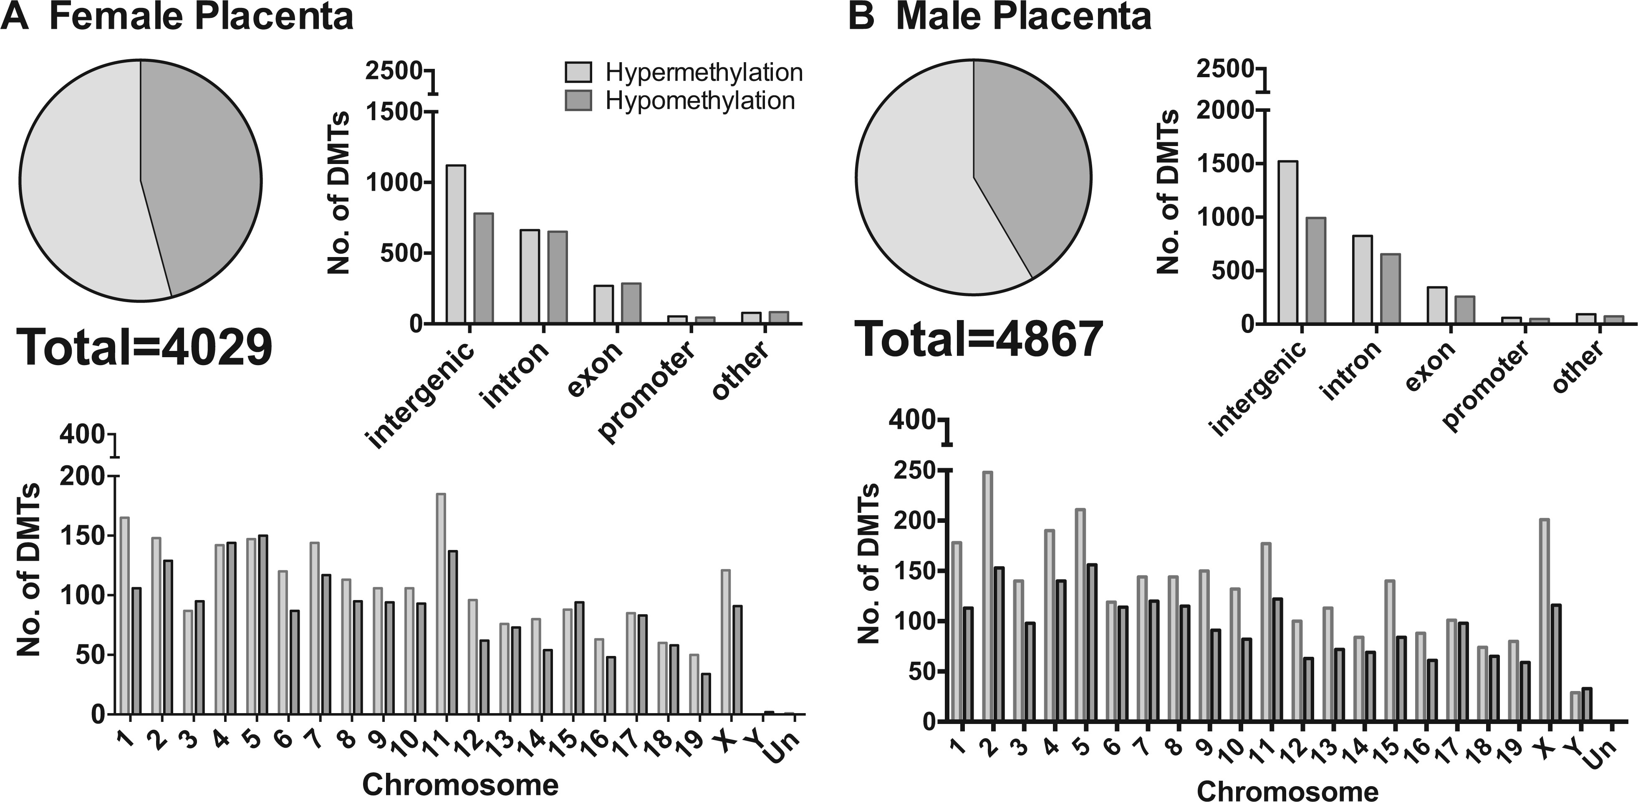
Figure 4. Genome-wide methylation analyses of NAT placenta reveal genome-wide methylation changes induced by ...
Notes:
Figure 4. Genome-wide methylation analyses of NAT placenta reveal genome-wide methylation changes induced by DNMT1o-deficiency alone. Genome-wide DNA methylation analysis of placental tissues in Naturally Cycling group. Genome-wide distributions of Differentially Methylated Tiles (DMTs) between genotypes are shown for (A) female and (B) male placenta derived from Naturally Cycling females (n = 5/genotype for both male and female analyses). Details as described in Figure 3 legend.
Unless provided in the caption above, the following copyright applies to the content of this slide: © The Author 2016. Published by Oxford University Press. All rights reserved. For Permissions, please email: journals.permissions@oup.com

Slide 5
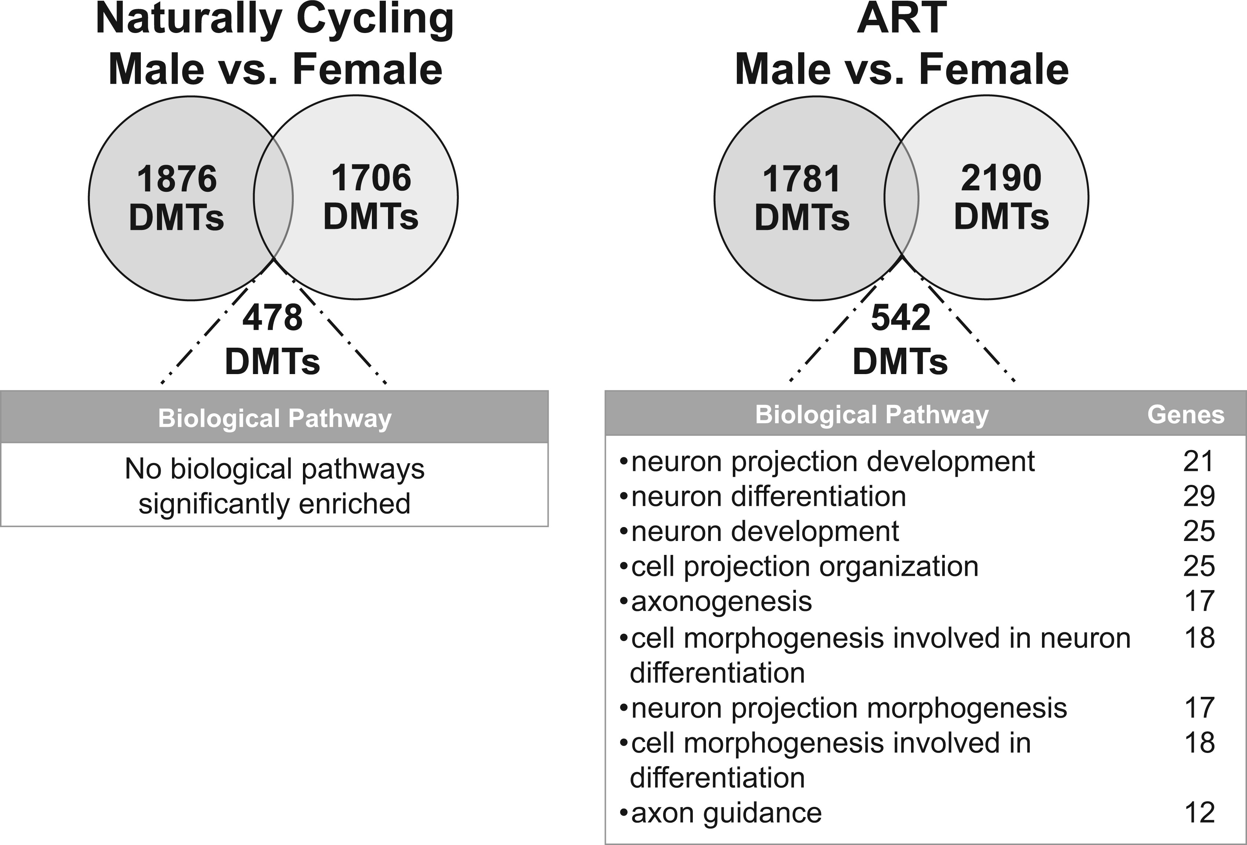
Figure 5. DAVID Pathway Analysis of conserved placental genic DMTs reveals an enrichment among neurodevelopmental ...
Notes:
Figure 5. DAVID Pathway Analysis of conserved placental genic DMTs reveals an enrichment among neurodevelopmental pathways only when maternal DNMT1o deficiency and ART are combined. Biological pathway analysis of conserved genes between male and female placental RRBS analyses. Pathways most significantly enriched by Benjamini-Hochberg corrected p-value are shown.
Unless provided in the caption above, the following copyright applies to the content of this slide: © The Author 2016. Published by Oxford University Press. All rights reserved. For Permissions, please email: journals.permissions@oup.com

