Slide 1
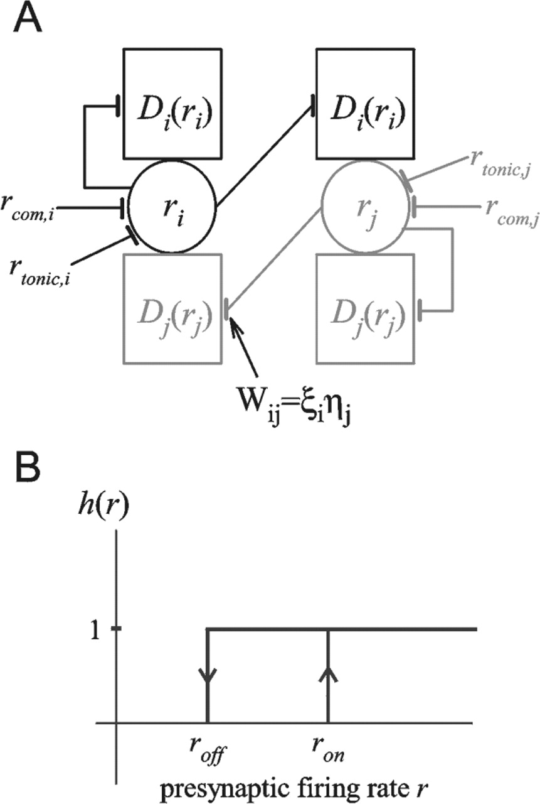
Figure 1. (A) Structure of the connections and inputs to the neurons in the analytic model network. Two of ...
Notes:
Figure 1. (A) Structure of the connections and inputs to the neurons in the analytic model network. Two of the N neurons in the network are shown. Neuron j projects to an identical dendritic compartment on every other neuron, characterized by the dendritic activation function Dj(rj). The contribution of this dendritic compartment to postsynaptic neuron i’s firing rate is WijDj(rj). Neuron i’s firing rate also reflects contributions from tonic input, rton,i, and command input, rcom,i. (B) The hysteretic steady-state activation relation of a bistable dendrite receiving input from a presynaptic neuron that fires at rate r.
Unless provided in the caption above, the following copyright applies to the content of this slide:

Slide 2
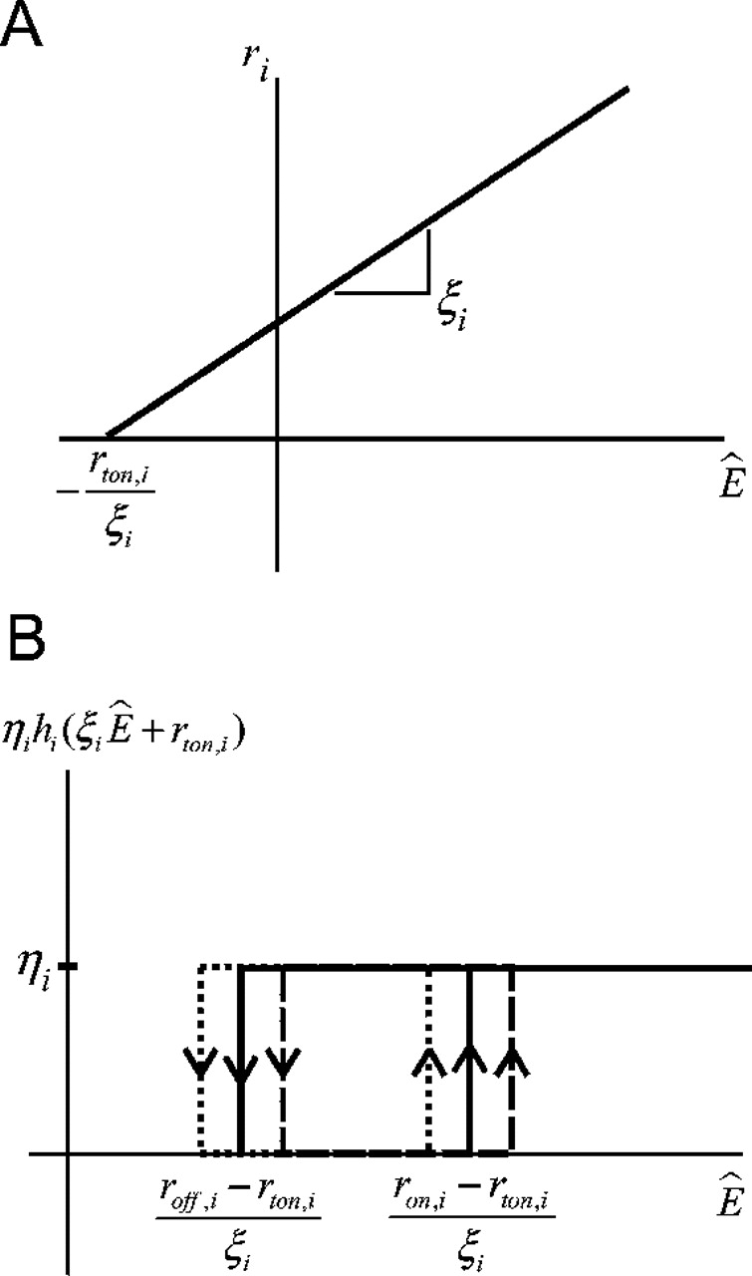
Figure 2. (A) Firing rate as a function of for a neuron with tonic background firing rate ...
Notes:
Figure 2. (A) Firing rate as a function of for a neuron with tonic background firing rate rton,i and with sensitivity to dendritic activation ζi. (B) Contribution to of the dendrites to which three neurons project. The weighted steady-state activations ηihi(ri) for each of these dendrites (solid, dashed and dotted lines) are plotted as a function of . The ‘on’ and ‘off’ thresholds as a function of are labeled for one dendrite (solid line).
Unless provided in the caption above, the following copyright applies to the content of this slide:

Slide 3
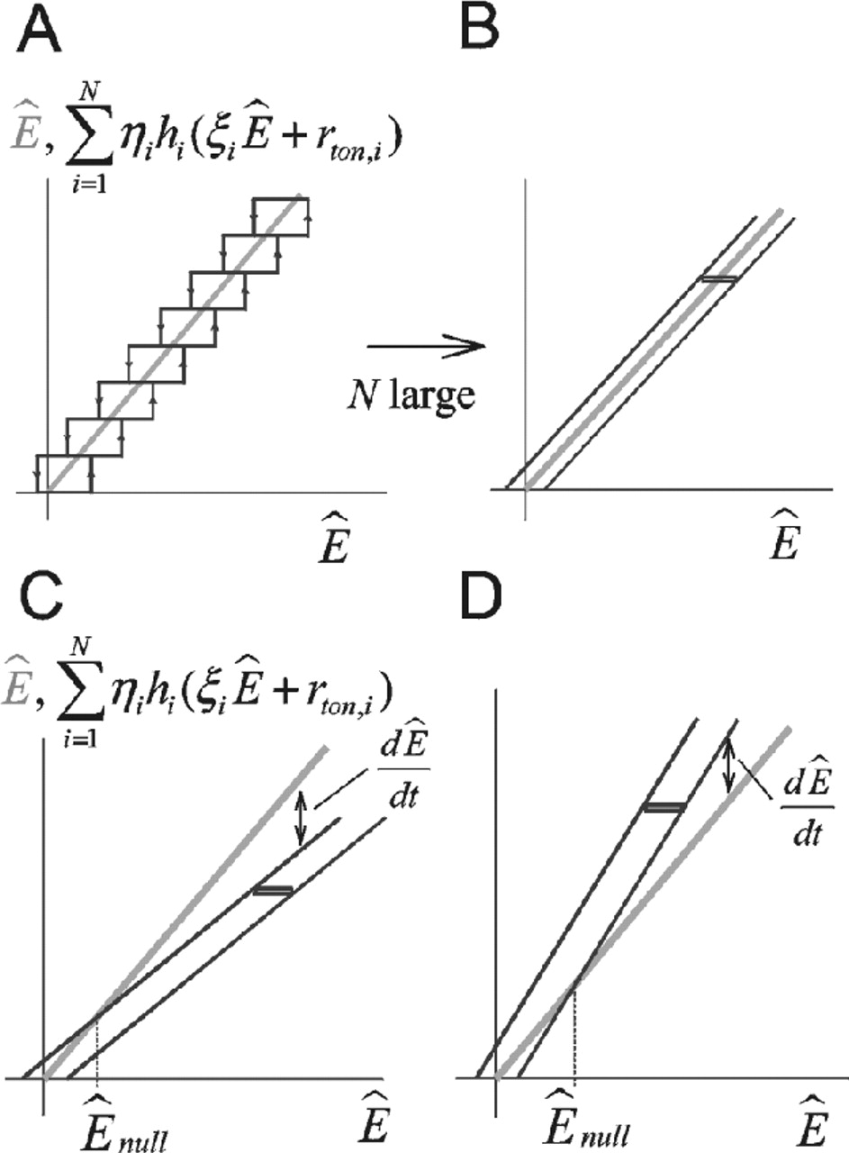
Figure 3. Graphical analysis of eye fixations. (A) Decay (gray line) and positive feedback (black hysteretic ...
Notes:
Figure 3. Graphical analysis of eye fixations. (A) Decay (gray line) and positive feedback (black hysteretic loops) contributions to eye velocity (equation 5) during fixations (rcom,i = 0). Stable fixations can occur at any value for which the decay and positive feedback relations intersect. (B) In the limit of large N, the hysteretic loops form a nearly continuous positive feedback ‘band’. The contribution of one dendrite is highlighted (black rectangle). (C,D) Positive feedback bands for leaky (C) and unstable (D) integrators. Stable fixations can occur at eye positions up to for which the band encloses the line. When the band does not enclose the line, drifts with a velocity proportional to the difference between the line and the near side of the band.
Unless provided in the caption above, the following copyright applies to the content of this slide:

Slide 4
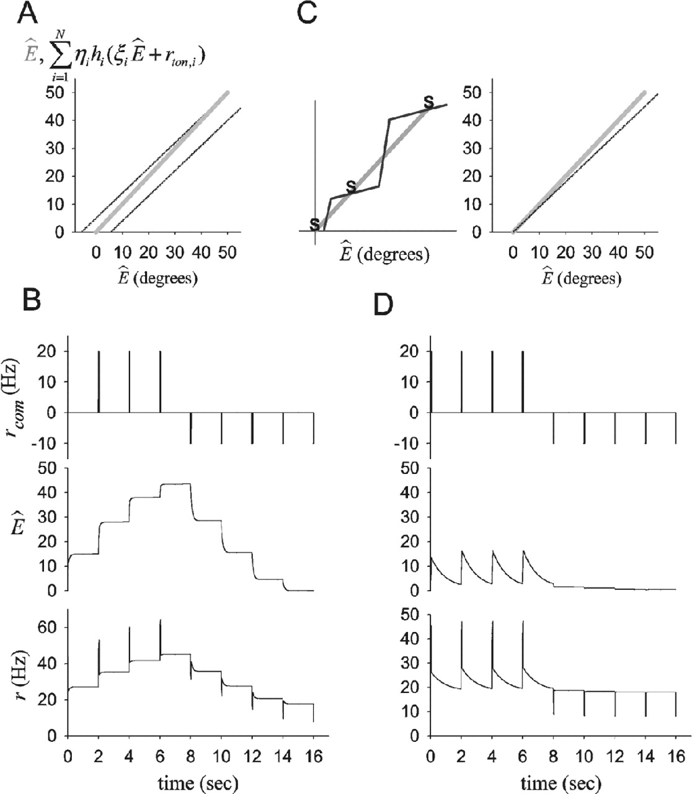
Figure 4. Hysteresis is the primary contributor to the robustness of stable fixations. (A) Decay line (gray) ...
Notes:
Figure 4. Hysteresis is the primary contributor to the robustness of stable fixations. (A) Decay line (gray) and positive feedback band (black) for a network of 100 neurons with hysteresis and coupling strengths W = ηζ decreased by 10% from W* (equation 15) for a network that tolerates ±10% mistuning. (B) The hysteretic network tolerates the 10% mistuning, producing stable firing rates over a quasi-continuous range of . Top, middle, and bottom panels, respectively, show the eye movement command received by each neuron, , and the firing rate of one neuron in the network as a function of time. (C) A recurrent excitatory network without hysteresis has a tradeoff between having a few discrete fixed points that are robust to mistuning (left, stable fixed points denoted by s) or a quasi-continuum of fixed points that are highly sensitive to mistuning (right, drawn for a 10% decrease of W from optimal). (D) The non-hysteretic network with band pictured in C (right) shows severe leak. Panels are as described in B. In all simulation figures, N = 100, where the maximum eye position = 50°, and the midpoint of the hysteretic rectangles = 35 Hz. ron and roff are chosen to set the tolerance to mistuning of the network according to equation 6 (for parallel-edge shaped bands) or equation 7 (for cone-shaped bands). Because the ηι are constant, uniform changes across the ζι determine the mistunings of W from W*. for the parallel-edge shaped bands. τdend= 100 ms in all figures except Figure 6.
Unless provided in the caption above, the following copyright applies to the content of this slide:

Slide 5
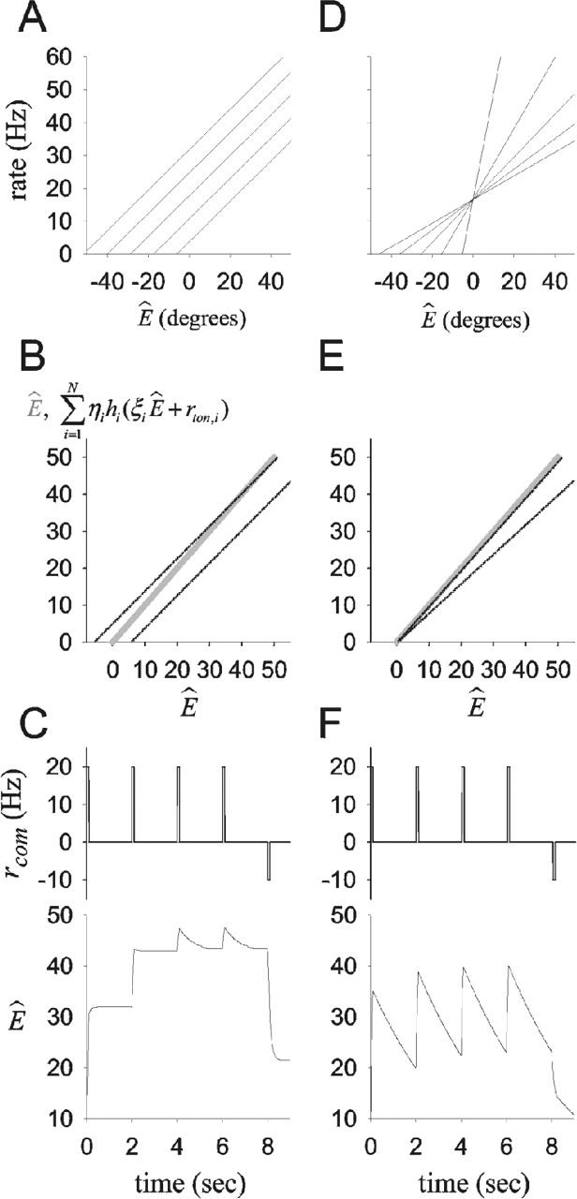
Figure 5. Relationship between firing rate versus relationships, shape of the band, and network behavior. ...
Notes:
Figure 5. Relationship between firing rate versus relationships, shape of the band, and network behavior. (A) Firing rate versus relationships of five neurons for a network with constant couplings Wij = ηζ and uniformly spaced rton,i. (B) Shape of the band for a network with firing rate relationships as depicted in A, and mistuning of weights by 12% for a band width that tolerates ±10% mistuning. (C) Performance for a leaky integrator with band shape as in B. decays rapidly towards a null position for > . (D) Firing rate versus relationships of five neurons for a network with constant rton,i = rton and staggered slopes where . (E) Shape of the band for a network with firing rate relationships as depicted in D, and mistuning of weights by 12% for a band width that tolerates ±10% mistuning. (F) Performance for a leaky integrator with band shape as in E. decays with a longer time constant than in C towards a null position = 0. For other parameter values, see caption of Figure 4.
Unless provided in the caption above, the following copyright applies to the content of this slide:

Slide 6
Figure 6. Dendritic hysteresis can lead to history dependence in rate–rate relationships. (A) Firing rates of ...
Notes:
Figure 6. Dendritic hysteresis can lead to history dependence in rate–rate relationships. (A) Firing rates of a low firing-rate threshold (top) and high firing-rate threshold (bottom) neuron in a well-tuned network with parallel-edge shaped band and with outer product form broken by having a linear dependence of the ‘on’ and ‘off’ dendritic-activation thresholds on the neuron’s firing-rate threshold. Parameters are as described in Figure 4 except that α=1, the son,i/α are equally spaced from 42 Hz for the lowest-threshold neuron down to 36 Hz for the highest firing-rate threshold neuron, and the soff,i/α are equally spaced from 28 Hz for the lowest firing-rate threshold neuron up to 34 Hz for the highest firing-rate threshold neuron. For the same value of firing rate of the low firing-rate threshold neuron (top, gray arrows), the high firing-rate threshold neuron has a relatively larger value following ON-direction saccades (bottom, gray arrows). Plots correspond to the 20th and 80th neurons in the network when neurons are ordered by firing-rate threshold. (B) Firing rates of the high firing-rate threshold neuron of panel A as a function of the low firing-rate threshold neuron’s firing rate following ON-direction (black) or OFF-direction (gray) saccades. Note the hysteretic relationship. (C) Qualitative explanation for ON–OFF hysteresis. Dendrites on the high firing-rate threshold neurons turn ‘on’ before those on the low firing-rate threshold neurons as the network activity increases (corresponding to firing rates and eye position increasing) and turn ‘off’ before those on the low firing-rate threshold neurons as the network activity decreases. This leads to relatively higher firing rates of the high firing-rate threshold neurons relative to the low firing-rate threshold neurons following ON-direction saccades and relatively lower rates following the OFF-direction saccades.
Unless provided in the caption above, the following copyright applies to the content of this slide:

Slide 7
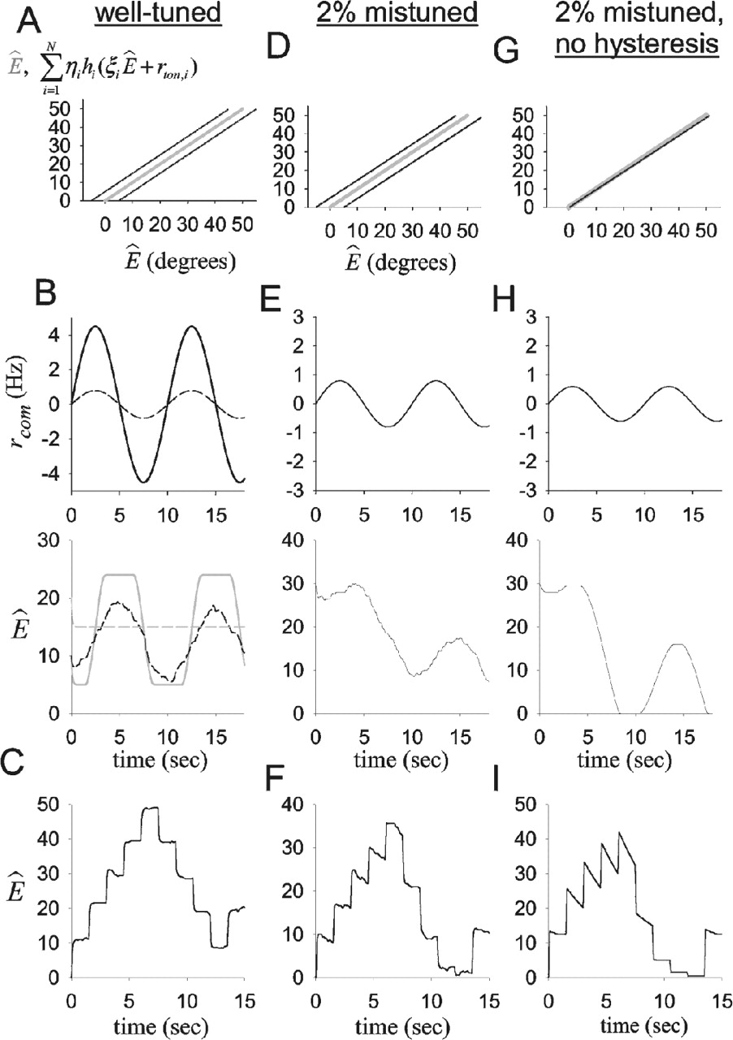
Figure 7. Performance of a network with dendritic hysteresis during the sinusoidal VOR. (A) Band shape for a ...
Notes:
Figure 7. Performance of a network with dendritic hysteresis during the sinusoidal VOR. (A) Band shape for a well-tuned network with band centered about the line. (B) The network response to 0.1 Hz sinusoidal input without noise shows a truncated sinusoidal behavior for larger input (A = 4.5 Hz, solid lines) and is unresponsive for smaller input (A = 0.8 Hz, top, dashed line; bottom, gray dashed line). With noise and the smaller (A = 0.8 Hz) input, the network is responsive throughout the sinusoidal cycle (bottom, black dashed line). σ = 4 Hz in all panels that include noise. (C) Fixations for the same amount of noise as in B. (D,G) Band shape for a network mistuned towards decay by 2% for a band width that produces stable fixations for ±10% mistuning of weights with noise (D) or for a non-hysteretic band and no noise (G). (E,H) The network response is more sensitive to negative velocity commands than to positive commands, causing to decay. The decay is less for the band with hysteresis (E; A = 0.8 Hz) than for one without (H; A = 0.6 Hz). (F,I) Fixations with hysteresis and noise show some decay (F) but less than is shown by the VOR (E) and much less than would occur in the absence of hysteresis (I). Saccadic amplitudes were set to give approximately equal ranges of eye position. Flat portions of traces in H and I reflect the effects of discreteness.
Unless provided in the caption above, the following copyright applies to the content of this slide:

Slide 8
Figure 8. Sources of non-uniqueness in the band structure. (A) When some dendritic hysteretic rectangles are ...
Notes:
Figure 8. Sources of non-uniqueness in the band structure. (A) When some dendritic hysteretic rectangles are wider than others (top two rectangles), the order of turning ‘on’ dendrites can be different from the order of turning ‘off’ dendrites. This can result in a different band structure for a given value of (dash on y-axis) depending on whether the input arrived at this value from a lower value of (top panel) or from a higher value (bottom panel). (B) When the input to a higher activation-threshold dendrite is greater than that to a lower activation-threshold dendrite (middle neurons of band), the higher activation-threshold dendrite may turn ‘on’ before the lower activation-threshold dendrite. Analogous behavior can occur for dendrites turning ‘off’.
Unless provided in the caption above, the following copyright applies to the content of this slide:

