Slide 1
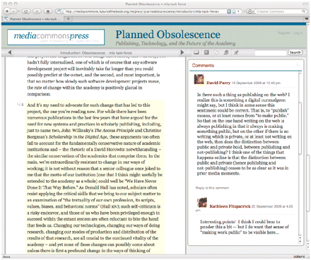
Fig. 1 Text and commentary from Fitzpatrick’s Planned Obsolescence as it appears in MediaCommons Press’s open-review ...
Notes:
Fig. 1 Text and commentary from Fitzpatrick’s Planned Obsolescence as it appears in MediaCommons Press’s open-review interface
Unless provided in the caption above, the following copyright applies to the content of this slide: © The Author 2010. Published by Oxford University Press on behalf of ALLC and ACH. All rights reserved. For Permissions, please email: journals.permissions@oxfordjournals.org

Slide 2
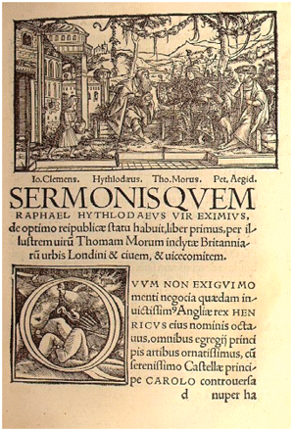
Fig. 2 The first page of Book 1 of the 1518 Utopia, featuring Holbein’s woodcut of the dialogue which frames the ...
Notes:
Fig. 2 The first page of Book 1 of the 1518 Utopia, featuring Holbein’s woodcut of the dialogue which frames the book (reproduced by permission of the Huntington Library, San Marino, California).
Unless provided in the caption above, the following copyright applies to the content of this slide: © The Author 2010. Published by Oxford University Press on behalf of ALLC and ACH. All rights reserved. For Permissions, please email: journals.permissions@oxfordjournals.org

Slide 3
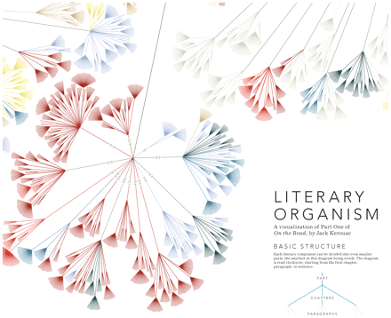
Fig. 3 Detail of Stefanie Posavec’s Literary Organism design, which shows Part One of Jack Kerouac’s On the Road ...
Notes:
Fig. 3 Detail of Stefanie Posavec’s Literary Organism design, which shows Part One of Jack Kerouac’s On the Road (reproduced with permission from Stefanie Posavec).
Unless provided in the caption above, the following copyright applies to the content of this slide: © The Author 2010. Published by Oxford University Press on behalf of ALLC and ACH. All rights reserved. For Permissions, please email: journals.permissions@oxfordjournals.org

Slide 4
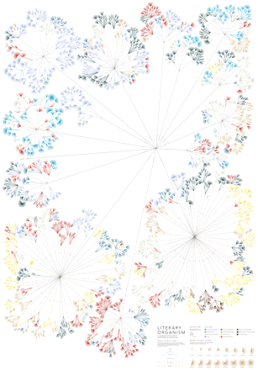
Fig. 4 This poster shows the entire text of On the Road, as configured into branching colour-coded themes by ...
Notes:
Fig. 4 This poster shows the entire text of On the Road, as configured into branching colour-coded themes by Stefanie Posavec (reproduced with permission from Stefanie Posavec).
Unless provided in the caption above, the following copyright applies to the content of this slide: © The Author 2010. Published by Oxford University Press on behalf of ALLC and ACH. All rights reserved. For Permissions, please email: journals.permissions@oxfordjournals.org

Slide 5
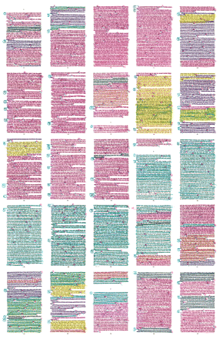
Fig. 5 Posavec shows here some of the manual work done in preparation for the infographic, involving marking the ...
Notes:
Fig. 5 Posavec shows here some of the manual work done in preparation for the infographic, involving marking the themes in the text with a highlighter and pen (reproduced with permission from Stefanie Posavec).
Unless provided in the caption above, the following copyright applies to the content of this slide: © The Author 2010. Published by Oxford University Press on behalf of ALLC and ACH. All rights reserved. For Permissions, please email: journals.permissions@oxfordjournals.org

Slide 6
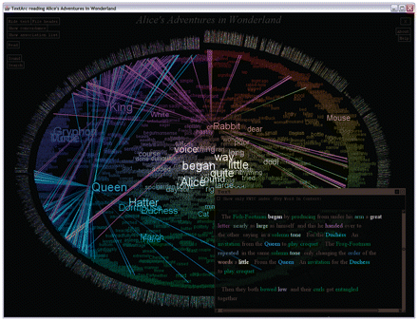
Fig. 6 TextArc, a visual text analysis tool, as applied to Alice's Adventures in Wonderland, showing inter-episodic ...
Notes:
Fig. 6 TextArc, a visual text analysis tool, as applied to Alice's Adventures in Wonderland, showing inter-episodic use of ‘Rabbit,’ and four foreshadowing references to ‘Queen’ before the co-occurring character ‘King’ appears (reproduced with permission from W. Bradford Paley).
Unless provided in the caption above, the following copyright applies to the content of this slide: © The Author 2010. Published by Oxford University Press on behalf of ALLC and ACH. All rights reserved. For Permissions, please email: journals.permissions@oxfordjournals.org

Slide 7
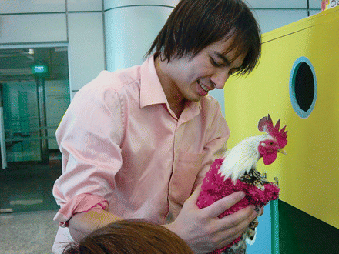
Fig. 7 Adrian Cheok’s Poultry Internet is intended as a means of increasing good relations between people and their ...
Notes:
Fig. 7 Adrian Cheok’s Poultry Internet is intended as a means of increasing good relations between people and their pets (http://www.youtube.com/watch?v=1x-8EzuMiqU). This image shows Cheok with the rooster Charlie, who is wearing the jacket that allows him to be petted remotely (reproduced with permission from Adrian Cheok).
Unless provided in the caption above, the following copyright applies to the content of this slide: © The Author 2010. Published by Oxford University Press on behalf of ALLC and ACH. All rights reserved. For Permissions, please email: journals.permissions@oxfordjournals.org

